Slide 1




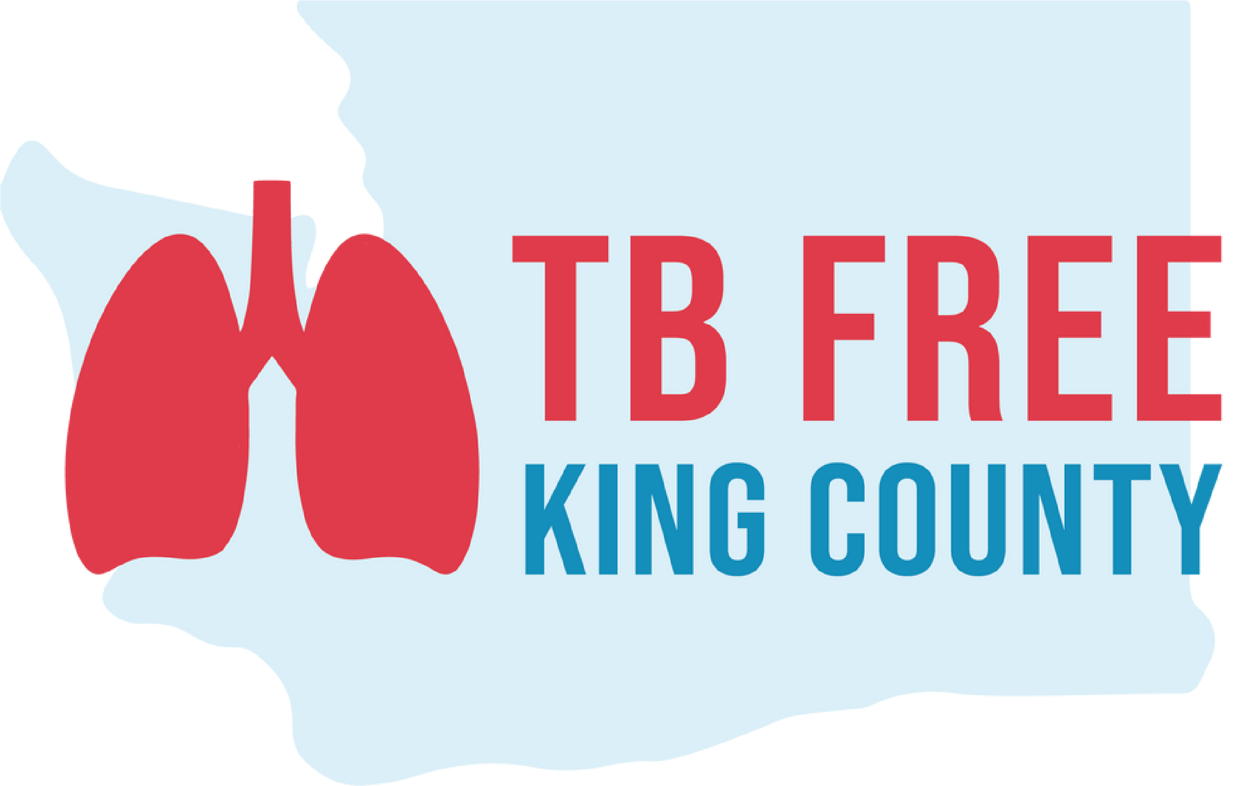
TB Cultural Profiles: A Model for Enhancing Medical Understanding Through Community Engagement
Value in Cancer Care Summit 2024
15 November 2024
Duncan Reid, MD, MS
Medical Director of EthnoMed
Clinical Assistant Professor
International Medicine Clinic
Harborview Medical Center
University of Washington
Notes:
We take care of patient’s from all of the world, and understanding their background can be essential to delivering quality medical care.
I will talking about two cultures specifically, but I hope that the approach of considering patient’s in the context of their background will be widely applicable to patients from diverse bacskgrounds, whether they are from immigrant communities, first nation, or Americans from different walks of life.

Slide 2
Relevant Financial Disclosures
I have nothing to disclose
Notes:
When I talk to residents in the hospital about cross cultural care, I have used this basic case taken from my own clinical experience

Slide 3
Outline
Case Presentation 1
  Brief Background of the Marshall Islands
  TB in King County
TB Profile Project Overview
  Current lessons from selected immigrant communities
  Relevance of approach for other diseases, such as cancer
Notes:
When I talk to residents in the hospital about cross cultural care, I have used this basic case taken from my own clinical experience

Slide 4
Case Presentation 1
60 year-old man with Stage 4 Chronic Kidney Disease and type 2 diabetes who recently developed a productive cough, night sweats, and weight loss. He is Marshallese-speaking.
What do you know about the Marshallese community? How could historical and geographic context help inform your care?
Notes:
When I talk to residents in the hospital about cross cultural care, I have used this basic case taken from my own clinical experience

Slide 5

Nickelodeon
Notes:
I ground it in the cultural icon of our times:

Slide 6
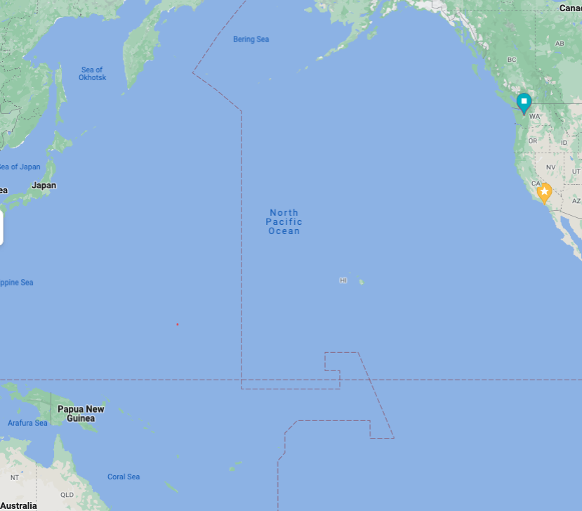
Google Maps

Slide 7
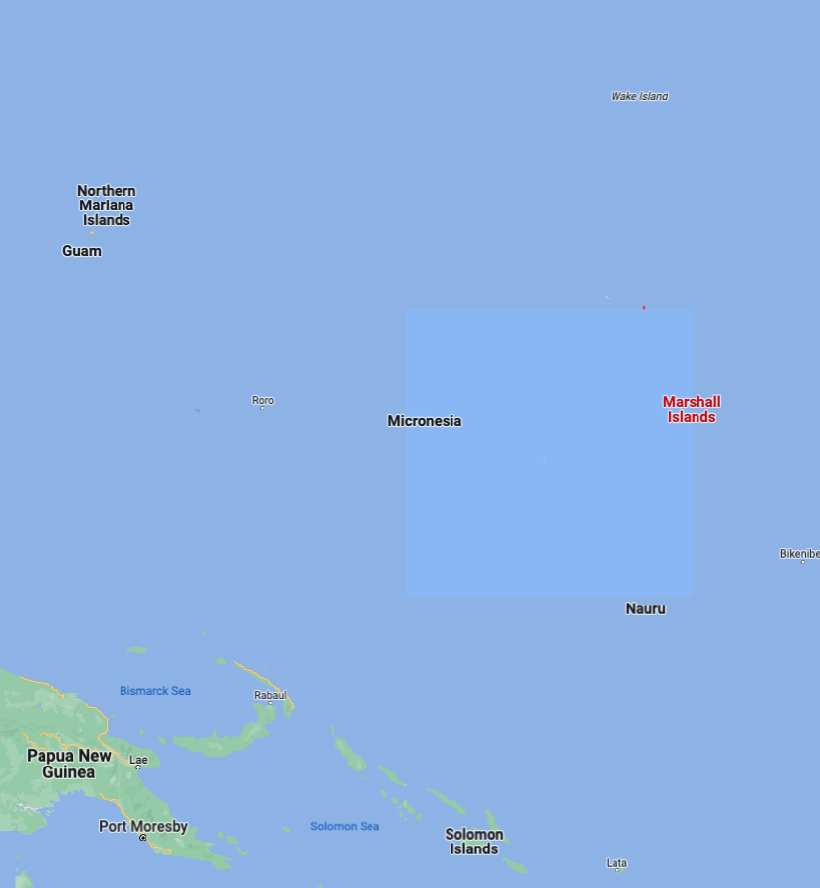
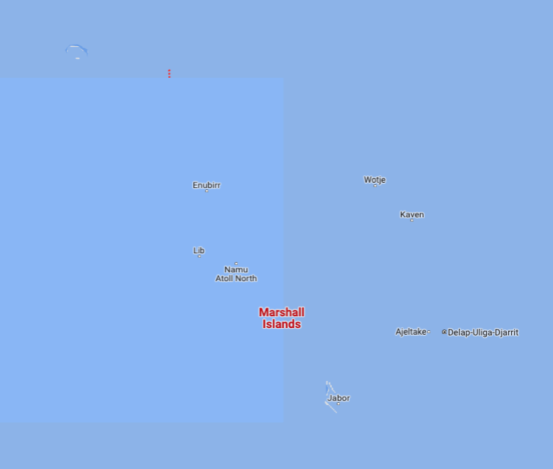
Google Maps

Slide 8
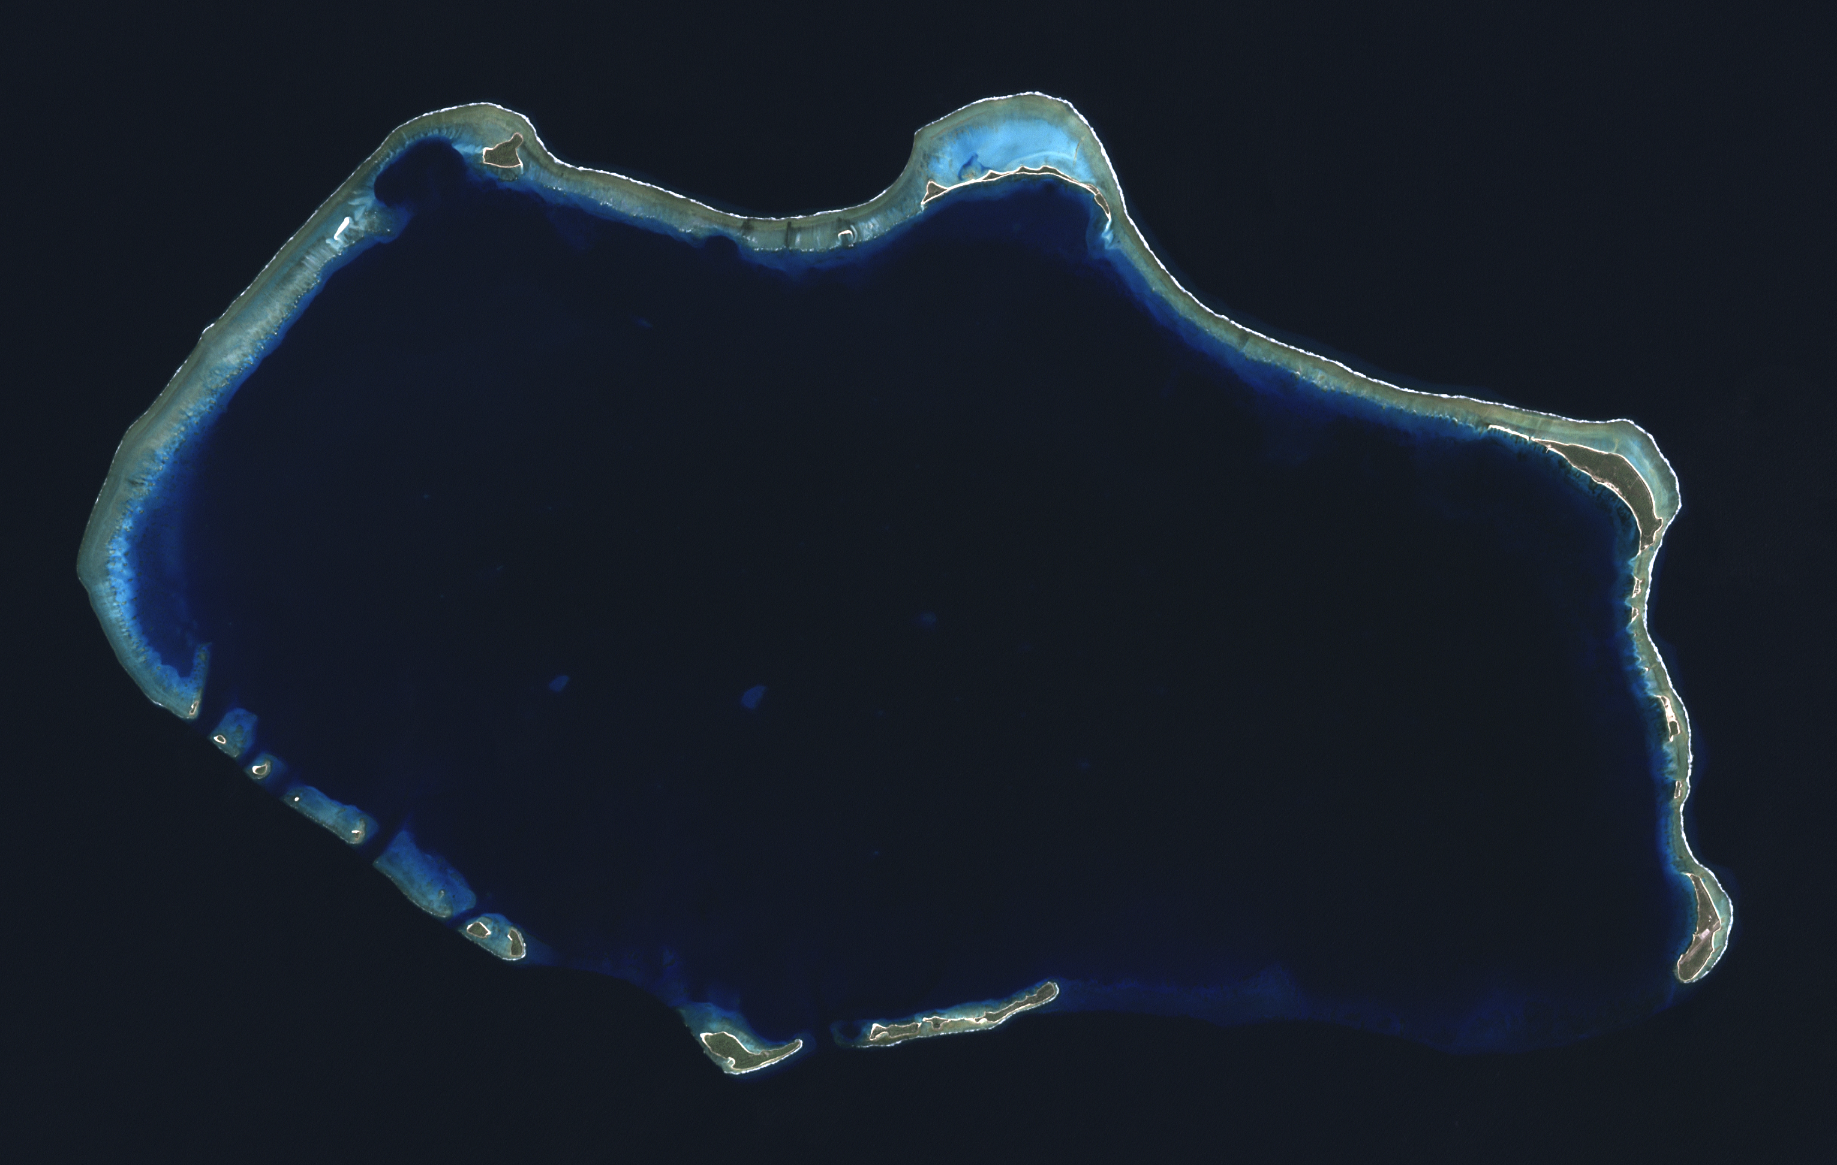
Google Maps

Slide 9
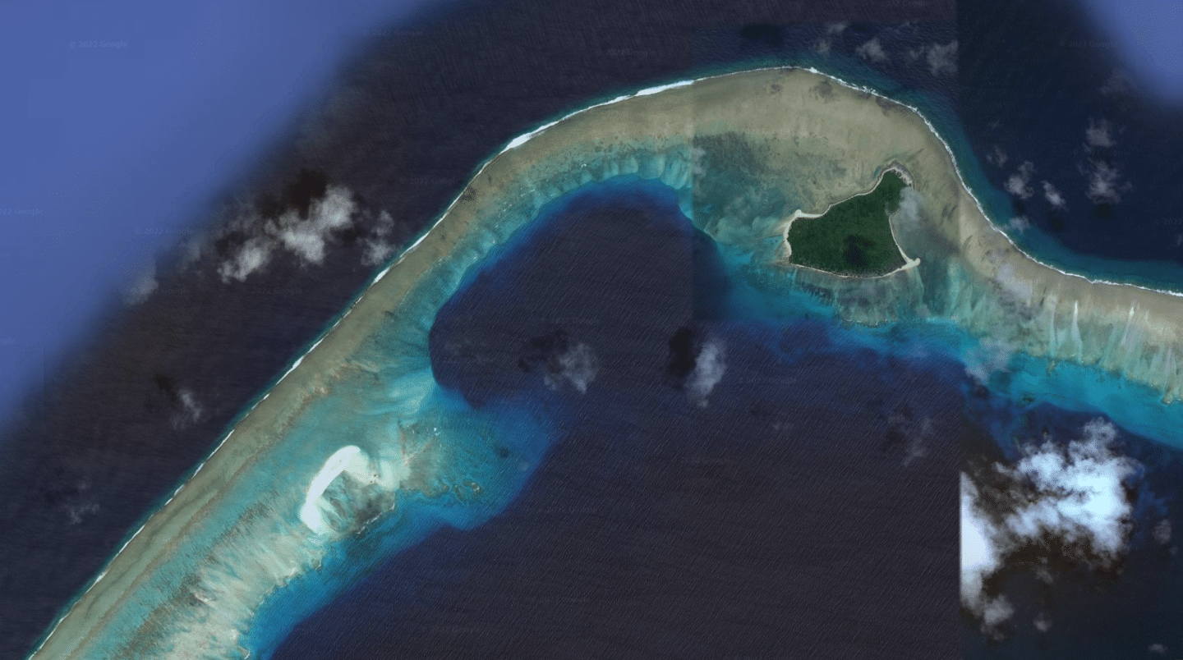
Google Maps

Slide 10
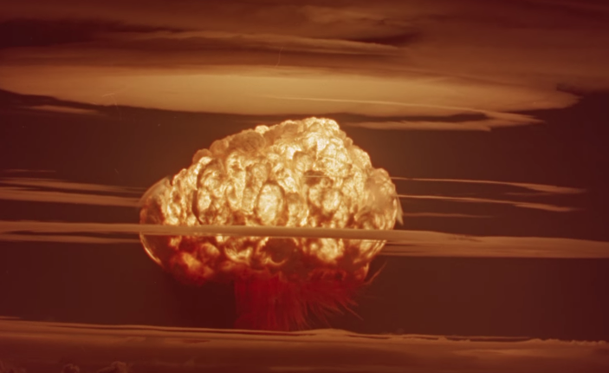

Slide 11
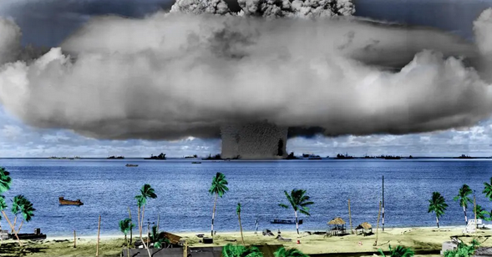
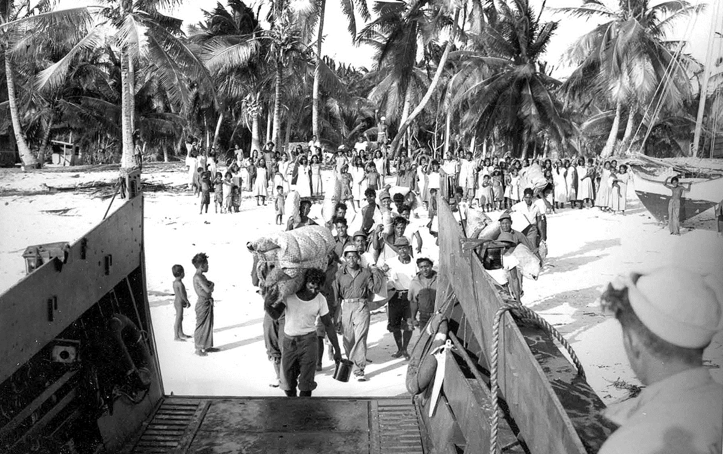
Chosen by the U.S. military as a nuclear testing site, over 60 nuclear tests through 1958, 20 of which deposited significant fallout
The Marshall Islands is a high-TB burden country with an estimated TB incidence of about 500 cases per 100,000 population per year in 2019 (WHO).
23% of the population estimated to have Type 2 Diabetes
Cancer: limited screening and diagnostic facilities
https://diabetesatlas.org/data/en/country/124/mh.html
Health Phys. 2010 August ; 99(2): 105–123. doi:10.1097/HP.0b013e3181dc523c.
Notes:
My point to residents:
How can you take good medical care of a patient from the Marshall Islands without knowing some of the most basic history as well as diseases.

Slide 12
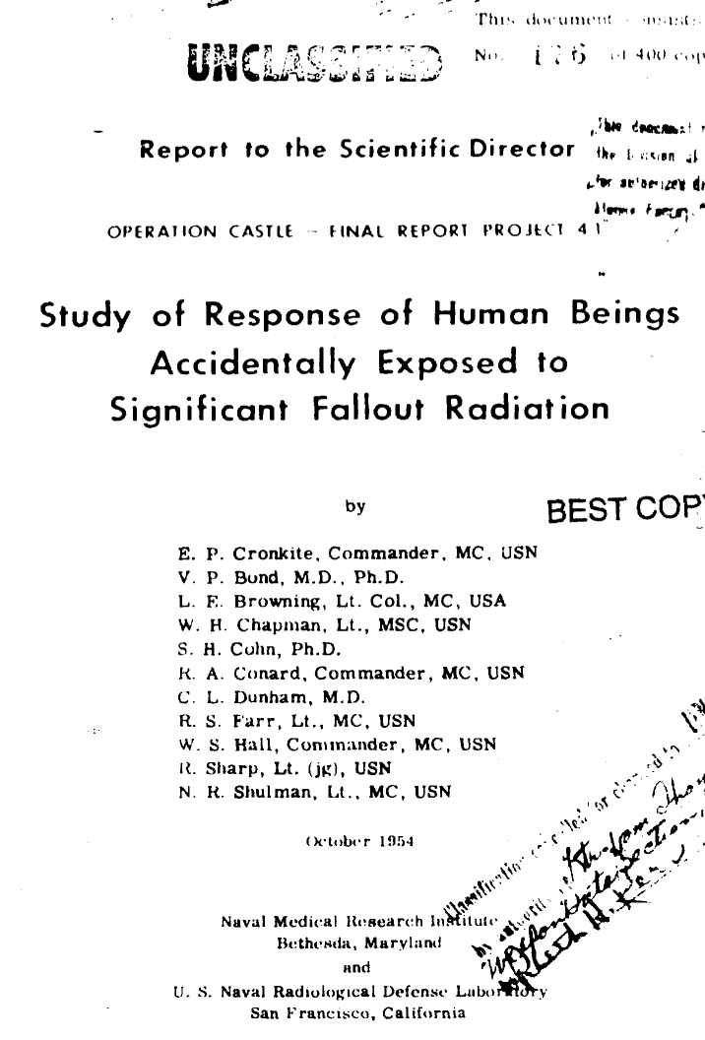
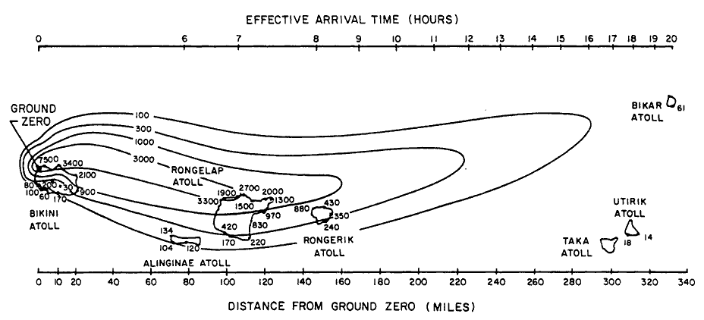
Project 4.1:
  Medical study and experimentation of Marshallese accidentally exposed to fallout from the Castle Bravo test
  The primary study was completed 75 days after the time of exposure
  No informed consent obtained
  Classified results, released in 1970s
  Legacy of distrust
Health Phys. 2010 August ; 99(2): 105–123. doi:10.1097/HP.0b013e3181dc523c.
Notes:
15 ⁄ 22
More details
The Bravo fallout plume spread dangerous levels of radioactivity over an area over 280 miles (450 km) long, including inhabited islands. The contour lines show the cumulative radiation exposure in roentgens (R) for the first 96 hours after the test.^{[34][35]} Although widely published, this fallout map is not perfectly correct.

Slide 13
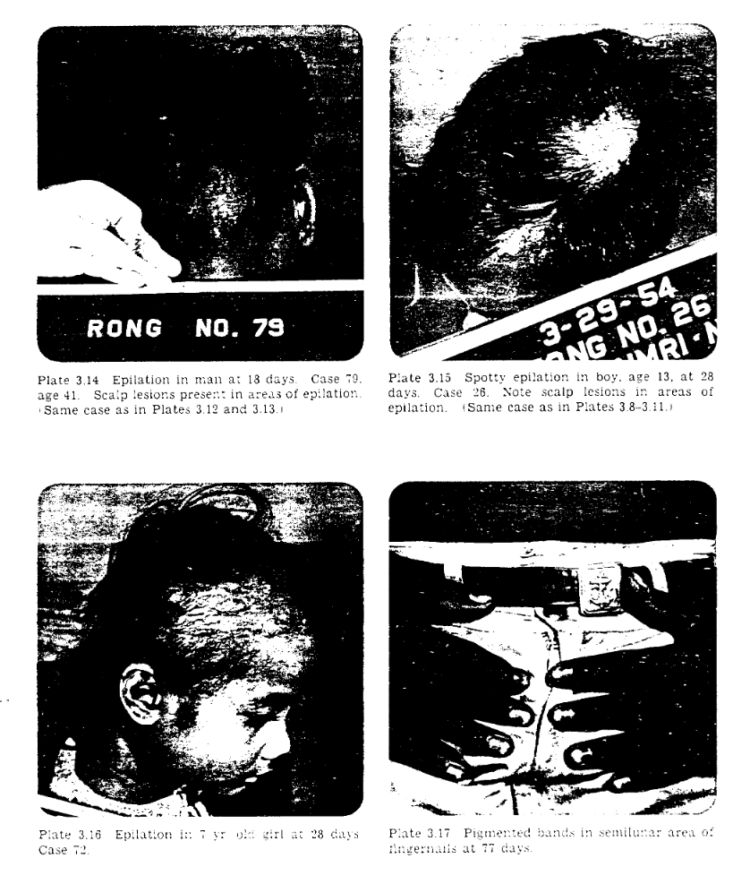
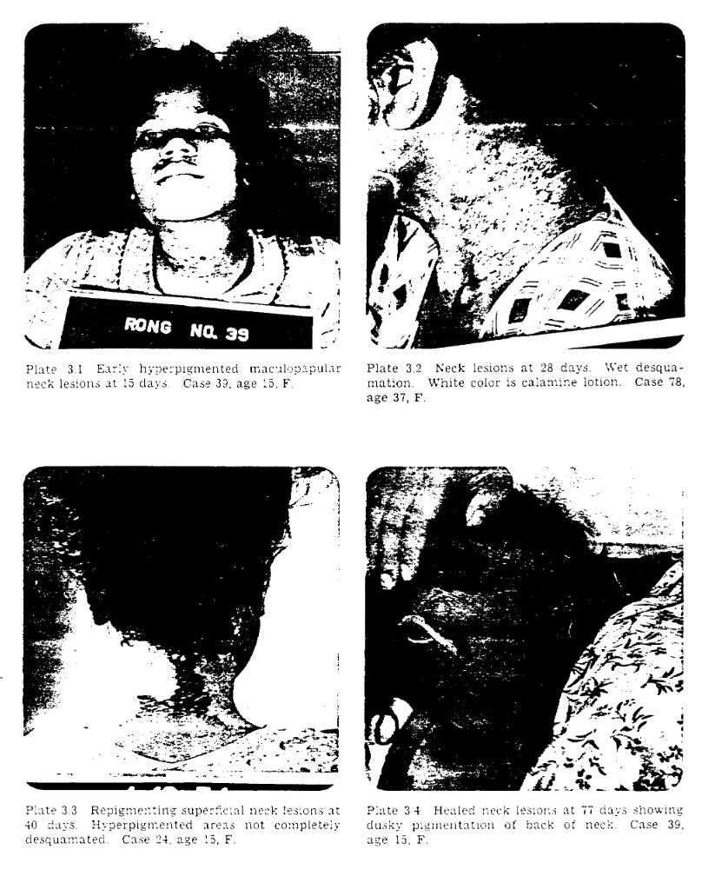
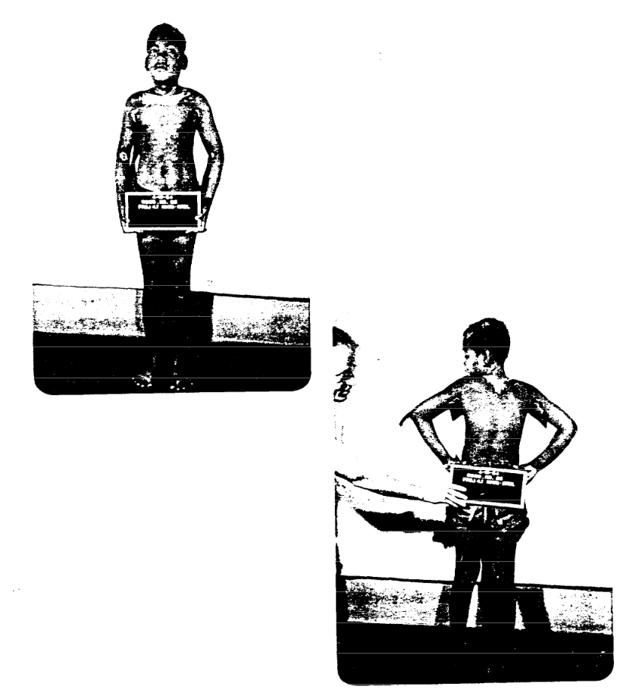
Images from Project 4.1:
https://www.dtra.mil/Portals/125/Documents/NTPR/newDocs/NTREReport/WT-923-Proj%204.1%20Response%20of%20Humans%20Accidentally%20Exposed%20to%20Significant%20Fallout%20Radiation%20Op%20CA.pdf
Notes:
My point to residents:
How can you take good medical care of a patient from the Marshall Islands without knowing some of the most basic history as well as diseases.

Slide 14
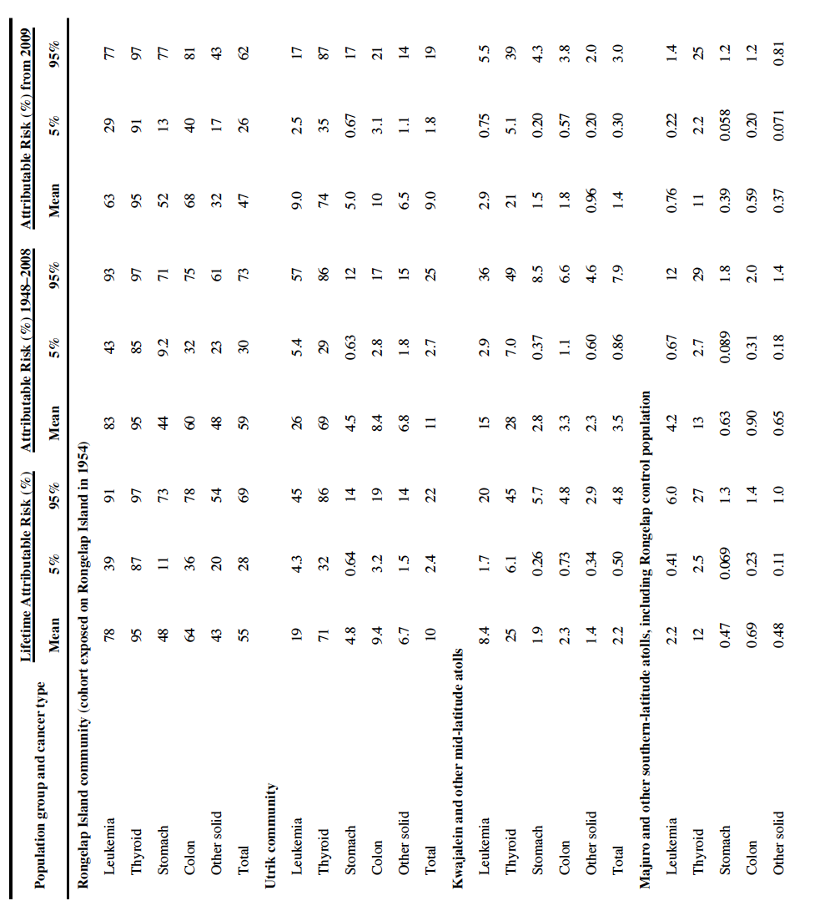
Until 2010, there had “not been a broad epidemiologic study of the Marshallese to determine the total numbers of cancers and other serious illnesses resulting from exposure to radioactive fallout”
In 2010 it was calculated that by sub-population, the projected proportion of cancers attributable to radiation from fallout between 43% and 95% on Rongelap Island (1.6% across all islands)
Projected proportion (in%) of total cancer risk attributable to
radioactive fallout by population and cancer site
Health Phys. 2010 August ; 99(2): 105–123. doi:10.1097/HP.0b013e3181dc523c.
Notes:
My point to residents:
How can you take good medical care of a patient from the Marshall Islands without knowing some of the most basic history as well as diseases.

Slide 15
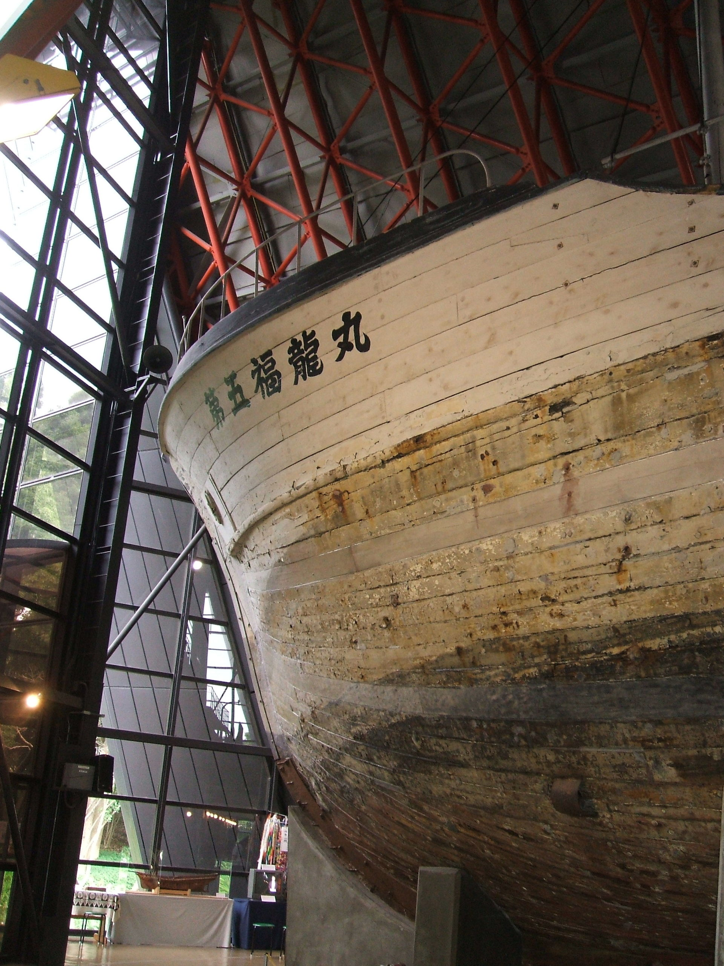
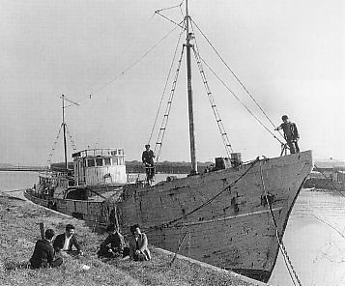
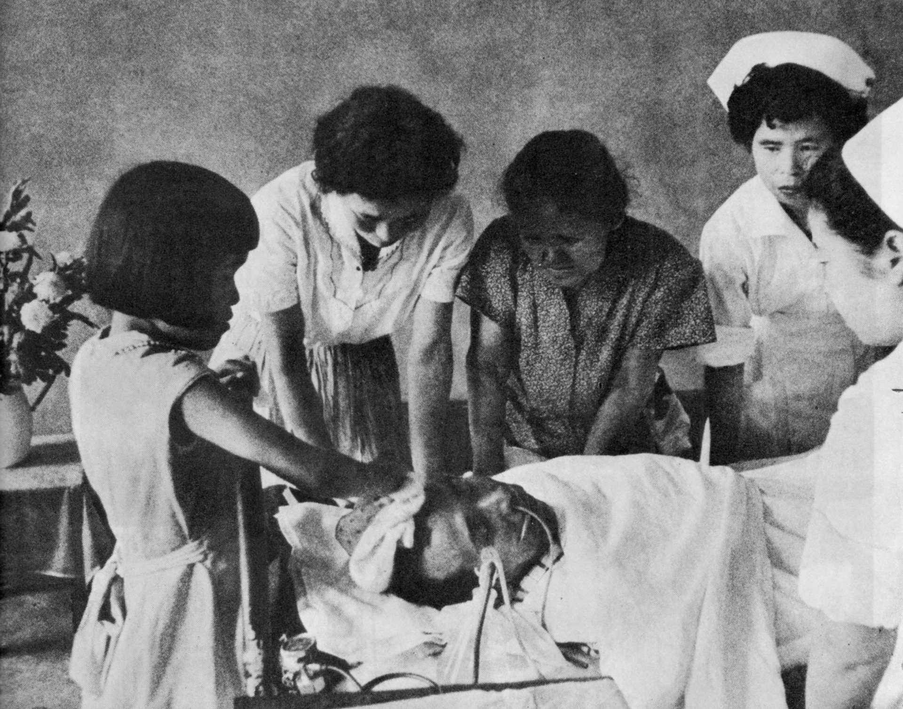
Daigo Fukuryu Maru
23 men on Japanese fishing vessel exposed to fallout from Castle Bravo
Radiation illness developed within days
Fishermen received annual checkups starting in 1957 at the National Institute of Radiological Science in Chiba
By carpkazu - 投稿者が撮影, Public Domain, https://commons.wikimedia.org/w/index.php?curid=3381752
Aikichi Kuboyama on deathbed

Slide 16

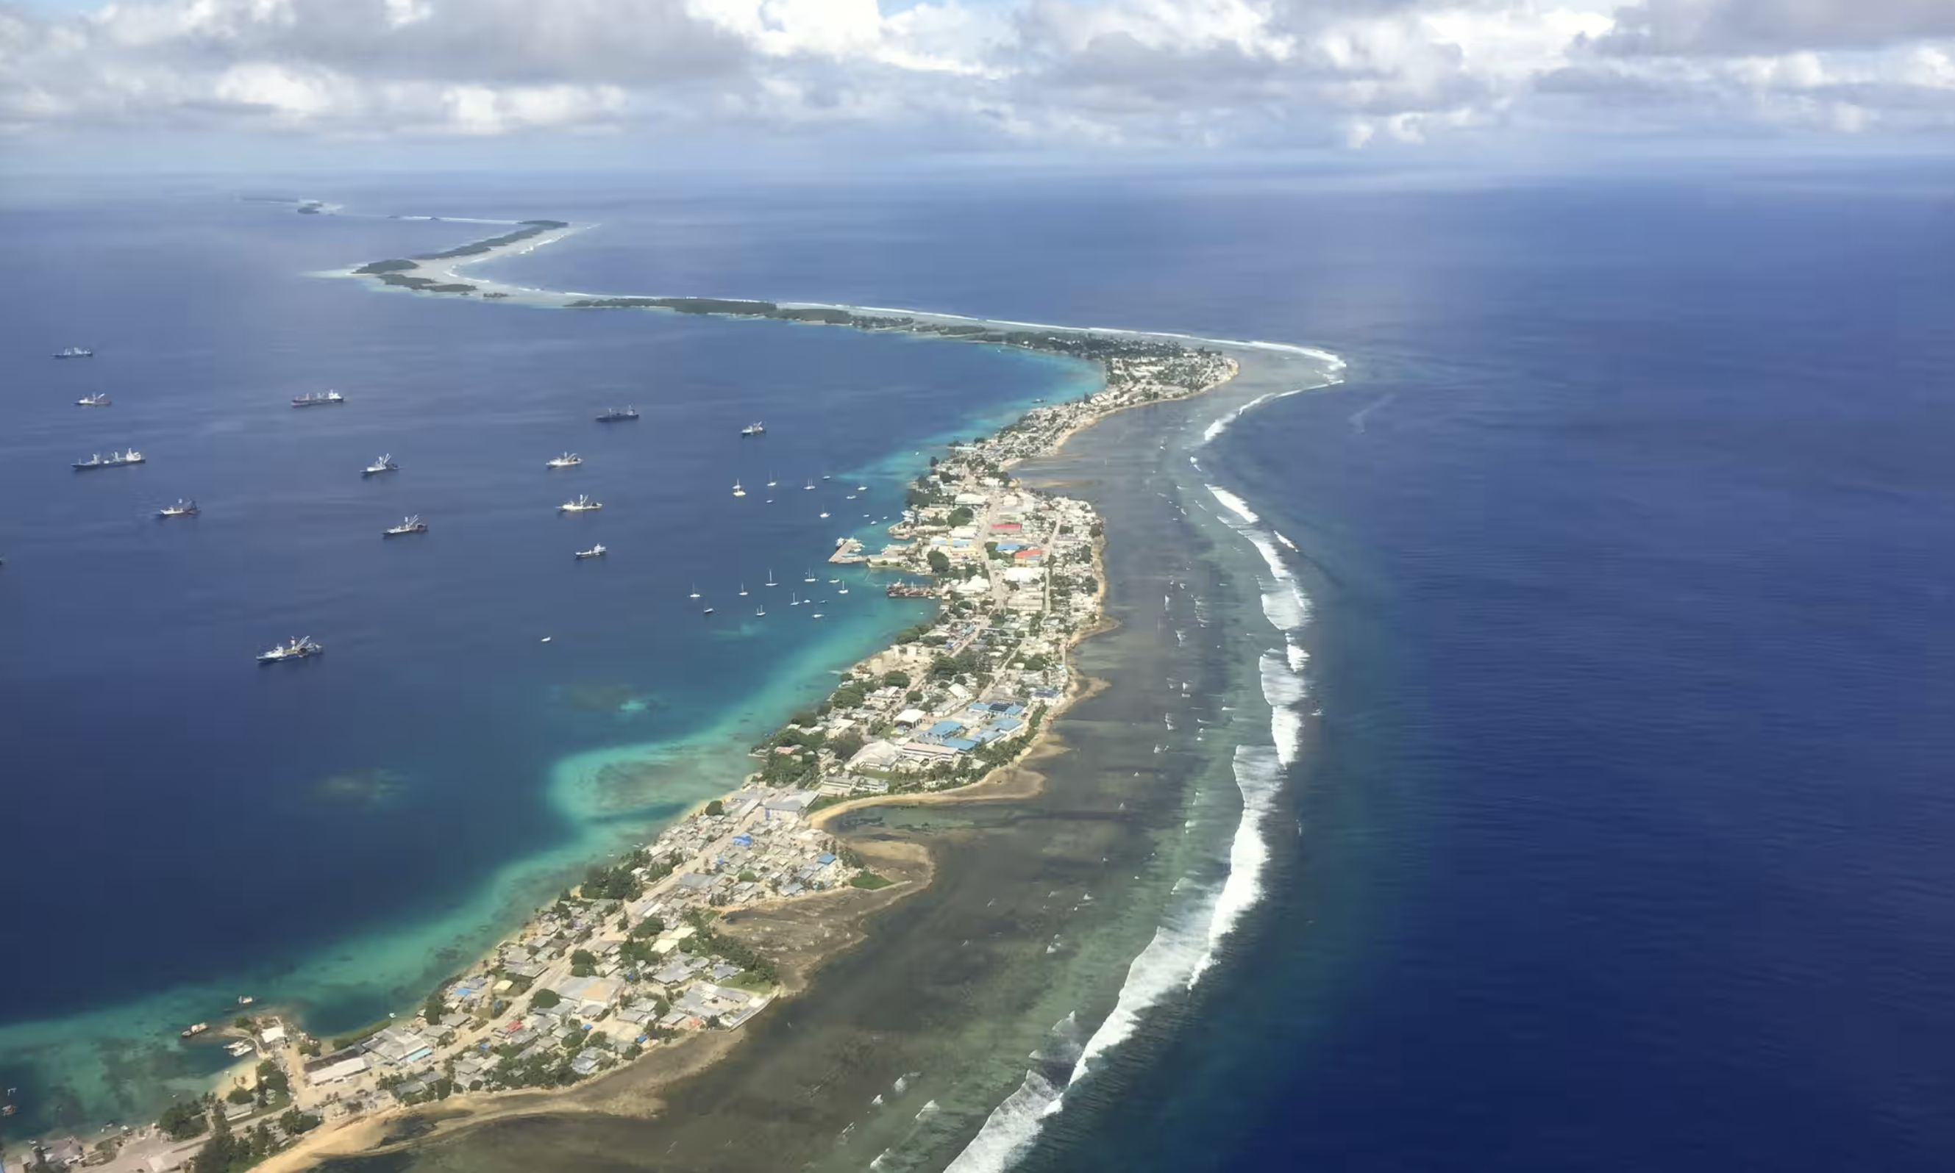
Photograph: World Bank
Notes:
My point to residents:
How can you take good medical care of a patient from the Marshall Islands without knowing some of the most basic history as well as diseases.

Slide 17
Cultural and Historical Context
Essential to providing patient-centered medical care
Can inform the provider/researcher:
  What diseases should be considered based on geography and history
  Potential sources of distrust
  How best to approach diagnosis and care
Notes:
Can also facilitate the development of rapport with the patient.

Slide 18
TB and Cancer
Stigma: Both carry stigma across communities regarding testing, treatment
TB previously untreatable: in Amharic, the term literally translates to “cancer of the lung”
Incomplete understanding: Limitations of understanding of both diseases across communities regarding treatment, prognosis
Barriers to access: Both diseases require prolonged treatment course, navigation of a complex medical system
Potential for misunderstanding: Side effects of treatment, poor outcomes, adverse effects can lead to mistrust from the community
Notes:
Can also facilitate the development of rapport with the patient.

Slide 19
TB in the Marshallese Community in WA State
Community members identified as Marshallese demographically accounted for 12.5% of cases in WA state in 2023
2010 census: 22,434 Marshallese in the U.S. (2207 in WA State)
2020: estimated 47,000 Marshallese in the U.S.
Notes:
The inclusion definition used:
*RMI Demographically Included TB Cases include anyone identifying as Marshallese demographically, by:
country of birth;
race/ethnicity;
language;
country of usual residence;
country of extended visit; or
parental country of birth.

Slide 20
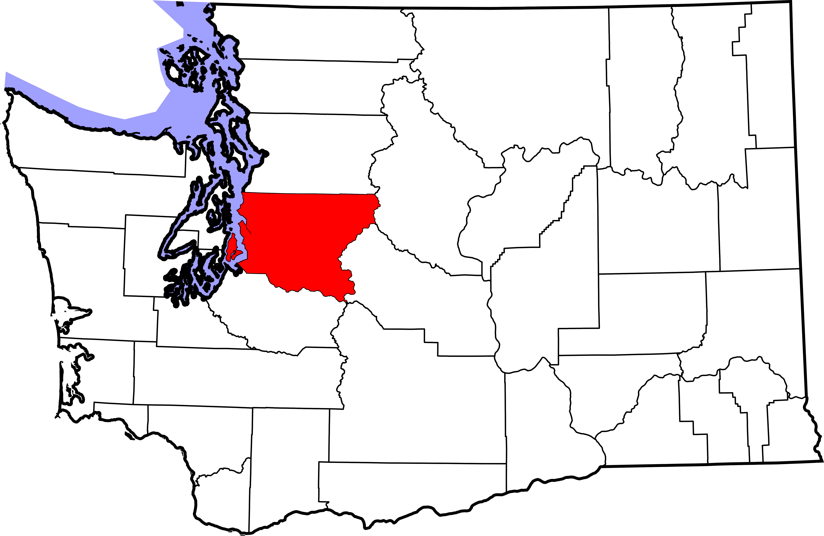
Tuberculosis in King County, Washington
In 2023 in King County:
109 cases of active TB
Incidence of 4.6 cases per 100,000
92% of cases occurred in people who were born outside the U.S.
Public health encountered :
resistance to screening and treatment
different levels of understanding across different communities
Wikimedia commons, Public domain

Slide 21


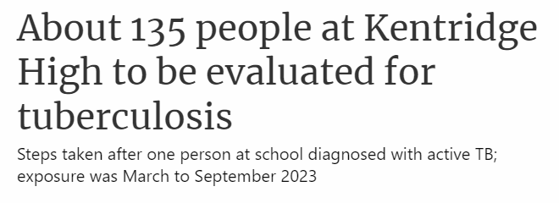
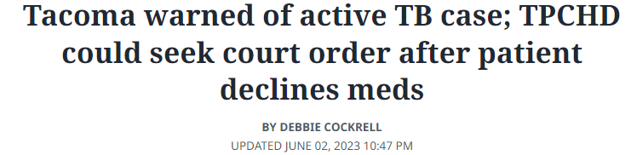
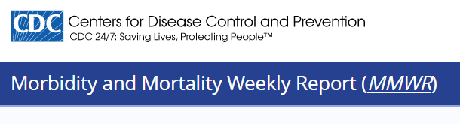
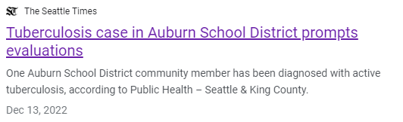
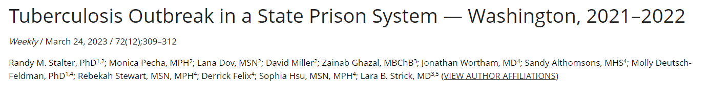

Slide 22
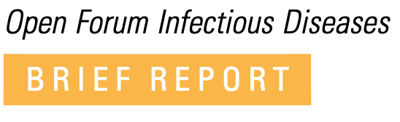
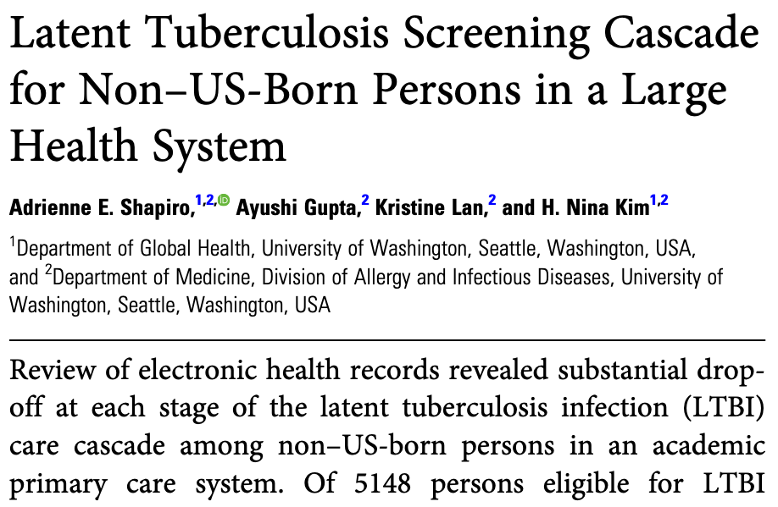
Primary Care Screening Rates are Low
Only 20% of those eligible for TB screening based on country of birth were screened in the UW primary care system

Slide 23
Cultural and Historical Context
Essential to providing patient-centered medical care
Can inform the provider:
  What diseases should be considered based on geography and history
  Potential sources of distrust
  How best to approach diagnosis and care
Notes:
Can also facilitate the development of rapport with the patient.

Slide 24
TB Cultural Profile Project
This project represents a collaboration among:
King County Public Health, TB Program
EthnoMed
Community House Calls, HMC
Notes:
Which was proposed and accepted for a TEA grant beginning in October 2023

Slide 25
TB Cultural Profile Project
This project represents a collaboration among:
King County Public Health, TB Program
  Community Navigator Program representing over a dozen communities in King County
EthnoMed
  A web resource based at Harborview Medical Center focused on cross-cultural medicine
Community House Calls, HMC
  Cultural Mediator Program in the Interpreter Services Department
Notes:
Which was proposed and accepted for a TEA grant beginning in October 2023

Slide 26
King County Public Health, TB Program
Performs community outreach, education, contact tracing, treatment
Issues with screening and treatment in the community:
  Low rates of clinic screening
  Stigma
  Poor understanding of disease (latent vs active TB), treatment options
  Barriers to health care access

Slide 27
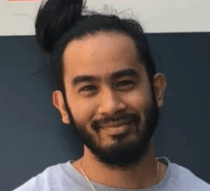
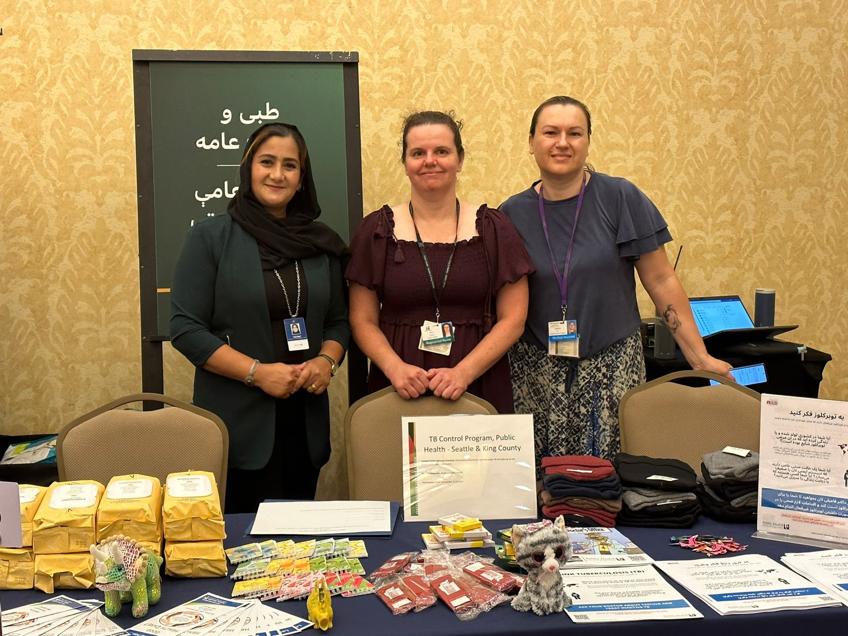
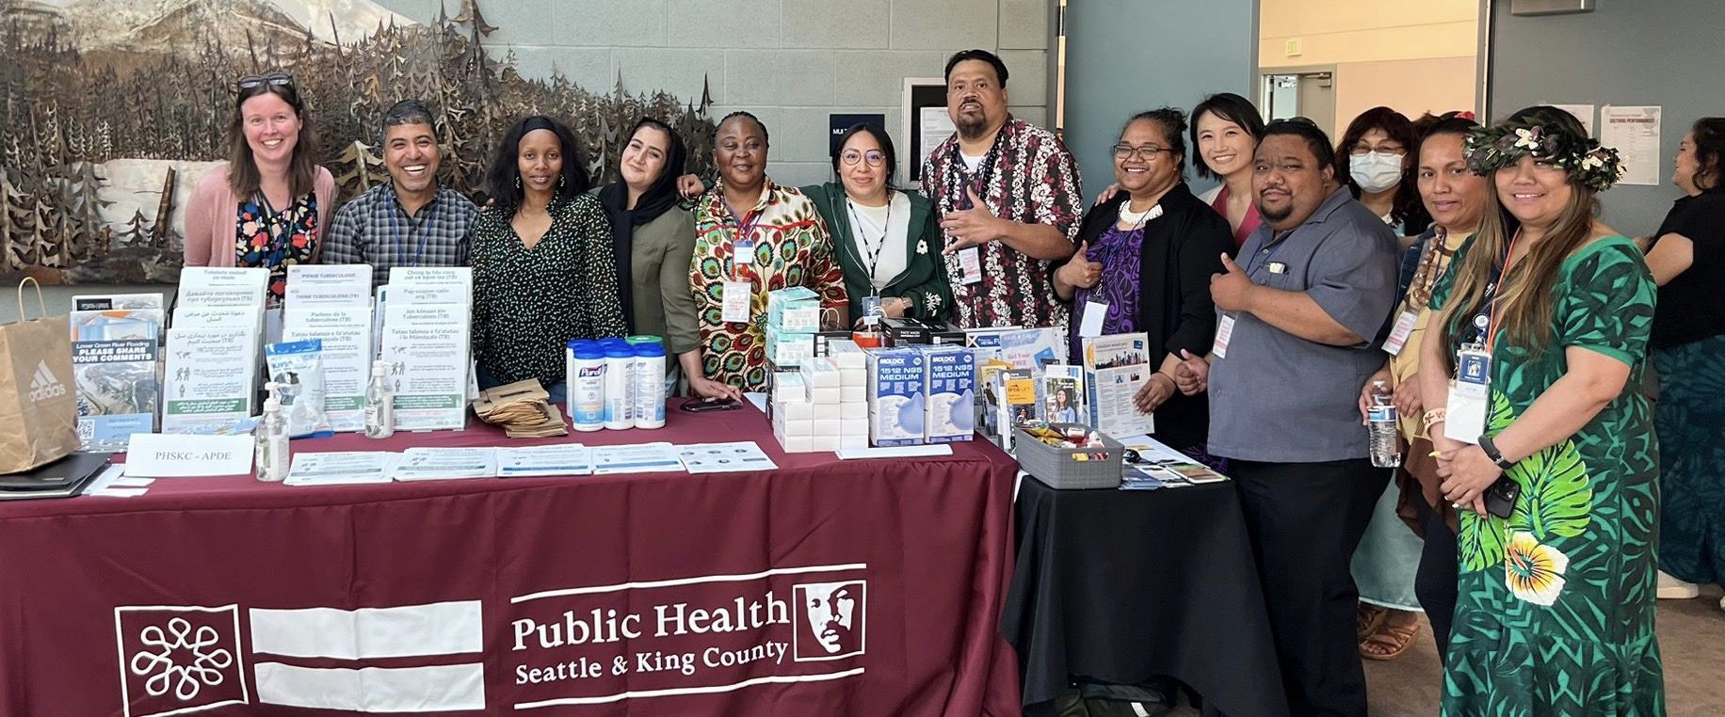
King County Public Health, TB Program
Community Navigator program established in 2020 as a response to COVID
Includes 25 Community Navigators and two Project Managers
  Expanded to include community outreach on a variety of topics, including tuberculosis
Franky Erra
Manager
Community Navigator Program

Slide 28
TB Cultural Profile Project
This project represents a collaboration among:
King County Public Health, TB Program
  Community Navigator Program representing over a dozen communities impacted by tuberculosis
EthnoMed
  A web resource based at Harborview Medical Center focused on cross-cultural medicine
Community House Calls, HMC
  Cultural Mediator Program in the Interpreter Services Department
Notes:
Which was proposed and accepted for a TEA grant beginning in October 2023

Slide 29
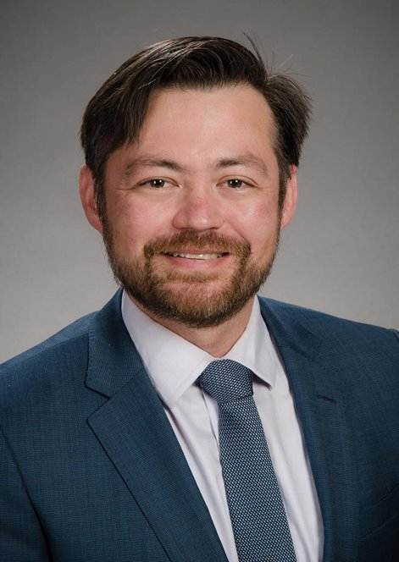
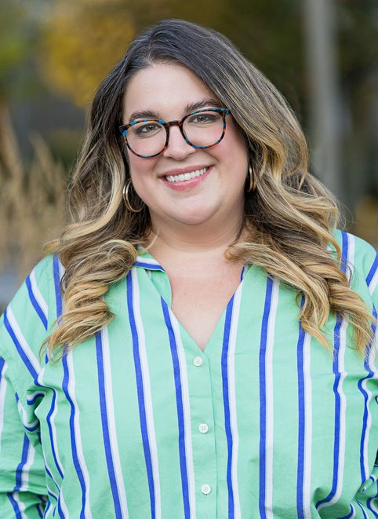
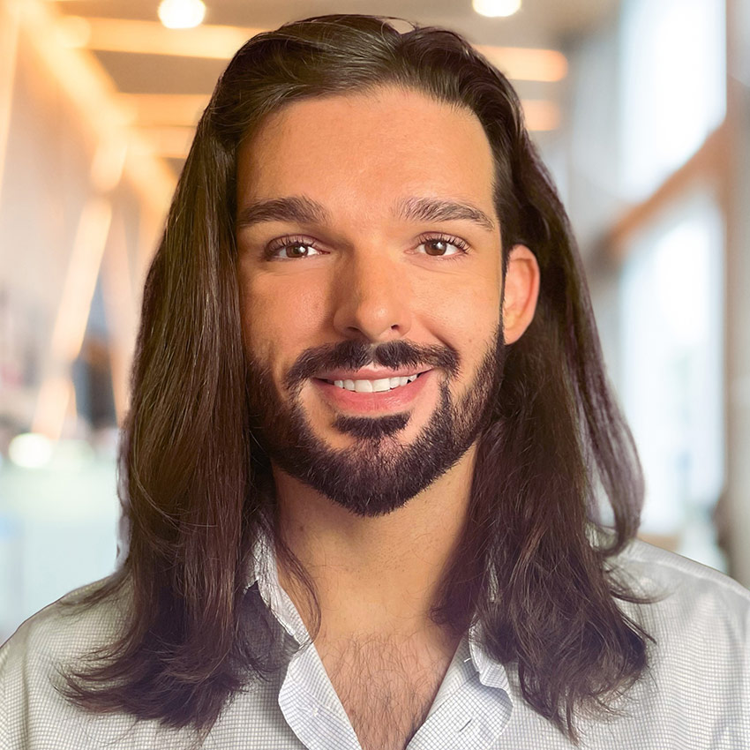
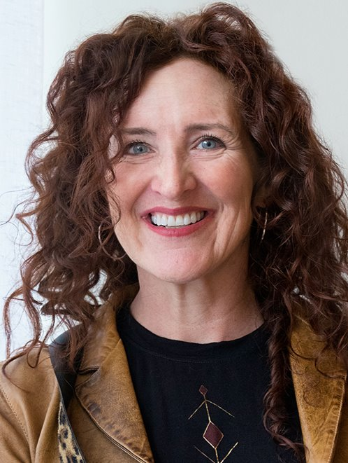



EthnoMed.org
EthnoMed is intended to be a community voice in the clinic.
We have relationships with local ethnic communities and the providers who care for them.
Content is developed in partnership with healthcare providers, community members, and UW students.
Duncan Reid
Medical Director
Celine Barthelemy
Manager
James Sherrell
Program Coordinator
Nityia Przelockii
Website Specialist
Chelsea Ng
Congolese TB Profile
Angshita Dutta
Marshallese TB Profile
Notes:
Which was proposed and accepted for a TEA grant beginning in October 2023

Slide 30
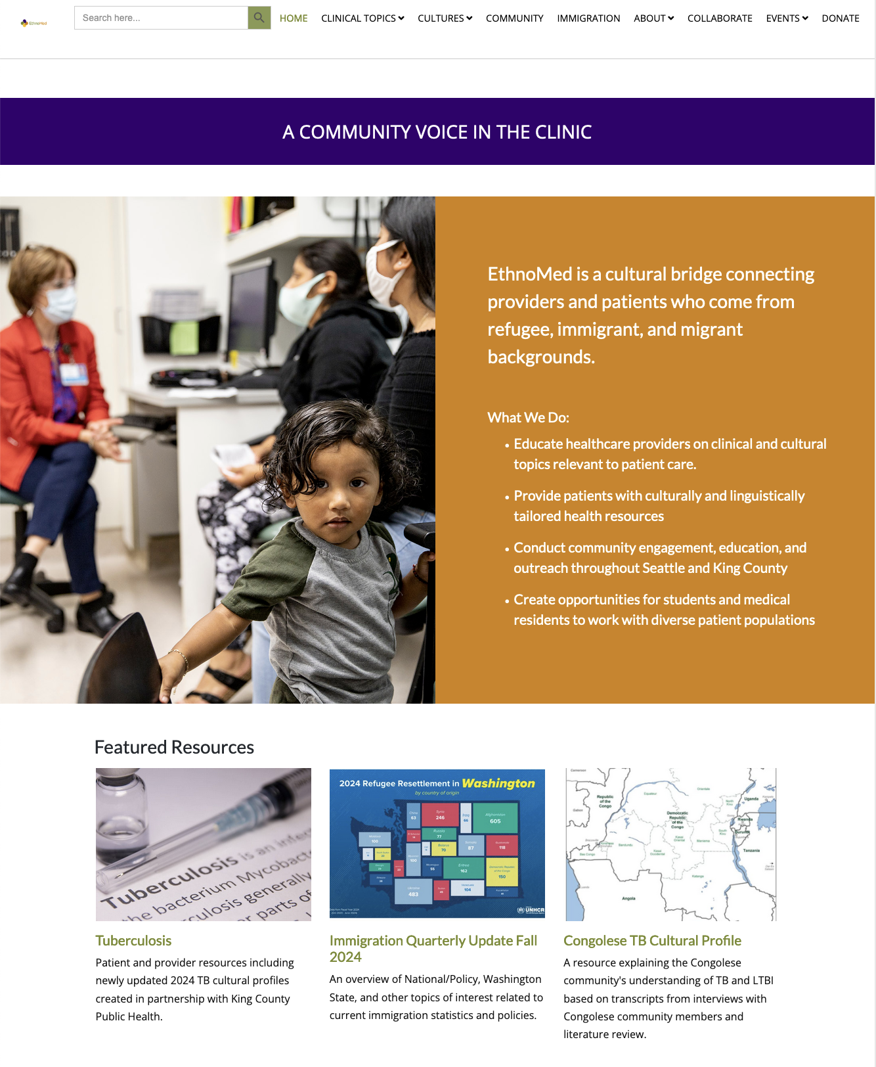
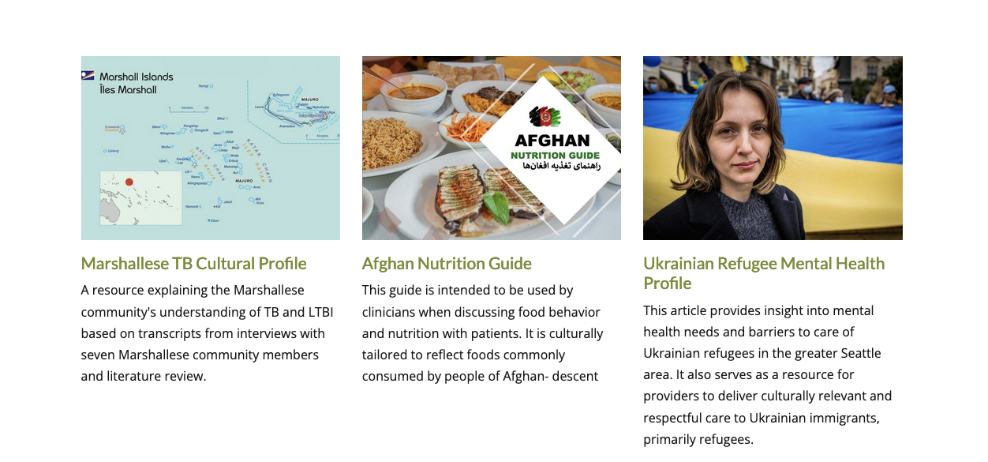
EthnoMed.org
Founded in 1993
We facilitate:
Provider Education and Support
Community Outreach
Collaboration across the UW system
Notes:
Which was proposed and accepted for a TEA grant beginning in October 2023

Slide 31
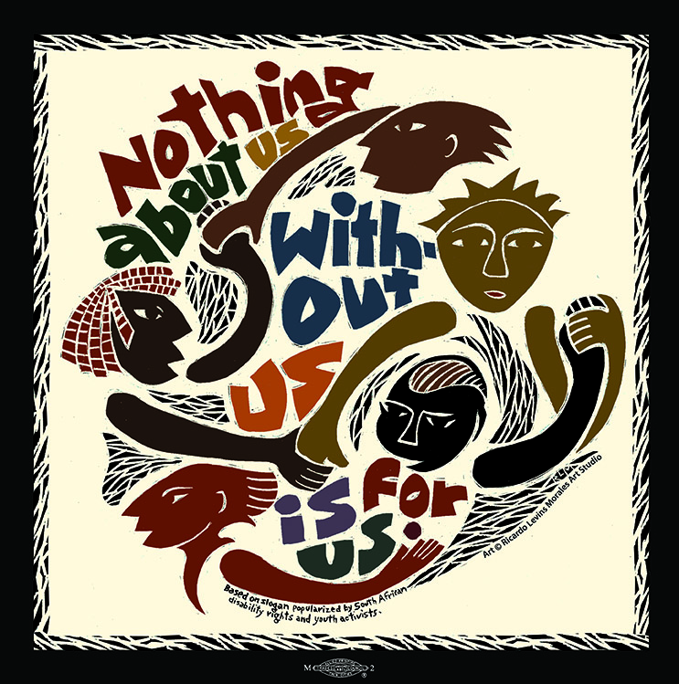
Community-Centered Approach
Nothing about us, without us, is for us
Slogan developed by South African disability rights and youth activists
Aligned with the goal of EthnoMed to involve communities in the development of resources
©Ricardo Levins Morales
Notes:
Development of resources which impact their own communities

Slide 32
TB Cultural Profile Project
This project represents a collaboration among:
King County Public Health, TB Program
  Community Navigator Program representing over a dozen communities impacted by tuberculosis
Ethnomed
  A web resource based at Harborview Medical Center focused on cross-cultural medicine
Community House Calls, HMC
  Caseworker Cultural Mediator Program in the Interpreter Services Department at Harborview
Notes:
Which was proposed and accepted for a TEA grant beginning in October 2023

Slide 33
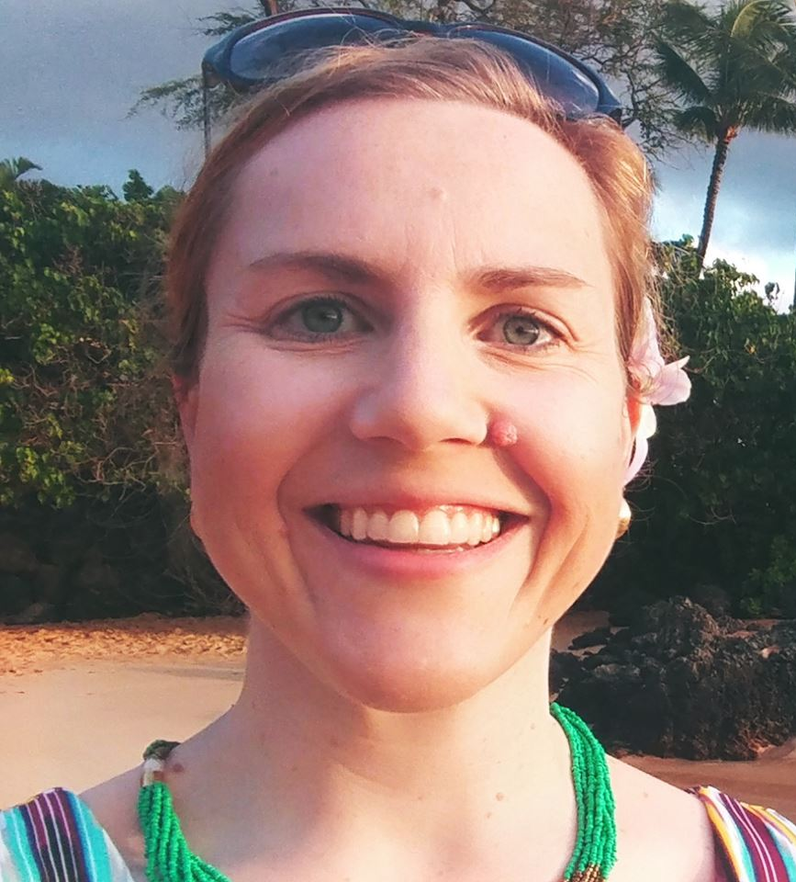
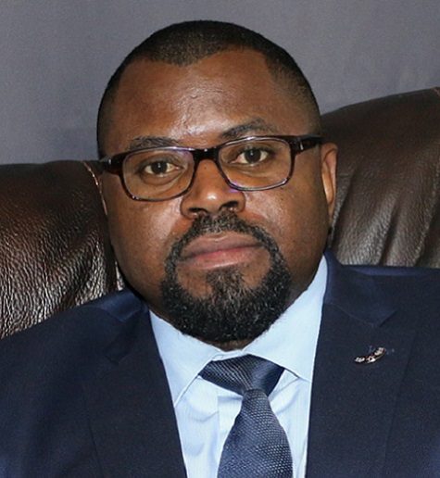
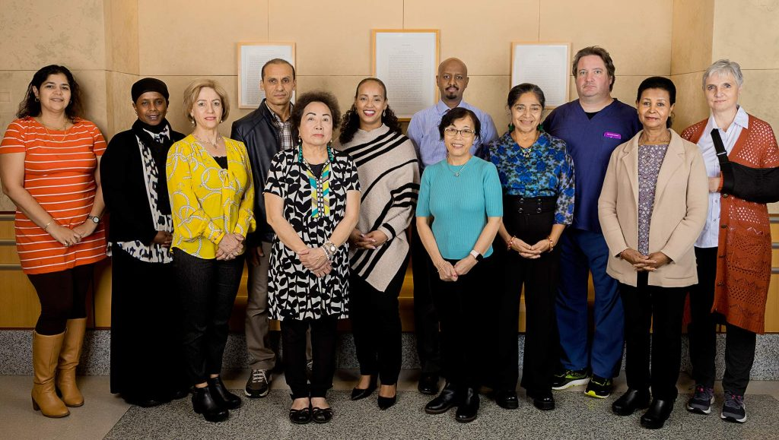
Interpreter Services Department
Yvonne Simpson
Senior Director
Language Access and
Cultural Advocacy
UWMC
Jean Jacques Kayembe
Director,
HMC Interpreter Services
Asmeret Tesfalem
Manager,
CCM Program
Caseworker Cultural Mediator Team
Notes:
Which was proposed and accepted for a TEA grant beginning in October 2023

Slide 34
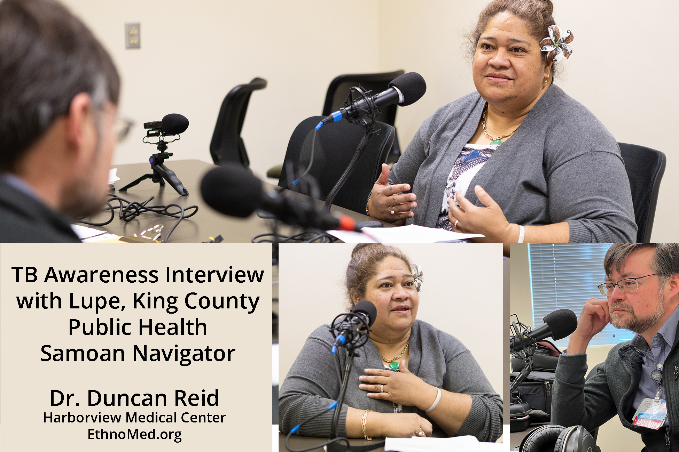

Slide 35
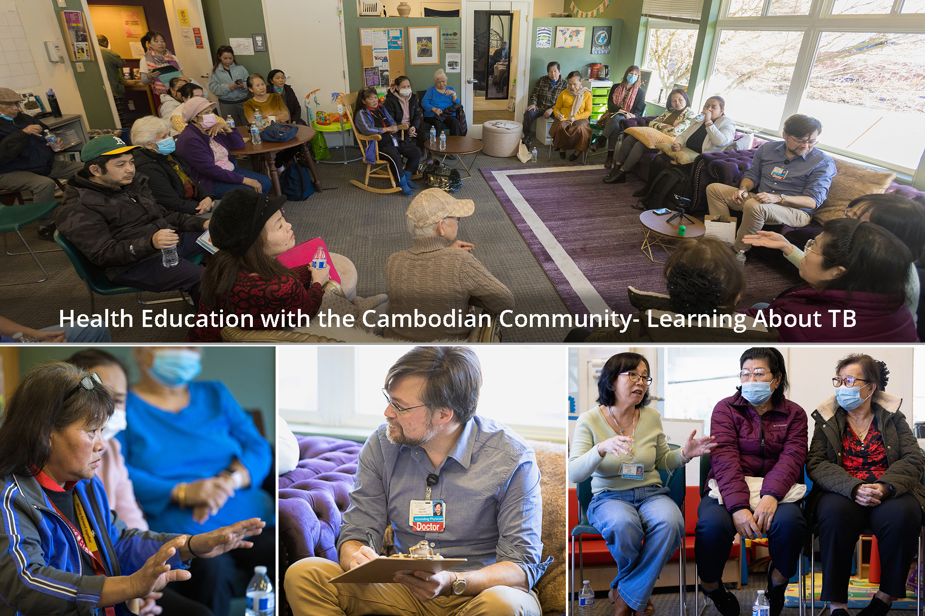

Slide 36
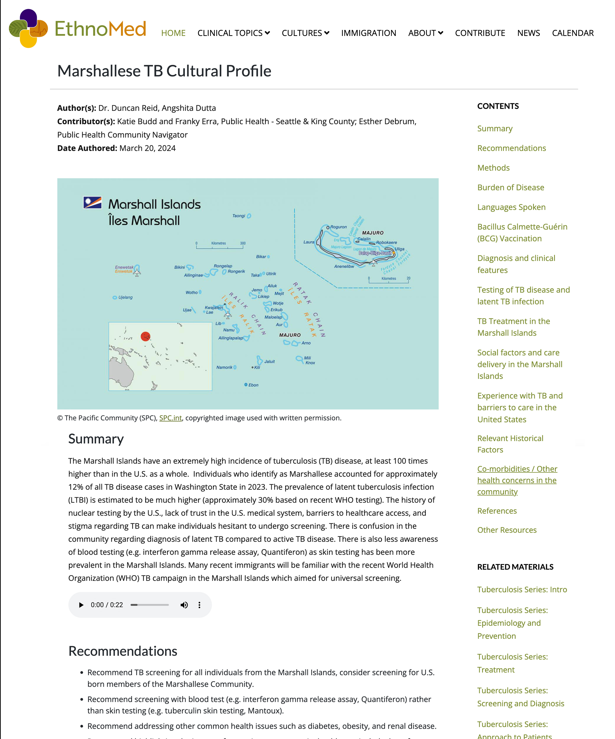
TB Cultural Profiles
Summary
Recommendations
Methods
Burden of disease
Languages spoken
BCG vaccination (rates and understanding)
Diagnosis and clinical features (recognized by community)
Testing of TB disease and LTBI
TB treatment (in home country)
Social factors and care delivery (in home country)
Experience with TB and barriers to care (in U.S.)
Other relevant historical factors
Comorbidities
Notes:
As well as social media campaigns

Slide 37
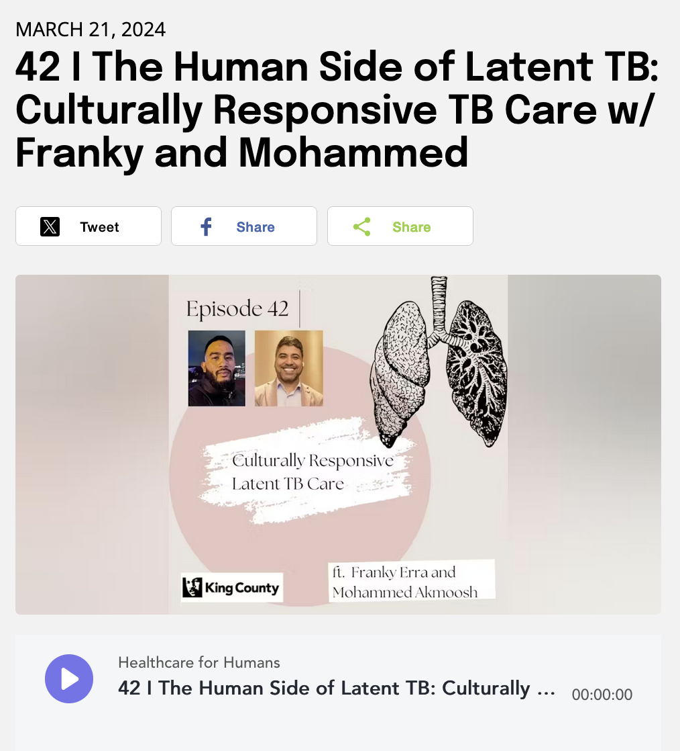
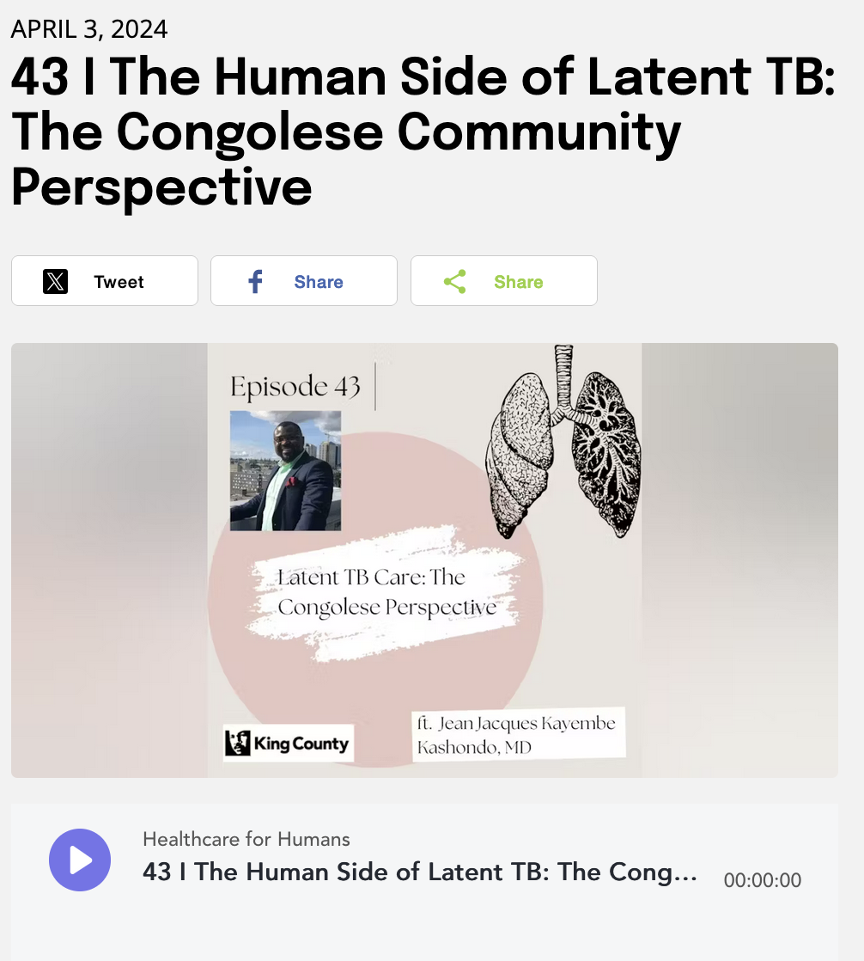
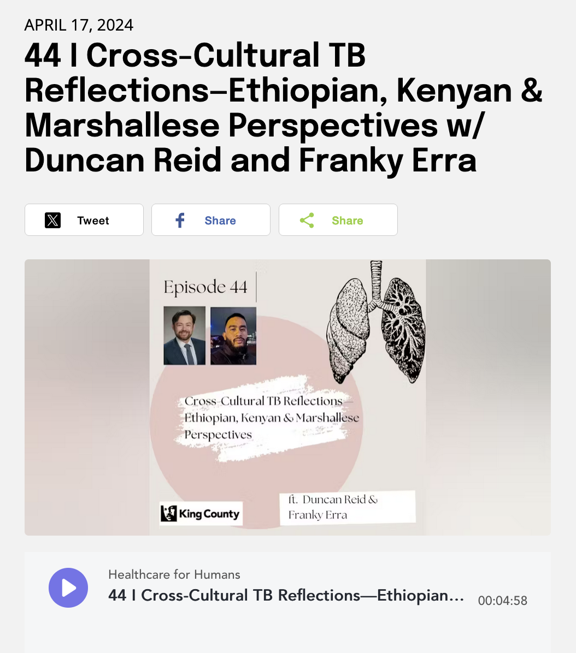
Community Interviews
Recordings / Podcast
  Professional quality audio recordings of all interviews
  Collaboration with podcast Healthcare for Humans
  Upcoming EthnoMed podcast based on these and other interviews
  Transcripts for thematic analyses
Notes:
As well as social media campaigns

Slide 38
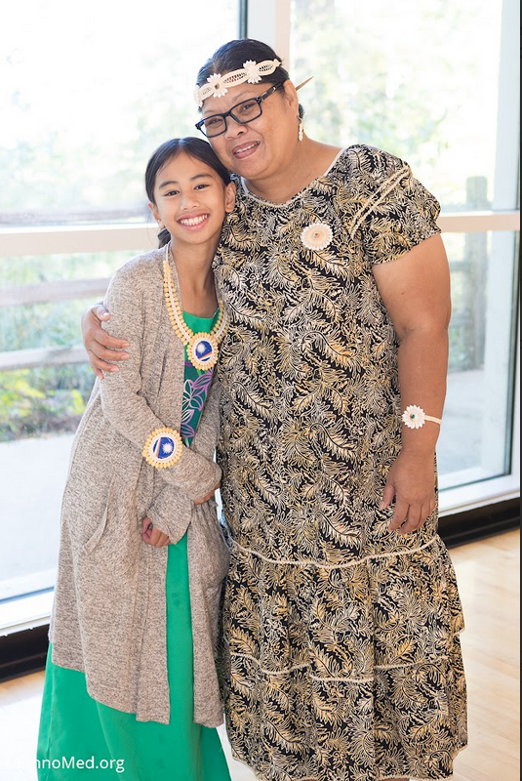
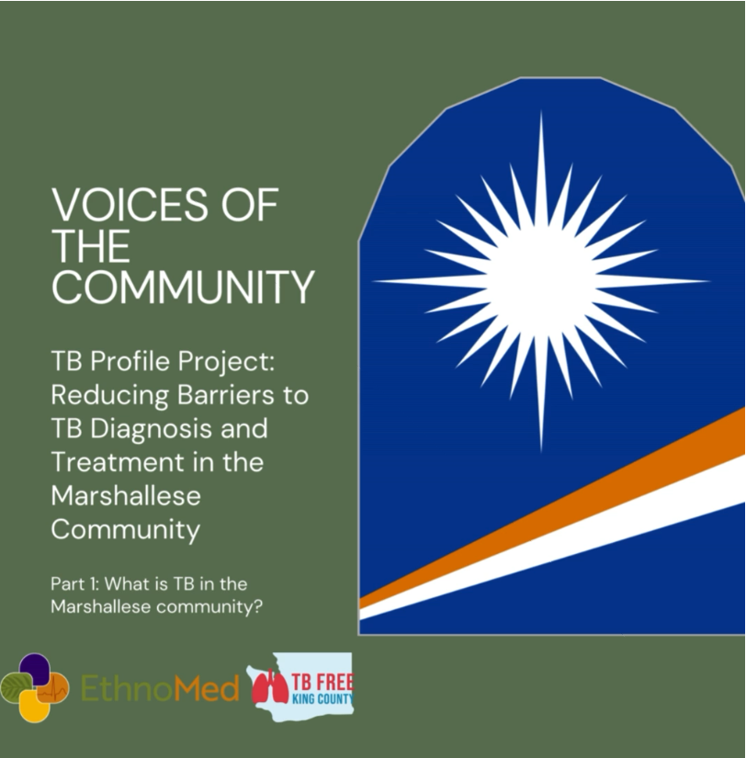
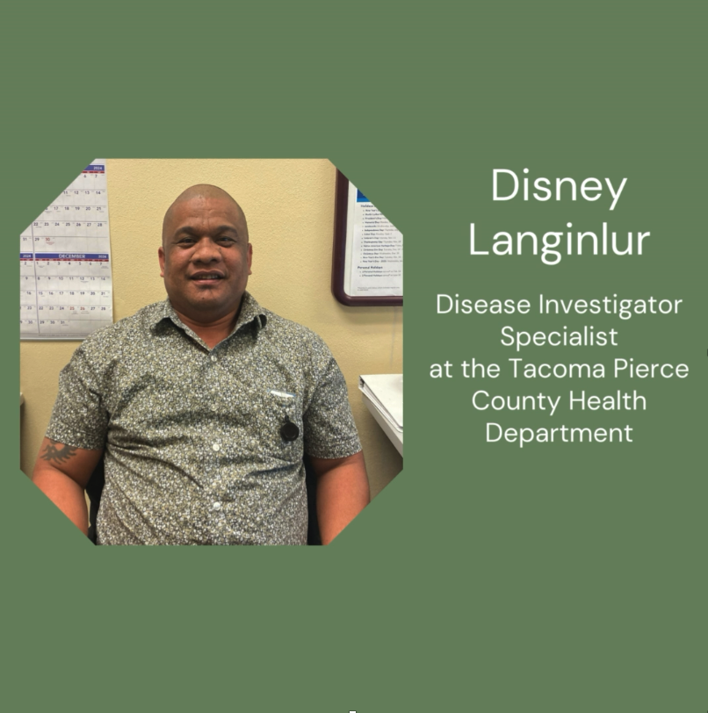
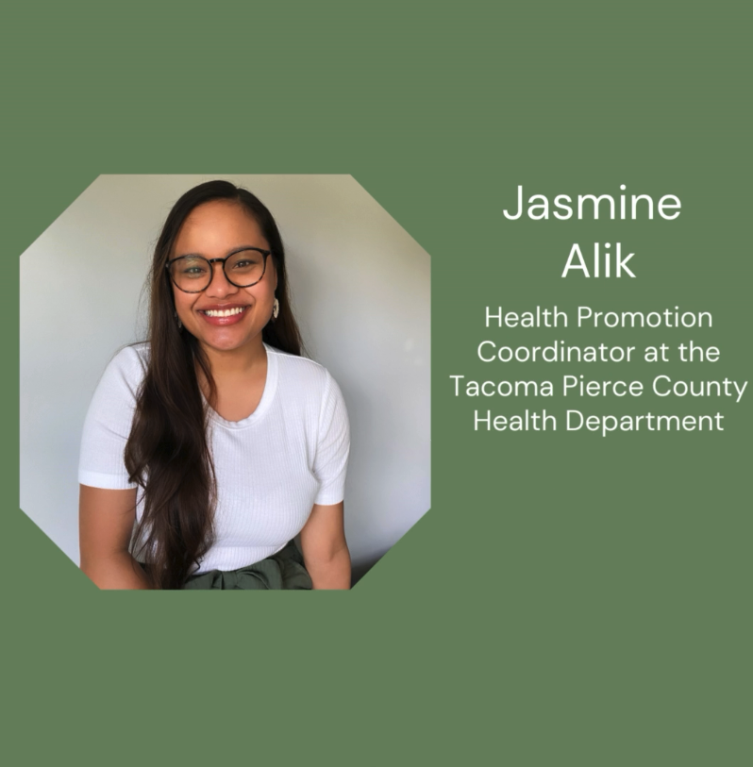
TB education materials
  Webmaster Nityia Przewlocki has been taking photos and video to be used in community-level TB information campaigns
  - Social media posts
  YouTube videos
  Catherine Evangelista with public health developing social media videos
Notes:
As well as social media campaigns

Slide 39
TB Cultural Profiles
We have completed 63 interviews with 88 participants spanning 15 communities
    Marshallese
    Congolese
    Kenyan
    Ukrainian
    Ethiopian
    Afghan
    Samoan
    Cambodian
    Mexican
    Cameroonian
    Vietnamese
    Chinese
    Filipino
    Iraqi
    Somali

Slide 40
Take-home points from Marshallese Community
  Awareness of coughing and weight loss as symptoms; less awareness of extrapulmonary TB
  Confusion regarding:
  TB disease vs LTBI (diagnosis, treatment)
Notes:
Based on interviews of five Marshallese community members

Slide 41
Take-home points from Marshallese Community
Social Factors in the Marshall Islands
  Little privacy in the Marshall Islands
  Social culture: not acceptable to isolate from close family
  Stigma surrounding diagnosis of both TB disease and LTBI
Testing and Treatment in the Marshall Islands
  Recent WHO campaign to screen and treat all individuals for TB disease and LTBI: DOT for both caused confusion about who had TB disease vs LTBI

Slide 42
Take-home points from Marshallese Community
Barriers to care in the U.S.
  Reluctance of patients to discuss TB with new providers
  Travel a common barrier
  Difficulty accessing translators
Cultural barriers
  Increased privacy in the U.S. decreased social pressures of getting tested and treated
  Reluctance to participate in screening events due to stigma, concern that results could jeopardize employment
  TB not a priority
  Common complaints of side effects from LTBI treatment
Notes:
All communities expressed confusion between diagnoses of latent and Active TB

Slide 43
Take-home points from Marshallese Community
Other relevant history
  Nuclear history: respondents were open about this history and wanted it more widely-shared, legacy of distrust; this is your history too
Other health concerns
  Diabetes, renal disease: barriers to care, often present late
  Poor diet established in the islands: prohibitively expensive produce
  Cancer screening and treatment
Approaches
  Collaboration with community church leaders who can build trust
  Help coordinate clinic travel
Notes:
All communities expressed confusion between diagnoses of latent and Active TB

Slide 44
Some additional take-home points
Kenyan Community:
  Two severe reactions to INH in the community, many community members unwilling to be treated for LTBI out of concern for side effects
Afghan Community:
  Those with TB disease would be given designated dishes to use at home, could affect marriage prospects
Ukrainian Community:
  Legacy of distrust from Soviet era medicine, including vaccination hesitancy; history of religious persecution
Chinese Community:
  Concern that TB could be hereditary
Notes:
All communities expressed confusion between diagnoses of latent and Active TB

Slide 45
Next steps
Explore opportunities and partnerships with cancer providers and researchers, including the Fred Hutch
  Maintain longitudinal relationships
  Build out existing community partnerships:
    Public Health Community Navigators
    Harborview Caseworker Community Mediators
Our team at EthnoMed.org can collaborate to develop community profiles

Slide 46

Acknowledgements
Community Volunteers
Mohammed Akmoosh
Shoshana Aleinikoff
Jasmine Alik
Katie Budd
Bayle Conrad
Esther Debrum
Marie Rose Embage
Franky Erra
Almaz Eshetie
Catherine Evangelista
Katelynne Gardner-Toren
Srirama Josylua
Svitlana Kryshtanovska
Disney Langilur
Susie Salem
Students
Angshita Dutta
Betelihem Gabreselassie
Zacharia Ismaio
Sahra Jama
Ria Mohan
Chelsea Ng
Hannah Perez
CCMs/Interpreters
Anab Abdullahi
Omar Abow
Bich Bui
Jeniffer Huong
Kim Lundgren
Yodit Wongelemengist
Tuberculosis Elimination Alliance
Firland Foundation
Public Health Seattle King County
HealthPoint clinic system
Interpreter Services Department at Harborview Medical Center

Slide 47


We want to hear from you!
To Stay Connected:
Follow us on Instagram, Facebook, LinkedIn, and YouTube @EthnoMedUW
Subscribe to the EthnoMed Newsletter
Students/Researchers: Check out our “Collaborations” page at EthnoMed.org
Email: ethnomed@uw.edu
Notes:
If you could plug here Nityia. First that our newsletter is back up and running so folks should sign up
Replace Email! Or just take off

Slide 48

Duncan Reid
Franky Erra
reidd@uw.edu
ferra@kingcounty.gov
Notes:
Like, follow, and share

Slide 49
Additional Slides

Slide 50


20 of these nuclear tests deposited measurable fallout on the Marshall Islands
Three sources of radiation
  External radiation from fallout deposited on the ground
  Internal irradiation from acute radionuclide intake soon after deposition of fallout
  Internal irradiation from chronic intakes of long-lived radionuclides
Health Phys. 2010 August ; 99(2): 105–123. doi:10.1097/HP.0b013e3181dc523c.
Notes:
My point to residents:
How can you take good medical care of a patient from the Marshall Islands without knowing some of the most basic history as well as diseases.

Slide 51
Until 2010, there had “not been a broad epidemiologic study of the Marshallese to determine the total numbers of cancers and other serious illnesses resulting from exposure to radioactive fallout”
In 2010 it was calculated that by sub-population, the projected proportion of cancers attributable to radiation from fallout between 43 and 95 percent on Rongelap Island
Health Phys. 2010 August ; 99(2): 105–123. doi:10.1097/HP.0b013e3181dc523c.
Notes:
My point to residents:
How can you take good medical care of a patient from the Marshall Islands without knowing some of the most basic history as well as diseases.

