Slide 1

Unique Barriers to Cancer Care Access for Rural Patients
Awareness is the first step to a solution

Slide 2
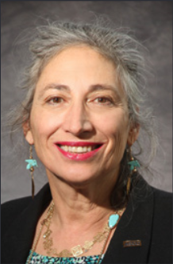
Banu Symington, M.D. MACP
Hematology & Medical Oncology
Medical Director
Sweetwater Regional Cancer Center
Rock Springs, WY
Disclosures: None

Slide 3


Slide 4


Slide 5
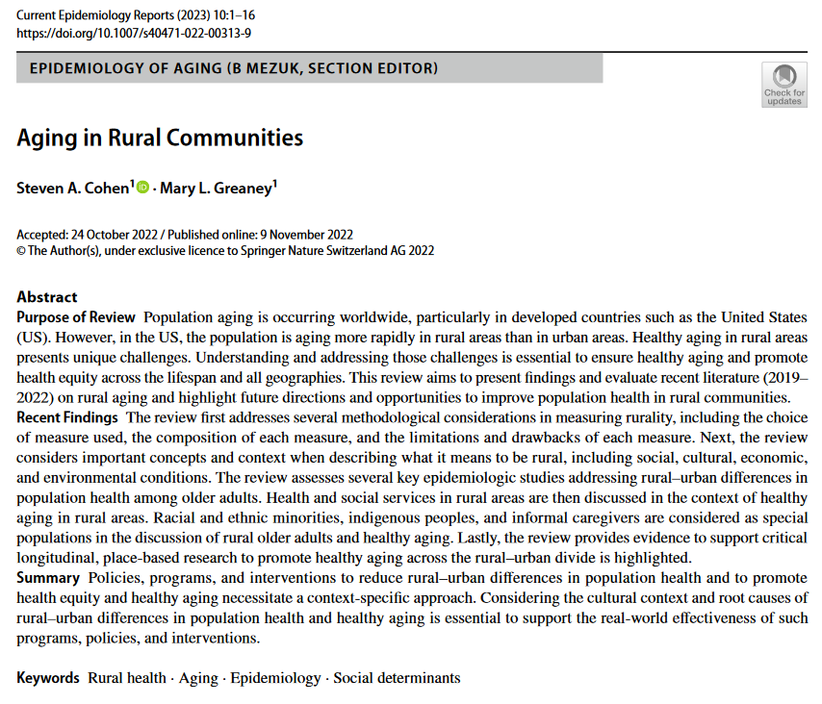


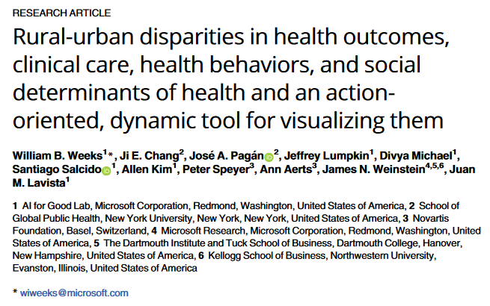
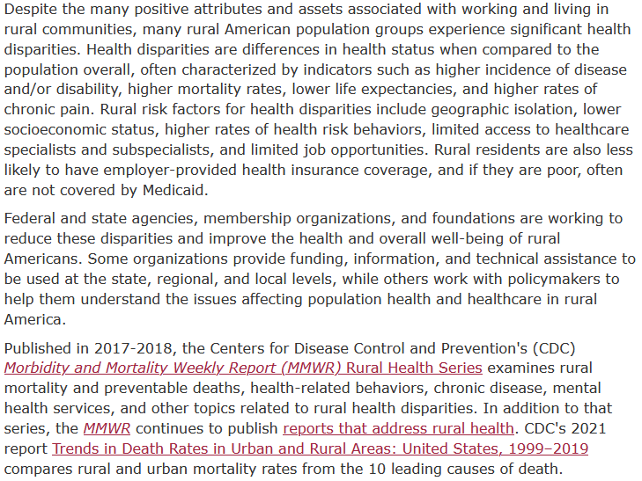
Rural Health Disparities
PMID: 36404874
PMID: 37788228

Slide 7
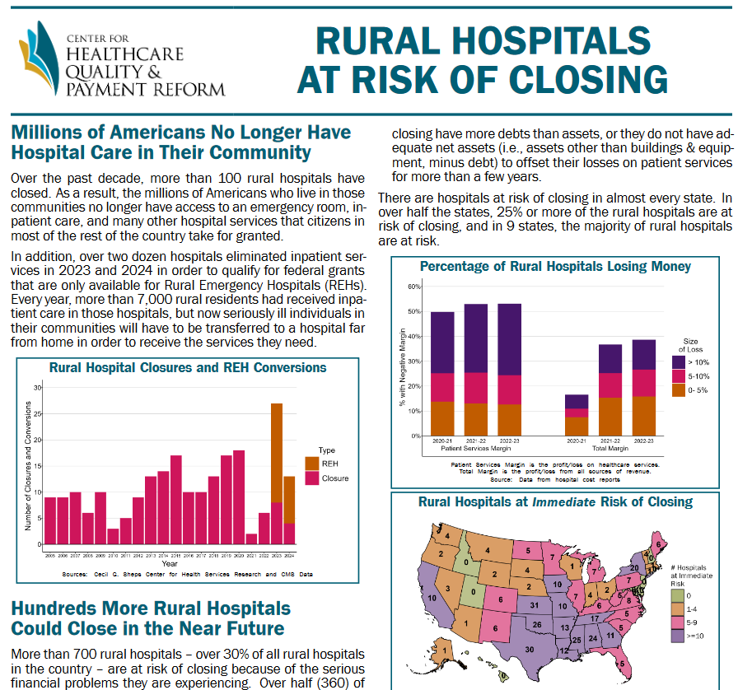
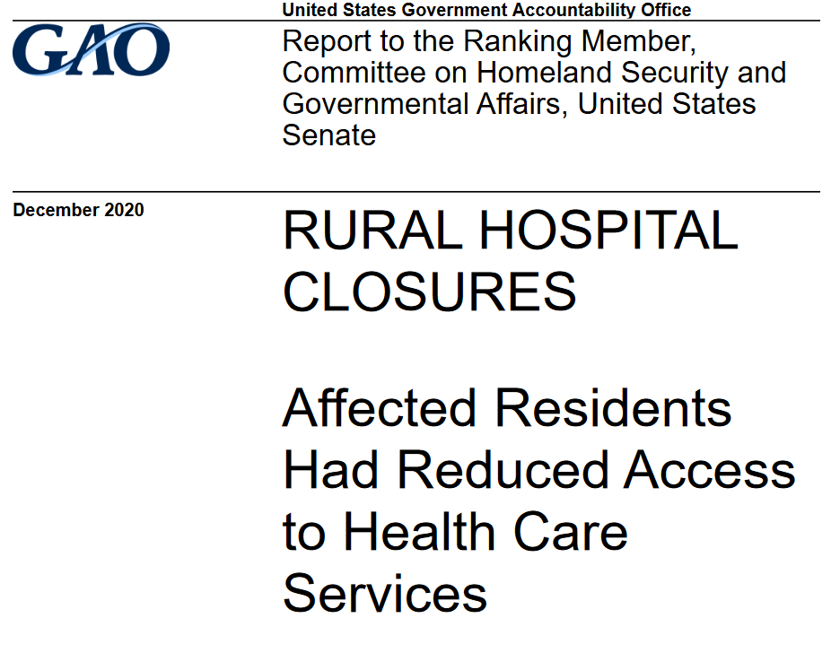
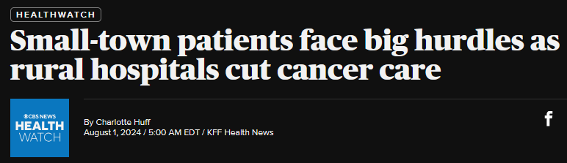
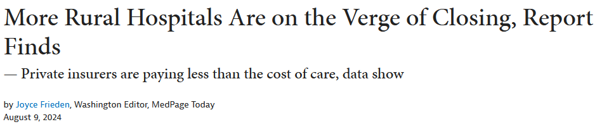
https://chqpr.org/downloads/Rural_Hospitals_at_Risk_of_Closing.pdf
GAO-21-93

Slide 8
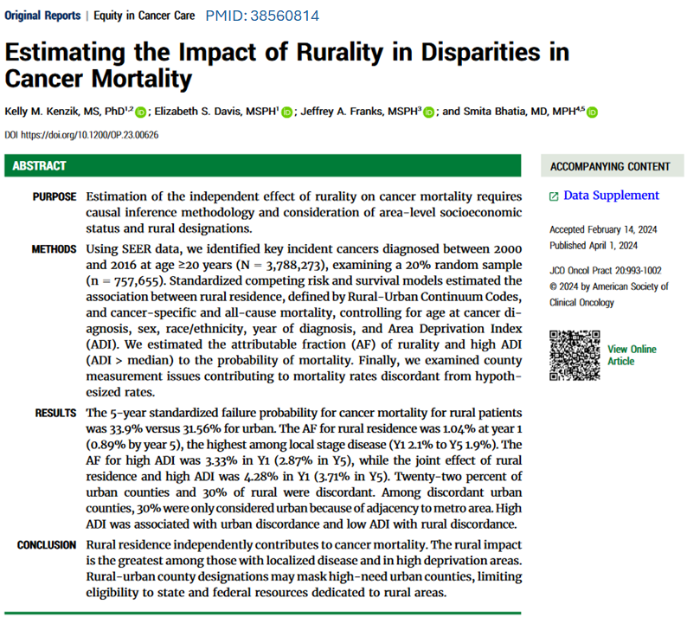
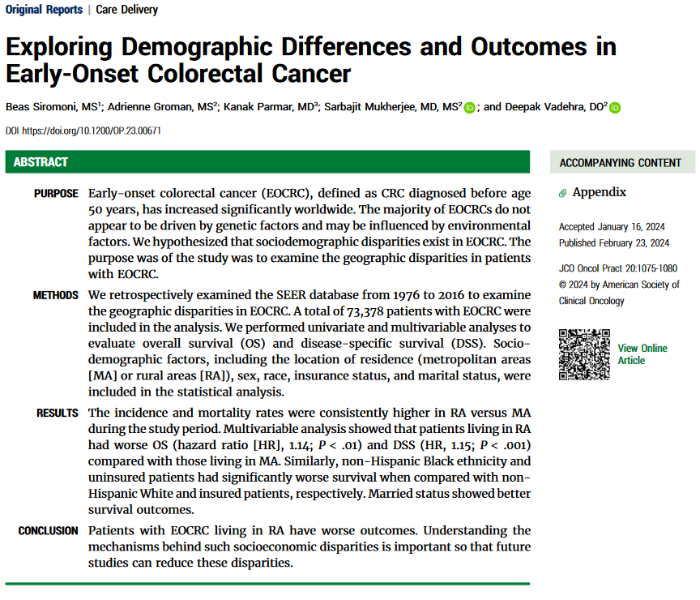
Impact of Rural Health Disparities
PMID: 38394477

Slide 9
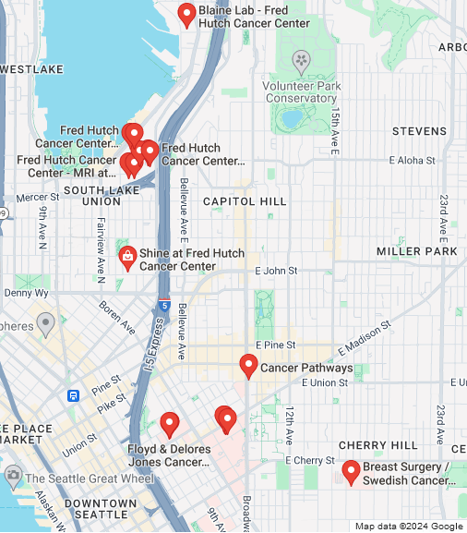
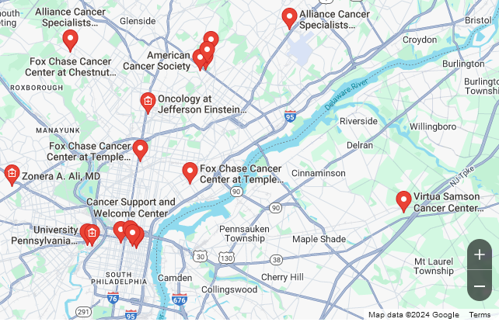
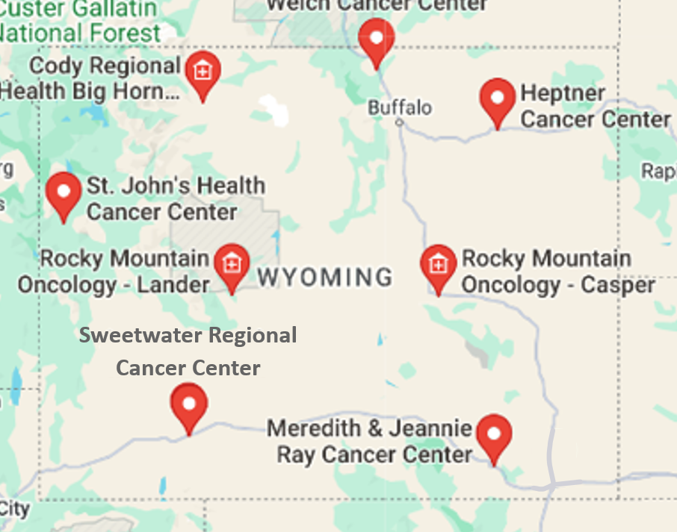
Cancer Center Distribution
Seattle, WA
Philadelphia, PA
Wyoming

Slide 10
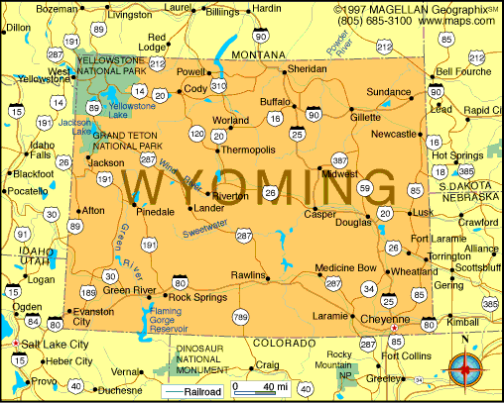
The State of Wyoming

Slide 11

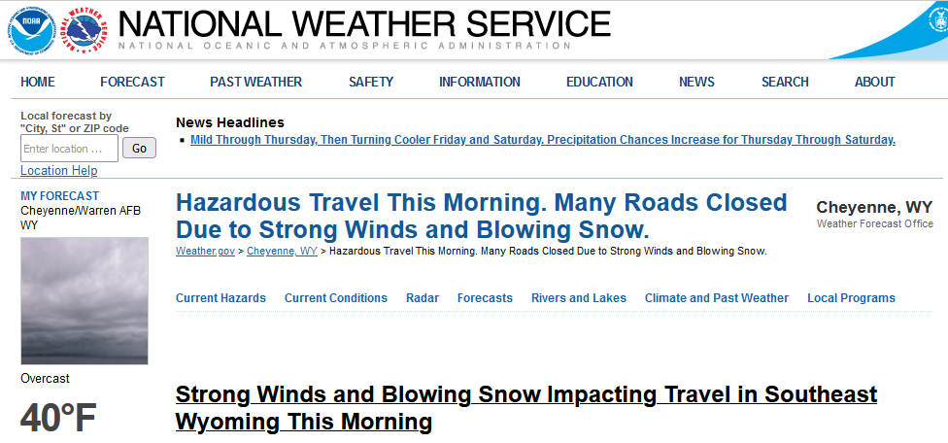
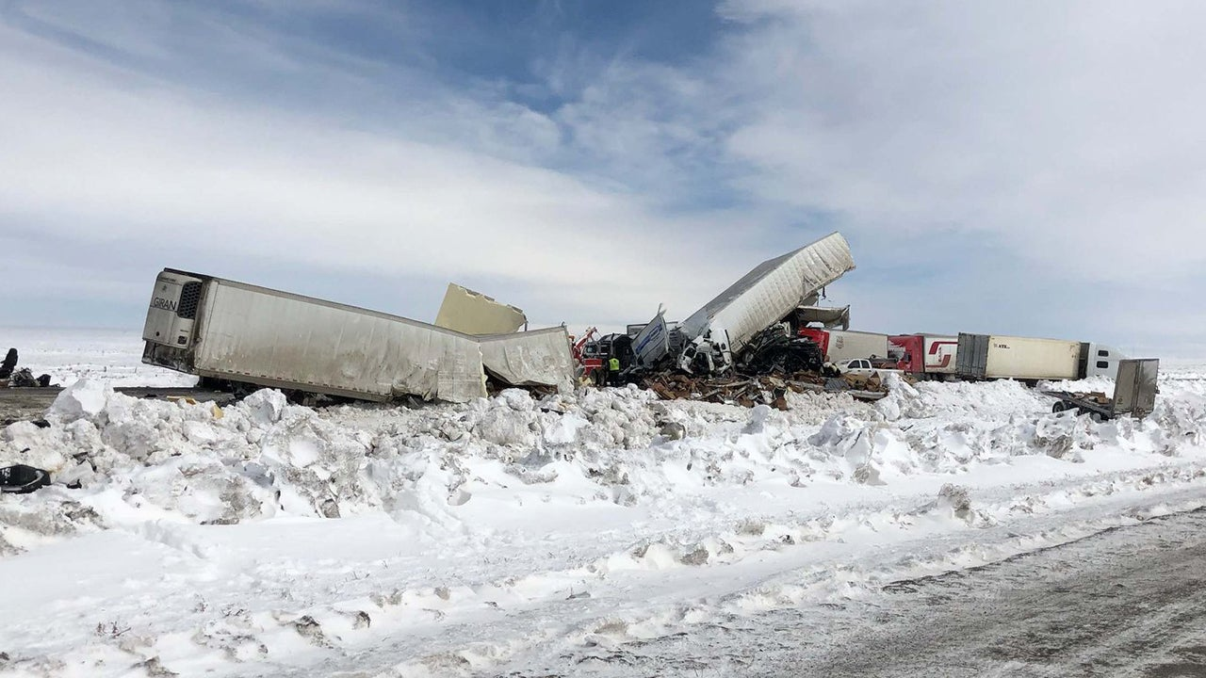
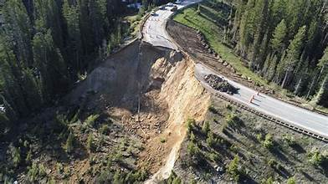
Rural Location Challenges
10/18/2024

Slide 12
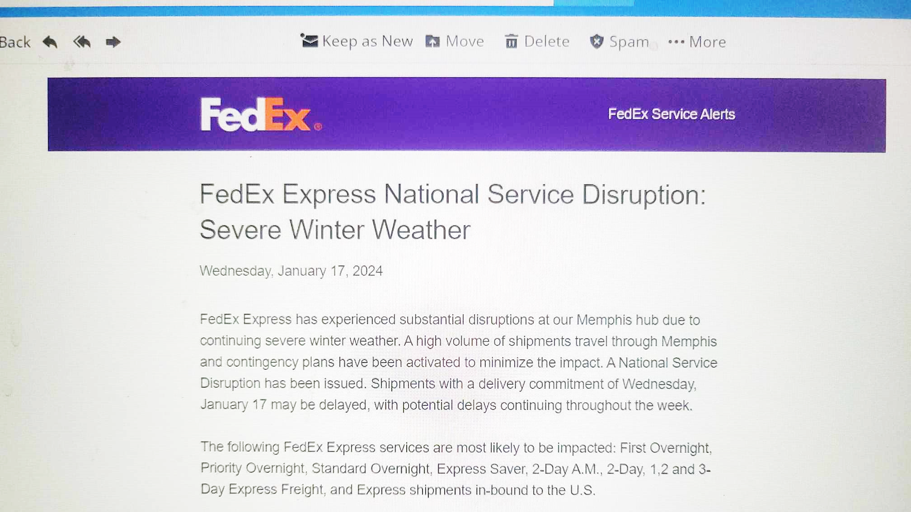
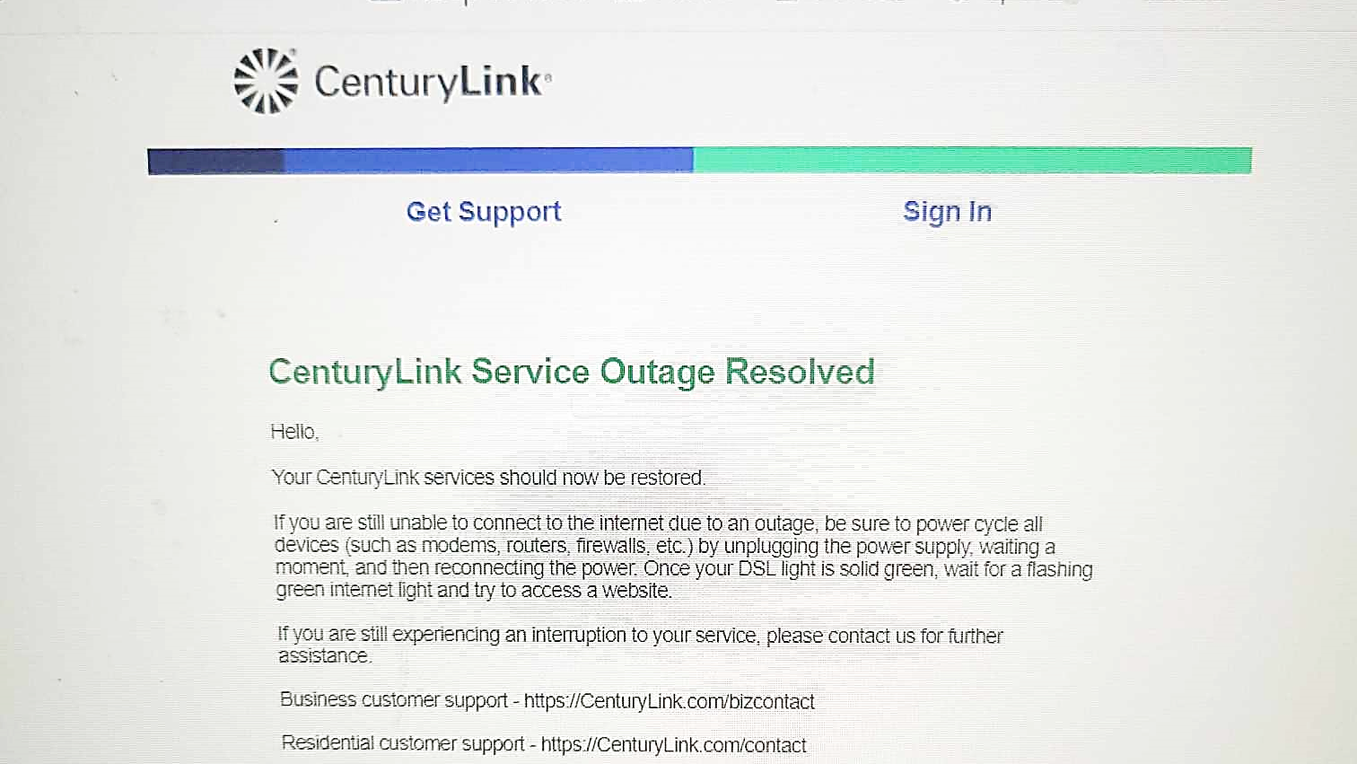

Slide 13
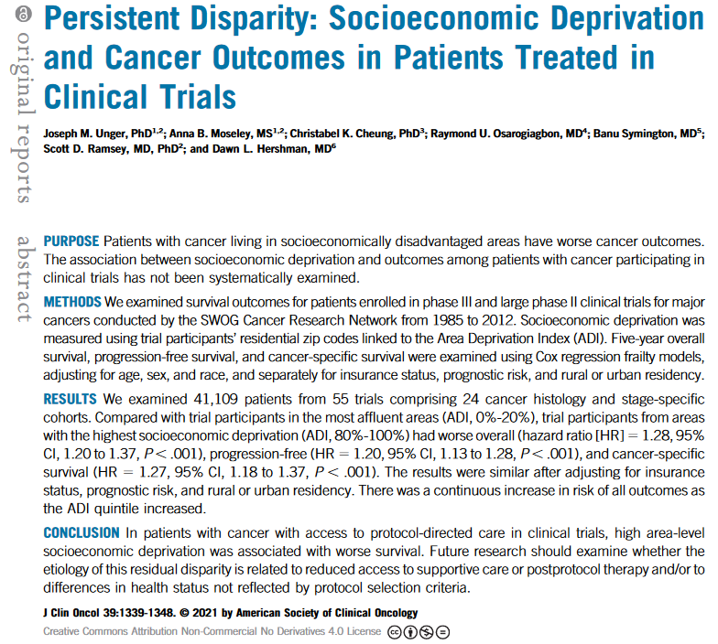
Clinical trials
PMID: 33729825
Improve patient outcomes, perhaps due to standardization of care or many eyes on the pt
Should be representative of all the patients in the nation but are not

Slide 14
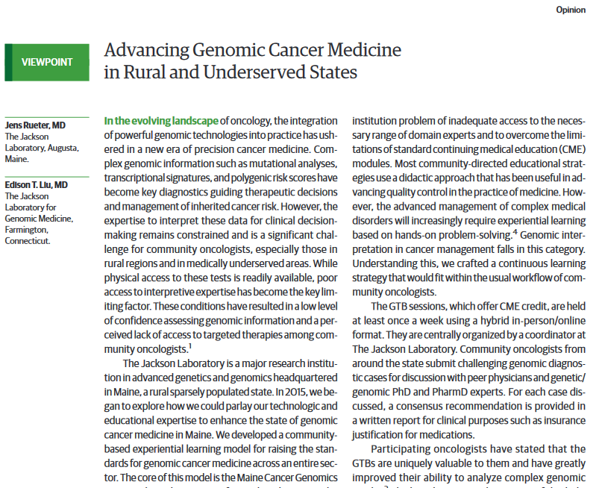

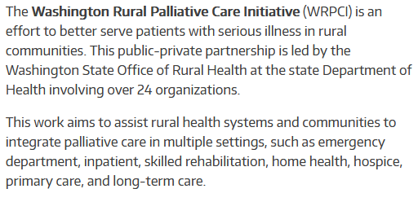
Movement Towards Solutions
JAMA Oncology
2024 Vol 10 No. 9
https://waportal.org/partners/washington-rural-palliative-care-initiative

Slide 15
SOLUTIONS Fix What You Can Fix
Manpower thru exposure
Expand telehealth/telephone coverage
National licensure credentialing for telehealth
Decentralize clinical trials so John Smith can participate from his home in WY
Realistic hospital reimbursement
Universal healthcare

Slide 17
Rural medicine is in danger
https://www.kevinmd.com/2024/10/why-rural-americas-health-care-crisis-is-getting-worse-and-what-it-means-for-retirees-podcast.html

Slide 18
I would like to thank the technical and artistic help of Lacey Reddick Clinical Trials Facilitator

Slide 19
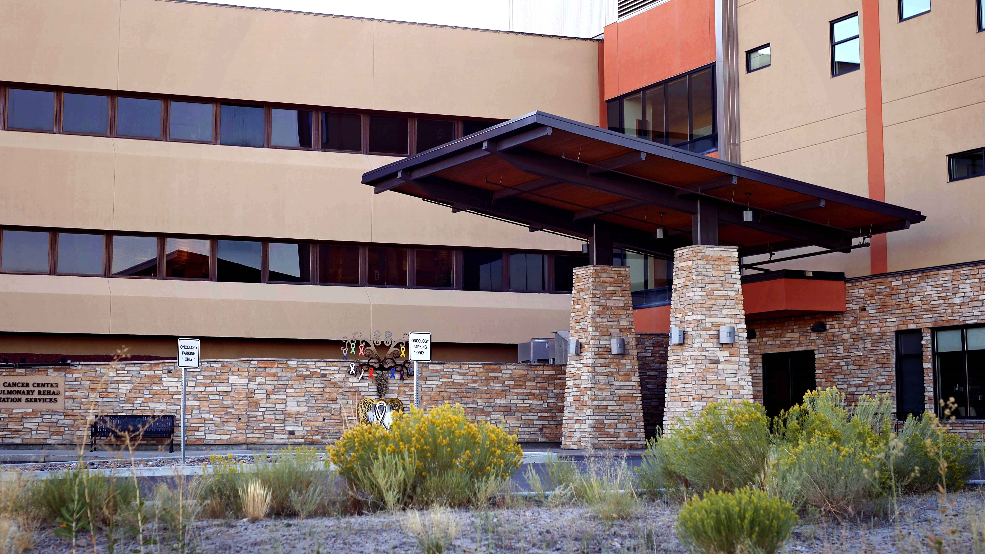
Thank you!
bsymington@sweetwatermemorial.com

