Slide 1

Access to Cancer Care in Washington State:
Data and Dialogue
Dr. Scott Ramsey
Dr. Veena Shankaran
Hutchinson Institute for Cancer Outcomes Research (HICOR)
Notes:
Good morning and thank you all for being here. The goal of this session is to present some new data and initiatives around the theme of Access to Care. At the end of this session, we will have time for an open discussion and would love to hear your feedback on the data we present, how it relates to your experience, and ideas about cancer care quality and research priorities in the new year.

Slide 2
HICOR Vision
We believe that every cancer patient should get quality care that meets their goals at a reasonable cost, wherever they live.
Notes:
HICORs vision is simple: We believe that every cancer patient should get quality care that meets their goals at a reasonable cost, wherever they live.

Slide 3
HICOR Data Repository
HEALTH
CARE CLAIMS
(2009 – 2023)
Data Sources
Premera Blue Cross
Regence BlueShield
WA Medicaid/UMP
Medicare
CANCER REGISTRY
RECORDS
(2009-2023)
Data Sources
Washington State Cancer Registry
CSS (Puget Sound SEER Registry)
CREDIT AND BANKRUPTCY RECORDS
(2013 – 2020)
Data Sources
WA Bankruptcy records
TransUnion credit data
Currently includes 466,865 patients; Represents 70% of insured WA cancer patients
Notes:
In working towards realizing this vision, HICOR has, for many years, reported on care quality and costs in WA state, using the data repository shown here. This unique database links cancer registry data to health care claims from the major payers in our state. Approximately 70% of insured WA state cancer patients are represented in this database. More recently, we have been able to link with credit data from one of the largest credit reporting agencies in the US; our goal in doing so was to better understand the cancer care costs from the patient perspective.

Slide 4
Barriers to Cancer Care
Financial
Affording / Accessing Care
Receipt of biomarker and germline testing
Participation in cancer research studies.
Stigma &
Racism
High Quality
Cancer Care
Geographic
Cultural &
Linguistic
Health
Insurance
Transportation
Notes:
The theme of today’s summit is Improving Patient Access to Care. The first step in improving access is understanding the many barriers to care including cultural and language barriers, racism, geographic barriers, access to health insurance, and financial barriers. Today you have already heard and will hear presentations about how we can identify and address these barriers. In this presentation, we will focus specifically on how these factors can influence affordability or access to care, receipt of biomarker testing, and patient participation in cancer research studies.

Slide 5
Impact of Cancer Diagnosis on Credit
Any Adverse Financial Event (AFE)
4.3 % (cancer) vs 2.4 % (control) p<0.001
OR 1.71 (95% CI 1.61-1.81)
adjusted for age, sex, credit line (pre-cancer), neighborhood
P value < 0.05 for all comparisons except foreclosures (0.08) and tax liens (p = 0.53))
Shankaran, V. et al. J Clinical Oncology. January 2022
Notes:
As it relates to financial barriers to and affordability of care, we at HICOR have conducted many studies showing that patients with cancer are at high risk for financial hardship -- also known as financial toxicity. In one of our recent studies, using the credit data linkage I just described, we showed that patients with cancer are 71% more likely to experience adverse financial events such as collections, delinquent payments, foreclosures, repossessions, and liens following diagnosis than similar matched patients without cancer.

Slide 6

Continuum of Financial Status
Social Determinants of Health
Health Related
Social Needs
Financial Toxicity
OOP Costs
Lost Productivity
Medical Debt
Anxiety and Distress
Financial Trade-Offs
Overall Survival
Treatment Adherence
QOL and Depression
Healthcare utilization
Financial Fragility
Consequences
Cancer Diagnosis
and Treatment
Khan et al. J Clin Oncol. 41: 3051-3058, 2023.
Notes:
We have also conducted research to show that financial hardship (or toxicity) can adversely impact survival, quality of life, and healthcare utilization. But through this work we have also come to recognize that financial toxicity is not simply a consequence of cancer diagnosis but rather exists on a continuum – and is more common and severe among individuals who may be financially vulnerable (or financially fragile) before diagnosis. Financially fragile individuals may not only be more likely to face financial hardship after cancer treatment but may be less likely to receive treatment at all due to issues around affordability and access.

Slide 7
Financial Fragility in Newly Diagnosed Cancer Patients
Notes:
To this end, we sought to describe to what extent patients with cancer in our state are financially fragile before they are diagnosed, as this is likely to affect their ability to interface with the healthcare system and afford recommended cancer treatment.

Slide 8
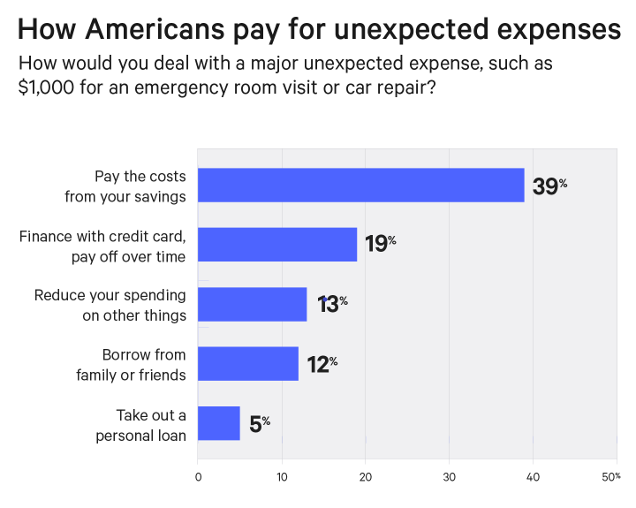
How Americans pay for unexpected expenses
Notes:
For context, most Americans can be described as financially fragile; with less than 40% being able to cope with an unexpected $1000 bill.
Patients with cancer come to their diagnosis with these same financial challenges that can influence their ability to drive to appointments, pay deductibles, cope with income loss, and so on. In other words, cancer patients are regular Americans with all the same day to day financial struggles but with the added shock of a severe, expensive, and life-threatening diagnosis.

Slide 9
1 in 5 patients are financially fragile at diagnosis
Measured using credit reports 3 months prior to diagnosis, Puget Sound region
Any Adverse Financial Event (AFE): 21.3 %
Third party collections 18.6%
    Charge-offs 2.2%
    Delinquent mortgage payments 2.6%
    Tax liens 2.6%
    Foreclosures 1.1%
    Repossessions 1.0%
Notes:
We found that over 20%, or 1 in 5, cancer patients are financially fragile – that is, have experienced at least one of the severe financial events shown on this slide, prior to diagnosis.

Slide 10
Financially fragility is associated with later stage diagnosis
Exposure = AFE within 2 years prior to diagnosis
Outcome = later stage (III/IV) cancer diagnosis (vs. early stage I/II)
Adjusted for = age, race, sex, marital status, year of dx, insurance type, area deprivation, rurality
OR = 1.33
Khor, S et al. ASCO Quality Care Symposium 2023
Notes:
We know from our prior work that being financially fragile is associated with later stage of cancer diagnosis. We presented these data at the ASCO quality meeting in 2023; this figure shows that patients with adverse financial events in the 2 years prior to diagnosis were more likely to be diagnosed with stage III/IV disease relative to stage I/II disease, after adjusting for a variety of factors that may also increase this risk

Slide 11
Financial fragility is more common in younger patients and Medicaid enrollees
Measured using credit reports 3 months prior to diagnosis, Puget Sound region
Payer Type | % with AFE
Commercial | 17%
Medicaid | 55%
Medicare | 16%
Multiple | 11%
Age | % with AFE
<40 | 39%
40-49 | 37%
50-64 | 28%
65+ | 13%
Notes:
Not surprisingly, we also found that financial fragility is more common among Medicaid enrollees and younger patients, with the highest rates among patients < 50 years old

Slide 12

Financial fragility varies by county
Measured using credit reports 3 months prior to diagnosis
Denotes counties with highest rates of financial fragility
San Juan
12%
Whatcom
17%
Skagit
17%
Island
15%
Clallam
13%
Snohomish
23%
Jefferson
14%
Kitsap
19%
King
20%
Grays Harbor
25%
Mason
21%
Thurston
21%
Pierce
29%
Notes:
We also see significant variability in the proportion of financially fragile cancer patients by county, with Pierce, Snohomish, and Grays Harbor counties having the highest proportion of financially fragile cancer pts, likely a reflection of the overall financial situation for individuals living in these areas.

Slide 13
Some clinics serve more financially fragile patients than others
Measured using credit reports 3 months prior to diagnosis, Puget Sound region, Patients with commercial and/or Medicare insurance
Notes:
Looking at clinics in the Puget sound region and focusing on patients with commercial or Medicare insurance, we see that the proportion of financially fragile pts seen at these clinics varies; in some clinics, over 20% of insured newly diagnosed cancer patients are financially fragile. Having access to commercial or Medicare health insurance, therefore, does not tell us much about the financial circumstances of the patients we see. In addition, recognizing that financial fragility might also influence some of the quality metrics we report, we plan to account for this baseline characteristic in future reports. We also think these findings suggest that, as a community, we need to devise strategies to screen for and address financial fragility at diagnosis and beyond – we will come back to this topic as a discussion point at the end of this session.

Slide 14
Community Cancer Care Report
State-Level Metrics:
Biomarker and Germline Testing
Notes:
Moving on to our newer metrics around biomarker and germline testing

Slide 15
What are the barriers to accessing biomarker and germline testing?
Biomarker testing, or somatic testing, provides information about the tumor and helps make treatment decisions.
Germline testing, or genetic testing, looks for inherited conditions to help guide treatment and inform family of increased risks of cancer.
Financial
Stigma &
Racism
High Quality
Cancer Care
Geographic
Cultural &
Linguistic
Health
Insurance
Transportation
Notes:
There are two common types of testing that we do in oncology. Somatic or biomarker testing is done on the tumor specimen to detect alterations or mutations within the cancer cells that may confer susceptibility or resistance to specific therapies. Germline testing is done by testing a blood sample or saliva swab to determine one’s own inherited genetic patterns that might have put them at increased risk for developing the cancer. Germline changes can also have implications for treatment. As we review the data for biomarker and germline testing in our state, we encourage you to think about barriers to testing that you’ve come across and we can dive into those during the open discussion.

Slide 16
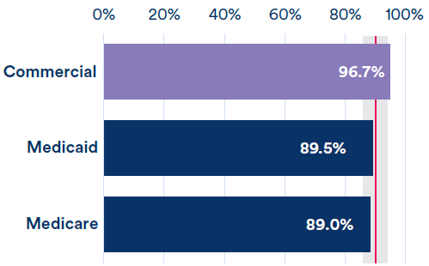
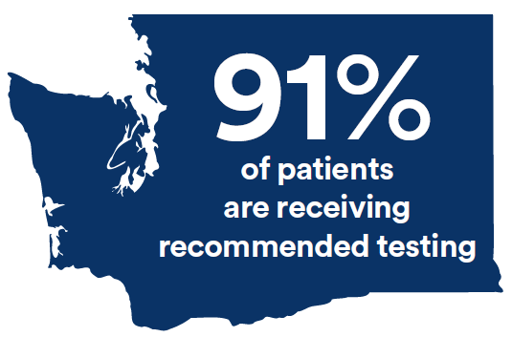
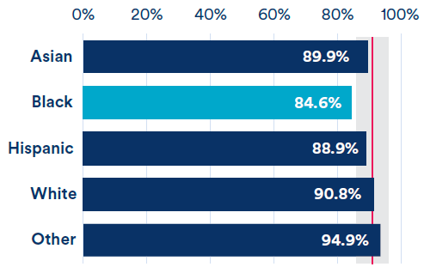
Community Cancer Care Report:
Biomarker Testing at Diagnosis for Metastatic NSCLC
2018-2020, WA State, testing in first four months of diagnosis
Tests included: EGFR, ALK, ROS1, NGS
Insurance Type
Race/Ethnicity
Notes:
First, it is well recognized now that in advanced or metastatic NSCLC, certain biomarker tests influence the choice of initial and subsequent therapies – these include EGFR, ALK, ROS1, as well as other mutations detected by next-gen sequencing panels. In general, we are doing very well as a state with approximately 91% of pts receiving one of these tests within 4 months of diagnosis. However, we do note some disparities. In particular, patients with commercial insurance are more likely to receive testing than those with Medicaid or Medicare insurance. Also, black patients are less likely to receive testing than patients of other races.

Slide 17
Potential New Metric:
Biomarker Testing at Diagnosis for Metastatic Colorectal Cancer
2017-2022, Puget Sound region
Testing in first six months of diagnosis
Payer Type | % with Testing
Commercial | 97%
Medicaid | 86%
Medicare | 88%
Multiple | 88%
Any Test: 90.0 %
Tests included:
MSI, MMR IHC, KRAS, NRAS, BRAF, NGS
Notes:
We are also starting to explore rates of biomarker testing in other cancers. In advanced CRC, for example, we looked at receipt of any of the following tests within the first 6 months of diagnosis (MSI, MMR IHC, KRAS, NRAS, BRAF, or NGS). And again, we see pretty high rates of testing at 90%. As with NSCLC, however, we see lower rates of testing in non commercially insured pts.

Slide 18




Community Cancer Care Report: Germline Testing
Breast Cancer
Ovarian Cancer
Pancreatic Cancer
Prostate Cancer
  Population
  Testing Period
  Tests
2 months prior through 24 months following diagnosis
  Breast: BRCA1/2
  Other: Any germline test
  Patients who meet guidelines for germline testing
  Diagnosed 2018-2020
Notes:
Moving on to germline testing. Given the importance of germline testing in specific groups of breast, ovarian, pancreatic, and prostate cancer patients as recommended by NCCN guidelines, we investigated the rate of testing in patients diagnosed between 2018 and 2020 looking at a window between 2 months prior to and 24 mo following diagnosis. For breast cancer, we looked at evidence of brca ½ testing while in the other cancers we looked at evidence that any germline testing had happened.

Slide 19
Community Cancer Care Report: Germline Testing
Breast Cancer
Ovarian Cancer
Pancreatic Cancer
Prostate Cancer
Mid 2000s
Early 2010s
Late 2010s
Late 2010s
Recommendations introduced
  Population
  Testing Period
  Tests
2 months prior through 24 months following diagnosis
  Breast: BRCA1/2
  Other: Any germline test
  Patients who meet guidelines for germline testing
  Diagnosed 2018-2020
Notes:
Germline testing in higher risk and younger breast cancer pts has been part of NCCN recommendations since the mid 2000s. For the other cancers, testing recommendations were introduced more recently with prostate/pancreatic germline testing recommendations introduced in the late 2010s. This is relevant because there is often a lag between recommendations and uptake in clinical practice and we want to acknowledge that, particularly in pancreatic and prostate cancer, there may be an implementation runway such that testing rates may be lower in 2018-2020 than they are at present day.

Slide 20
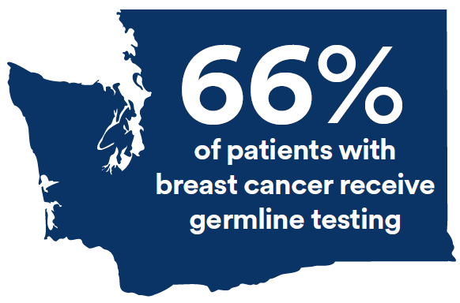
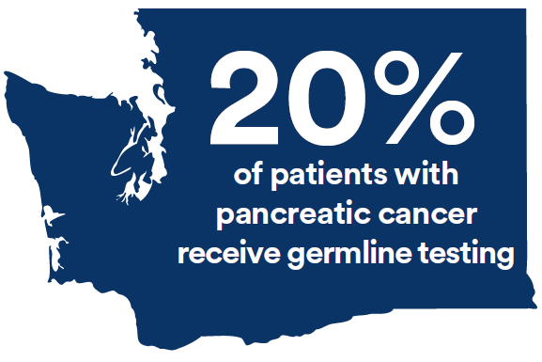
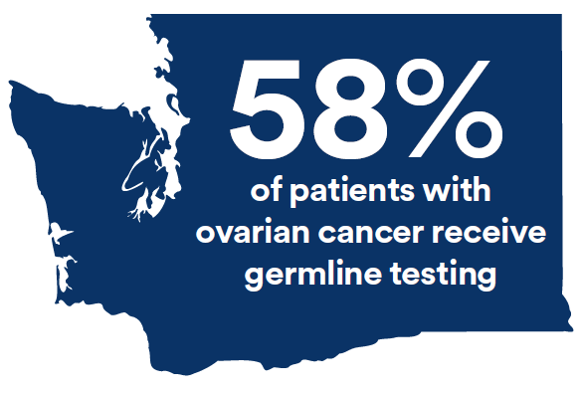
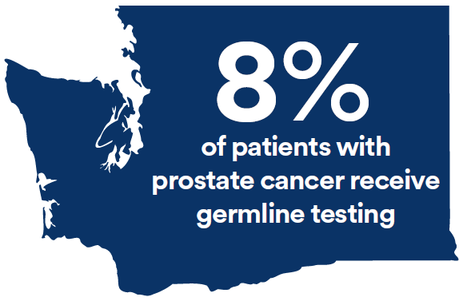
Community Cancer Care Report: Germline Testing
Breast
Pancreatic
Ovarian
Prostate
Notes:
Here are our results. Despite the fact that brca ½ testing has long been recommended in breast cancer, we find that only 66% of women with breast cancer who meet criteria for testing received it. Only 58% of women with ovarian cancer received germline testing. The numbers are lower for pancreatic and prostate cancer, with only 20% and 8% of pts tested respectively. Even accounting for the time in takes to implement guidelines into clinical practice, we would argue these numbers are quite low when a reasonable expectation should be that at least 80% of eligible patients get tested.

Slide 21
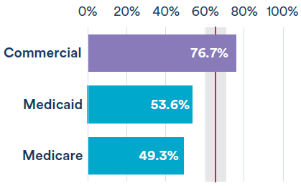
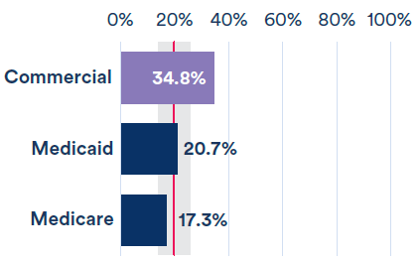
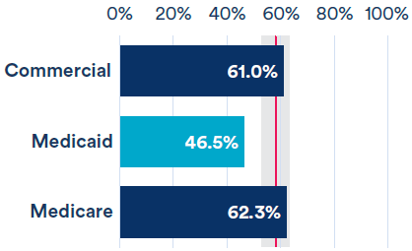
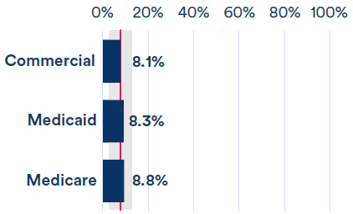
Germline Testing – Disparities by Insurance Type
Breast
Pancreatic
Ovarian
Prostate
Notes:
As with biomarker testing, we do see disparities in testing by insurance type, with commercially insured pts with breast and pancreatic cancer more likely to receive testing that those with Medicare or Medicaid insurance.

Slide 22
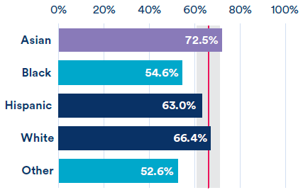
BRCA1/2 Testing – Disparities by Race/Ethnicity
Breast
Notes:
And here again among pts with breast cancer who meet criteria for testing, we see that black patients are less likely to receive testing than pts of other groups.

Slide 23
BRCA1/2 Testing – Variability in clinic testing rates
Patients with commercial and/or Medicare insurance, Not risk adjusted, Diagnosis years 2018-2020
Breast
Notes:
We also see variability between clinics in rates of testing, with some clinics testing just above half of eligible pts while others test close to 80% of eligible pts. This variability suggests that some clinics may face more barriers to testing than others.

Slide 24
Breast/ovarian germline testing is stable, pancreatic/prostate increasing
Puget Sound region, Diagnosis years 2017-2022, Minimum 6 months of enrollment after diagnosis, Testing up to 24 months
80%
40%
Breast
Pancreas
70%
14%
Ovary
Prostate
Notes:
We did look to see if testing has improved in more recent years. Focusing on the population in the Puget sound region for whom we have more recent data, we see that rates of germline testing in breast and ovarian cancer were pretty constant while there does seem to be an increase in testing rates in pancreas and prostate cancer – an encouraging sign, though even in 2022, rates were still quite low. We’d like to hear from all of you about your experience with and barriers to recommending, receiving, ordering, and paying for germline testing at the end of this session.

Slide 25
Fred Hutch Initiative:
Expanding Access to Cancer Research in Washington State
Notes:
But first, I’d like to turn it over to Dr. Ramsey who will be discussing our recent initiative to expand access to cancer research in our state.

Slide 26
Expanding Access to Cancer Research
VISION
By 2030, 1 in 5 Washington State cancer patients will be enrolled in a research study.

Slide 27


Finding a Better Way: A New Cancer Research Paradigm for our Community
CHALLENGES
SOLUTIONS/PROGRAM GOALS
For Patients
Build a research program focused on improving care and the care experience to address clinic challenges and ease the treatment journey for patients.
Make it easier to conduct and participate in cancer trials for both clinics and for patients.
Time and financial burden
Uncertainties about the experience
Not offered by provider
For Oncology Clinics
Administrative burden
Financial burden
Applicability to the patients or practice
Notes:
Easier for clinics: Minimal start up burden, low touch, makes sense as a business model tool
Easier for patients: Study purpose and eligibility are simple to understand, low burden, experience is a “net positive” no matter the study outcome
Not drug studies

Slide 28
How We Work
Talk with clinics and other research stakeholders in WA state to identify cancer care challenges and priorities
Leveraging Fred Hutch expertise and infrastructure, partner with clinics to develop research studies tailored to clinic workflow, patient population and research goals
Secure study funding and launch new trials within the state

Slide 29
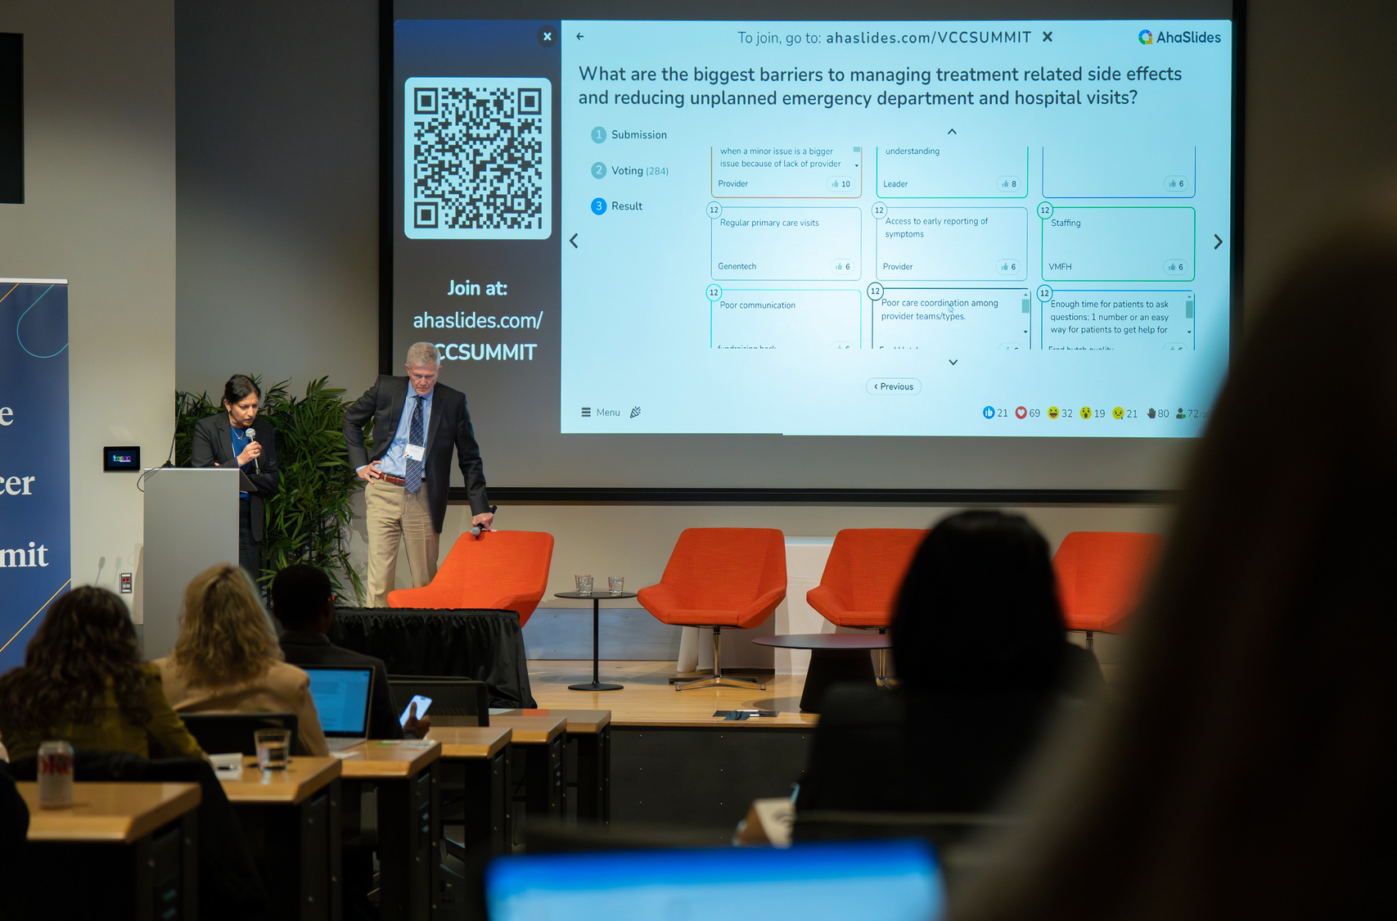
Last year we asked about your cancer care priorities and research interests. This is what you said…
Insurance coverage restrictions are barriers to germline testing
Prior auth requirements for growth factors and generics
Lack of real-time data to inform risk analysis
Ensure access to patients who live in remote settings
Hospice and palliative care
Timing of transition to public/private insurance after diagnosis for AI/AN patients
Improve long term side effect management
Patient and family education
Workup delays to specialists
Education about symptom management
Mental health support

Slide 30





We are launching cancer care delivery pilot studies based on identified community areas of interest
Active or opening soon
PAYMENT
Limited duration, unrestricted cash payments following a cancer diagnosis could be an efficient and effective means to improve outcomes after a cancer diagnosis.
Interview community cancer clinics to identify barriers/facilitators to study feasibility and conduct a pilot study in WA to test a randomized intervention of unrestricted payments in a small sample of cancer patients.
DISCOVER
Assess the relationship between insurance status, health-related social needs, and symptoms during chemotherapy.
60 patients with cancer who are undergoing chemotherapy will wear a Fitbit tracker and complete a web-based daily symptoms survey for 4 weeks.
PRO-ACTIVE
Assess if a virtual fitness program reduces cancer-rated fatigue in patients undergoing radiation for breast cancer.
Evaluate if patients can be identified and referred to the program via a patient-reported outcomes screening tool.

Slide 31


Looking for clinic partners for a 2025 launch:
Talking about cancer (TAC): study to help advanced cancer patients and their caregivers have advanced care planning discussions
Assess if the TAC remote training helps patients with advanced cancer and their informal caregivers talk about cancer, treatment and advanced care planning needs
Evaluate TAC feasibility and acceptability by measuring advanced care planning engagement, participant distress, prognostic understanding and caregiver burden
REGENT Prostate Study: Testing a remote, comprehensive germline genetic testing program for prostate cancer patients
Assess feasibility, uptake and patient/provider satisfaction of a remote, comprehensive germline genetic testing program that includes video-based patient education, and access to germline genetic testing and genetic counseling, and expert review of results for metastatic cancer patients in WA

Slide 32





Information about the Trials Expansion Protocols
 | Dr. Hiba Khan REGENT Prostate Study: Testing a remote, comprehensive germline genetic testing program for prostate cancer patients
 | Dr. Erin Gillespie PRO-ACTIVE: A Remote exercise program to reduce radiation related fatigue during breast cancer treatment
 | Karma Kreizenbeck HICOR Director, Research and Partnerships
 | Kate Watabayashi HICOR Senior Program Manager
Notes:
After introducing the purpose of the QR code, stay on the slide long enough for people to get their phones out and scan.

Slide 33
Summary and Discussion
Financial fragility
Many of our patients are financially fragile at the time they are diagnosed with cancer.
How does your clinic screen for financial health?
Germline testing
Overall, testing rates are below goal for breast, ovarian, pancreatic, and prostate cancer.
What are barriers and facilitators to testing?
Trials expansion
Based on your feedback, we are opening studies testing interventions for symptom management, palliative care, germline testing and financial toxicity.
What are cancer research priorities in 2025?
Financial
Stigma &
Racism
High Quality
Cancer Care
Geographic
Cultural &
Linguistic
Health
Insurance
Transportation

Slide 34

We want to hear from you!
When we come together,
big things happen!
We invite members of your organization to meet with us to discuss your cancer research priorities, challenges, and interests. ​
Karma Kreizenbeck (kkreizen@fredhutch.org)
Notes:
Not the end of the conversation.
Encourage people to reach out with their thoughts.

