Slide 1
Addressing Financial Hardship Associated with Cancer
Mateo Banegas
Associate Professor
University of California, San Diego

Slide 2

Paul’s Story
Armed services veteran
Single-income household
High-deductible health plan
Diagnosis & Treatment
Multiple myeloma
Chemotherapy and physical therapy
Social/Economic Situation
Unable to afford out-of-pocket (OOP) costs
Stopped working soon after diagnosis
To make ends meet: collected cans, housesitting, $ from friends
Needs identified: medical bills, food, utilities, transportation
Result
Connected with Community Navigator
Received medical financial assistance (MFA)
Financial support from Leukemia Lymphoma Society
Enrollment in Medicaid
NCI R01CA237322 (Henrikson/Banegas); NCT05018000

Slide 3
Assessment 1
Assessment 2
Assessment 3
Month 1
Month 2
Month 3
Month 4
Month 5
Month 6
Randomization,
Welcome Call
Referred for food, housing, transportation assistance
Medicaid Application
Review insurance coverage, start of new calendar year
Medical Bill and OOP clarification
Connected w/ VA
Enrolled in SNAP
MFA Application
(Awarded 75%)
LLS Financial Support Awarded
(Urgent Need and Transportation
Reimbursement)
Ppt unexpectedly admitted to inpatient
Unemployment Application
Plan for steps after CAFÉ
Ppt discharged from inpatient
Referred to Case Mgr. to help apply for LLS funds
Unemployment appeal support

Slide 4
Financial hardship
…a situation in which an individual (or family) is unable to pay for essential living expenses, including the costs to ensure the health and welfare of the individual/family.
adapted from U.S. Internal Revenue Service

Slide 5
Typology of Financial Hardship
Material Conditions
Psychological
Response
Behavioral
Coping
Out-of-pocket expenses
Medical Debt
Lost wages
Emotional distress related to cancer care costs
Worry about loss of income due to cancer
Taking less medication
Skipping utility payments
Delaying medical care
Altice et al. JNCI. 2017 [PMID: 27754926]

Slide 6
National Prevalence of Cancer-related Financial Hardship
Zheng et al. Cancer. 2019 [PMID: 30663039]

Slide 7
Facing Medical Debt, Social & Financial Sacrifices
Banegas et al. J Cancer Survivorship 2018 [PMID: 31123985]

Slide 8
Why is it important to help patients deal with financial hardship?
70% of patients want to discuss costs of care with their health care teams
Greater risk of delaying or skipping high-value care
Financial hardship associated with increased risk of mortality
Greater risk of using high-cost care (ED, Hospital)

Slide 9
Health equity is achieved when every person has the opportunity to “attain his or her full health potential” and no one is “disadvantaged from achieving this potential because of social position or other socially determined circumstances.”
Centers for Disease Control and Prevention

Slide 10
How do we intervene and prevent financial hardship among patients and their families?

Slide 11
Financial Hardship-Related Processes in US Oncology Practices: 2022 NCI Landscape Survey
Social Worker evaluation (65%)
78%
screen patients for financial hardship
(n=200/258 of oncology practices)
Medical Team assess during rooming (48%)
Patient Survey (44%)
Banegas et al. JCO Oncology Practice [Under Review]

Slide 12
Financial Hardship-Related Processes in US Oncology Practices: 2022 NCI Landscape Survey
What happens if financial hardship identified?
Social Worker (96%)
Financial Navigator (69%)
Billing Staff (58%)
Banegas et al. JCO Oncology Practice [Under Review]

Slide 13
Principal Investigator(s) | Project Number (Agency) | ClinicalTrials.gov Identifier | Study Title
Blinder V | Alliance (PCORI) |  | Addressing Financial Needs to Improve Cancer Outcomes
Blinder V | R01CA214785 R37CA214785 (NCI) | NCT03572374 | Breast Cancer and the Workforce Communication App: A RCT of English/Spanish intervention to promote long-term job retention
Doherty, M | One Family Foundation, Social Impact Fund |  | Guaranteed Income and Financial Treatment (GIFT) Trial
Henrikson NB; Banegas MP | R01CA237322 (NCI) | NCT05018000 | Cancer Financial Experience (CAFÉ): Clinic-based intervention to address financial hardship for people with cancer
Kirchhoff A; Park E | R01CA276825 (NCI) | NCT05829070 | Improving Health Insurance Experiences for Adolescent and Young Adult Cancer Patients
Park E Kirchhoff A | R01CA271380 (NCI) |  | Assessing the effect of virtual navigation interventions to improve health insurance literacy and decrease financial burden: A CCSS randomized trial
Sadigh, G | R01CA272680 (NCI) | NCT06295367 | Effectiveness of Out-of-Pocket Cost COMmunication & Financial Navigation (CostCOM) in Cancer Patients
Shankaran V | R01CA248656 (NCI) SWOG S1912CD | NCT04960787 | Financial Navigation to Improve Understanding & Management of Financial Aspects of Cancer Care for Patients & Their Spouses (CREDIT)
Wheeler SB; Rosenstein D | R01CA240092 (NCI) | NCT04931251 | Addressing Cancer Related Financial Toxicity in Rural Oncology Care Settings

Slide 14
Types of Financial Hardship Solutions
FINANCIAL NAVIGATION
HEALTH POLICY
HOSPITAL/HEALTH SYSTEM FINANCIAL ASSISTANCE
COMMUNITY HEALTH
WORKER
EMPLOYMENT & WORKFORCE ASSISTANCE
PHARMACEUTICAL FINANCIAL ASSISTANCE
HEALTH INSURANCE
NAVIGATION
UNIVERSAL CASH TRANSFER
NON-PROFIT ORGANIZATIONS

Slide 15
Four Key Components to Reduce Financial Hardship
Learnings from the Cancer Financial Experience (CAFÉ) Trial
Goal: reduce financial hardship among patients w/ cancer
Aware
…of the resources, both inside & outside the system, to help w/ financial questions & concerns.
Ask
…the patient, proactively, if they have any questions or concerns related to the costs of their care.
Adjust
…the care plan to align with patient’s current financial and life situation.
Assist
…patients with resources & services by providing a warm handoff.

Slide 16
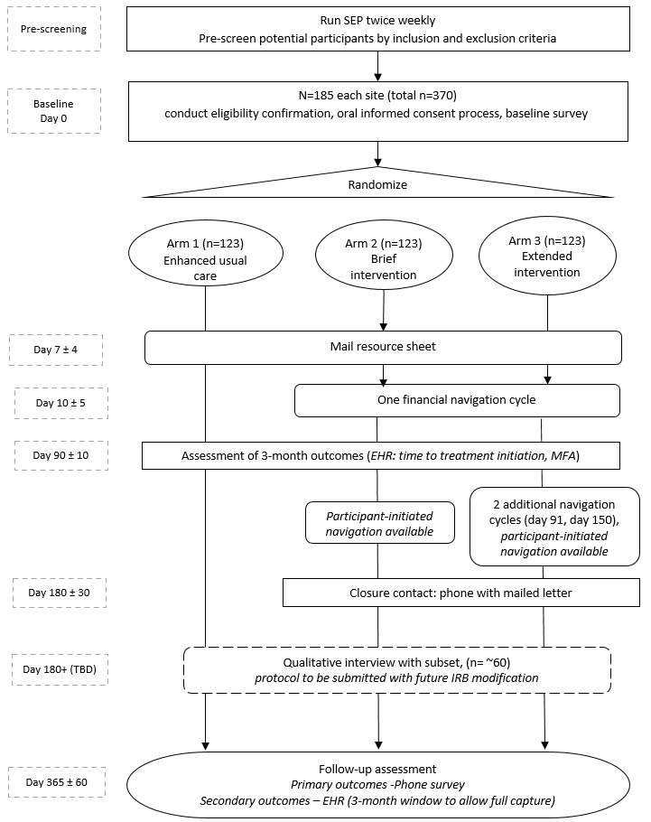
CAFÉ Trial Design
Enhanced Usual Care – resource sheet, baseline & 12-mo f/u survey
Brief Intervention – 6 mos. navigation, 1 proactive outreach, baseline & 12-mo f/u survey
Extended Intervention – 6 mos. Navigation, 3 proactive outreaches, baseline & 12-mo f/u survey

Slide 17
CAFÉ Baseline Results

Slide 18
Ensuring a Diverse Participant Cohort
KEY FACTORS
Purposeful recruitment of a diverse, inclusive, and representative participants
Feasible plan to enrich sample
Resources devoted to achieving goals
Multilingual staff, messaging, and study materials
34%
of CAFÉ participants from under-represented populations

Slide 19
Financial Hardship of CAFÉ Participants at Baseline
Low Financial Distress:
50.4% (n=187)
InCharge Score >7-10
Moderate Financial Distress:
19.1% (n=71)
High Financial Distress:
30.5% (n=113)
InCharge Score >5-7
InCharge Score 1-5

Slide 20
Understanding Participants’ Baseline Financial Hardship (from InCharge Scale)
How do you feel about your current financial situation?
1: Feel Overwhelmed | 7.5%
2 | 3.5%
3 | 5.4%
4: Sometimes Worried | 12.1%
5 | 12.9%
6 | 8.6%
7: Not Worried | 8.9%
8 | 9.4%
9 | 8.4%
10: Feel Comfortable | 19.1%
Don’t Know | 4.0%
How often do you worry about being able to meet normal monthly living expenses?
1: Worry all the Time | 7.3%
2 | 4.0%
3 | 7.0%
4: Sometimes Worry | 8.4%
5 | 10.8%
6 | 4.6%
7: Rarely Worry | 8.4%
8 | 8.6%
9 | 6.7%
10: Never Worry | 30.5%
Don’t Know | 3.8%
How frequently do you find yourself just getting by financially and living paycheck to paycheck?
1: All the time | 17.3%
2 | 3.0%
3 | 4.6%
4: Sometimes | 5.7%
5 | 7.3%
6 | 2.7%
7: Rarely | 7.0%
8 | 5.1%
9 | 4.6%
10: Never | 39.1%
Don’t Know | 3.8%

Slide 21
In the past 3 months, have you had trouble paying for…

Slide 22
Key Takeaways
When measuring cancer-related financial hardship, it is important to consider the timing of potential participants along the care continuum (e.g., at diagnosis vs. in treatment)
Financial hardship is a dynamic process (i.e., changing over time), so repeated screening throughout the care continuum offers the best opportunity to identify this social need
Four Key Steps to Address Financial Hardship: Aware, Ask, Adjust, Assist
Measuring social needs, beyond financial hardship, enables the healthcare team to develop a care plan that aligns with individuals current life situation

Slide 23

Acknowledgements
Nora Henrikson (MPI)
Amanda Petrik (KPNW, Site PI)
Marlaine Figueroa-Gray (KPWA, Site PI)
John Dickerson (Biostatistician)
Melissa Anderson (Biostatistician)
Blake Locher (KPNW, CAFÉ Navigator)
Jennifer Rivelli (KPNW, CAFÉ Navigator)
Debra King (KPWA, CAFÉ Navigator)
Lisa Schulman (KPWA, CAFÉ Navigator)
Erin Keast (KPNW, Analyst)
Arvind Ramaprasan (KPWA, Analyst)
Jennifer Schneider (KPNW, Research Associate)
John Ewing (KPWA, Research Associate)
Dan Sapp (KPNW, Program Manager)
Aaron Scrol (KPWA, Program Manager)
Robin Garcia (KPWA, Survey)
_____________________________________
Mary Cooley, DFCI
Emily Dressler, Wake Forest
Charles Kamen, Univ. of Rochester
Carol Kittel, Wake Forest
Chandylen Nightingale, Wake Forest
Scott Ramsey, FHCRC
Lynne Wagner, UNC

Slide 24
Thank you
Matthew (Mateo) P. Banegas, PhD, MPH, MS
Associate Professor, Radiation Medicine and Applied Sciences
Co-Director, Center for Health Equity Education and Research
Member, Cancer Control Program, Moores Cancer Center
UC San Diego
mbanegas@health.ucsd.edu

