Slide 1
Improving Patient Access to Care –
A Journey Through Advocacy and Impact
Paula Chambers Raney

Slide 2

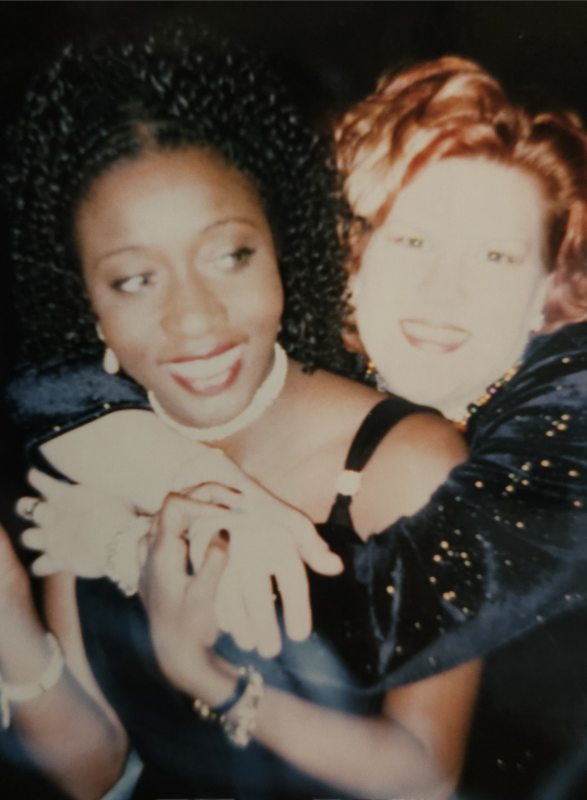
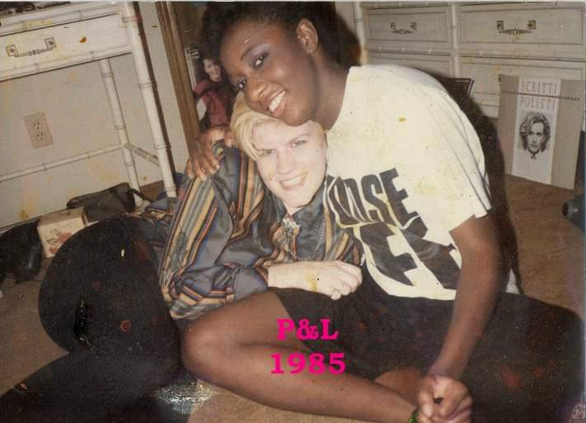
Before Diagnosis: The Journey to Understanding
Notes:
This slide introduces my life before I received a colorectal cancer diagnosis. I want to convey the journey to finally understanding what was happening with my health, including the misdiagnoses and the difficulties in finding answers. I will touch on my personal life, including my 10-year wedding anniversary, and how my relationships provided support as I navigated this challenging time. This part of my story sets the stage for the barriers that many in marginalized communities face when trying to understand their health risks.

Slide 3
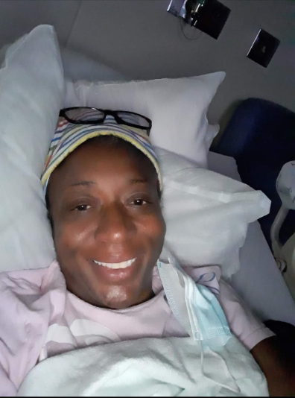
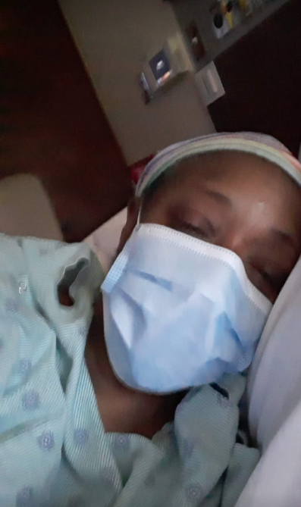
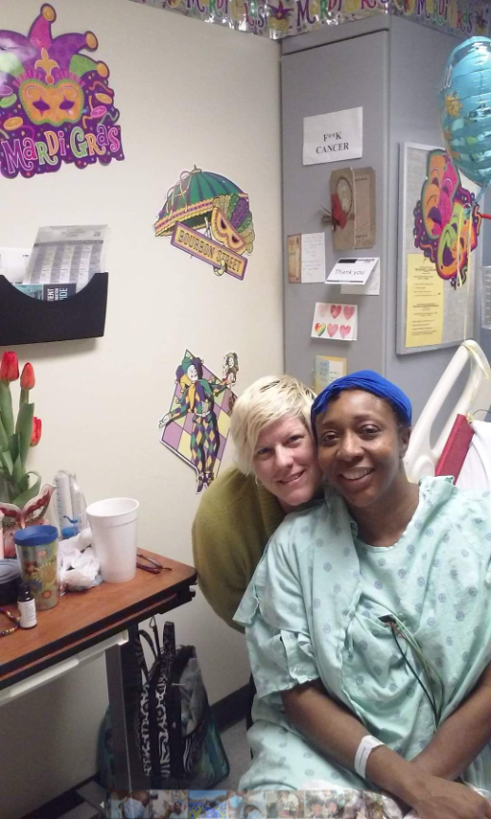
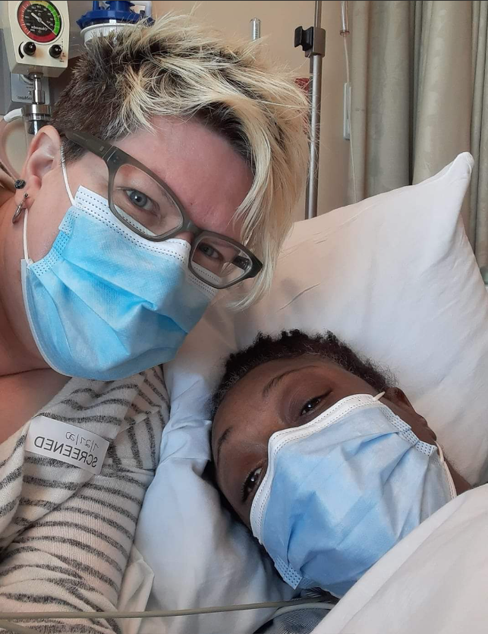
During Treatment: Navigating the System
Notes:
This slide highlights my experiences during treatment, starting from the day I was diagnosed on January 27, 2015. Here, I’ll discuss the struggles I faced navigating the healthcare system, such as high treatment costs, transportation challenges, and finding supportive care. This period marked a turning point as I began to realize the systemic obstacles patients encounter, particularly in Black and Brown communities. It’s also where I started to find my voice as an advocate, motivated by the barriers I was experiencing firsthand.

Slide 4
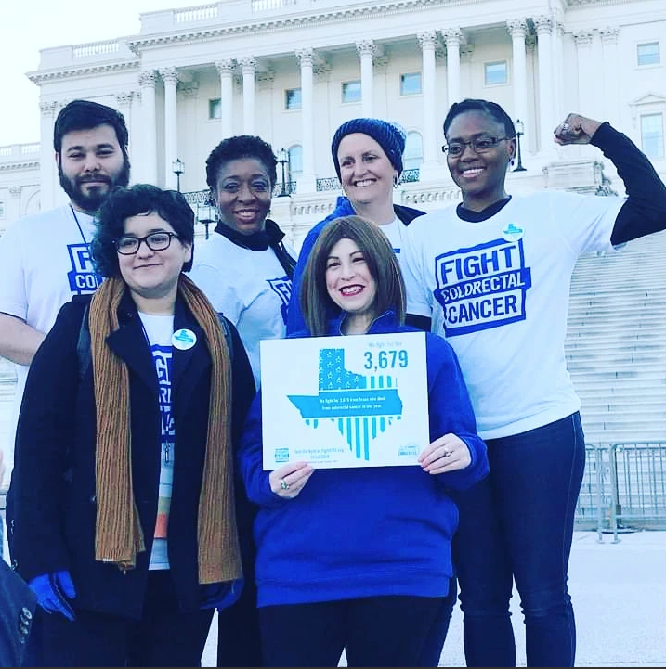
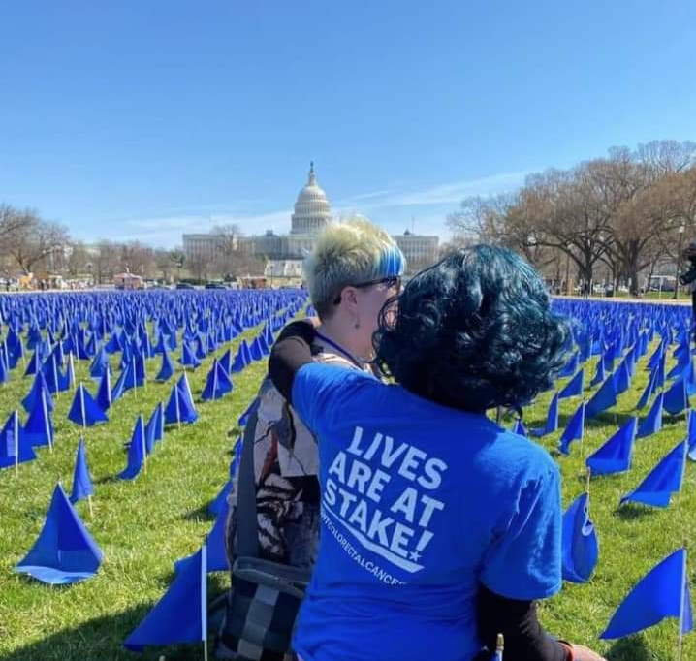
Beyond Treatment: Advocacy and Impact
Notes:
In this slide, I’ll focus on my transition into advocacy work following treatment. This includes my role with Fight Colorectal Cancer, my travels around the country, and my focus on improving access to care for marginalized communities. I’ll discuss efforts like raising awareness for genetic testing and educating communities about colorectal cancer risks, especially within Black and Brown communities in Houston and nationwide. My story has come full circle, from patient to advocate, with a goal of helping others overcome the barriers I faced.

Slide 5
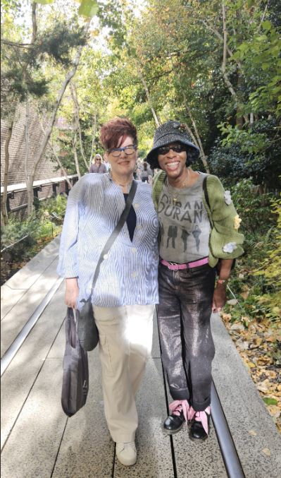
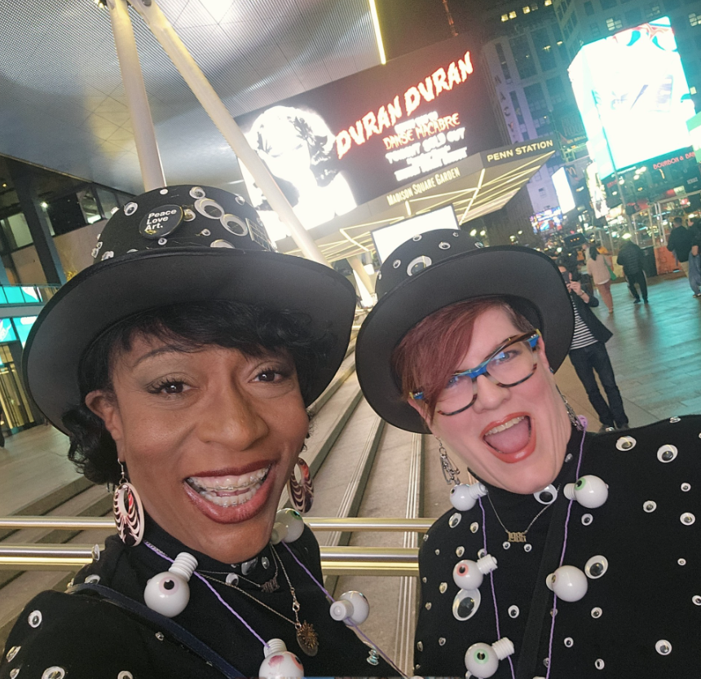
“All You Need is Now”

Slide 6


Let’s Stay Connected
Instagram: @ILoveLR69
Linktree: linktr.ee/pclove1
Email:
Paula@fightcrc.org

