Slide 1

Cancer Care Delivery Brainstorm: How to address Current Challenges

Slide 2
Working Together to Find Solutions
Our goal has always been to use the community reports, working group meetings, and Summit to work together to identify ideas for improving care
Participating in today’s Summit we have Patients, Caregivers, Patient Advocates, Health Educators, Medical Directors, Students, Nurse and Patient Navigators, Researchers, Nurses, Providers, Policy Makers
This session is dedicated to hearing your ideas about challenges, priorities, ideas for improvement, and/or study ideas

Slide 3

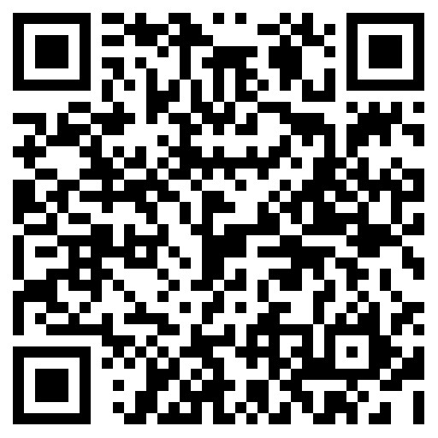
How to Participate
We will be using Ahaslides for this interactive session using virtual sticky notes
Discussion prompts can be accessed on your phone through the URL https://ahaslides.com/VCCSUMMIT or by scanning the QR Code below
Notes:
We encourage you to share your ideas with those around you.

Slide 4
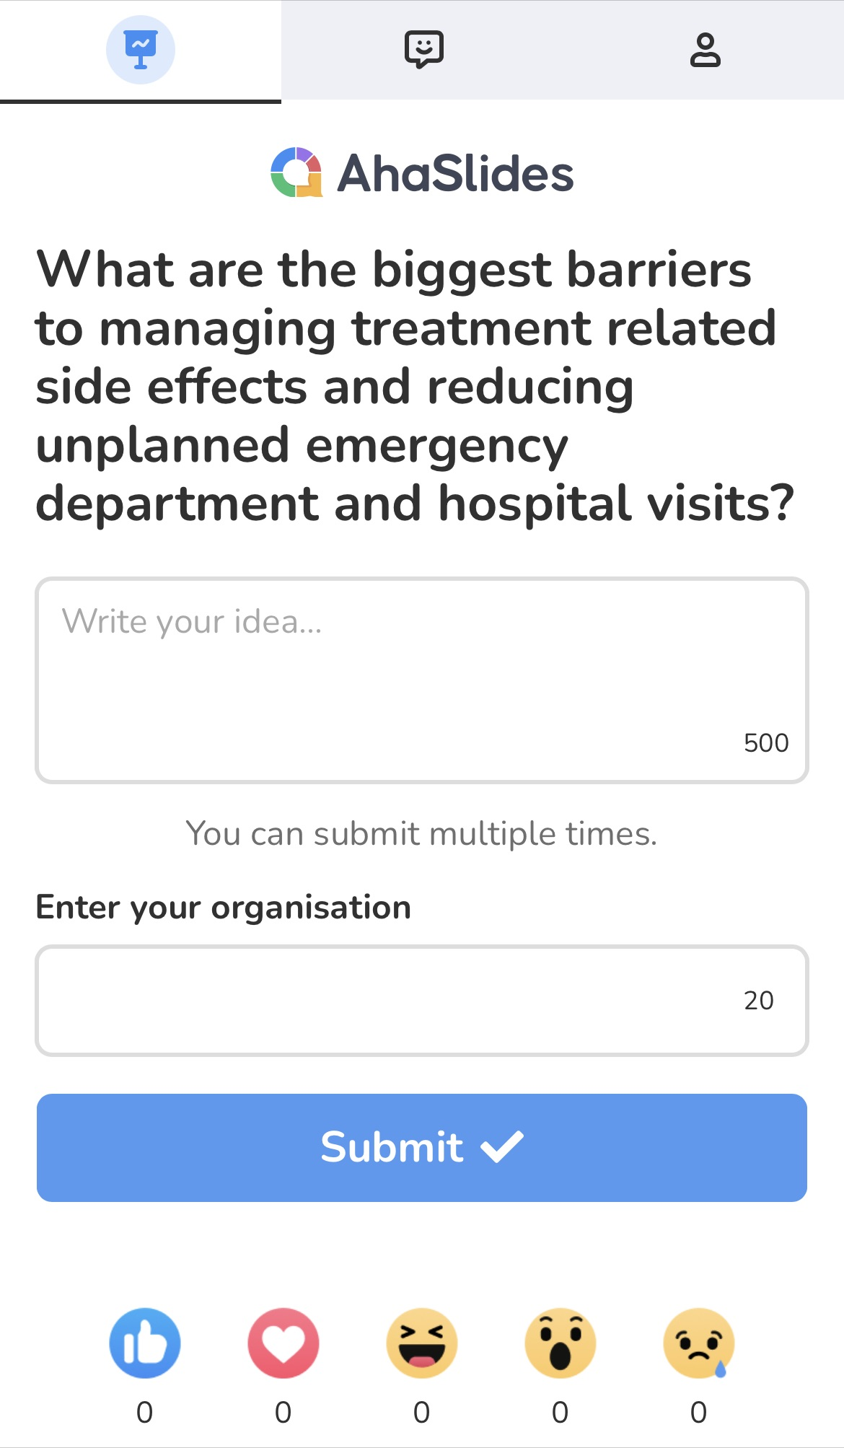
How to Participate
Please submit one idea at a time, but send in as many ideas as you have
Note where it asks for organization please include your role:
Patient
Payer
Provider
Researcher
Community Advocate
Other
We will then review answers and spend time discussing as a group
Everyone is welcome to ask questions, expand on ideas, and share opinions
Need help getting set up on your smartphone? Wave to one of our HICOR team members who will provide tech support
Notes:
We encourage you to share your ideas with those around you.
https://powerpoint.ahaslides.com/slide/100248324

