Slide 1

The Mid-South Miracle:
Implementing Structured Lung Cancer Care Delivery in a High-Risk Population
Ray U. Osarogiagbon, MBBS FACP
Chief Scientist, Baptist Memorial Health Care Corporation
Director, Multidisciplinary Thoracic Oncology Program
Baptist Cancer Center, Memphis, TN.
Osarogiagbon RU. ‘The Mid-South Miracle.’ Fred Hutch Cancer Center Value in Cancer Care Summit 2023. November 2, 2023.

Slide 2
DECLARATIONS
Chair: Board of Directors, Hope Foundation for Cancer Research (SWOG)
Co-chair: IASLC N-Staging Sub-Committee, IASLC Prognostic Factors Subcommittee; SWOG Early Lung Cancer Sub-Committee
Consultant: American Cancer Society, AstraZeneca, Genentech/Roche, National Cancer Institute
Member: Fleischner Society
Patents: Lymph node specimen collection kit, Method for lymph node analysis
Scientific Advisory Board: National Cancer Institute, Druckenmiller Center for Lung Cancer Research, MSKCC; GO2 Foundation; Lung Cancer Foundation of America; LUNGevity Foundation; University of Pennsylvania Telehealth Research Center of Excellence (TRACE); Dartmouth Health Center of Biomedical Research Excellence (COBRE); Fred Hutch Cancer Center, Hutchinson Institute for Cancer Outcomes Research (HICOR); AstraZenaca US Lung Ambition Advisory Council; Median Technologies, Nice, France.
Speaker: Medscape, Tryptych Healthcare Partners
Steering Committee: National Lung Cancer Round Table, NCI Cancer Prevention Steering Committee, Genentech Inc SKYSCRAPER-15 (G045006).
Stock: Eli Lilly, Gilead Sciences, Pfizer, Bridge Bio
Osarogiagbon RU. ‘The Mid-South Miracle.’ Fred Hutch Cancer Center Value in Cancer Care Summit 2023. November 2, 2023.

Slide 3
Take-Home Messages
Lung Nodule Programs provide a robust, complementary, epidemiologically sound pathway to early lung cancer detection.
  Provides access to early detection to a non-overlapping, high-risk population.
  Concurrent deployment alleviates looming disparities inadvertently induced by LDCT.
  Can be implemented even when LDCT unavailable.
Multidisciplinary decision-making saves lives, synthesizes decision-making.
Close attention to surgical quality a vital component for population impact.
Program-based care creates the shortest pathway to population-level lung cancer outcomes improvement.
The best treatment is a clinical trial; build clinical trials infrastructure where the population is.
Osarogiagbon RU. ‘The Mid-South Miracle.’ Fred Hutch Cancer Center Value in Cancer Care Summit 2023. November 2, 2023.

Slide 4
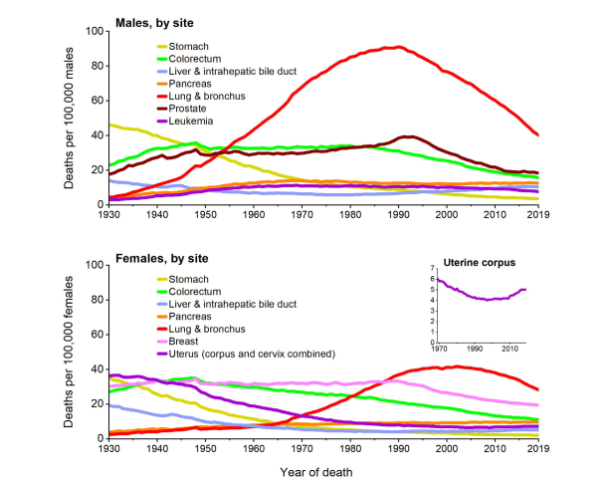
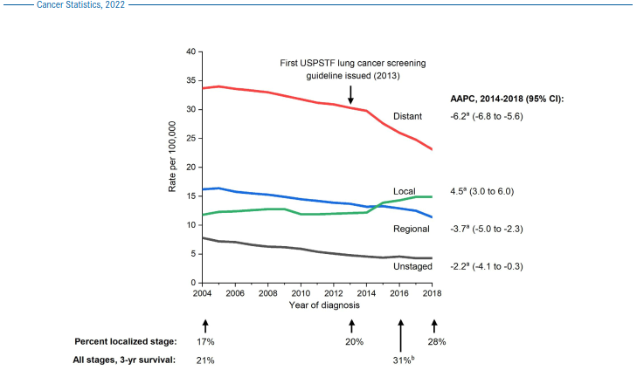
The Good News: Evolving US Lung Cancer Statistics
Siegel RL, Miller KD, Fuchs HE, Jemal A. Cancer statistics, 2022. CA Cancer J Clin. 2022 PMID: 35020204.
Osarogiagbon RU. ‘The Mid-South Miracle.’ Fred Hutch Cancer Center Value in Cancer Care Summit 2023. November 2, 2023.

Slide 5

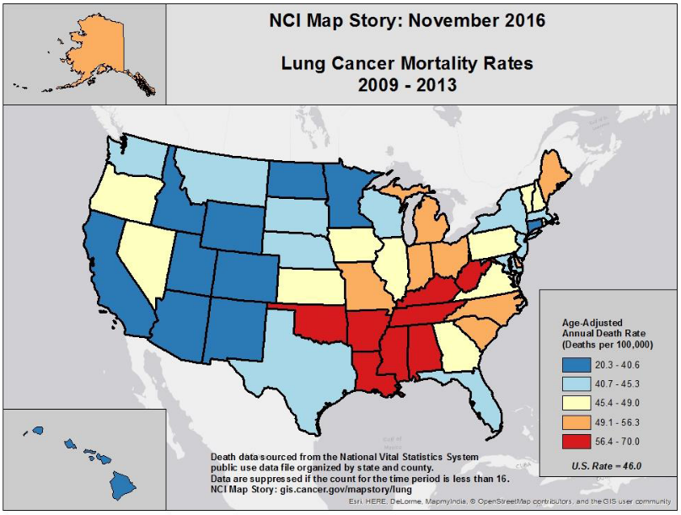
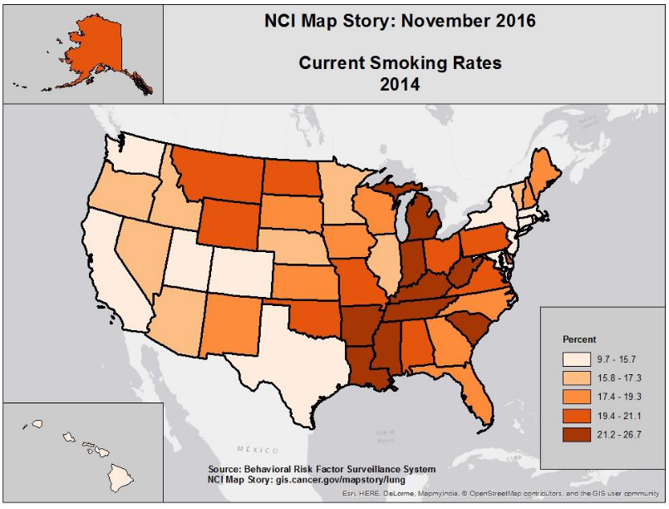
Epidemiology of Lung Cancer in the US:
A Tale of Geographic Disparity
Trends and Patterns of Disparity in Cancer Mortality Among
US Counties. Mokdad AH et al, JAMA.2017; 317(4):388-406.
Osarogiagbon RU. ‘The Mid-South Miracle.’ Fred Hutch Cancer Center Value in Cancer Care Summit 2023. November 2, 2023.

Slide 6
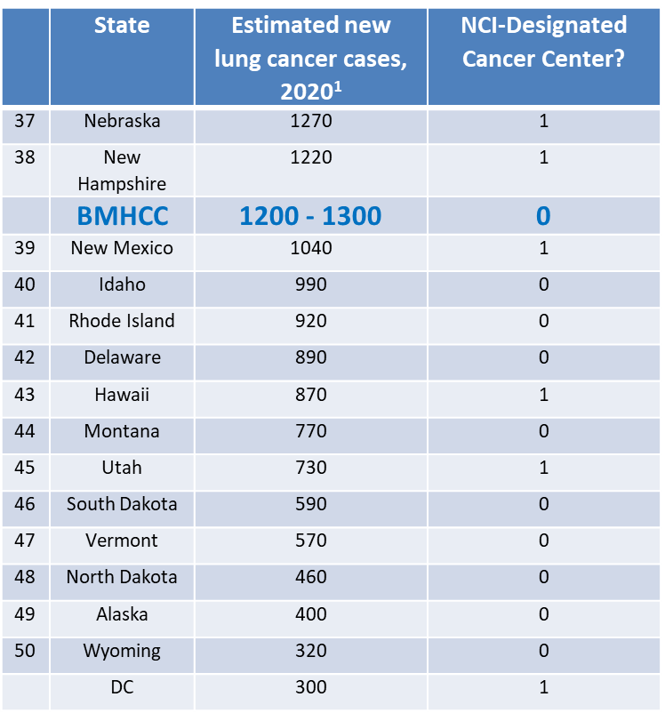
If BMHCC was a state….
¹ Siegel RL, Miller KD, Jemal A. Cancer Statistics, 2020. CA Cancer J Clin 2020;70:7-30.
Osarogiagbon RU. ‘The Mid-South Miracle.’ Fred Hutch Cancer Center Value in Cancer Care Summit 2023. November 2, 2023.

Slide 7
  Inverse proportionality between number of targets and intervention leverage
Social policies
Institutions
Providers
Patients
Patients
Providers
Institutions
Social policies
Number of intervention targets
Impact of intervention target
Osarogiagbon RU. ‘The Mid-South Miracle.’ Fred Hutch Cancer Center Value in Cancer Care Summit 2023. November 2, 2023.

Slide 8
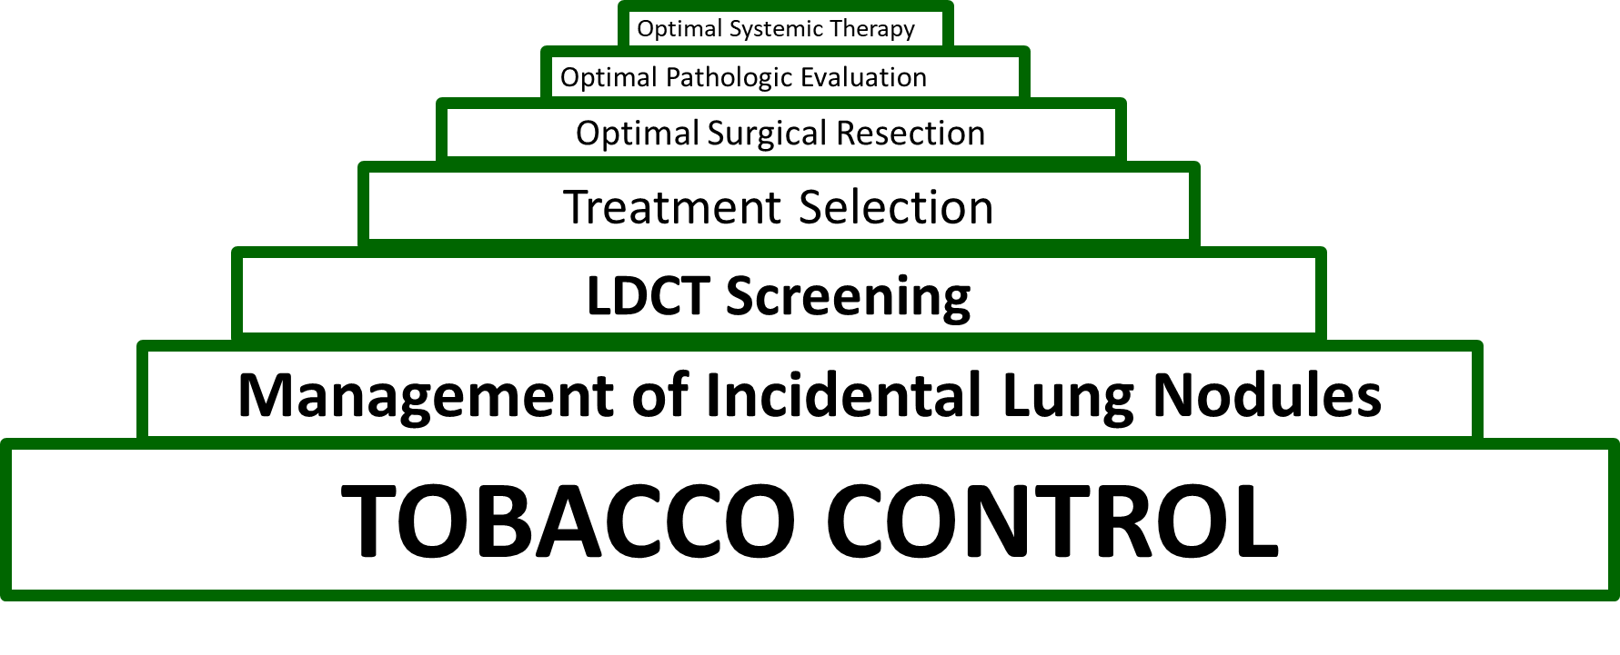
Implementing The Mid-South Miracle:
Goal: Reduce Lung Cancer Mortality >25% Over 10 Years
Objectives: sustained, rigorous implementation of seven specific clinical programs
The Population Impact Pyramid
A Three-Tiered Approach
D & I Science
How?
Team Science
Who?
Population Science
Why?
Osarogiagbon RU. ‘The Mid-South Miracle.’ Fred Hutch Cancer Center Value in Cancer Care Summit 2023. November 2, 2023.

Slide 9
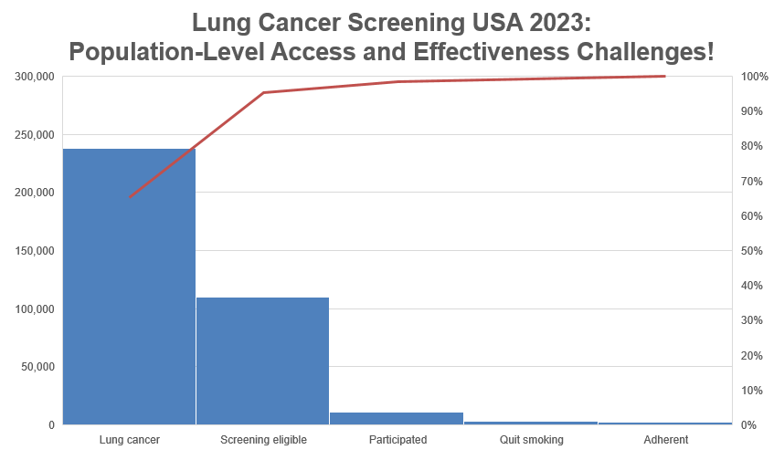
Lung Cancer Screening Saves Lives! But…
Improve eligibility criteria!
Cost-efficient risk stratification, patient selection!!!
Eliminate access barriers!!
Osarogiagbon, Yang, Sequist. ASCO Educational Book 2023
Osarogiagbon. AZ Pan-Asia Lung Cancer Summit. Sheraton Towers, Singapore. September 13, 2023

Slide 10
Outlier
Fedewa SA, et al. J Natl Cancer Inst. 2020. PMID: 33176362.
Osarogiagbon. PL01.02. Disparities in Lung Cancer Care Across the Population . 09/08/21
Notes:
Here is another illustration of the point. The red line is the state-level US average proportion of eligible persons who have had LDCT screening, it is approximately 5% by this analysis.
Although we see KY (#1 per capita mortality state) as a good outlier, which appears to contradict my point….
We also see that MS, AR, TN, WV, AL (#s 2 to 6) are low outliers.
Here is an example of organizational level barriers driving disparity.

Slide 11
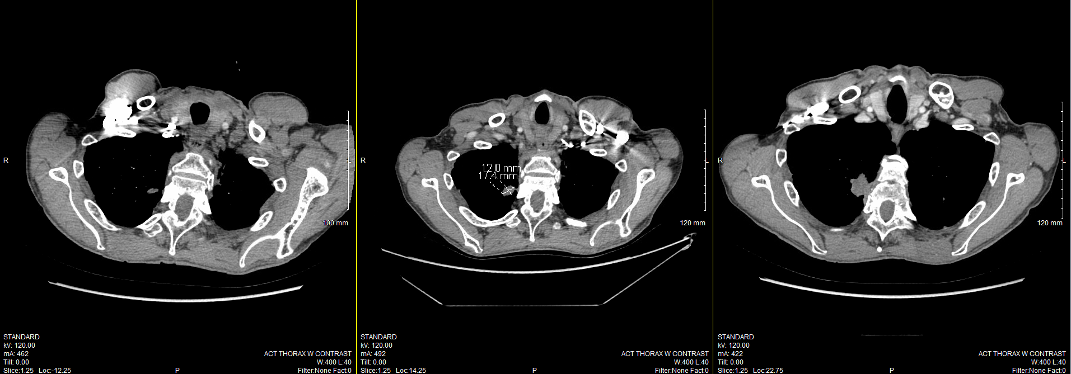
Avoid this… save lives!
February, 2020
June, 2020
April, 2021
Osarogiagbon RU. ‘The Mid-South Miracle.’ Fred Hutch Cancer Center Value in Cancer Care Summit 2023. November 2, 2023.

Slide 12
Guideline-Concordant Management of Incidentally Detected Lung Nodules^{1,2}
Pros:
  Starts from the point of detection of potentially malignant lung lesion
  LDCT eligibility criteria less relevant
  Bypasses LDCT implementation barriers
  Leverages existing clinical material, infrastructure
  Expands the reach of early detection to hard-to-reach populations
  Alleviates a medico-legal quandry
Cons:
  Requires some infrastructure for identifying, tracking, oversight
  Optimally requires transparent, interdisciplinary decision-making
¹Gould MK, Donington J, Lynch WR, et al. ACCP evidence-based clinical practice guidelines. Chest. 2013 PMID: 23649456,
²MacMahon H, Naidich DP, Goo JM, et al. From the Fleischner Society 2017. Radiology. 2017 PMID: 28240562.
Osarogiagbon RU. ‘The Mid-South Miracle.’ Fred Hutch Cancer Center Value in Cancer Care Summit 2023. November 2, 2023.

Slide 13
Detecting Early Lung Cancer (DELUGE) in MS Delta
Program Volumes
Ratio 2.5:1
Annual Volumes | 2015 | 2016 | 2017 | 2018 | 2019 | 2020 | 2021 | 2022 | 2023*
Nodule | 452 | 2,415 | 2,985 | 3,406 | 3,981 | 3,923 | 5,951 | 5,817 | 3,562
LDCT | 28 | 232 | 452 | 1,012 | 1,416 | 1,758 | 2,384 | 3,081 | 2,614
Cumulative Rates of Detection
Nodule – 6.14%
LDCT –3.43%
*Data through August 2023
Osarogiagbon RU. ‘The Mid-South Miracle.’ Fred Hutch Cancer Center Value in Cancer Care Summit 2023. November 2, 2023.

Slide 14
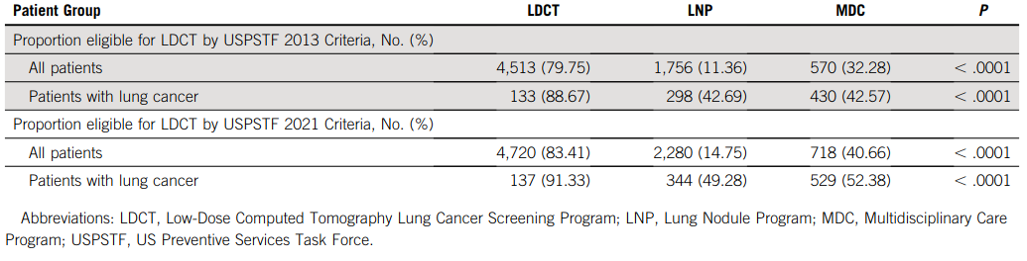
ILNP: Complementary Pathway to Early Lung Cancer Detection?
Even if 100% of eligible persons by USPSTF 2021 criteria had been enrolled into LDCT screening, ILNP would have detected 20% of all stage I/II patients in the entire cohort.
Osarogiagbon, et al. Epub J Clin Oncol.
PMID: 35258994 DOI: 10.1200/JCO.21.02496
Osarogiagbon RU. ‘The Mid-South Miracle.’ Fred Hutch Cancer Center Value in Cancer Care Summit 2023. November 2, 2023.

Slide 15
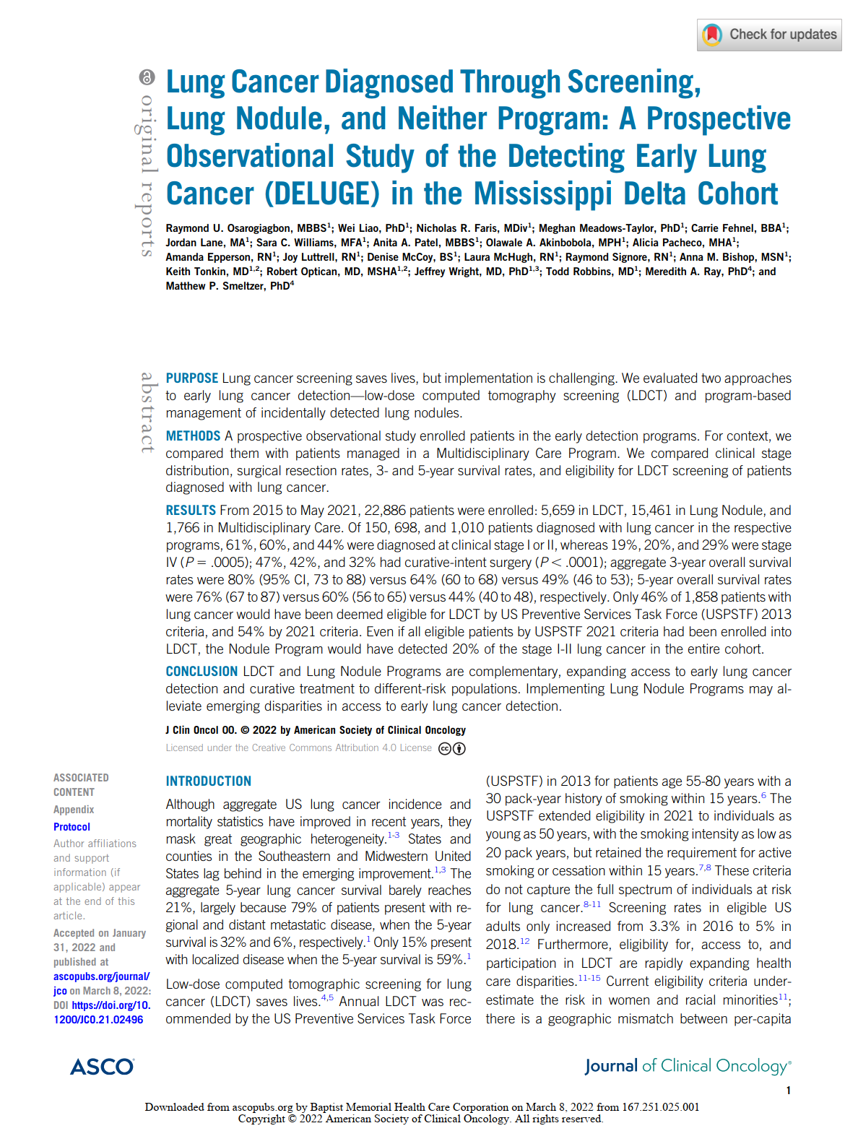
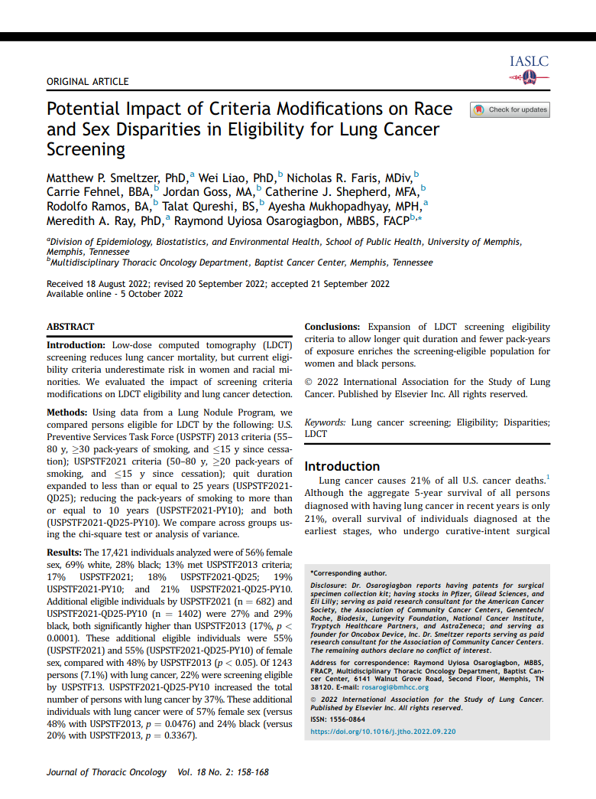
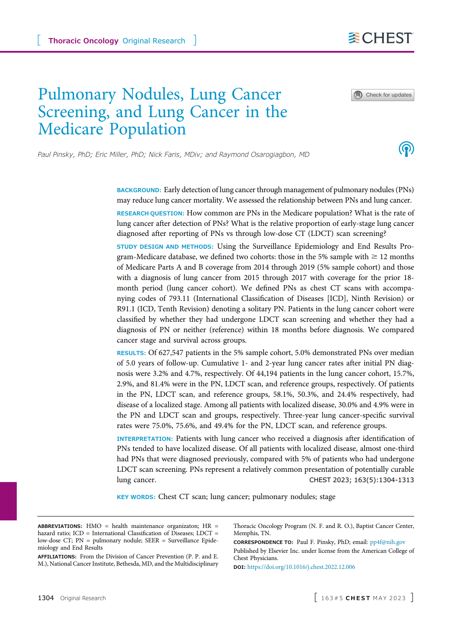
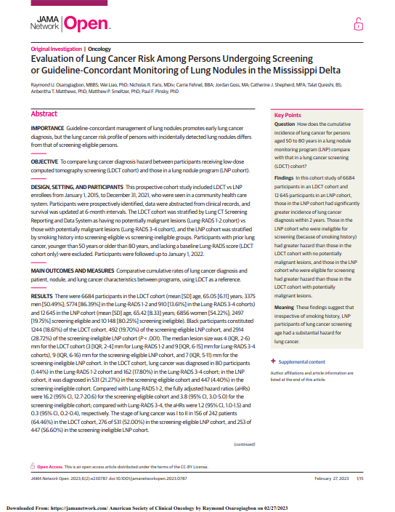
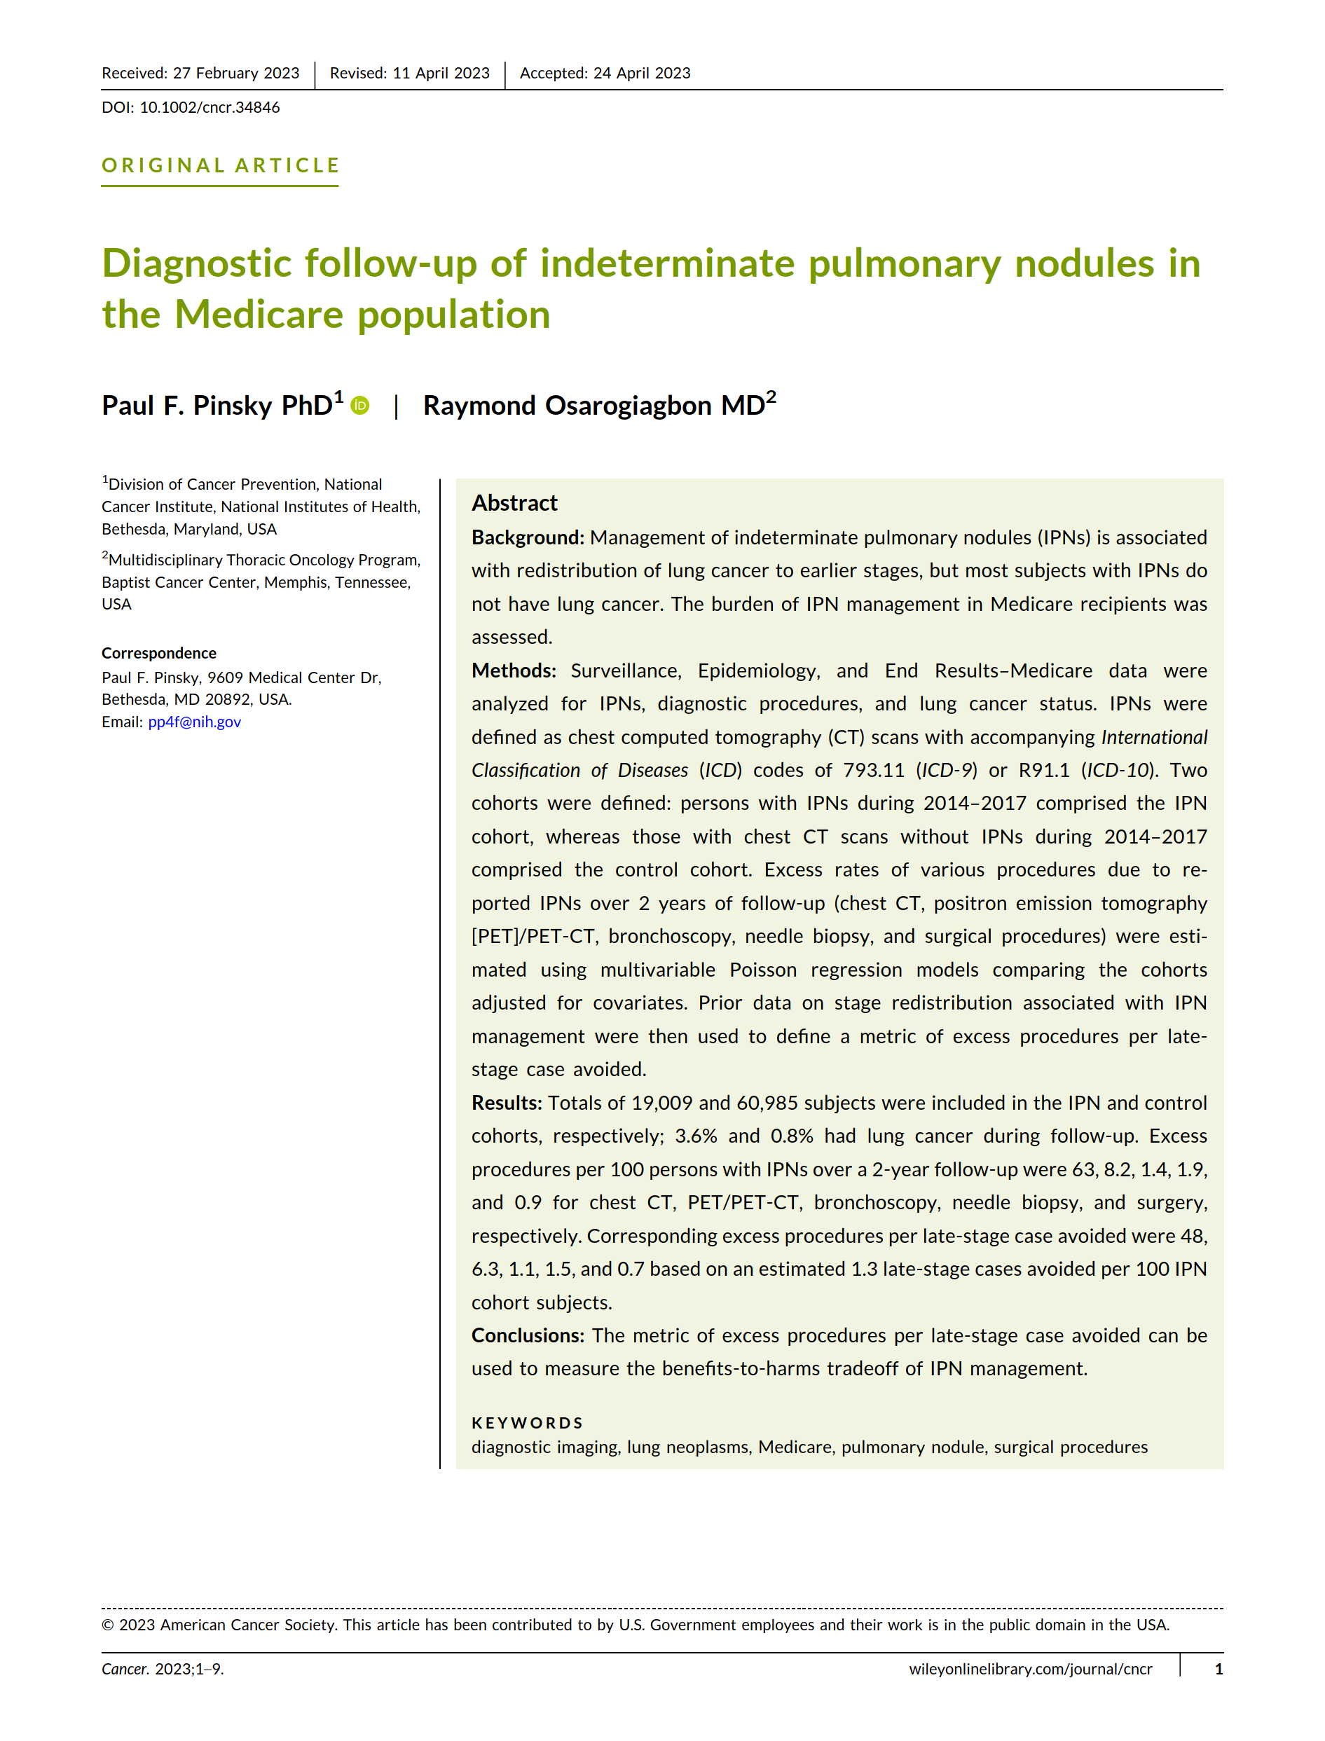
Osarogiagbon RU. ‘The Mid-South Miracle.’ Fred Hutch Cancer Center Value in Cancer Care Summit 2023. November 2, 2023.

Slide 16
Structured Multidisciplinary Decision-Making
Osarogiagbon RU. ‘The Mid-South Miracle.’ Fred Hutch Cancer Center Value in Cancer Care Summit 2023. November 2, 2023.

Slide 17


Lung Cancer Care is Complex!
Anatomy
Patient characteristics
Widening array of options
Provider factors
Care-delivery systems
Lesion detection
Diagnostic biopsy
Staging tests
Treatment
Outcome evaluation
CXRª
CT scanª
CT-guided needle^{ab}
Bronchoscopy^{cb}
VATS/RATS^{db}
Mediastinoscopy^{db}
Chamberlain^{db}
Open surgical^{db}
PET-CTª
Brain CT or MRIª
Bone scanª
Thoracentesis^{acdeb}
Pericardiocentesis^{adb}
EBUS^{cdb}
EUS^{cdfb}
CT-guided biopsy^{ab}
Mediastinoscopy^{db}
Chamberlain^{db}
VATS/RATS^{db}
VAMLA^{db}
TEMLA^{db}
Open surgical^{db}
Surgery^{db}
XRT^{f}
Chemo^{d}
Targeted therapy^{d}
Surgery + chemo^{dbe}
Surgery + XRT^{dbg}
Surgery + chemo + XRT^{dbeg}
Chemo + surgery^{edb}
ChemoXRT + surgery^{egdb}
Palliative care ^{cdegh}
Hospice care^{hi}
Clinical^{cdeg}
CTª
PET-CTª
INVOLVED PHYSICIAN SPECIALIST
a Radiologist; b Pathologist; c Pulmonologist; d Surgeon; e Medical Oncologist; f Gastroenterologist; g Radiation Oncologist; h Palliative care specialist; i Hospice care specialist.
Osarogiagbon RU. Achieving better quality of lung cancer care. In: Tanoue L, Detterbeck F, editors. Lung Cancer: A Practical Approach to Evidence-Based Clinical Evaluation and Management. St. Louis, MO: Elsevier; 2018:167-182.
Presenter’s Organization Logo

Slide 18
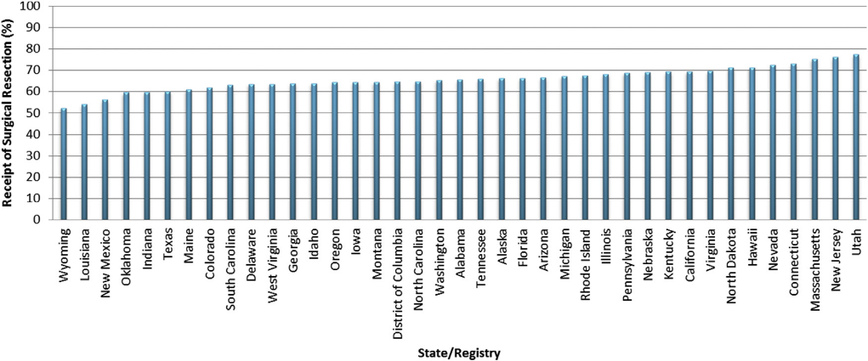
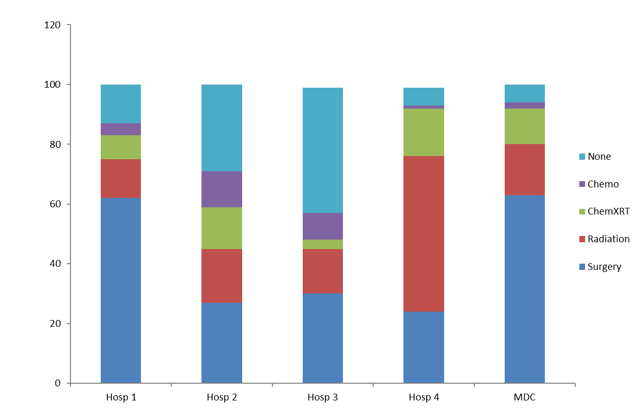
Problem: Guideline-Discordant Treatment
Sineshaw, Wu, Flanders, Osarogiagbon, Jemal. J Thorac Oncol 2016
County-level range: 12.8% to 91.7%!
Sineshaw, Sahar, Osarogiagbon, Flanders, Yabroff, Jemal. Chest. 2020;157:212-222.
Treatment of Stage I/II NSCLC- Single Healthcare System. Osarogiagbon, Unpublished
Osarogiagbon. PL01.02. Disparities in Lung Cancer Care Across the Population . 09/08/21
Notes:
What about getting appropriate treatment?
Here is the US state-level disparity in use of surgical resection for stage I/II NSCLC, you see it ranges from about 50% in Wyoming, to almost 80% in MA, NJ and UT.
This is bad? The county-level disparity is even worse, ranging from 13% to 92%!
What might be going on here? Well, here is a snap shot from a single healthcare system with multiple different hospitals: stage I/II lung cancer. Surgical resection rates varied from >60% to <25%; but you also see that the use of radiation therapy for stage I/II NSCLC also varied wildly, from <15% in hospital 1 to >50% in hospital 4; most disturbing, the rate of ‘no treatment’ was >40% in hospital 3.
Here is an example of institutional and provider level driver of care and, most likely, outcome disparities.

Slide 19
What is ‘Multidisciplinary Care’?
A title/brand/marketing opportunity?
A program?
Care by a group of individuals?
A set of benchmarks or standards?
A set of behaviors?
A set of beliefs? A way of thinking? Conceptual model built around principles of care?
Osarogiagbon RU. ‘The Mid-South Miracle.’ Fred Hutch Cancer Center Value in Cancer Care Summit 2023. November 2, 2023.

Slide 20


Stakeholder Perspectives: Multidisciplinary Model
 | Patients & Caregivers | Physicians | Hospital Admins. | Health Insurance
Benefits
Physician collaboration | + | + | + | +
Coordinated care | + | + | + | +
Concordance with recommendations | + | + | + | +
Timeliness of care | + | + | + | +
Challenges
Financial disincentives |  | +
Scheduling conflicts |  | +
Conflicting treatment opinions |  | +
Lack of validated benchmarks |  |  | + | +
27: Bridging the Quality Chasm in Lung Cancer Care Setting - Kedia

Slide 21
Multidisciplinary Care: A Definition
Delivered by a coordinated team committed to processes that enhance certain group behaviors believed to be necessary for high quality outcomes.
demonstrated
Osarogiagbon RU. ‘The Mid-South Miracle.’ Fred Hutch Cancer Center Value in Cancer Care Summit 2023. November 2, 2023.

Slide 22
MultiD Care Saves Lives
‘Building a multidisciplinary bridge across the quality chasm of thoracic oncology…’
Baptist Memorial Healthcare Corporation NSCLC patients 2011-2017
Ray MA, et al. JTO Clin Res Rep 2021. PMID: 34590046
Osarogiagbon RU. ‘The Mid-South Miracle.’ Fred Hutch Cancer Center Value in Cancer Care Summit 2023. November 2, 2023.

Slide 23
The Immutable Core of Multidisciplinary Care
A coordinated team…
Team
  Anatomy
    All physician specialties/skill sets (diagnosticians, tissue procurers, treatment specialists)
    Central coordination through navigators
    Must include the patient and their caregivers
  Physiology
    Recognition of the team by members and non-members
    Commitment to mutually agreed team-level objectives
    Interdependent functionality toward team objectives
    Regular reflection to regulate and adapt team objectives and processes
Osarogiagbon RU. ‘The Mid-South Miracle.’ Fred Hutch Cancer Center Value in Cancer Care Summit 2023. November 2, 2023.

Slide 24
Team Science Principles
1. Shared mental models
      What do we seek to achieve?
      How do we achieve it?
      How can we tell where we are in getting from here to there (benchmarking)?
2. Mutual trust
3. Mutual performance monitoring
      Evidence-based care
      Concordance between recommendations and care delivery
      Quality and safety of care
4. Backup behavior
      Program success independent of single individuals’ availability: ‘the show goes on.’
5. Psychological safety
      Team members empowered to speak up.
6. Closed-loop communication
      Content, structure and reliability of message.
Continuous data collection, analysis and interpretation CORE PRINCIPLE!
Osarogiagbon RU. ‘The Mid-South Miracle.’ Fred Hutch Cancer Center Value in Cancer Care Summit 2023. November 2, 2023.

Slide 25
Applied Team Science: Multidisciplinary Team-Based Care
Team Principles
Shared Mental Models Mutual Trust Mutual Performance Monitoring Backup Behavior Psychological Safety Closed-Loop Communication
Team Behaviors
Commitment to pre-agreed conference and meeting logistics
Systematic, prospectively coordinated case selection: eg. all new cases
Commitment to standard, evidence-based care (evaluation and treatment) pathways Consideration of all relevant clinical information/perspectives Multi-level incorporation of patient/caregiver perspectives
Team meeting results in precise, strategic, evidence-based consensus plan. The consensus plan is documented, quickly and verifiably communicated to all team members
Team Benchmarks
Attendance at regular conference Attendance at monthly program meeting(s)
% of cases presentations that are prospective % of institutional cases presented at conference
Concordance between consensus recommendations and care delivered Guideline concordant staging practice Stage-appropriate treatment rate
% of patients with a conference note completed % of conference notes routed to entire care team % of case presentations for which stage is articulated and documented Verifiable/timely communication of recommendations
Team Targets
Team members are present at all team meetings At least one of each specialty present at all conferences (med onc, rad onc, surgery, pulm, pathology, radiology, navigation) All conference cases are presented by the referring provider or their pre-specified delegate
100% prospective presentations 50% in Y1, 70% in Y2, 90% all subsequent years
80% concordance rate All discordant care documented with reason(s) why 80% guideline concordant staging practice 80% stage appropriate treatment rate
100% of presentations have a conference note completed, including attributed stage and detailed recommendations with justifications 100% of conference notes are routed to care team within 48 hours
Osarogiagbon RU. ‘The Mid-South Miracle.’ Fred Hutch Cancer Center Value in Cancer Care Summit 2023. November 2, 2023.

Slide 26
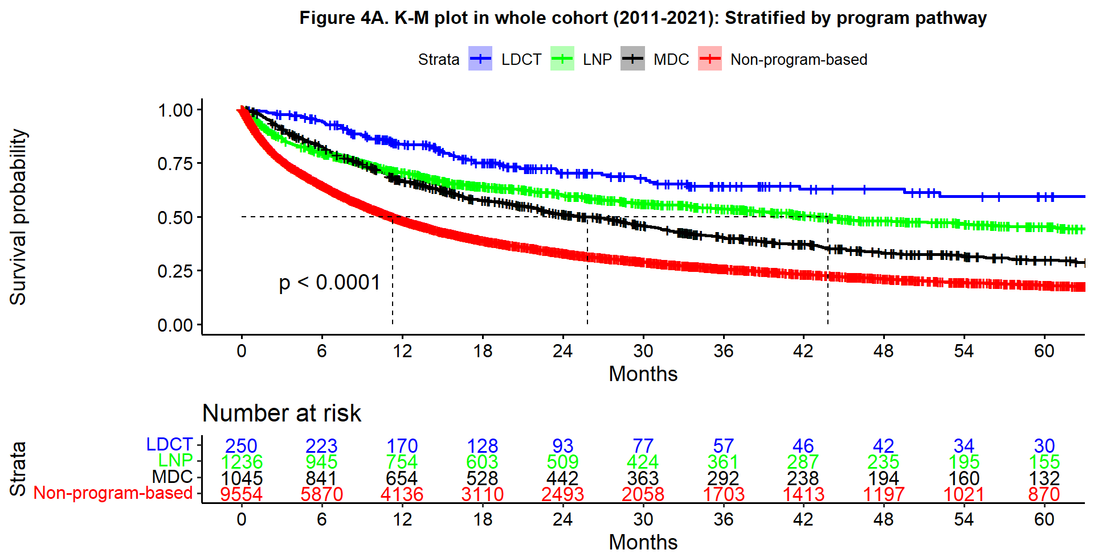
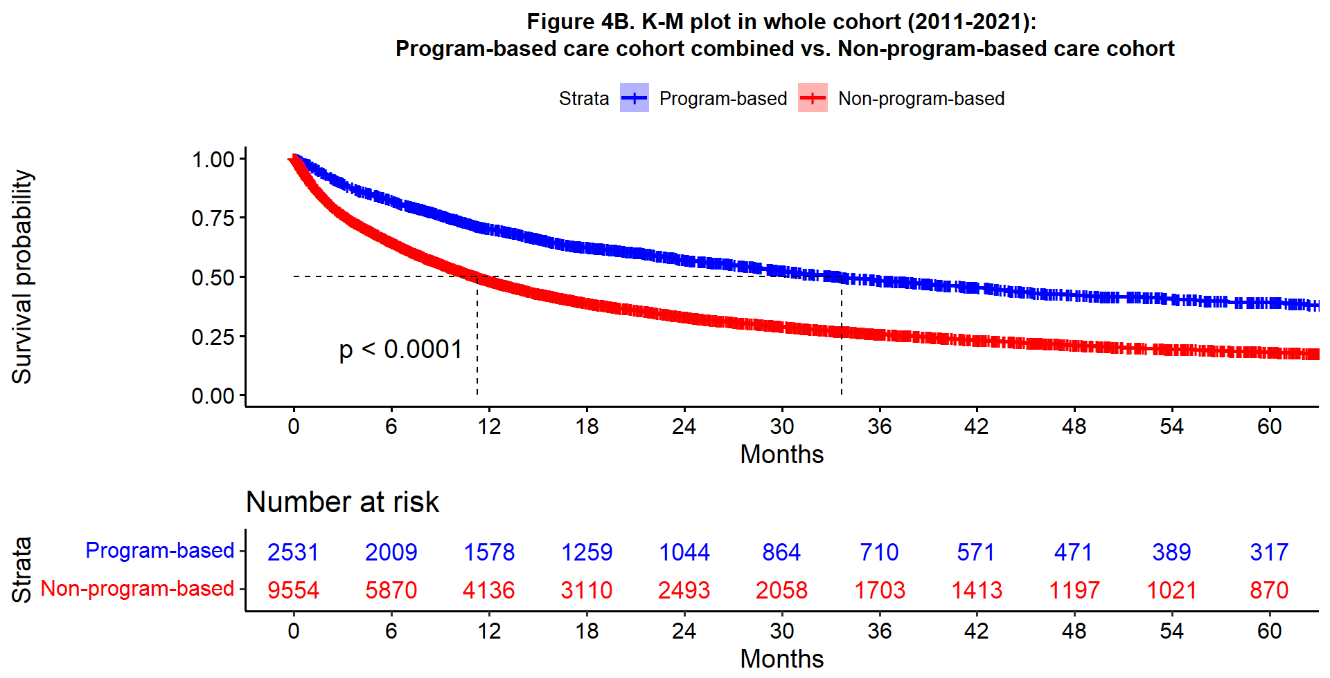
Red Bar Challenge: BMHCC 2015 - 2021
Liao W, et al. Under peer review
Osarogiagbon RU. ‘The Mid-South Miracle.’ Fred Hutch Cancer Center Value in Cancer Care Summit 2023. November 2, 2023.

Slide 27
Surgical Quality Improvement:
The Mid-South Quality of Surgical Resection (MS-QSR) Project
Osarogiagbon RU. ‘The Mid-South Miracle.’ Fred Hutch Cancer Center Value in Cancer Care Summit 2023. November 2, 2023.

Slide 28
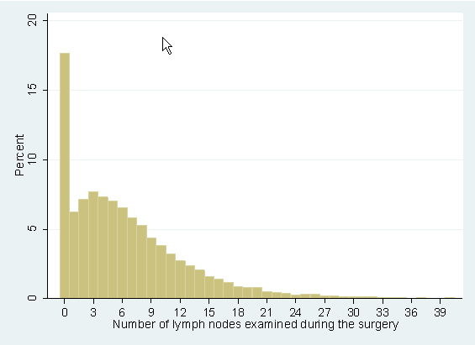
The Problem: Poor Surgical Quality Begets Poor Outcomes
The main component of the problem: poor pathologic nodal evaluation
Osarogiagbon RU, et al. Ann Thorac Surg. 2014
PMID: 24266949
Osarogiagbon RU, et al Ann Thorac Surg. 2016
PMID: 27262908
Osarogiagbon RU, et al. Ann Thorac Surg. 2017
PMID: 28366464

Slide 29
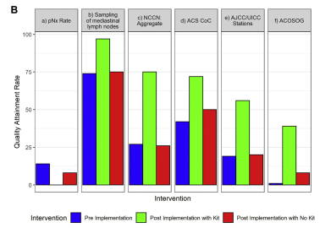
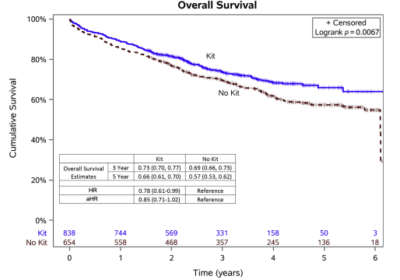
Osarogiagbon et al. J Thorac Oncol. 2021. PMCID: PMC8012255.
Osarogiagbon RU. ‘The Mid-South Miracle.’ Fred Hutch Cancer Center Value in Cancer Care Summit 2023. November 2, 2023.

Slide 30
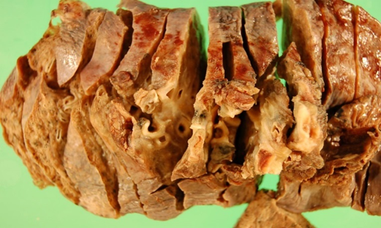
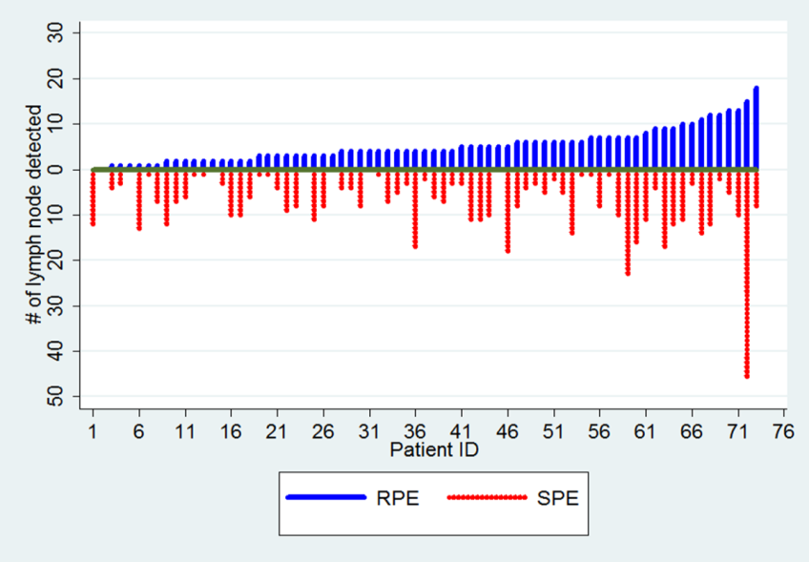
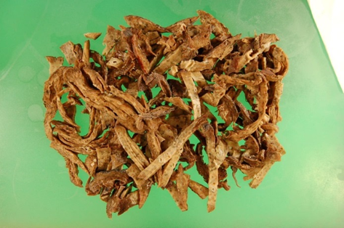
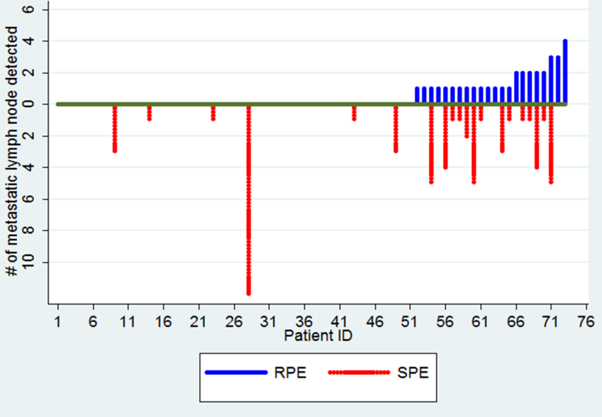
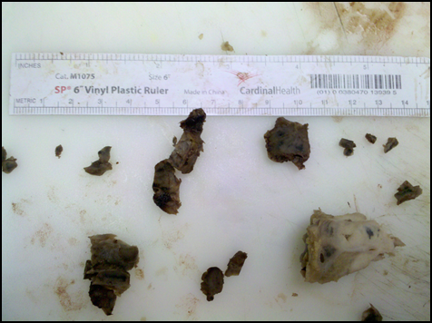
Takes Two to Tango: Pathology Interventions
Specimens with Discarded Lymph Nodes
pN0 Specimens with Found Metastasis
Discarded lymph nodes were found in 90% of lobectomy specimens
60% of intrapulmonary lymph nodes were discarded without examination
29% of discarded lymph nodes had metastasis, including 12% of pN0 specimens
Ramirez RA, et al, JCO 2012;30(23):2823-2828. PMID: 22778318.

Slide 31
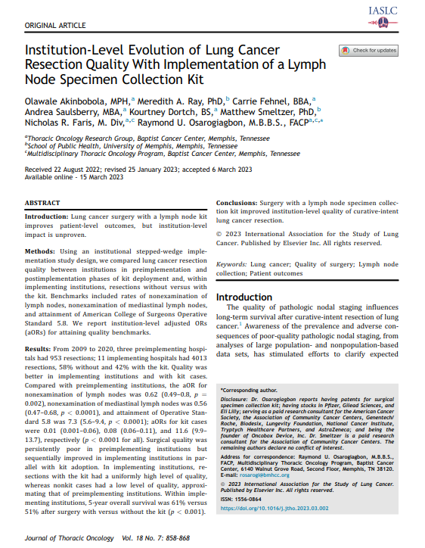
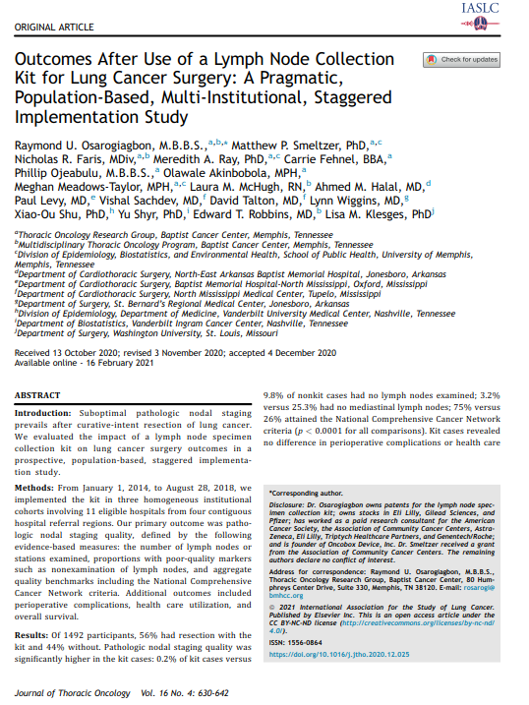
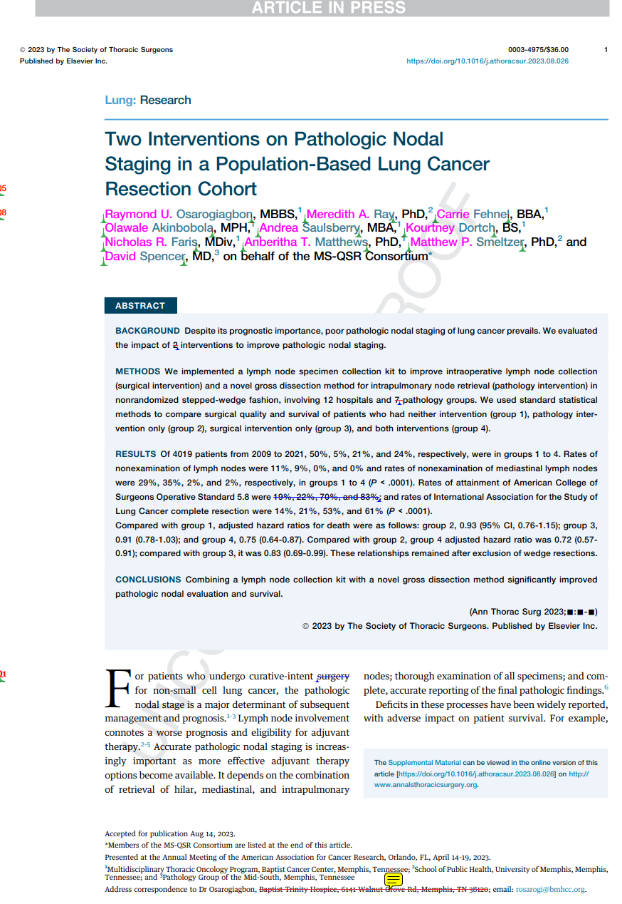
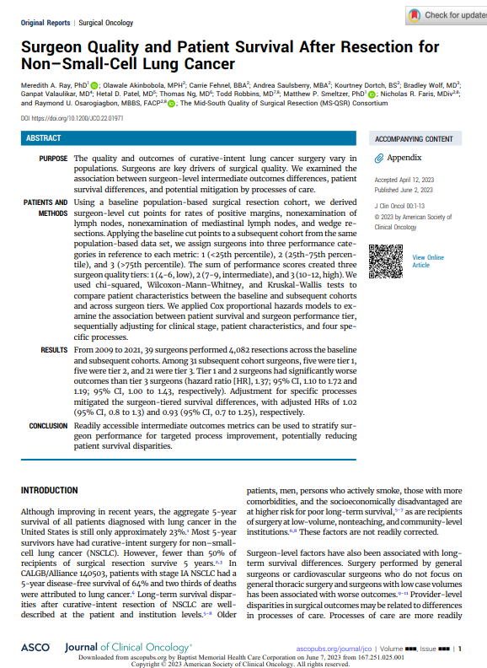

Slide 32
Building clinical trials infrastructure in research deserts…
Osarogiagbon RU. ‘The Mid-South Miracle.’ Fred Hutch Cancer Center Value in Cancer Care Summit 2023. November 2, 2023.

Slide 33
Clinical Trials Matter Because….
‘The best treatment is a clinical trial.’
‘Tomorrow’s treatment, today.’
‘Shooting fish in a barrel’: biology-driven experimentation.
Equitable access to clinical trials matters because…
  Extrapolation of benefit/harms in unstudied populations
  Timely accrual, completion, interpretation, implementation…
  Yes,……….. lives matter!
Osarogiagbon RU. ‘The Mid-South Miracle.’ Fred Hutch Cancer Center Value in Cancer Care Summit 2023. November 2, 2023.

Slide 34
In this age of rapid-fire discovery, ‘the best treatment is a clinical trial…’
Proportion of Black patients by setting
Proportion of Black patients by setting for common cancers
Unger JM, Hershman DL, Osarogiagbon RU, Gothwal A, Anand S, Dasari A, Overman M, Loree JM, Raghav K. Representativeness of Black Patients in Cancer Clinical Trials Sponsored by the National Cancer Institute Compared With Pharmaceutical Companies. JNCI Cancer Spectr. 2020. PMID: 32704619
Osarogiagbon RU. ‘The Mid-South Miracle.’ Fred Hutch Cancer Center Value in Cancer Care Summit 2023. November 2, 2023.

Slide 35
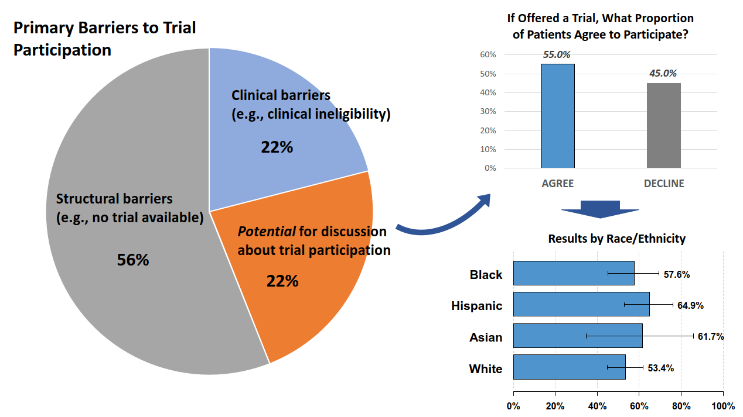
The Real Barriers to Clinical Trials Participation
Unger JM, Vaidya R, Hershman DL, Minasian LM, Fleury ME. Systematic Review and Meta-Analysis
of the Magnitude of Structural, Clinical, and Physician and Patient Barriers to Cancer Clinical Trial
Participation. J Natl Cancer Inst. 2019;111:245-255. PMID: 30856272
Unger JM, Hershman DL, Till C, Minasian LM, Osarogiagbon RU, Fleury ME, Vaidya R. "When Offered to Participate": A Systematic Review and Meta-Analysis of Patient Agreement to Participate in Cancer Clinical Trials. J Natl Cancer Inst. 2021;113:244-257. PMID: 33022716

Slide 36

Framework for Solutions
Understand where the true barriers are.
Identify stakeholders:
  Policymakers, organizations
  Care delivery institutional leadership
  Clinicians
  Funders/sponsors
  Patients/caregivers
  Advocacy groups
  Clinical trialists
Make the stakeholder-centered case to each!
Build infrastructure… meet the people where they are.
Set goals, benchmark, measure, measure, measure….
Osarogiagbon RU. ‘The Mid-South Miracle.’ Fred Hutch Cancer Center Value in Cancer Care Summit 2023. November 2, 2023.

Slide 37
Benchmarking, data collection, analysis and feedback
Organizational
  Institutional case-volumes
  Clinical trials portfolio
Physician
  Credentialed
  Participating
  Accruing
Research staff
  Recruitment
  Training
  Retention
Cultural:
  ‘We are not a university, why are we doing this?’
  ‘Time is money, this is a waste of time…’
Osarogiagbon RU. ‘The Mid-South Miracle.’ Fred Hutch Cancer Center Value in Cancer Care Summit 2023. November 2, 2023.

Slide 38
Finding Enduring Solutions….!
Build infrastructure where they population of interest resides: ‘meet people where they are…’
Data centricity: ‘you can’t improve what you don’t measure…’
Game out progress, set expectations: ‘fail to plan, plan to fail…’
Team-building: ‘shared mental models, closed loop communication, mutual performance monitoring, mutual trust, back-up behavior, etc.’
Financial models for sustainability: ‘no margin, no mission’
Leverage technology
Osarogiagbon RU. ‘The Mid-South Miracle.’ Fred Hutch Cancer Center Value in Cancer Care Summit 2023. November 2, 2023.

Slide 39
Take-Home Messages
Lung Nodule Programs provide a robust, complementary, epidemiologically sound pathway to early lung cancer detection.
  Provides access to early detection to a non-overlapping, high-risk population.
  Concurrent deployment alleviates looming disparities inadvertently induced by LDCT.
  Can be implemented even when LDCT unavailable.
Multidisciplinary decision-making saves lives, synthesizes decision-making.
Close attention to surgical quality a vital component for population impact.
Program-based care creates the shortest pathway to population-level lung cancer outcomes improvement.
The best treatment is a clinical trial; build clinical trials infrastructure where the population is.
Osarogiagbon RU. ‘The Mid-South Miracle.’ Fred Hutch Cancer Center Value in Cancer Care Summit 2023. November 2, 2023.

Slide 40
MSM: Acknowledgements
DELUGE
Administrators
Parker Harris, MHA
Margaret DeBon, PhD
Nicholas Faris, M.Div. (Clinical Program)
Alicia Pacheco, MHA (Research Program)
System Support
Jillian Foster
Angela Fox
Dustin Box
Robert Vest
Praveen Pola
Shirley Banks
Pam Beasley
Data managers
Jordan Lane, MA
Talat Qureshi, BS
Rudy Ramos, BA
Sara C. Williams MFA
Data scientists/Analysts
Wei Liao, PhD
Navigators
Amanda Epperson, RN
Joy Luttrell, RN
Denise McCoy, BA
Linda Ragon, RN
Audrey Rushing, RN
Beth Smith, AAS
Kim Adams
Clinicians
Greg Jenkins, MD
Pulmonologists:
Anurag Mehotra, MD
Muhammad Sheikh, MD
Jeffrey Wright, MD
Radiologists:
Shannon Gulla, MD
James Machin, MD
Robert Optican, MD
Keith Tonkin, MD
Thoracic Surgery:
Todd Robbins, MD
Sam Signore, RN
Past Support
Diane Richards
Funding Support
Baptist Memorial Health Care Foundation
MultiD Program
Administrators
Carrie Fehnel, BBA
Data managers
Anita Patel, MBBS
Navigators
Jasmine Banks
Christie Ellis, RN
Laura McHugh, RN
Samantha Parker, RN
Sam Signore, RN
Research Coordinators
Courtney Berryman
Sarah Lafferty
Erin Finley
Data scientists/Analysts
Meghan Taylor, PhD
Clinicians
Philip Lammers, MD
Thomas Ng, MD
Todd Robbins, MD
Shailesh Satpute, MD
Past Support:
Penny Kershner
Angela Fulford
Laurie Quick
Kristi Roark
Shirley Banks
Folabi Ariganjoye
Funding Support
PCORI: IH-1304-6147: ‘Building a multidisciplinary bridge across the quality chasm in thoracic oncology.’
MS-QSR
Administrators
Carrie Fehnel, BBA
Data managers
Wale Akinbobola, MPH
Kourtney Dortch
Andrea Saulsberry
Data scientists/Analysts
Meredith Ray, PhD
Epidemiologists
Matthew Smeltzer, PhD
Past Support
Philip Ojeabulu, MD
Funding Support
2R01CA172253: ‘Improving pathologic nodal staging of resected lung cancer.’
Tobacco Control
Clinical Support
John Powell, NP
Laura McHugh, RN
Joy Luttrell, RN
Pharmacy
Alexander Quesenberry
Hannah Alley
Glenn Roma
Past Support
Laurie Quick
Rachel Hendrix
NCORP
System Support
Reyna Aza Salinas
Lucinda Boldien
Paige Gibbons
Mary Rehak
Lori Lynch
Tracy Stewart
Ann Bishop
Research Coordinators
Komal Lotay
Laurel Morgan
Mariesha Willliams
Elizabeth Mathews, RN
Rita Frank
Jodie Baker
Katie Baty, RN
Carol Ragon, RN
Lauren Wheeler, RN
Lauren Wooten, RN
Clinicians
Stephen Behrman, MD
Salil Goorah, MD
Donald Gravenor, MD
Philip Lammers, MD
Alyssa Throckmorton, MD
Pharmacy
Alexander Quesenberry
Hannah Alley
Glenn Roma
Past Support
Amber Sinquefield
Liset Taybo
Emma Draluck
Bianca Jackson
Toya Kimble
Manali Jaglekar
Cheryl Houston-Harris
Antoinette Stone
Dawn Smith
Linda Sullins
Samantha Potts
Shelia Carr
Tracy Camp
Funding Support
UGA1CA189873:
Baptist Memorial Health Care/Mid South NCORP Minority Underserved Consortium
The ‘Mid-South Miracle’ is now operationally funded by BMHCC.

