Slide 1

Cancer Action Plan of Washington Coalition and 5-Year Plan
Katie Treend, MPH - Comprehensive Cancer Control Program Coordinator
Rebecca Bryant – Director of Government Relations, Fred Hutchinson Cancer Center

Slide 2
Contact
Katie’s Email: Katie.Treend@doh.wa.gov
Rebecca’s Email: rbryant@fredhutch.org

Slide 3
Cancer Action Plan of Washington (CAPOW)
Who are We?
What are we Doing?

Slide 4
Current Coalition Structure
Who is a part of the Coalition?
Co-led by several organizations
WA Department of Health (DOH), Fred Hutch, American Cancer Society, South Puget Intertribal Planning Agency, Andy Hill Care Fund
Who is in charge of the Cancer Plan?
Housed by Coalition
Currently Drafted by DOH
Input from Community Partners
Sign off by Coalition
Shared responsibility for goals and objectives.
Yearly Evaluation and Report Out to Coalition
Led by DOH and others

Slide 5
How the Coalition Works
Comprehensive cancer control is about people working together to identify problems and develop solutions to better use limited resources and create better outcomes.
Coordinate efforts, overcome challenges and accomplish goals together.
Leverage partnerships and resources.
Collaborative goals and objectives.
Unify existing Task Groups or Working Groups.
Operating under “One Roof”
Can be formal or informal.
Variable by State.

Slide 6
Washington
State wide Cancer Coalition and 5-Year Plan
History and Context

Slide 7
What is CCCP?
Established in 1998, CDC’s National Comprehensive Cancer Control Program (NCCCP) provides funds, guidance, and technical assistance to help cancer control coalitions implement effective and sustainable plans to prevent and control cancer. NCCCP currently supports—
All 50 states and the District of Columbia.
Including WA through DOH
8 U.S.-associated Pacific islands/territories.
7 tribes and tribal organizations.
Including South Puget Intertribal Planning Agency and Northwest Portland Area Indian Health Board.

Slide 8
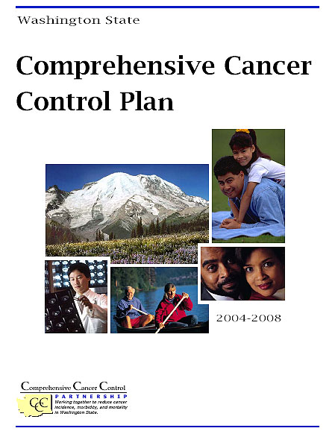

It all began in 2001…
2001:
WA DOH receives Comprehensive Cancer Control (CCC) planning grant from CDC
Washington Comprehensive Cancer Control Partnership formed to write the CCC plan
2004:
Washington State five-year CCC Plan (2004-2008) completed and launched
WA DOH receives CCC implementation grant from CDC
Working groups/committees formed for implementation
2009:
Washington State CCC Plan updated for five more years (2009-2013)

Slide 9

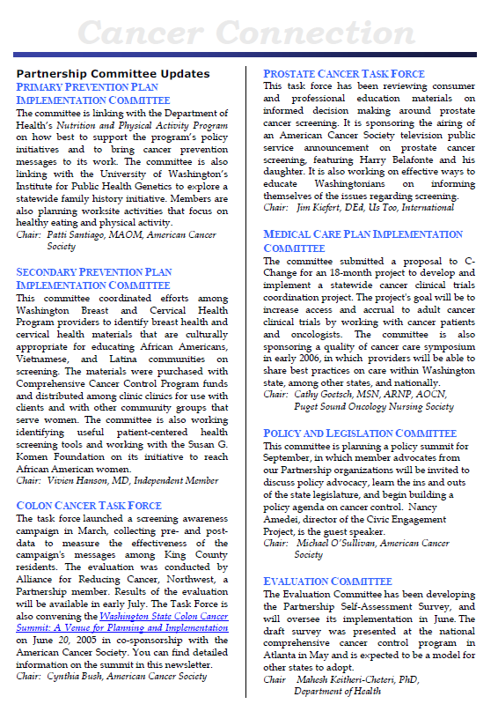
Power of Partnership
In 2004 Washington CCC Partnership became Washington CARES About Cancer Partnership, comprised of over 40 member organizations across the state.
WA DOH provided operational and technical support to the Partnership as members worked on implementation of the CCC plan.
Provided opportunities to:
Share information (via working group meetings, annual summit, newsletter and list-serv)
Collective and individual support for ballot initiatives related to cancer, such as “Health Indoor Air for All Washington”, which prohibited smoking in public places.
Community
Action
Research
Evidence-based Systems

Slide 10
What Happened to WA’s Cancer Coalition?
Disbanded sometime prior to 2016.
Last plan expired in 2013
Some working groups still exist.
Focus shifted to supporting topic-specific work groups and priority areas.

Slide 11
Current Coalition Status
Kick-Off meeting held June 13th
Coalition Check-In Meeting October 5th
Next meeting - January 24th, 2024
Coordinated with Washington State Cancer Registry for Advisory Committee Meeting
Conversations about Data Needs
Presented Draft Cancer Plan
Currently Seeking Feedback

Slide 12
5 – Year Cancer Plan
Roadmap of how organizations or coalitions can address burden of cancer specific to Washington.
Utilizing registry data and other surveillance to report cancer burden.
Measurable goals and objectives that highlight program priorities and track progress.
Yearly evaluation and reporting.
Not adding new work to your plate.
Putting a spotlight on all that you are currently doing.
Other Plans: Comprehensive Cancer Control Plans | CDC

Slide 13
Washington
5-Year Cancer Plan

Slide 14
Framework
CDC Priority Areas:
Primary Prevention, Early Detection & Screening, Health and Wellbeing of Cancer Survivors, Health Equity/Social Determinants of Health
Objectives:
“SMARTIE” format
Specific, Measurable, Attainable, Time Bound, Inclusive, and Equity Focused
Measurable baseline and 5-year targets
In line with Healthy People 2030
Example: “Reduce the overall cancer incidence rate.”
Baseline: 474.6 (Washington State Cancer Registry, 2019)
Target: 454

Slide 15
Framework
Objectives:
Some may not have target
Plan should be progressive and include things we want to measure or believe should be measured.
Strategies:
Not exhaustive.
Guiding list for those currently or wanting to engage in this area.
Think of who will be reading this.

Slide 16
Context
Sections:
Principle Goals
Top 5 Cancer Sites (based on incidence rate)
Lung and Bronchus
Breast Cancer
Colorectal Cancer
Prostate Cancer
Melanoma of the Skin
HPV Related Cancers
Genetic Testing and Counseling
Pediatric and Young Adult Cancer
Quality of Life
Health Equity and Social Determinants of Health will be built in throughout
With context in Background Section and key strategies.

Slide 17
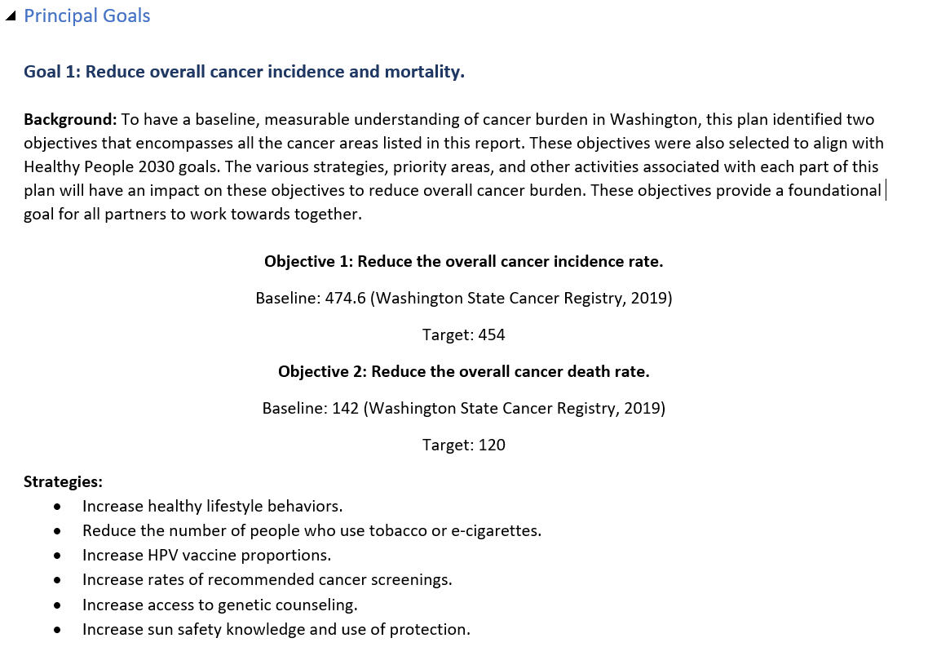
Revised Framework
Expand to include definitions and evidence
Focus Here
Next phase of revisions

Slide 18
Planning Timeline
Draft Plan June 2023
Revise Plan June 2023 - October 2023
Finalize Objective Framework October 2023 – January 2024
Build Strategies October 2023 - January 2024
Strategies Building Session January 24th, 2024
Coalition Sign-Off Spring/Summer 2024

Slide 19
5-Year Cancer Plan
Objectives

Slide 20
Principal Goals
Objective 1: Reduce the overall cancer incidence rate.
Baseline: 474.6 (Washington State Cancer Registry, 2019)
Target: 454
Objective 2: Reduce the overall cancer death rate.
Baseline: 142 (Washington State Cancer Registry, 2019)
Target: 120
Objective 3: Increase the proportion of cancer survivors who are living 5 years or longer after diagnosis of Cancer.
Baseline: 69.4% (U.S. Cancer Statistics 2019)
Target: 80%

Slide 21
Lung and Bronchus Cancer
Objective 4: Decrease the incidence rate of Lung and Bronchus Cancer.
Baseline: 48 per 100,000 (Washington State Cancer Registry, 2019)
Target: 44 per 100,000
Objective 5: Decrease the mortality rate of Lung and Bronchus Cancer.
Baseline: 30.6 per 100,000 (Washington State Cancer Registry, 2019)
Target: 27 per 100,000
Objective 6: Decrease the percentage of people who get diagnosed with Lung and Bronchus Cancer at the late stage.
Baseline: 29.3 per 100,000 (Washington State Cancer Registry, 2019)
Target: 26 per 100,000
Objective 7: Reduce the percentage of adults who *smoke commercial tobacco products*.
Baseline: 10.8% (BRFSS, 2020)
Target: 8%
Objective 8: Increase the proportion of cancer survivors who are living 5 years or longer after diagnosis of Lung and Bronchus Cancer.
Baseline: 26.1% (U.S. Cancer Statistics 2019)
Target: 30%

Slide 22
Lung and Bronchus Cancer
Objective 9: Decrease the number of people exposed to Radon.
Baseline:
Target:
Objective 10: Increase the number of people who get screened for Lung Cancer.
Baseline: TBD (BRFSS, 2024)
Target: TBD

Slide 23
Breast Cancer
Objective 11: Decrease the incidence rate of Breast Cancer.
Baseline: 163.6 per 100,000 (Washington State Cancer Registry, 2019)
Target: 159 per 100,000
Objective 12: Decrease the mortality rate of Breast Cancer.
Baseline: 19.2 per 100,000 (Washington State Cancer Registry, 2019)
Target: 16 per 100,000
Objective 13: Increase the percentage of people aged 50-75 who get screened for breast cancer.
Baseline: 74.7% (BRFSS, 2020)
Target: 80%
Objective 14: Increase the proportion of cancer survivors who are living 5 years or longer after diagnosis of Breast Cancer.
Baseline: 92.5% (U.S. Cancer Statistics 2019)
Target: 95%

Slide 24
Colorectal Cancer
Objective 15: Decrease the incidence rate of Colorectal Cancer
Baseline: 33 per 100,000 (Washington State Cancer Registry, 2019)
Target: 30 per 100,000
Objective 16: Decrease the mortality rate of Colorectal Cancer.
Baseline: 11.9 per 100,000 (Washington State Cancer Registry, 2019)
Target: 10 per 100,000
Objective 17: Increase the percentage of adults aged 45-75 who *get screened* for colorectal cancer.
Baseline: 73.5% (BRFSS, 2020)
Target: 80%
Objective 18: Increase the proportion of cancer survivors who are living 5 years or longer after diagnosis of Colorectal Cancer.
Baseline: 67% (U.S. Cancer Statistics 2019)
Target: 70%

Slide 25
Prostate Cancer
Objective 19: Decrease the incidence rate of Prostate Cancer
Baseline: 98.2 per 100,000 (Washington State Cancer Registry, 2019)
Target: 94 per 100,000
Objective 20: Decrease the mortality rate of Prostate Cancer.
Baseline: 18.9 per 100,000 (Washington State Cancer Registry, 2019)
Target: 15 per 100,000
Objective 21: Increase the proportion of cancer survivors who are living 5 years or longer after diagnosis of Prostate Cancer.
Baseline: 96% (U.S. Cancer Statistics 2019)
Target: 97%
Objective 22: Increase the percentage of people who make informed decisions about screening for prostate cancer.
Baseline: TBD
Target: TBD

Slide 26
Melanoma of the Skin Cancer
Objective 23: Decrease incidence rate of melanoma of the skin.
Baseline: 53.2 per 100,000 (Washington State Cancer Registry, 2019)
Target: 40 per 100,000

Slide 27
HPV-Related Cancers
Objective 24: Decrease the incidence rate of all HPV-related cancers.
Baseline: 11.8 per 100,000 (Washington State Cancer Registry, 2015-2019)
Target: 9 per 100,000
Objective 25: Decrease the incidence rate of female Cervical Cancer.
Baseline: 6.5 per 100,000 (Washington State Cancer Registry, 2015-2019)
Target: 4 per 100,000
Objective 26: Decrease the incidence rate of male Oropharyngeal Cancer.
Baseline: 8.7 per 100,000 (Washington State Cancer Registry, 2015-2019)
Target: 7 per 100,000
Objective 27: Increase the percentage of adolescents, aged 11 to 12 years who have completed the HPV vaccination series.
Baseline: 11.6% (Washington State Immunization Information System, 2021)
Target: 80%
Objective 28: Increase percentage of adolescents aged 11 to 12 years who have had at least 1 dose of the HPV vaccine series.
Baseline: 36.4%
Target: 90%
Objective 29: Increase the percentage of people who get screened for cervical cancer.
Baseline: 72.8% (BRFSS, 2020)
Target: 80%

Slide 28
Genetic Testing and Counseling
Objective 30: Increase number of people who are tested for all hereditary cancer syndromes by regional genetic clinics.
Baseline: 230 (everyone)
96 (those with family history)
Target: TBD
Objective 31: Increase the proportion of people at increased risk who get genetic counseling for breast and/or ovarian cancer.
Baseline: TBD
Target: TBD
Objective 32: Increase the proportion of people with colorectal cancer who get tested for Lynch syndrome.
Baseline: TBD
Target: TBD

Slide 29
Pediatric and Young Adult
Need measurable objectives to include in this section.

Slide 30
Quality of Life
Objective: Increase the percentage of people who participate in physical activities.
Baseline: 82.2% (BRFSS, 2020)
Target: 90%
Objective: Reduce the percentage of adults with heavy alcohol use.
Baseline: 7.2% (BRFSS, 2020)
Target: 3%
Objective: Decrease the number of cancer survivors who smoke commercial tobacco.
Baseline: 10.4% (BRFSS, 2020)
Target: 7%

Slide 31
Things to Consider
Accuracy
Data
What’s Missing?
Do these objectives accurately reflect what we are working on?
Are these objectives going to reduce cancer burden?
Wordsmith’s welcome!
Are current sources of data appropriate?
Are sources able to be identified?
Are targets too bold or too safe?
Objectives
General Topic Areas

Slide 32
How to Provide Feedback or Join the Coalition
Contact Katie or Rebecca
Contact Katie Treend: Katie.Treend@doh.wa.gov or
Rebecca Briant: rbryant@fredhutch.org
Send comments directly or request word document to track-changes
How long?
All objectives will be finalized for next coalition meeting (January 24th, 2024).

Slide 33
Questions?

