Slide 1

Cancer Care in Washington State 2023
Dr. Scott Ramsey
Hutchinson Institute for Cancer Outcomes Research (HICOR)

Slide 2
Vision
We believe that every cancer patient should get quality care that meets their goals at a reasonable cost, wherever they live.

Slide 3
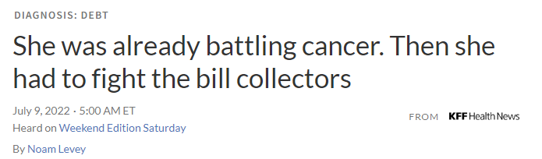
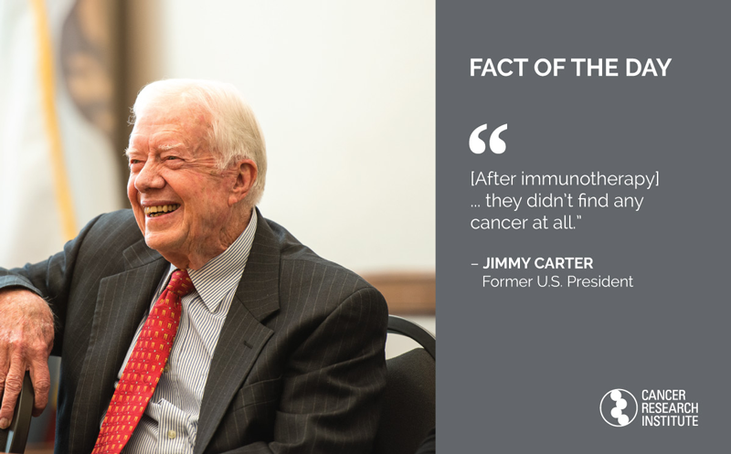

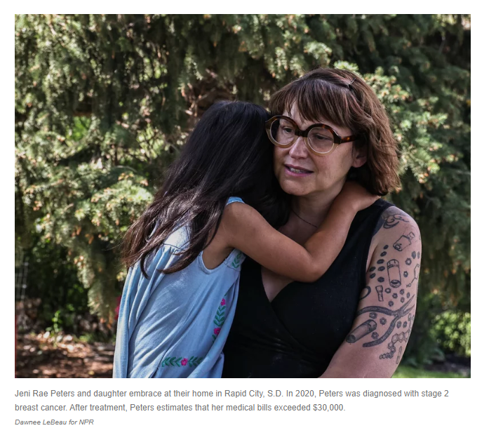
Promise of Cancer Care: Technology, Access & Equity
Increasingly realizing the potential of precision medicine
Broader understanding of health-related social needs that impact patient care and outcomes

Slide 4




Challenges Since COVID: What we’ve heard
Clinics:
  Staffing problems
  Drug shortages
  Financial strains
Patients:
  Access difficulties (primary and cancer care)
  Impact of health-related social needs
  Racism
  Financial distress
Payers:
  Declines in recommended screening procedures
  Continued expansion of new, very high- cost therapies
Everyone:
  Leadership turnovers

Slide 5
Challenges Since COVID: What we’ve heard
Clinics:
  Staffing problems
  Drug shortages
  Financial strains
Patients:
  Access difficulties (primary and cancer care)
  Impact of health-related social needs
  Racism
  Financial distress
Payers:
  Declines in recommended screening procedures
  Continued expansion of new, very high- cost therapies
Everyone:
  Leadership turnovers
Is this the new normal or old normal?

Slide 6





What the Data Tells – Community Cancer Care Report
Notes:
What we know about care in our region:
Based on community input starting as far back as 2014
Measures are reported at the clinic level for Medicare and Commercial enrollees.
In 2020 we put out a special report comparing Medicaid to Commercial patients.
This past year we added new measures based on community input and included Medicaid reporting all in one document.
There is generally good adherence to care process measures and we’ve even retired a few of the metrics because of overall good measurement across all clinics.

Slide 7
Shout-outs!

Slide 8
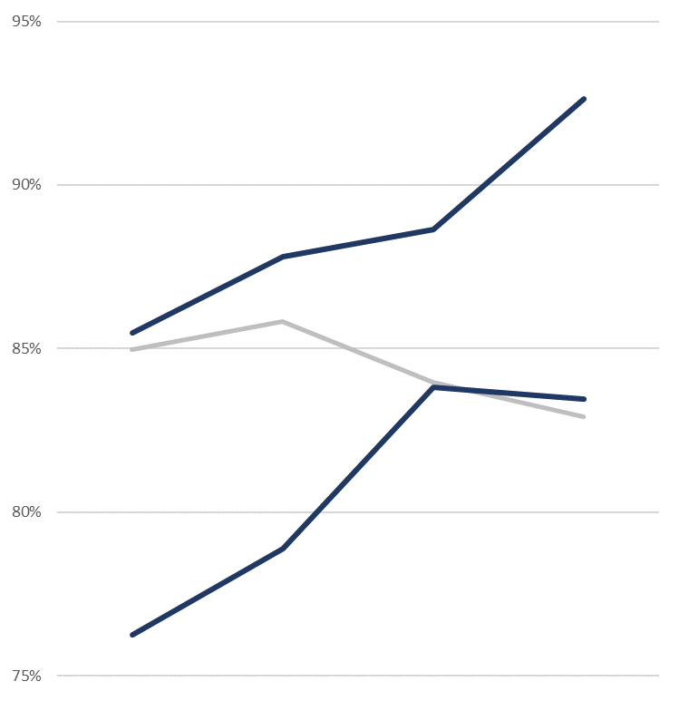
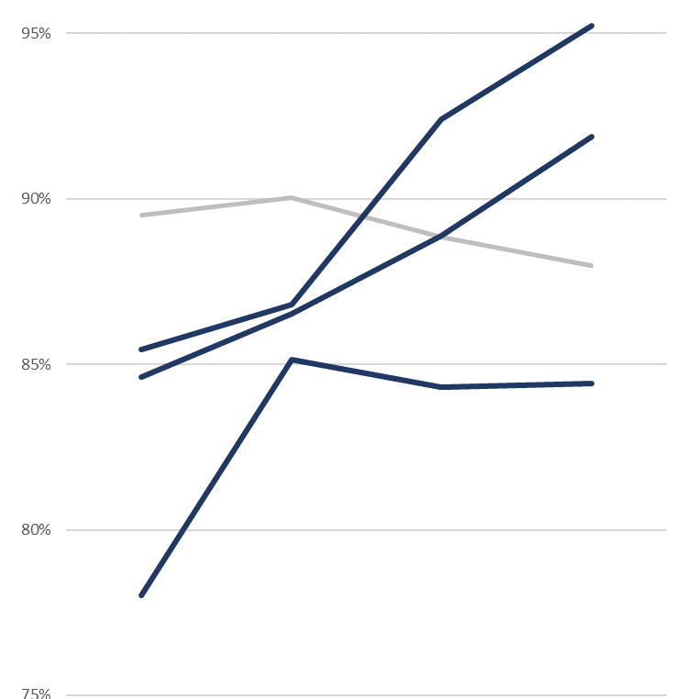


Appropriate Therapy
(Breast, Colorectal, Lung)
Appropriate Therapy
(Breast Only)
Regional Change
-2.0%
Regional Change
-1.5%
Significant improvement since 1st report:
  Northwest Medical Specialties
  MultiCare Health System
Significant improvement since 1st report:
  PeaceHealth
  MultiCare Health System
  CHI Franciscan
Top performers, 2023 report:
  Northwest Medical Specialties
  Providence Regional Cancer Partnership
  Providence Health & Services
Top performers, 2023 report:
  Northwest Medical Specialties
  PeaceHealth
  Providence Health & Services

Slide 9
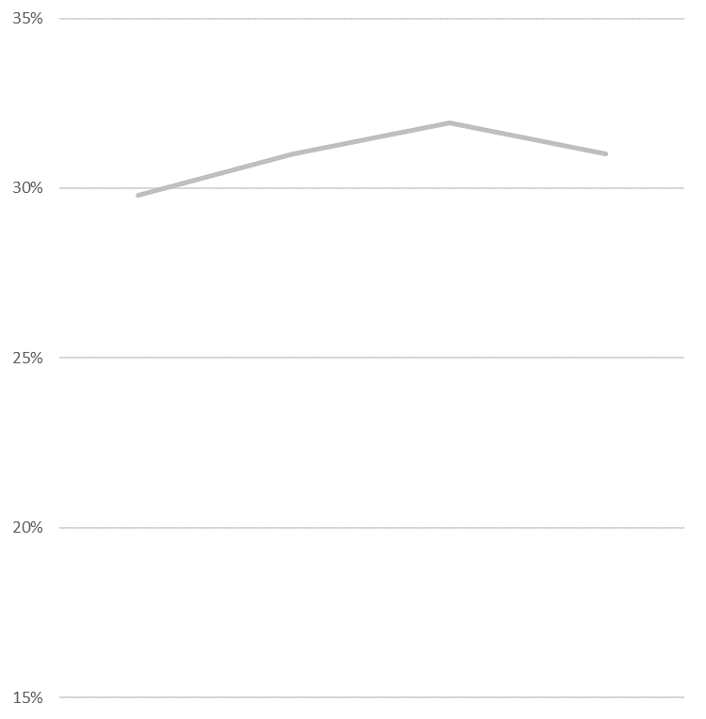
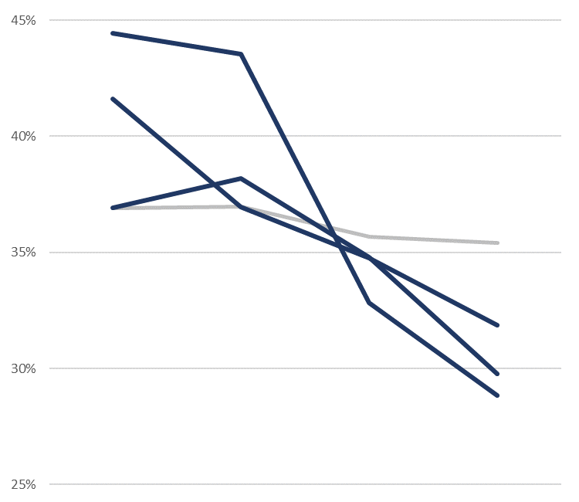
Emergency Department Use During Chemo
Inpatient Stays During Chemo
Regional Change
+1.2%
Regional Change
-1.5%
Significant improvement since 1st report:
Significant improvement since 1st report:
  Osborn Cancer Care
  Northwest Medical Specialties
  Overlake Medical Center
Top performers, 2023 report:
  Northwest Medical Specialties
  The Polyclinic
  Summit Cancer Centers
  Cancer Care Northwest
Top performers, 2023 report:
  Providence Regional Cancer Partnership
  Northwest Medical Specialties
  Yakima Valley Memorial

Slide 10
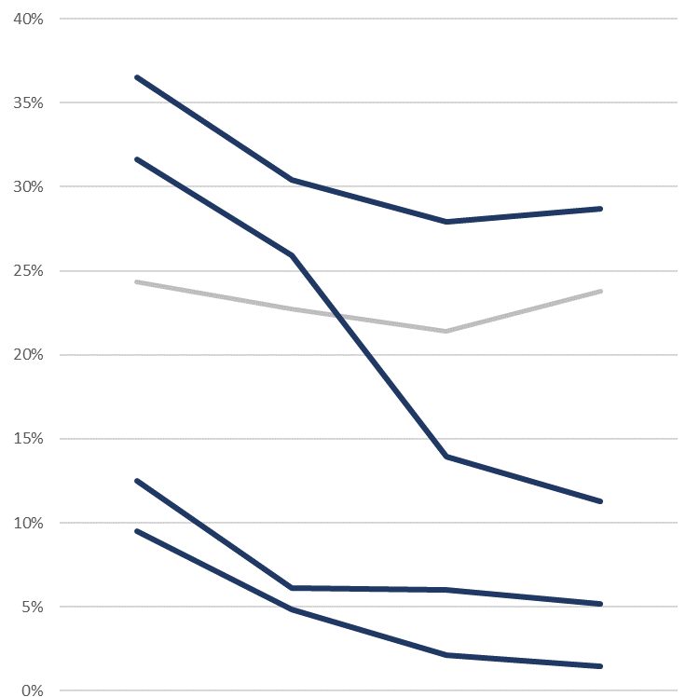
Breast Cancer Tumor Marker Testing during Surveillance
Significant improvement since 1st report:
  CHI Franciscan Health
  Northwest Medical Specialties
  UW SCCA & Northwest
  MultiCare Health System
Top performers, 2023 report:
  Virginia Mason
  Northwest Medical Specialties
  MultiCare Health System
Regional Change
-0.6%

Slide 11
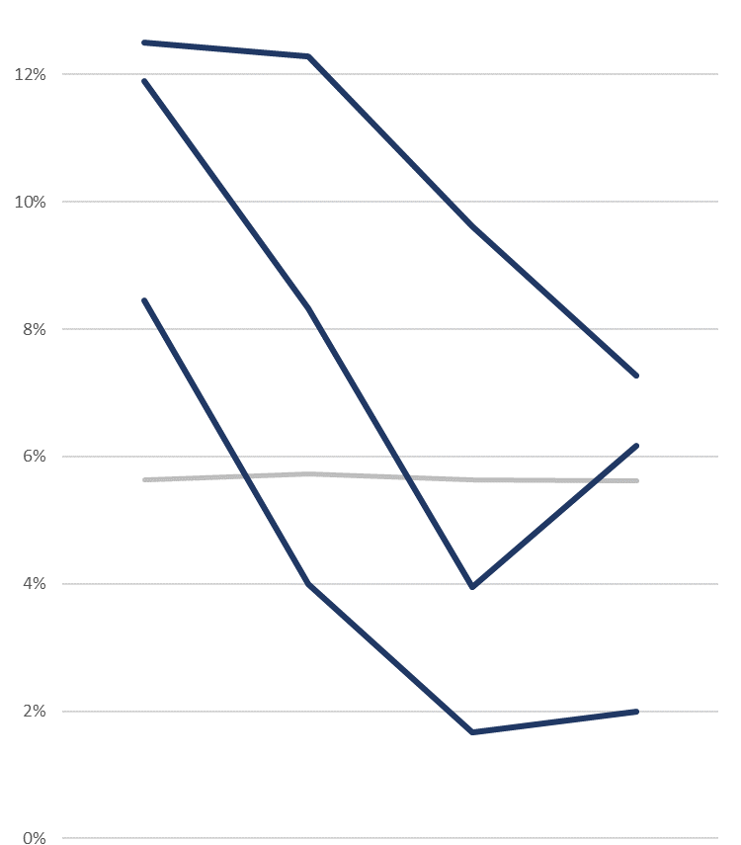
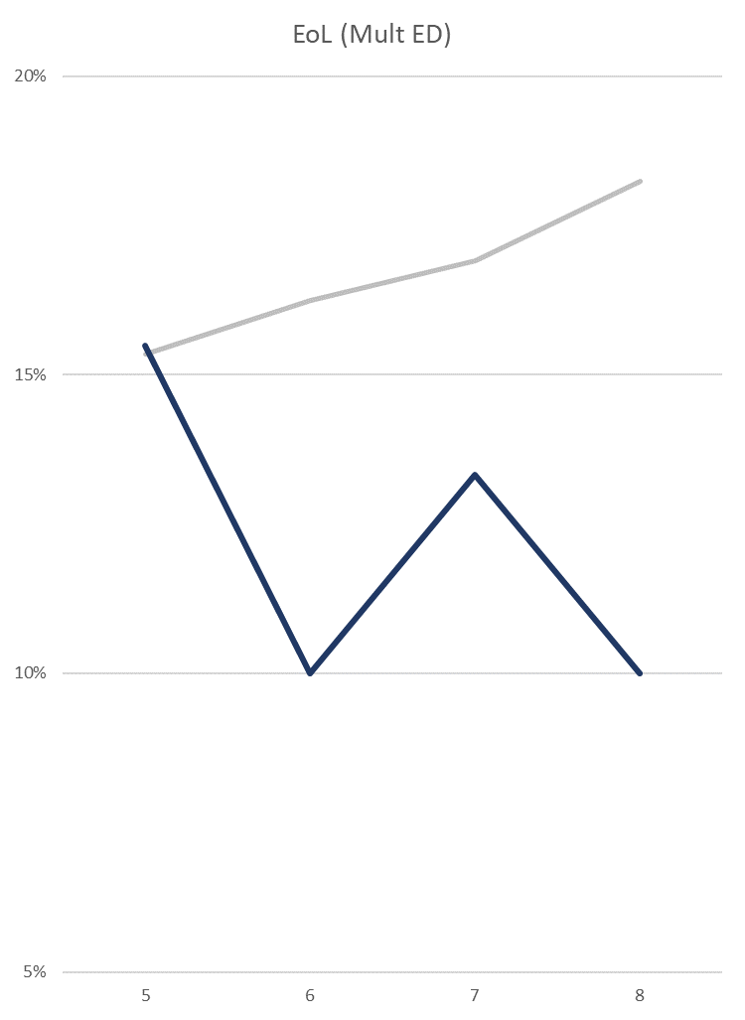
Chemotherapy in Last 14 Days of Life
Multiple ED Visits in Last 30 Days of Life
Regional Change
0.0%
Regional Change
+2.9%
Significant improvement since 1st report:
  Compass Oncology
  The Polyclinic
  Partner Oncology
Significant improvement since 1st report:
  Compass Oncology
Top performers, 2023 report:
  Overlake Medical Center
  Swedish
  Vancouver Clinic
Top performers, 2023 report:
  PeaceHealth
  UW SCCA & Northwest
  Confluence Health

Slide 12
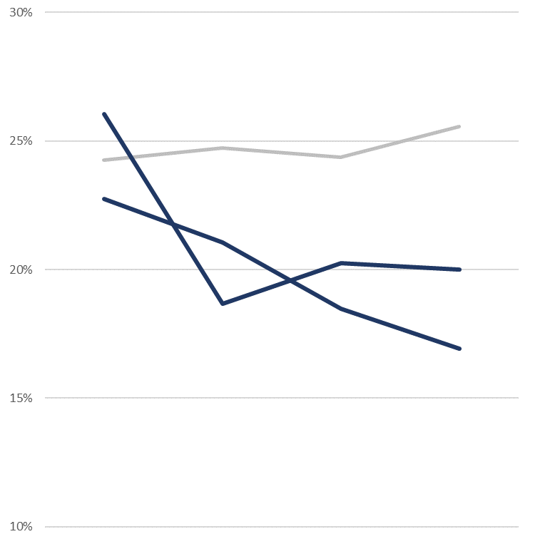
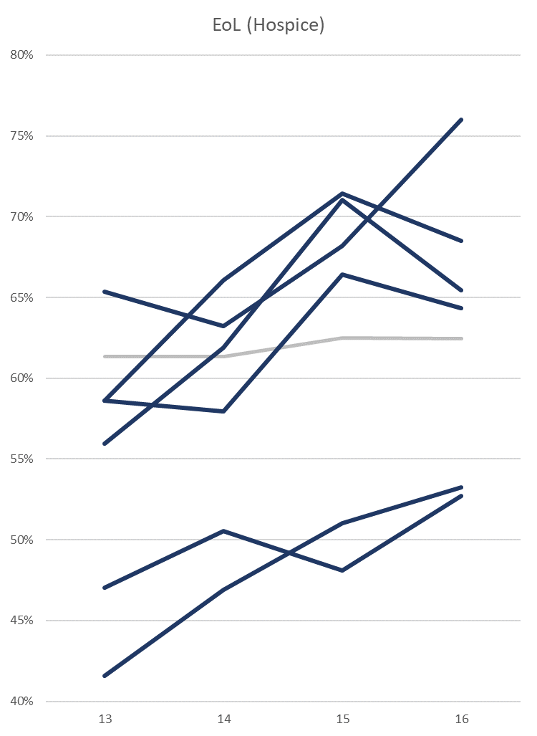
ICU Stay in Last 30 Days of Life
Hospice at least 3 Days Prior to Death
Regional Change
+1.3%
Regional Change
+1.1%
Significant improvement since 1st report:
  Trios Health
  Providence Regional Cancer Partnership
Significant improvement since 1st report:
  Olympic Medical Center Vancouver Clinic
  The Polyclinic Island Hospital
  Trios Health NWMS
Top performers, 2023 report:
  Summit Cancer Centers
  PeaceHealth
  Cancer Care Northwest
Top performers, 2023 report:
  PeaceHealth
  Overlake Medical Center
  Cancer Care Northwest

Slide 13
Community Cancer Care Report
New Quality Metrics!

Slide 14
Community Cancer Care Report New Metrics
State-Level Reporting
Biomarker Testing for Metastatic Lung Cancer
  Biomarker testing for metastatic lung cancer
Germline Testing
  Germline testing for breast cancer
  Germline testing for ovarian cancer
  Germline testing for pancreatic cancer
  Germline testing for prostate cancer
Timeliness of Care :
  Time to start of treatment
Thanks to Steering Committee and Working Groups for help in prioritizing and developing new metrics
Thanks to Patients and Patient Advocates for reviewing and refining our reporting
Notes:
Populations measured were those that met NCCN guideline recommendations.

Slide 15
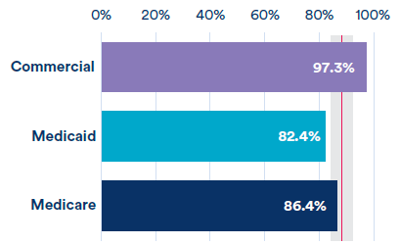
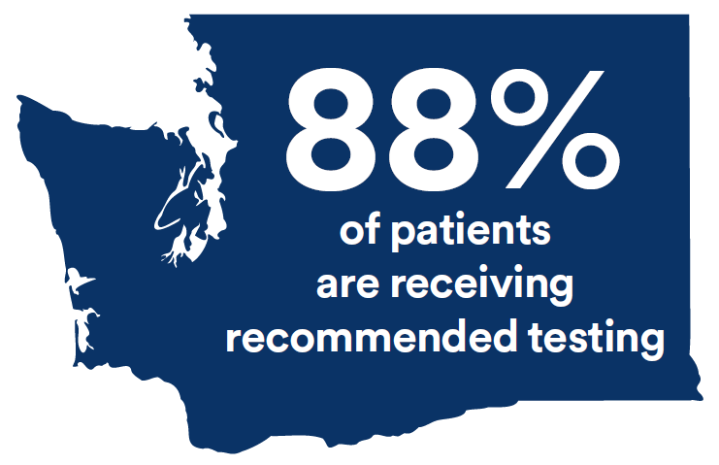
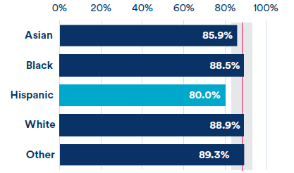
CCCR New Metrics
Biomarker Testing at diagnosis for metastatic NSCLC
Insurance Type
Race/Ethnicity

Slide 16
CCCR New Metrics
Biomarker Testing at diagnosis for metastatic NSCLC

Slide 17
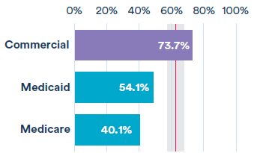
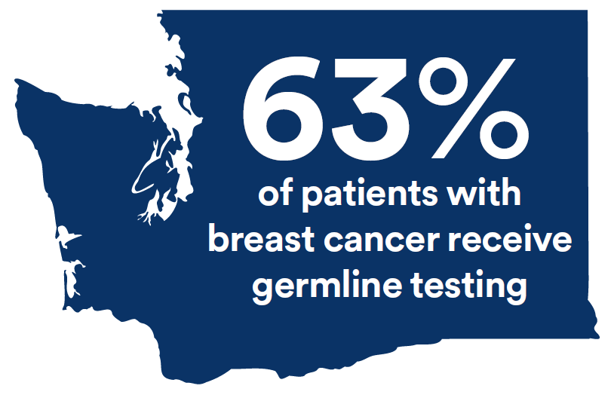
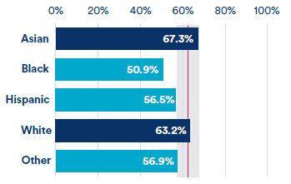
CCCR New Metrics
BRCA1/2 testing for patients with breast cancer
(in first two years following diagnosis)
Insurance Type
Race/Ethnicity

Slide 18
CCCR New Metrics
BRCA1/2 testing for patients with breast cancer
(in first two years following diagnosis)

Slide 19
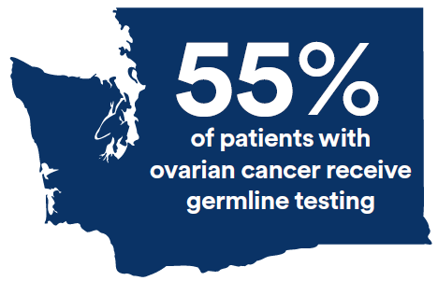
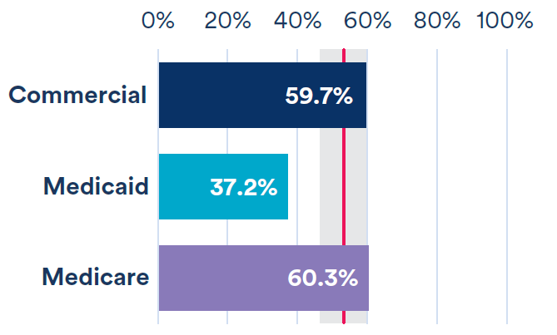
CCCR New Metrics
Germline testing for patients with ovarian cancer
(in first two years following diagnosis)
Insurance Type
Notes:
Race/Ethnicity breakdown and clinic distribution not available due to small numbers

Slide 20
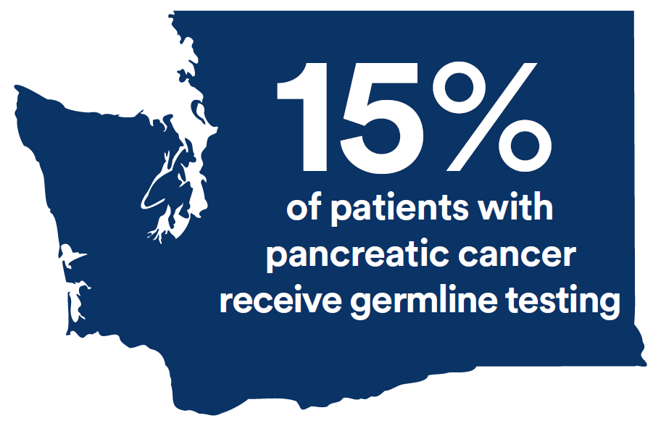
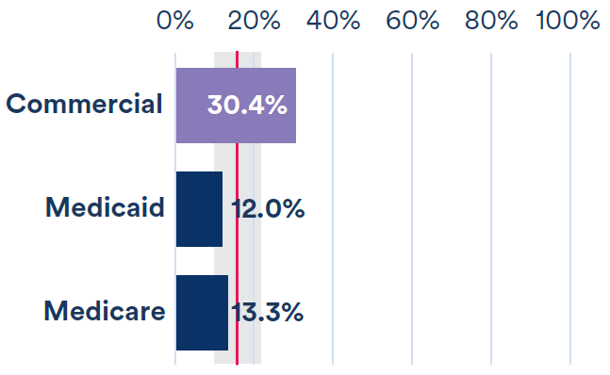
CCCR New Metrics
Germline testing for patients with pancreatic cancer
(in first two years following diagnosis)
Insurance Type
Notes:
Race/Ethnicity breakdown and clinic distribution not available due to small numbers

Slide 21
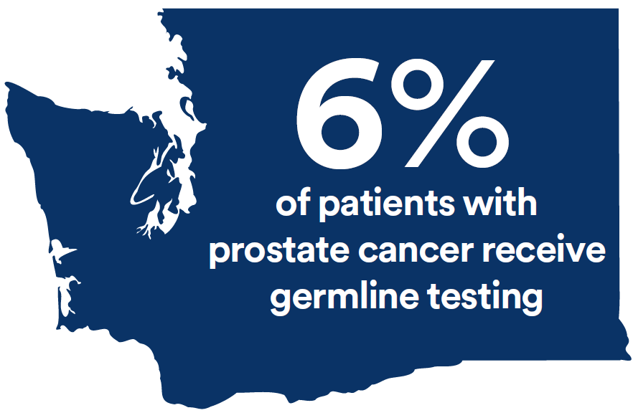
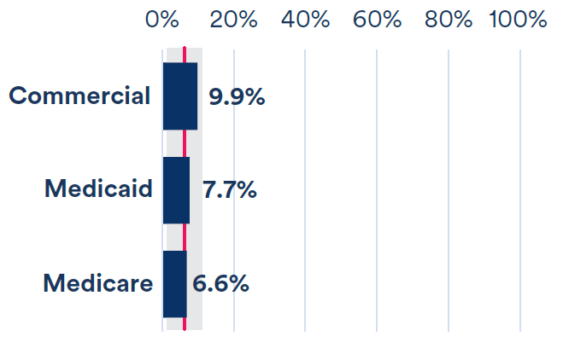
CCCR New Metrics
Germline testing for patients with prostate cancer
(in first two years following diagnosis)
Insurance Type
Notes:
Race/Ethnicity breakdown and clinic distribution not available due to small numbers

Slide 22
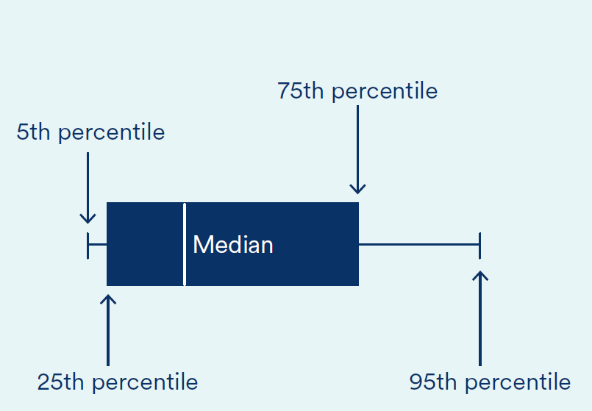
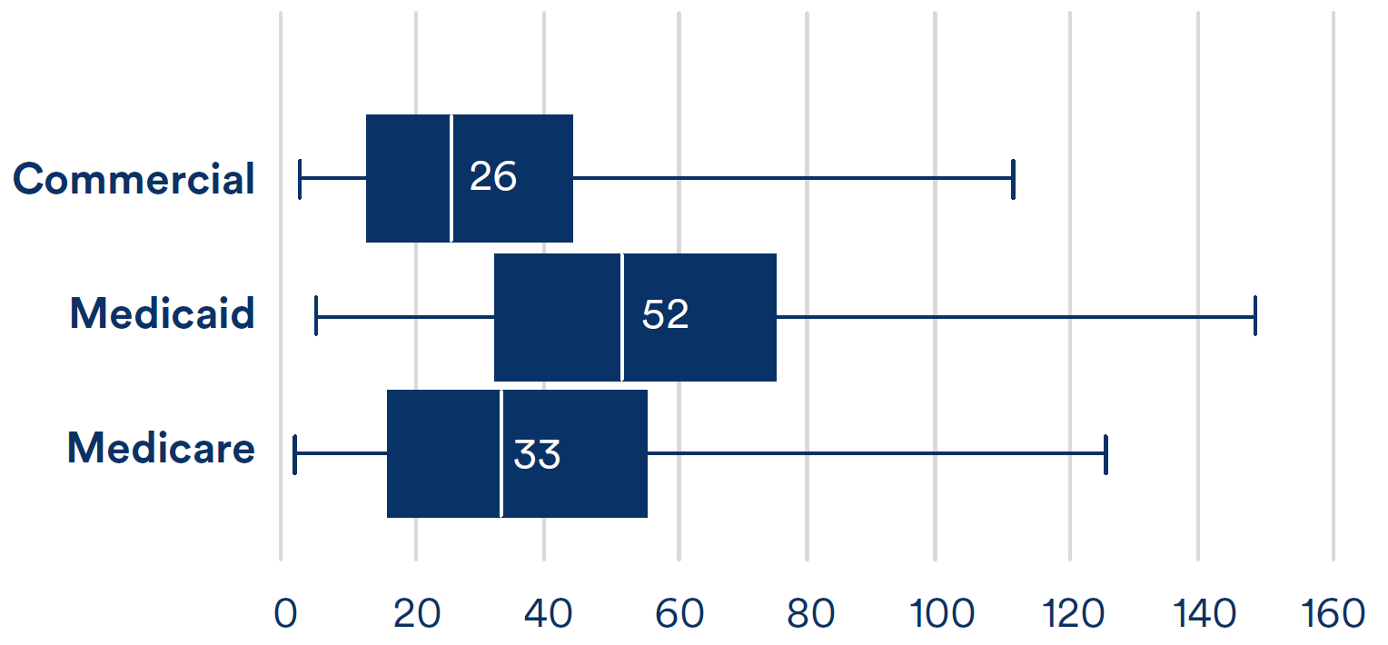
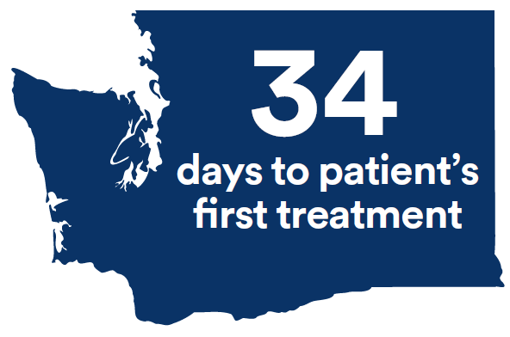
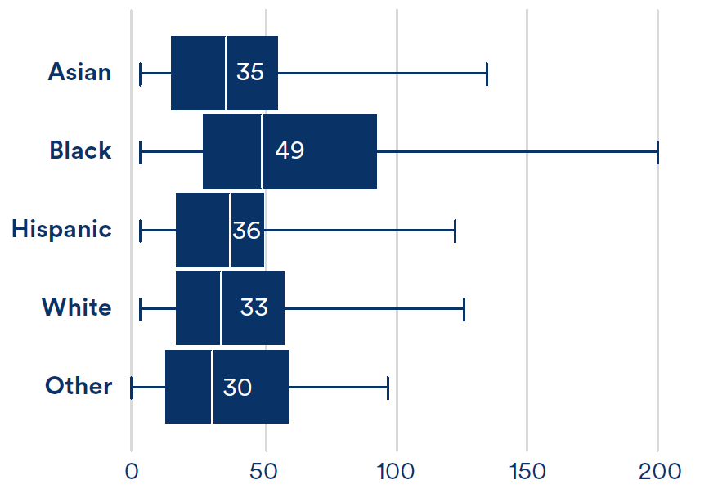
CCCR New Metrics
Legend for Figures
Time to start of therapy
Insurance Type
Race/Ethnicity
Notes:
Statistically significant longer time to treatment for Medicaid, Medicare, and Black patients.

Slide 23
CCCR New Metrics

Slide 24
Cost and Quality Reporting
What’s next?
Updates to the 2023 Community Cancer Care Report (Thank you for your feedback!)
Determine next steps for reporting new measures
Notes:
Always looking for new metrics that are important to all stakeholders, use this meeting to let us know

Slide 25

Beyond Reporting
Looking Ahead
Establishing Priorities
  What can we address together as a community?
Deciding how we define success
  Improving care delivery?
  Patient Experience?
  Practitioner experience?
  Costs of care?
    Patient burden
    System burden
Designing and testing new programs

Slide 26
New HICOR Initiative
Expand Access to Cancer Research in Washington State

Slide 27


Less than 1 in 20 cancer patients in WA enroll in a clinical trial.
Barriers to Participating in Cancer Research
Patients
Time and Financial Burden
Uncertainties about the Experience
Not offered participation in a trial
Oncology Practices
Administrative Burden
Financial burden
Applicability to the patients or the practice

Slide 28
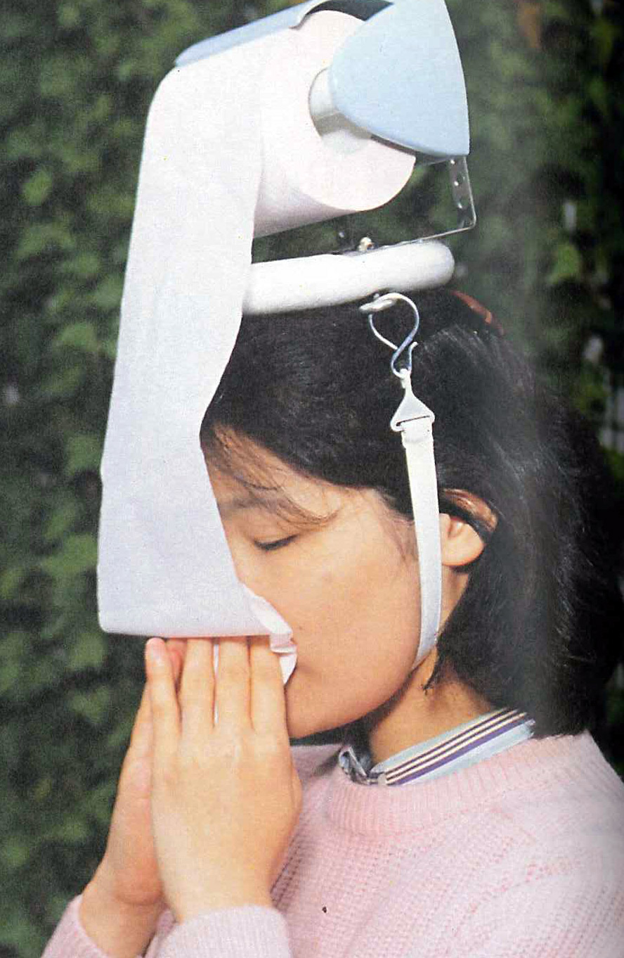
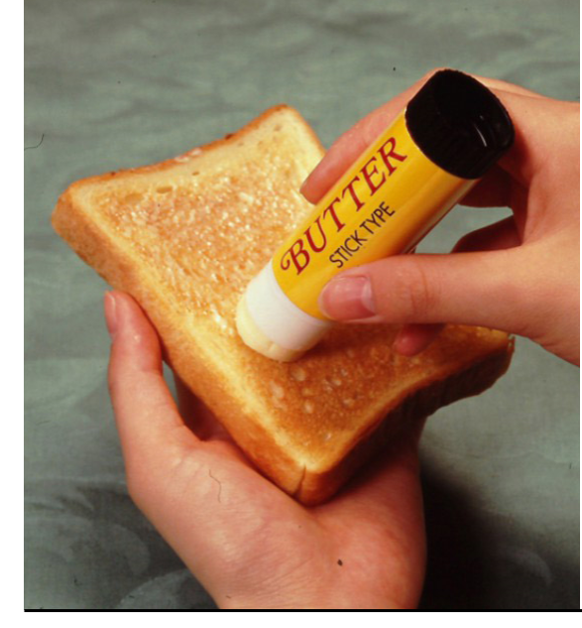

Is there a better way?
Notes:
When you work together you can do better

Slide 29
Redefining the Clinical Trial Paradigm for our Community
Build a research program that focuses on improving care and the care experience
  Helping clinics solve challenges
    Getting the right treatment to the right patient at the right time
    Reducing practitioner burnout
  Making the journey easier for patients
    Getting to care: Addressing barriers in the home and the community
    Ending financial toxicity

Slide 30
Redefining the Clinical Trial Paradigm for our Community (1)
Build a research program that focuses on improving care and the care experience
  Helping clinics solve challenges
    Getting the right treatment to the right patient at the right time
    Reducing practitioner burnout
  Making the journey easier for patients
    Getting to care: Addressing barriers in the home and the community
    Ending financial toxicity
Cancer Care Delivery Research

Slide 31
Redefining the Clinical Trial Paradigm for our Community
Make it easier to sponsor and participate in clinical trials
  Easier for Clinics
    Minimal startup burden
    Low touch – fits into clinic workflow
    Relevant to the patients they see
    Makes sense as a business model
  Easier for Patients
    Simple to understand the study’s purpose and if they are eligible
    Participating is not a burden
    Experience is a ”net positive” no matter the outcome of the study
    All patients screened and offered participation

Slide 32
Redefining the Clinical Trial Paradigm for our Community
Make it easier to sponsor and participate in clinical trials
  Easier for Clinics
    Minimal startup burden
    Low touch – fits into clinic workflow
    Relevant to the patients they see
    Makes sense as a business model
  Easier for Patients
    Simple to understand the study’s purpose and if they are eligible
    Participating is not a burden
    Experience is a ”net positive” no matter the outcome of the study
    All patients screened and offered participation
Pragmatic trials

Slide 33
Pragmatic Studies in Cancer Care Delivery
Examples*
A proactive financial navigation intervention to address financial hardship (Randomized Trial)
Remote genomic tumor board intervention versus usual practice (Randomized Trial)
Serum tumor marker directed monitoring versus usual care for metastatic hormone receptor positive HER-2 breast cancer (Randomized Trial)
Automated, guideline-based standing order intervention for colony stimulation factor prescribing (Pragmatic Trial)
**Cancer Cooperative Group Network Trials
Notes:
Simplify language

Slide 34
VISION
By 2030, 1 in 5 Washington State cancer patients will be enrolled in a research study.

Slide 35




When we come together,
big things happen

Slide 36
We want to hear from you!
We invite members of your organization to meet with us to discuss your cancer research priorities, challenges, and interests. ​
Using your input, we aim to design studies that are easier for community clinics to implement and for patients to join.
Please contact Karma Kreizenbeck (kkreizen@fredhutch.org)
​to share your ideas or learn more about this work

