Slide 1
Identifying and Addressing Disparities in Precision Medicine and Germline
Genetic Testing in Prostate Cancer
Heather H. Cheng, MD, PhD
Associate Professor, Medicine/Oncology
University of Washington
Fred Hutchinson Cancer Center
HICOR 8th Value in Cancer Care Summit
Bell Harbor Conference Center, Seattle, WA
November 2, 2023

Slide 2
Disclosures
Research Funds to Institution: Clovis Oncology, Color Health, Janssen, Medivation, Promontory Pharmaceutics, Sanofi
Consultant: AstraZeneca, Janssen, CureBRCA
Royalties: UpToDate

Slide 3
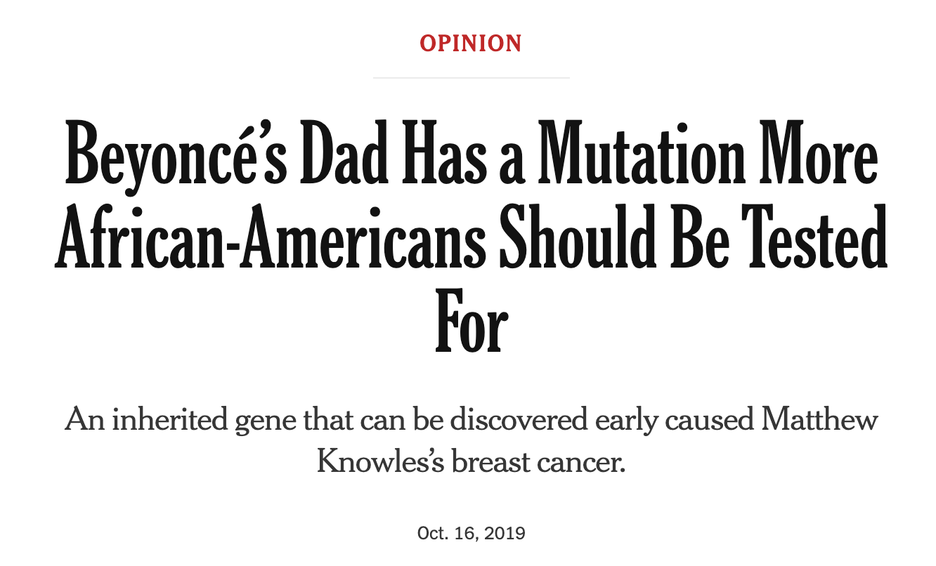


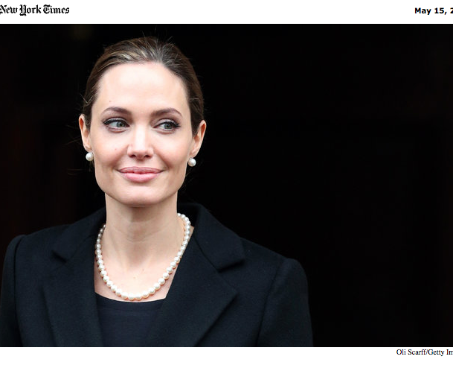
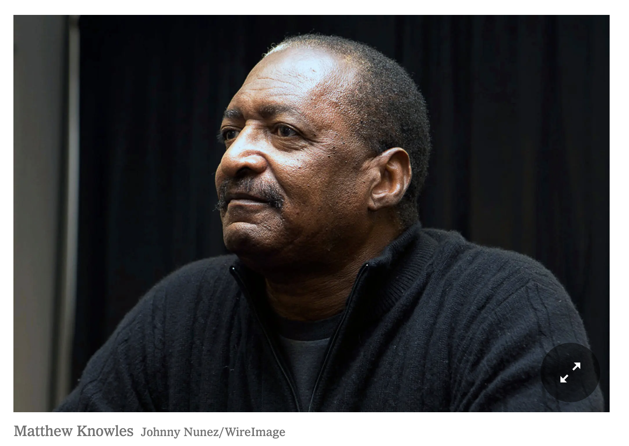
Raise your hand if…

Slide 4
Outline
Background what is prostate cancer genetics and why does it matter
Clinical Actionability why is it even more important now
Genetics Care Delivery what has been tried (clinical and research)
Conclusions and Future Directions what do we need to do better

Slide 5
Prostate Cancer Statistics in 2023
New Cancer Cases in US Men, 2023¹
Most common cancer diagnosis and second-leading cause of cancer death in US men¹
  288,300 new cases and 34,700 deaths
More diagnoses of distant-stage PC²
  Doubled from 4% in 2003 to 8% in 2017
More life-prolonging therapies³
More men living with metastatic PC^{4,5}
  By 2030, ~192,500 will be living with metastatic PC
Prostate | 288,300 | 29%
Lung and bronchus | 117,550 | 12%
Colon and rectum | 81,860 | 8%
Urinary bladder | 62,420 | 6%
Melanoma of the skin | 58,120 | 6%
Kidney and renal pelvis | 52,360 | 5%
Non-Hodgkin lymphoma | 44,880 | 4%
Oral cavity and pharynx | 39,290 | 4%
Leukemia | 35,670 | 4%
Pancreas | 33,130 | 3%
All sites | 1,010,310 | 100%
1. Siegel. CA Cancer J Clin. 2023;73:17. 2. Siegel. MMWR. 2020;69:1473. 3. NCCN. Prostate cancer. v.1.2023.
4. Kelly. Eur Urol Focus. 2018;4:121. 5. Devasia. Cancer Epidemiol Biomarkers Prev. 2023;[Epub].
Heather H. Cheng, MD PhD

Slide 6
Prostate Cancer Disease States
At Risk
Localized
(curable)
Advanced
(treatable)
Too small to see
Visible metastases
Responds to ADT
Biochemical
recurrence
mCSPC
Early Detection
for
Prostate Cancer
Definitive Treatment:
Surgery
vs
Radiation +/- testosterone suppression
Active
Surveillance
ADT not sufficient
M0
CRPC
mCRPC
Current clinical trials for molecular subtypes
ADT = androgen deprivation therapy (testosterone suppression)
FDA-approved targeted therapies options
Urology
Primary Care
Urology
Medical Oncology
Radiation Oncology
Urology
Urology
Radiation Oncology
Medical Oncology
Heather H. Cheng, MD PhD

Slide 7
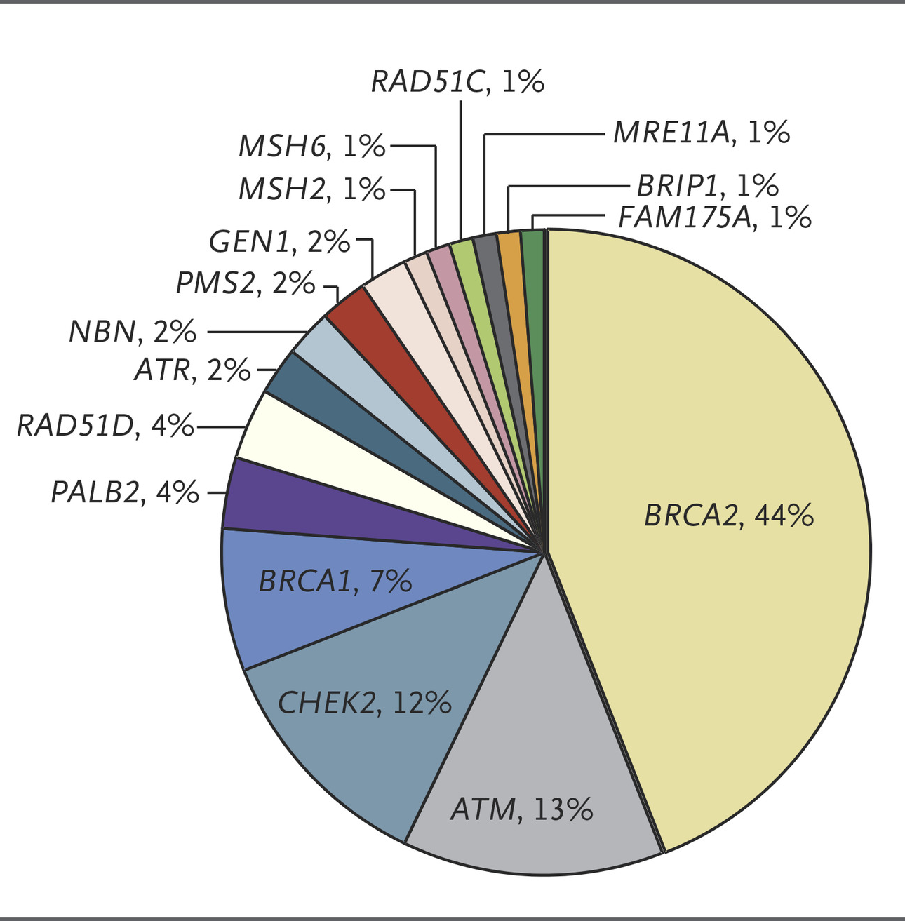
Background
~10% of men with metastatic prostate cancer carry inherited mutations in DNA repair genes (inherited cancer risk genes).
Important because…:
  Precision therapy (PARP inhibitors, immune checkpoint inhibitors)
  Prognosis: cancers behave more aggressively
  Family members may share same cancer risk
  Cancer screening and prevention implications
NCCN guidelines: genetic testing should be considered (2017) then recommended (2019) in patients with metastatic prostate cancer (first consider then recommend)
Pritchard, et al NEJM 2016
Heather H. Cheng, MD PhD

Slide 8




Hereditary (Germline) genetics vs Tumor genetics
INHERITED DNA
(Hereditary, Germline DNA)
CANCER-SPECIFIC DNA
(Tumor, Genomic, Somatic DNA)
parent
child
“Master Blueprints” Inherit half of our DNA from each parent
Changes are in ALL healthy cells of the body
Some changes in genes (variants/mutations) are linked with higher risks of cancer
Typically blood or saliva
Healthy cell DNA doesn’t change over time
“Working Manual” Starts from Master Blueprints, then acquires mistakes over time
Changes are NOT passed on to children
Must test cancer cells/tissue
Test methods are evolving
Cancer may evolve
Heather H. Cheng, MD PhD

Slide 9
WHY Test for Inherited Cancer Risk:
IT MAY HELP YOU—understand the risk of prostate and other cancers and find earlier
IT MAY HELP YOUR FAMILY—understand their cancer risks, and have potentially life-saving options
IT MAY HELP YOU—have additional targeted treatment options for your prostate cancer
(Germline)
GENETIC TESTING
for inherited cancer risk
(Genomic)
TUMOR TESTING
Risk for
other cancers
Family
cancer risk
Heather H. Cheng, MD PhD

Slide 10

Rapid changes in past few years
2016 >10% mPC with inherited DNA repair mut
2016 SCCA Prostate Cancer Genetics Clinic
2019 NCCN recommend germline genetic testing for all men with metastatic and high-risk localized PC
Mutations in BRCA1/2 thought to be rare and more for family
No substantive changes to prostate cancer management until 2020
2015 SU2C: 20-25% mCRPC with DNA repair defects
TREATMENT: PARPis, platinum, immunotherapies
2000
2005
2010
2015
2020
2023
BRCA1 BRCA2
identified
2016 NCCN Early Detection PC: inquire about fam hx and BRCA1/2
2020 FDA approval for rucaparib and olaparib
2023 FDA approval for abiraterone+olaparib
abiraterone+niraparib
enzalutamide+talazoparib
2013 gBRCA1/2 carriers with PC: more aggressive cancer and worse survival (Castro, et al)
Heather H. Cheng, MD PhD

Slide 11
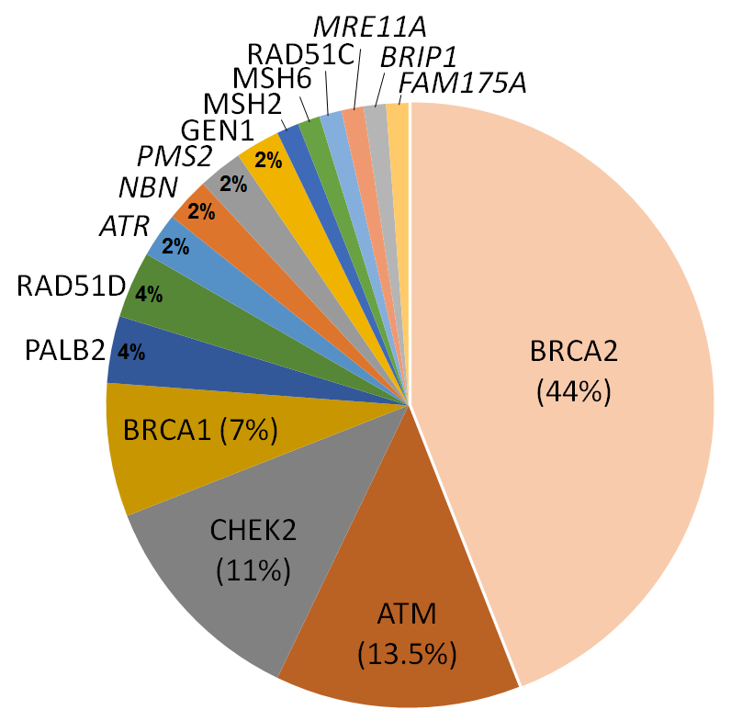
10% of men with metastatic prostate cancer carries an inherited mutation in a DNA repair gene
At Risk
Localized
(curable)
Advanced
(treatable)
Too small to see
Visible metastases
Early Detection
for
Prostate Cancer
Responds to ADT
Biochemical
recurrence
mCSPC
Definitive Treatment:
Surgery
vs
Radiation +/- testosterone suppression
Active
Surveillance
ADT not sufficient
Non-metastatic
CRPC
mCRPC
11.8% (82/692) with inherited mutations in DNA repair genes
Many without family history
Known/suspected autosomal cancer predisposition
Pritchard, et al. 2016 NEJM
Heather H. Cheng, MD PhD

Slide 12

Genetic effects on cancer risk: small vs large effect gene variants
BRCA2:
“rare variant”
(1 in 260);
increases risk (5-9x)
Average lifetime risk
of prostate cancer:
~1 in 8 men
common DNA changes that have small effect on risk (<1.5x), add together = “polygenic risk”
Heather H. Cheng, MD PhD

Slide 13
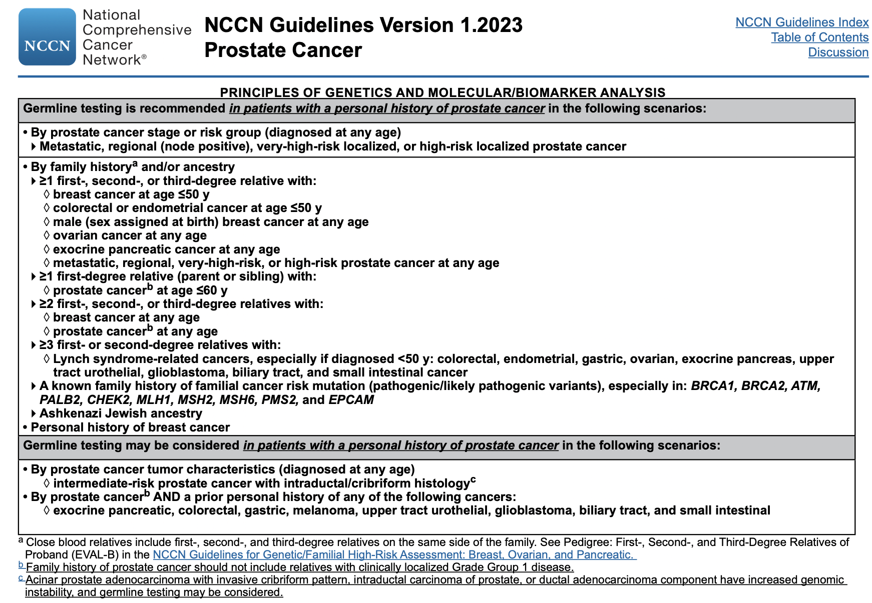
Who should be offered genetic testing for inherited cancer risk?
Recommend in patients with:
Metastatic, lymph node positive, Gleason 8-10, PSA>20)
Family history of known cancer risk gene (BRCA2, BRCA1, Lynch Syndrome)
Family history of cancer, esp. breast, pancreatic, ovarian
Ashkenazi Jewish ancestry
A diagnosis of male breast cancer
Heather H. Cheng, MD PhD

Slide 14
Clinical Actionability:
Precision Treatment

Slide 15
10% of men with metastatic prostate cancer carries an inherited mutation in a DNA repair gene
At Risk
Localized
(curable)
Advanced
(treatable)
Too small to see
Visible metastases
Early Detection
for
Prostate Cancer
Responds to ADT
Biochemical
recurrence
mCSPC
Definitive Treatment:
Surgery
vs
Radiation +/- testosterone suppression
Active
Surveillance
ADT not sufficient
Non-metastatic
CRPC
mCRPC
11.8% (82/692) with inherited mutations in DNA repair genes
Many without family history
Known/suspected autosomal cancer predisposition
Pritchard, et al. 2016 NEJM
Heather H. Cheng, MD PhD

Slide 16

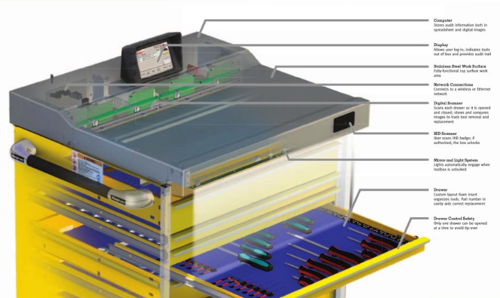

Treatment Toolbox for Advanced Prostate Cancer
At Risk
Advanced
(treatable)
Too small to see
Visible metastases
Responds to ADT
Biochemical
recurrence
mCSPC
Androgen deprivation therapy (ADT)
Abiraterone (Zytiga)
Docetaxel (Taxotere)
Apalutamide (Erleada)
Darolutamide (Nubeqa)
Sipuleucel-T (Provenge)
Enzalutamide (Xtandi)
Cabazitaxel (Jevtana)
Radium-223 (Xofigo)
Vipivotide tetraxetan (Pluvicto)
ADT not sufficient
Non-metastatic
CRPC
mCRPC
Pembrolizumab
Rucaparib
Olaparib
Abiraterone/olaparib
Abiraterone/niraparib
Enzalutamide/talazoparib
Carboplatin
Heather H. Cheng, MD PhD

Slide 17
Prostate Cancer Disease States
At Risk
Localized
(curable)
Advanced
(treatable)
Too small to see
Visible metastases
Responds to ADT
Biochemical
recurrence
mCSPC
Early Detection
for
Prostate Cancer
Definitive Treatment:
Surgery
vs
Radiation +/- testosterone suppression
Active
Surveillance
ADT not sufficient
M0
CRPC
mCRPC
Could we use targeted treatments prior to surgery to improve chance of cure?
Heather H. Cheng, MD PhD

Slide 18




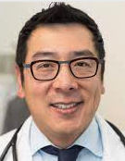


SWOG S2210: a phase ii study of Carboplatin before surgery
for High Risk localized prostate cancer in people with inherited BRCA1/2 mutations
Activated August 14, 2023!
Potentially curable prostate cancer, but high risk for not being cured (Gleason 8-10, GG4-5, PSA>20)
and inherited BRCA1/2 mutations
surgery to remove prostate
Primary Endpoint:
Pathologic complete response rate (at time of surgery, no residual cancer is found)
-Overall survival
4 doses of carboplatin (known to be very effective in BRCA1/2 cancers
Megan
Keim
Sam
Callis
Cathy
Tangen
Tanya
Dorff
Evan Yu
Dan Lin
Nick
Vogelzang
(in memoriam)
Heather H. Cheng, MD PhD

Slide 19


Care Delivery & Implementation

Slide 20
How Can Patients Get Hereditary (Germline) Genetic Testing?
Referral to a genetic counselor or geneticist
Treating provider provides pre-test education & consent and orders testing
Patient initiated testing platforms (ex: Color & Invitae)
Direct to consumer Testing (ex: 23&Me, Promethease)
Clinical Trial (e.g. GENTLEMEN, PROMISE)
Szymaniak and Facchini, et al. J Onc Practice, 2019
Heather H. Cheng, MD PhD

Slide 21
Prostate Cancer Genetics Clinic (c.2016)
Heather H. Cheng, MD PhD

Slide 22



GENetic Testing for MEN
with metastatic prostate cancer
www.gentlemenstudy.org
Started 2016
Alexandra Sokolova
Deb
Bowen
(in memoriam)
Roman Gulati
Hannah Loesch
Brianna Woo
Colin Sievers
Katerina Alexander
Nola Klemfuss
Evan Yu
Pete Nelson
Bruce Montgomery
  OBJECTIVE: Remove barriers to genetic testing that may provide critical information for men with metastatic prostate cancer living in Washington State (later U.S.) and their families
    Recruitment from clinic, support groups, newsletters, social media outreach
    Self-enrolled, Web-based informed consent
    Web-based patient survey: family history, knowledge, behavior, distress
    Upload supporting data to verify metastatic PCa: PSA, pathology, scans
    Patients are mailed Color Genomics saliva kit (costs covered by study)
    Color Genomics pre-test video and post-test phone access to counselors
    Patients receive result; invited to follow-up additional genetic counseling,
    cascade testing, opportunities for research/registry participation, etc.
  .

Slide 23
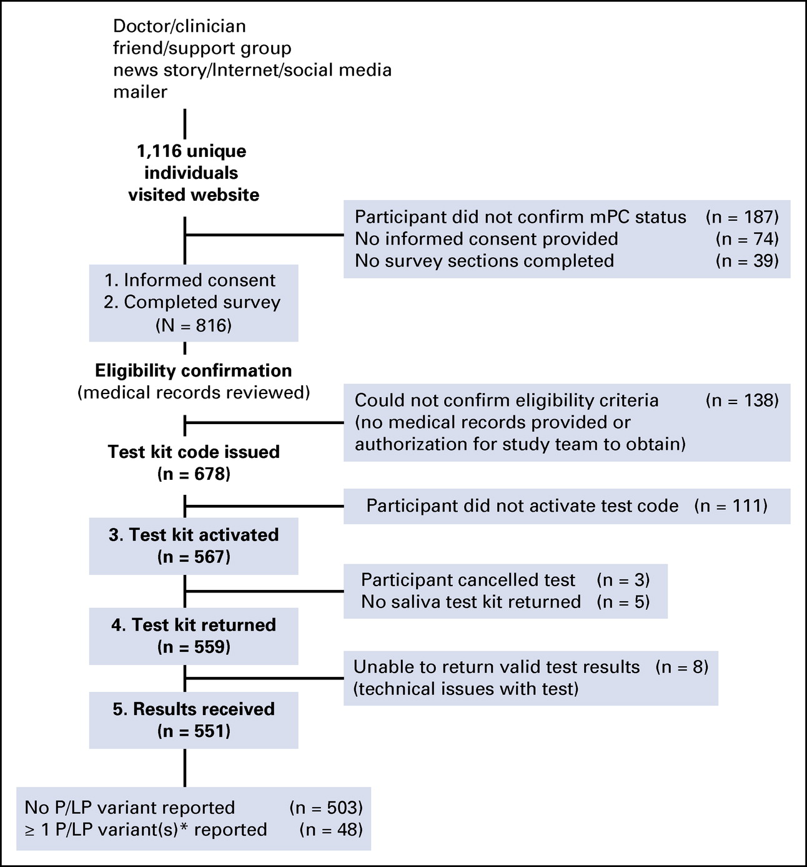
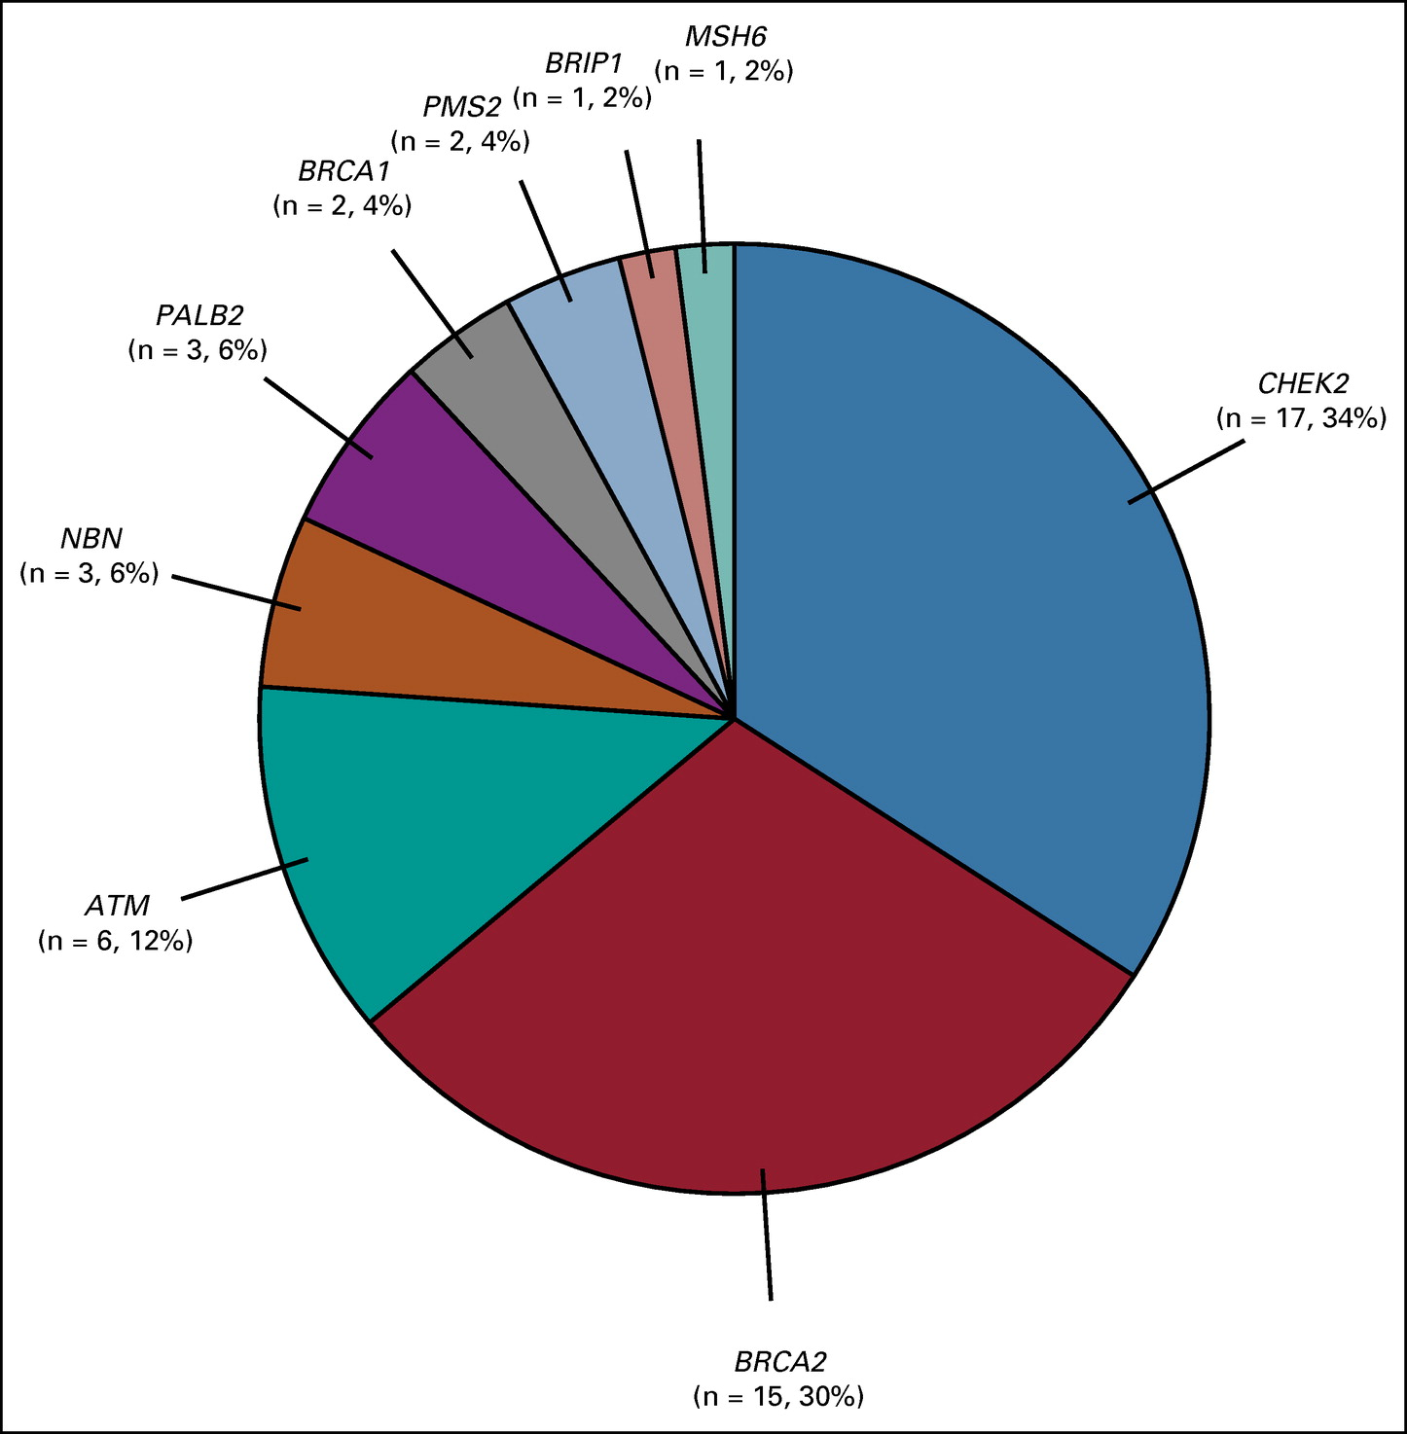
GENTleMEN results
Cheng, et al. 2023 JCO PO

Slide 24
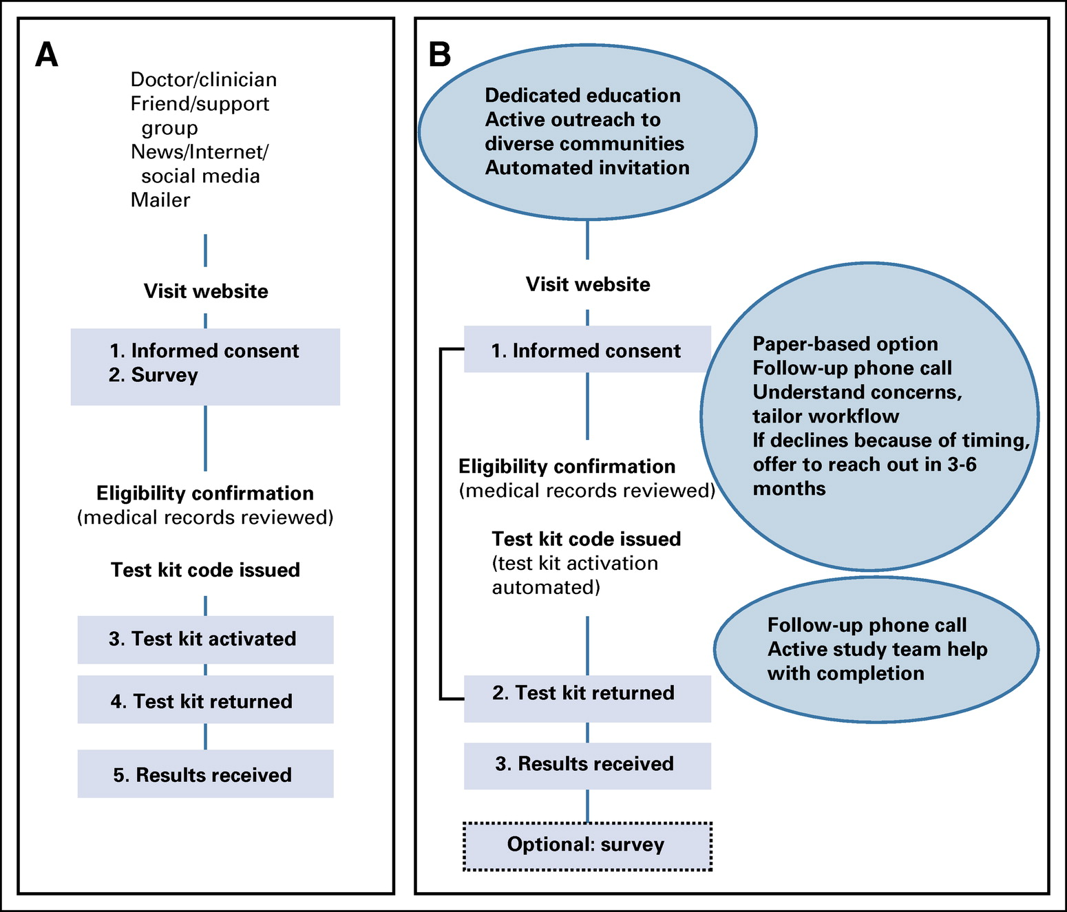
GENTleMEN…yes, we can…
1. We can deliver genetic testing remotely
2. We can engage patients in research remotely
3. More on demographics in a moment
4. Drop off can be improved, e.g….
WHAT CAN WE DO BETTER?
WHO ARE WE MISSING?
Cheng, et al. 2023 JCO PO

Slide 25
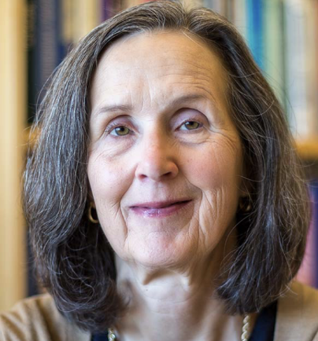
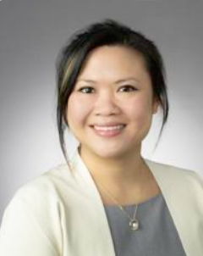

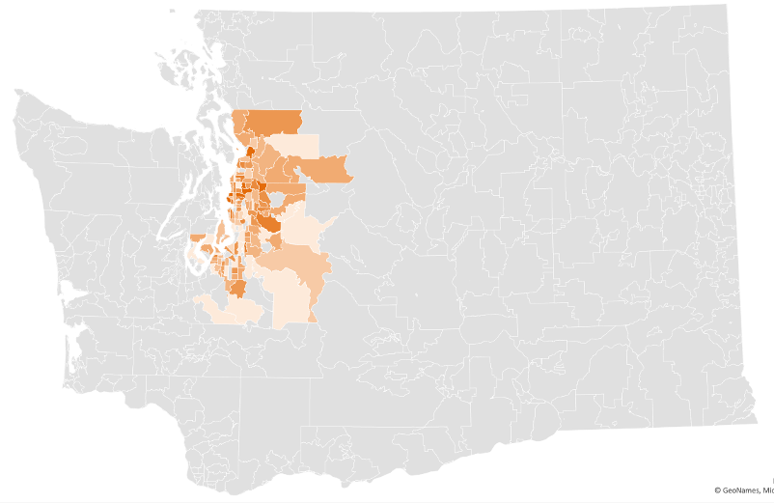
Using Cancer Registry to Learn Which
Patients May be Missed: GIFTS
Cancer Surveillance System (CSS) Data on cancer incidence, treatment, and demographics in Western Washington
population: New mPC cases in WWA diagnosed betw 1/2018 and 3/2022
Janet Stanford
Risa Wong
Hiba Khan
OBJECTIVES
Describe the patterns and gaps in testing amongst patients with mPC in the Western Washington community
Offer free testing for mPC patients in our community who have not yet undergone germline genetic testing (a la GENTLEMEN)
Understand uptake of testing when offered with phone assistance and with no cost
Khan, oral presentation at ASCO 2022
Khan et al., in preparation

Slide 26
GIFTS Design
Hiba Khan
Study introduction
Requested questionnaire
Completed questionnaire
Offered free genetic testing through GIFTS
41%
Deceased,
ill or
incapacitated
Reported prior genetic testing
11%
Did not request questionnaire
48%
Khan, oral presentation at ASCO 2022
Khan et al., in preparation
Notes:
-After identification, these individuals are mailed a postcard introducing the GIFTS study and asking if they may be interested in participating to obtain free germline genetic testing (next)
-A population of individuals was noted to be deceased, ill or incapacitated, and thus were excluded from further participation or analysis.
-In order to move forward to obtain free genetic testing, participants requested and eventually completed a simple questionnaire that included questions regarding basic demographics and prior genetic testing. Our research coordinator called the participants and discussed the study in more detail. If interested in moving forward and obtaining genetic testing, participants requested and completed the questionnaire, per mail or online per their preference. (next) Those that were not interested could decline to participate. (next)
-Those that completed the questionnaire indicate whether or not they have already completed germline testing (next). If they have not, they are offered it for free through our partner, Color Genomics.
-After exclusion of deceased and ill patienst, We generally note the presence of two groups in our population; the ones who did not express interest in germline testing, and did NOT respond to our questionnaire visualized in orange, and those that WERE interested and DID respond to the questionnaire to move on to testing visualized in blue.
-In total, 502 patients were identified through CSS that met diagnostic criteria, after exclusion of previously mentioned individuals, we have 409 patients diagnosed with metastatic prostate cancer in our community between January 2018-March 2022. 53% of total participants did NOT respond to the questionnaire, while 47% of participants did respond
-As you can see, the majority of participants who did not respond were not able to be reached by our coordinator, or directly refused. There were some participants that our RC was not able to speak to due to a language barrier.
-Of the 192 participants who did express interest and responded to the questionnaire, 177 of them have completed it, with saliva kits sent to 123. We have results back for 83 of those participants.
In the next few slides, I’ll detail descriptive findings from our initial analysis.

Slide 27
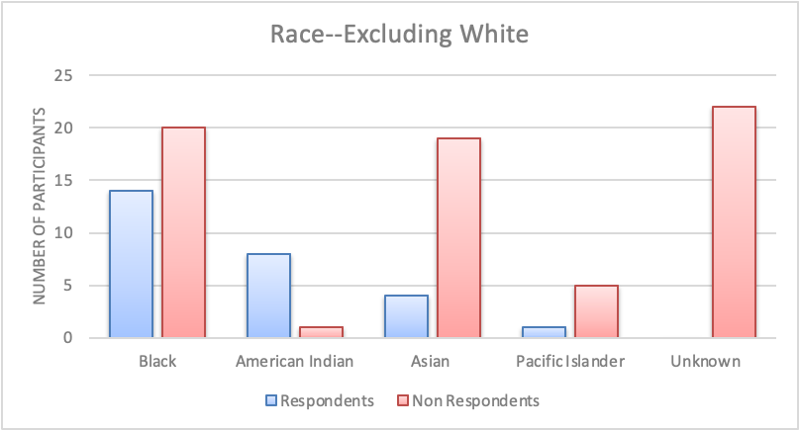
GIFTS Results
Hiba Khan
Study introduction
Requested questionnaire
Completed questionnaire
Offered free genetic testing through GIFTS
Reported prior genetic testing
Demographics of Respondents compared to Non-Respondents:
Majority of respondents were White
Proportion esp. low among Black, Asian, Pacific Islanders
Particularly high among American Indian men
Khan, oral presentation at ASCO 2022
Khan et al., in preparation
Notes:
-After identification, these individuals are mailed a postcard introducing the GIFTS study and asking if they may be interested in participating to obtain free germline genetic testing (next)
-A population of individuals was noted to be deceased, ill or incapacitated, and thus were excluded from further participation or analysis.
-In order to move forward to obtain free genetic testing, participants requested and eventually completed a simple questionnaire that included questions regarding basic demographics and prior genetic testing. Our research coordinator called the participants and discussed the study in more detail. If interested in moving forward and obtaining genetic testing, participants requested and completed the questionnaire, per mail or online per their preference. (next) Those that were not interested could decline to participate. (next)
-Those that completed the questionnaire indicate whether or not they have already completed germline testing (next). If they have not, they are offered it for free through our partner, Color Genomics.
-After exclusion of deceased and ill patienst, We generally note the presence of two groups in our population; the ones who did not express interest in germline testing, and did NOT respond to our questionnaire visualized in orange, and those that WERE interested and DID respond to the questionnaire to move on to testing visualized in blue.
-In total, 502 patients were identified through CSS that met diagnostic criteria, after exclusion of previously mentioned individuals, we have 409 patients diagnosed with metastatic prostate cancer in our community between January 2018-March 2022. 53% of total participants did NOT respond to the questionnaire, while 47% of participants did respond
-As you can see, the majority of participants who did not respond were not able to be reached by our coordinator, or directly refused. There were some participants that our RC was not able to speak to due to a language barrier.
-Of the 192 participants who did express interest and responded to the questionnaire, 177 of them have completed it, with saliva kits sent to 123. We have results back for 83 of those participants.
In the next few slides, I’ll detail descriptive findings from our initial analysis.

Slide 28
GIFTS Results
Hiba Khan
Study introduction
Requested questionnaire
Completed questionnaire
Offered free genetic testing through GIFTS
41%
Reported prior genetic testing
11%
88% (168/192) of those who indicated interest in genetic testing received testing
Of all respondents who had any genetic testing, 7% (9/128) of them had pathogenic variant identified, including in ATM (1), BRCA2 (3), BRIP1 (1), CHEK2 (1), PALB2 (1), and PMS2 (2)
Khan, oral presentation at ASCO 2022
Khan et al., in preparation
Notes:
-After identification, these individuals are mailed a postcard introducing the GIFTS study and asking if they may be interested in participating to obtain free germline genetic testing (next)
-A population of individuals was noted to be deceased, ill or incapacitated, and thus were excluded from further participation or analysis.
-In order to move forward to obtain free genetic testing, participants requested and eventually completed a simple questionnaire that included questions regarding basic demographics and prior genetic testing. Our research coordinator called the participants and discussed the study in more detail. If interested in moving forward and obtaining genetic testing, participants requested and completed the questionnaire, per mail or online per their preference. (next) Those that were not interested could decline to participate. (next)
-Those that completed the questionnaire indicate whether or not they have already completed germline testing (next). If they have not, they are offered it for free through our partner, Color Genomics.
-After exclusion of deceased and ill patienst, We generally note the presence of two groups in our population; the ones who did not express interest in germline testing, and did NOT respond to our questionnaire visualized in orange, and those that WERE interested and DID respond to the questionnaire to move on to testing visualized in blue.
-In total, 502 patients were identified through CSS that met diagnostic criteria, after exclusion of previously mentioned individuals, we have 409 patients diagnosed with metastatic prostate cancer in our community between January 2018-March 2022. 53% of total participants did NOT respond to the questionnaire, while 47% of participants did respond
-As you can see, the majority of participants who did not respond were not able to be reached by our coordinator, or directly refused. There were some participants that our RC was not able to speak to due to a language barrier.
-Of the 192 participants who did express interest and responded to the questionnaire, 177 of them have completed it, with saliva kits sent to 123. We have results back for 83 of those participants.
In the next few slides, I’ll detail descriptive findings from our initial analysis.

Slide 29
GIFTS Results
Hiba Khan
Study introduction
Requested questionnaire
Completed questionnaire
Offered free genetic testing through GIFTS
41%
Deceased,
ill or
incapacitated
Reported prior genetic testing
11%
Did not request questionnaire
About half did not indicate interest in testing after outreach…WHY?
48%
Khan, oral presentation at ASCO 2022
Khan et al., in preparation
Notes:
-After identification, these individuals are mailed a postcard introducing the GIFTS study and asking if they may be interested in participating to obtain free germline genetic testing (next)
-A population of individuals was noted to be deceased, ill or incapacitated, and thus were excluded from further participation or analysis.
-In order to move forward to obtain free genetic testing, participants requested and eventually completed a simple questionnaire that included questions regarding basic demographics and prior genetic testing. Our research coordinator called the participants and discussed the study in more detail. If interested in moving forward and obtaining genetic testing, participants requested and completed the questionnaire, per mail or online per their preference. (next) Those that were not interested could decline to participate. (next)
-Those that completed the questionnaire indicate whether or not they have already completed germline testing (next). If they have not, they are offered it for free through our partner, Color Genomics.
-After exclusion of deceased and ill patienst, We generally note the presence of two groups in our population; the ones who did not express interest in germline testing, and did NOT respond to our questionnaire visualized in orange, and those that WERE interested and DID respond to the questionnaire to move on to testing visualized in blue.
-In total, 502 patients were identified through CSS that met diagnostic criteria, after exclusion of previously mentioned individuals, we have 409 patients diagnosed with metastatic prostate cancer in our community between January 2018-March 2022. 53% of total participants did NOT respond to the questionnaire, while 47% of participants did respond
-As you can see, the majority of participants who did not respond were not able to be reached by our coordinator, or directly refused. There were some participants that our RC was not able to speak to due to a language barrier.
-Of the 192 participants who did express interest and responded to the questionnaire, 177 of them have completed it, with saliva kits sent to 123. We have results back for 83 of those participants.
In the next few slides, I’ll detail descriptive findings from our initial analysis.

Slide 30










SPORE Project 1
Aim 1: Define the interaction of BRCA1/2 and multi-ancestry PRS across diverse populations.
Burcu Darst
Colin Pritchard
Dan Lin
Newly diagnosed prostate cancer cases identified in CSS and now WA State Cancer Registry
*
*
*gDRG
Yaw Nyame
PRSm
Incident PCa in
multi-ancestry
(not exclusively white) patients

Slide 31


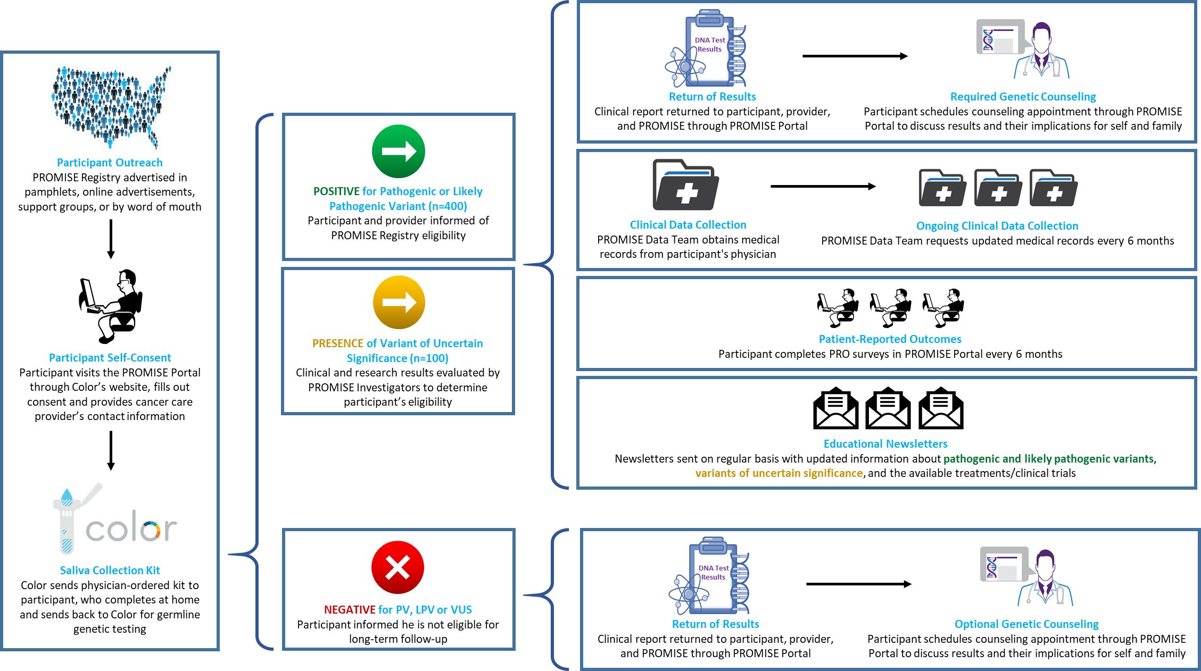

Slide 32
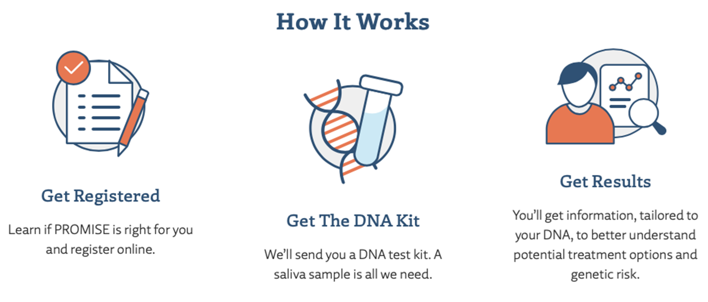
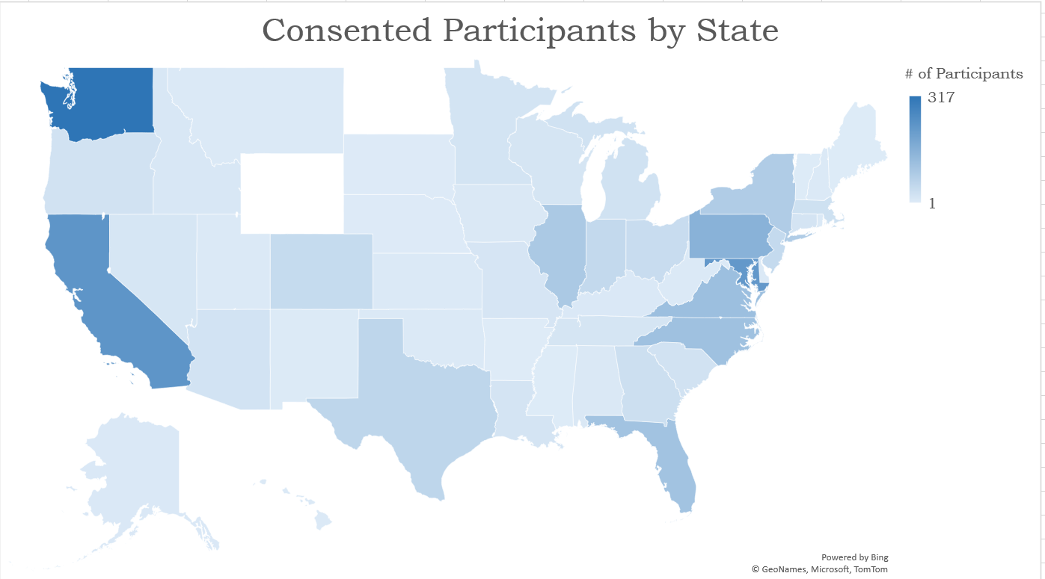
2,689 consented participants
1,932 genetic testing results returned
(goal: 5,000)
240 participants eligible for long-term follow-up
(goal: 500)
Clinicaltrials.gov ID:
NCT04995198
ProstateCancerPromise.org
Heather H. Cheng, MD PhD

Slide 33
Moving towards tailored options at every step….
At Risk
Localized
(curable)
Advanced
(treatable)
Too small to see
Visible metastases
Early Detection
for
Prostate Cancer
Responds to ADT
Biochemical
recurrence
mCSPC
Definitive Treatment:
Surgery
Active
Surveillance
Definitive Treatment
Radiation+/- ADT
ADT not sufficient
Non-metastatic
CRPC
mCRPC
Urology
Primary Care
Urology
Medical Oncology
Radiation Oncology
Urology
Urology
Radiation Oncology
Medical Oncology
Heather H. Cheng, MD PhD

Slide 34




VISION
SISTERS
⬆risk of breast, ovarian cancer
Breast and Ovarian Cancer Prev
FIRST DEGREE RELATIVES:
50% likelihood of sharing risk variant
Cascade testing
BROTHERS
⬆risk of prostate cancer
PATROL: Prostate cancer
early detection study
~2 in 10 men with metastatic prostate cancer have a DNA repair gene mutation¹
DAUGHTERS
⬆risk of breast, ovarian cancer
Breast and Ovarian Cancer Prev
GIFTS
GENTleMEN
Prostate Cancer Genetics Clinic
Targeted therapies:
platinum, PARPi
SONS
⬆risk of prostate cancer
PATROL: Prostate cancer
early detection study
Heather H. Cheng, MD PhD
34

Slide 35
Conclusions
Inherited (germline) genetic testing for cancer risk is recommended for high-risk localized, node positive and metastatic prostate cancer patients, regardless of family history of cancer.
This genetic testing is increasingly important for cancer treatment options, clinical trials and potentially life-saving for family members
Cancer Care Delivery:
  We can deliver germline genetic testing via internet-based methods
  We can use cancer registries (and health systems) to do better, but key disparities persist

Slide 36
Future Directions (Welcome your ideas and partnership)
Need better understanding of barriers and improve tailored education and workflow, esp. in diverse populations, health systems and communities
Engage health systems to provide systematic/automated invitations and multi-tiered support for prostate cancer screening and earlier intervention
Standardize coverage of genetic testing, and encourage cascade testing (How can we help relatives across healthcare plans?)
How can we better engage males and people at risk for prostate cancer to be proactive in health (genetics and PSA screening)

Slide 37







UW/FHCC (GU)
Burcu Darst*
Agnes Gawne
Petros Grivas
Roman Gulati
Michael Haffner
Jessica Hawley
Andrew Hsieh
Hiba Khan*
Aaron Lin
Hannah Loesch
Bruce Montgomery*
Colm Morrissey
Pete Nelson*
Heather O’Brien
Patrick Panglasui
Ruben Raychaudhuri
Michael Schweizer
Alexandra Sokolova*
Janet Stanford
Evan Yu*
Risa Wong*
Brianna Woo
Todd Yezefski
UW Urology
Kristin Follmer
Daniel Lin*
John Gore
Chenee Holcomb
Lisa Newcomb
Yaw Nwame
Erika Wolff
Jonathan Wright
In Memoriam
Deb Bowen
Nick Vogelzang
Funding
ACT-Brown
DOD
IPCR
PCF
NIH/CCSG
PNW SPORE
Acknowledgments
Patients and their Families
Patients and their Families
UW Lab Medicine and Pathology
Colin Pritchard*
Eric Konnick
Brian Shirts
FHCC/Genetics/Prevention
Lauren Brown
Marianne Dubard-Gault
Lauren Facchini
Lorraine Naylor
Sarah Knerr
PROMISE/PCCTC
Channing Paller (JHU)
Jake Vinson
Rebecca Green
Christina Tran

Slide 38



Thank You! hhcheng@uw.edu

