Slide 1
Health-Related Social Needs: Impact on Cancer Care and Outcomes Robin Yabroff, PhD
November 2, 2023

Slide 2
Overview
1
Health Equity
2
Cancer Care and Outcomes in the United States
3
Social Determinants of Health and Health-Related Social Needs
4
Efforts to Address Health-Related Social Needs
5
American Cancer Society Activities
2
Notes:
Define
Share data
Describe how SDOH and HRSN underly many disparities in cancer care and outcomes
Highlight some efforts to address HRSN

Slide 3
What is Health Equity?
“Health equity means that everyone has a fair and just opportunity to be as healthy as possible.
This requires removing obstacles to health such as poverty, discrimination, and their consequences, including powerlessness and lack of access to good jobs with fair pay, quality education and housing, safe environments, and health care.”
Source: Robert Wood Johnson Foundation
Notes:
I start by defining health equity. RWJ defines as: I really like the RWJ definition because it highlights structural aspects of Social Determinants of Health

Slide 4

Notes:
Distinguish between equality and equity

Slide 5
Health Equity through the Cancer Lens
Health equity means that everyone has a fair and just opportunity to prevent, detect, treat, and survive cancer.
Cancer is a disease that can affect anyone, but it doesn’t affect everyone equally.

Slide 6
Cancer-Related Spending and Mortality Rates in the United States Compared with other High-Income Countries
Chow RD, Bradley EH, Gross CP. Comparison of Cancer-Related Spending and Mortality Rates in the US
vs 21 High-Income Countries. JAMA Health Forum. 2022;3(5):e221229.
Notes:
The United States leads the world in health care spending. As shown in this recently published study examining cancer spending and mortality, when we look at per capita cancer care spending along the x axis and cancer mortality rates along the y axis, we see that the per capita health care spending is the highest among high-income countries.
Longstanding Disparities in cancer care and outcomes – by geography, race and ethnicity, socioeconomic status, and health insurance coverage
At the same time, cancer mortality rates in the US are higher than in other high income countries that spend far less per capita on cancer care.
Suggests many opportunities to improve cancer care delivery in the United States, including through delivery of effective, but underutilized interventions.

Slide 7
Access Barrier to Care Because of Cost in Past 12 Months, Selected Countries
Percentage
Source: Commonwealth Fund International Health Policy Survey

Slide 8
Disparities in Care Across the Cancer Control Continuum
Risk Assessment and Prevention
Screening and Detection
Diagnosis
Treatment
Survivorship
End-of-Life Care
Notes:
Disparities in cancer survival and mortality are a direct result of disparities in reciept of risk assessment and prevention, screening and detection, diagnosis, treatment, survivorship and end of life care.
I am going to use this framework in the three illustrative examples I mentioned earlier.

Slide 9
Longstanding Disparities in Cancer Care and Outcomes in the United States
Geography
Socioeconomic status
Race and ethnicity
Health insurance coverage
Social determinants of health and health-related social needs
Notes:
Geography between and within country as well as urban and rural
Health insurance coverage because it is modifiable and strongly associated with improved access to care and outcomes
SDoH – structural factors where people live, work, play and age. Root causes of underlying inequalities

Slide 10
Geographic Disparities in Cancer Mortality
Rates in the United States, Males 2014-2018
Source: Islami F, Guerra CE, Minihan A, et al. American Cancer Society's report on the status of cancer disparities in the United States, 2021. CA Cancer J Clin. 2021. Epub ahead of print. PMID: 34878180.
Notes:
Geographic variation in cancer mortality among men – here highest mortality in dark red in southeastern portion of the US. This map is by congressional district.
Notably, the cancer mortality rates in some states (Mississippi, West Virginia, Kentucky, and Oklahoma) are of similar magnitude or exceed some of the highest cancer mortality rates in the world.

Slide 11
Racial and Ethnic Disparities in Cancer Incidence and
Mortality Rates in the United States, 2015-2019
Source: Islami F, Guerra CE, Minihan A, et al. American Cancer Society's report on the status of cancer disparities in the United States, 2021.
CA Cancer J Clin. 2021. Epub ahead of print. PMID: 34878180.
Notes:
We also have striking disparities in cancer incidence by race and ethnicity. Orient orange and red.
NH Black males have higher incidence rates than NH White males (x vs y) and also higher mortality rates.
The situation is different for females. NH Black females have lower incidence rates than NH White females, but higher mortality rates.
Say it another way. Despite lower incidence rates, Black Females have higher mortality rates than white females.

Slide 12
Socioeconomic Disparities in 5-year Survival Following Cancer Diagnosis in United States
SES measured with area deprivation index, with indicators of education, occupation, wealth, income distribution, unemployment rate, poverty rate, and housing quality linked to SEER data. SOURCE: Singh GK, Jemal A. Socioeconomic and Racial/Ethnic Disparities in Cancer Mortality, Incidence, and Survival in the United States, 1950-2014: Over Six Decades of Changing Patterns and Widening Inequalities. J Environ Public Health. 2017
Notes:
Some of the disparities of I shown you so far are related to variation in socioeconomic status. This figure shows socioeconomic disparities in survival following cancer diagnosis –socioeconomic status was measured with the area deprivation index, which incudes indicators for education, occupation, wealth, income distribution, unemployment rate, poverty rate, and housing quality.
In this graph, the lowest socioeconomic quintle is in blue and highest quintile is in orange. You can see much lower survival in low SES quintiles–50% survived 5 years vs 66% survived 5 year. Follows a dose-response pattern.

Slide 13
Socioeconomic Disparities in Survival Following Cancer Diagnosis, by Race and Ethnicity
SES measured with area deprivation index, with indicators of education, occupation, wealth, income distribution, unemployment rate, poverty rate, and housing quality linked to SEER data. SOURCE: Singh GK, Jemal A. Socioeconomic and Racial/Ethnic Disparities in Cancer Mortality, Incidence, and Survival in the United States, 1950-2014: Over Six Decades of Changing Patterns and Widening Inequalities. J Environ Public Health. 2017
Notes:
In this next figure, have stratified by race and ethnicity to show NH White and NH Black. See the same pattern in both, but even within socioeconomic quintile, lower survival for Non-Hispanic black people with cancer than non-Hispanic white patients, within every quintile of SES.
For example, in the lowest income quintile shown in blue, 46% of people who were NH Black survived 5 years compared with 51% of people who where NH White. The same is true for all other SES quintiles

Slide 14
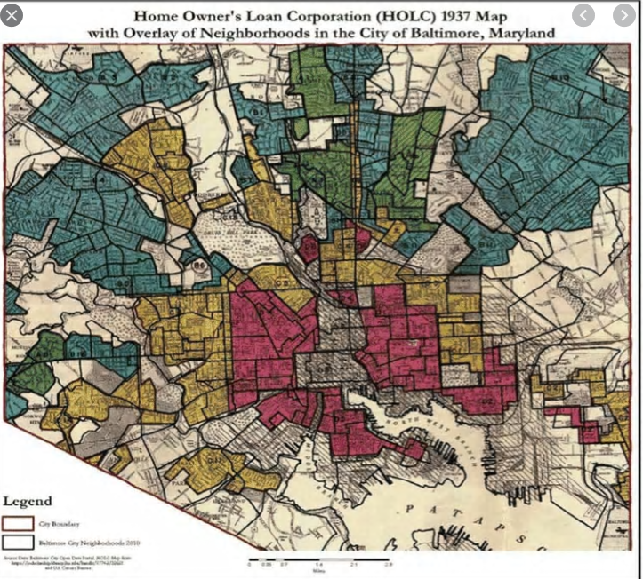
Structural Racism: Historic Redlining
Growing evidence
that residence in
redlined areas associated
with worse cancer survival
and higher mortality rates
Notes:
: In the 1930s, the federally-sponsored Home Owners’ Loan Corporation (HOLC) created maps that directed mortgage financing based largely on a neighborhood’s racial composition. American neighborhoods were subdivided into four risk-based rankings Neighborhoods with large Black populations were mapped in red and flagged as hazardous areas for mortgage financing. Redlining created a platform for systemic disinvestment in these neighborhoods leading to barriers in access to resources that persist today.
Agree

Slide 15
Disparities in Survival by Health Insurance Coverage among Colorectal Cancer Patients Aged <65 years in the United States
Source: Miller KD, Nogueira L, Devasia T, Mariotto AB, Yabroff KR, Jemal A, Kramer J, Siegel RL. Cancer treatment and
survivorship statistics, 2022. CA Cancer J Clin. 2022 doi: 10.3322/caac.21731. Data from the National Cancer Database
Notes:
Now I am going to describe disparities by health insurance coverage. I am showing you national data on survival among patients newly diagnosed with colorectal cancer diagnosed between 2005 and 2009. This graph shows 5-year survival following diagnosis on the x-axis and % surviving on the y-axis. Data are stratified by stage of disease at diagnosis, which is generally the strongest predictor of survival.
Here you can see that uninsured patients with stage II disease have the worse 5-year survival than uninsured patients with stage I disease. This is not at all surprising and in fact it is expected – stage is strongly associated with prognosis. What is especially striking is that patients with stage II disease with private insurance actually have better survival than patients with stage I disease without health insurance.

Slide 16
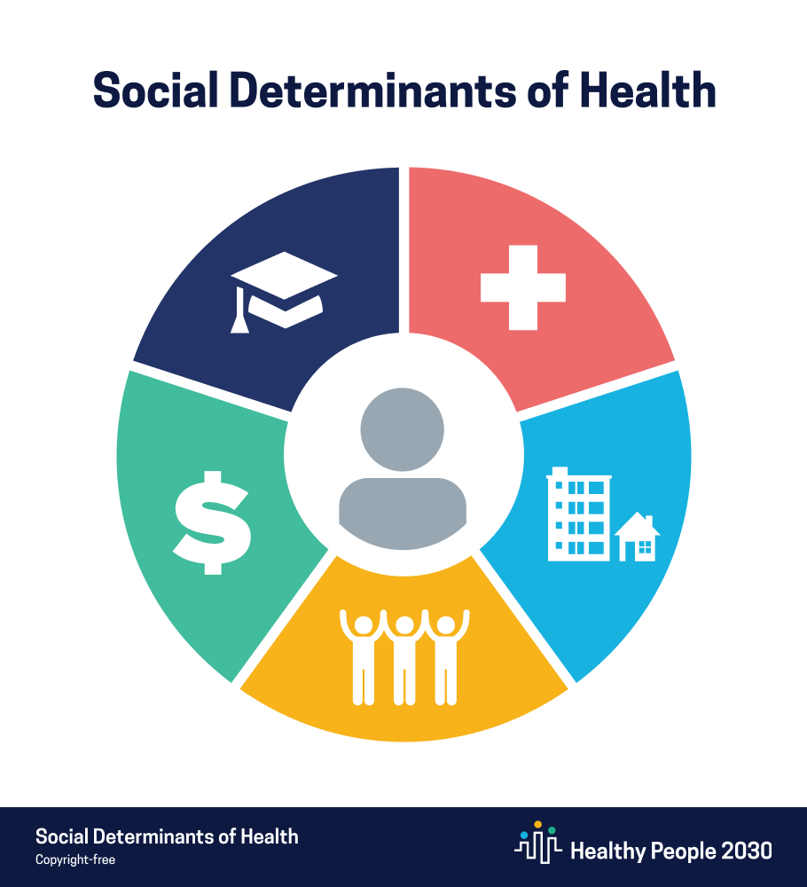
Education Access
and Quality
Healthcare Access
And Quality
Neighborhood and
Built Environment
Economic
Security
Social and Community Context
Notes:
SDOH = structural factors where people live, work, play and age. Root causes of underlying inequalities

Slide 17

Health-Related Social Needs
Limited health literacy
Lack of health insurance coverage, transportation to care
Financial insecurity,
unemployment,
food insecurity
Housing Instability
Lack of informal caregivers
Notes:
Inter-related. Having housing instability affects employment opportunities,

Slide 18
Financial Worries and Food insecurity
among Cancer Survivors Aged 40-64 years
Source: Zheng Z, Jemal A, Tucker-Seeley R, Banegas MP, Han X, Rai A, Zhao J, Yabroff KR. Worry About Daily Financial Needs and Food Insecurity Among Cancer Survivors in the United States.
Natl Compr Canc Netw. 2020 Mar;18(3):315-327.
Notes:
Worries about standard of living, monthly bills, housing costs; Food insecurity – worried about food running out, food not lasting or unable to afford balanced meals
Among survivors

Slide 19
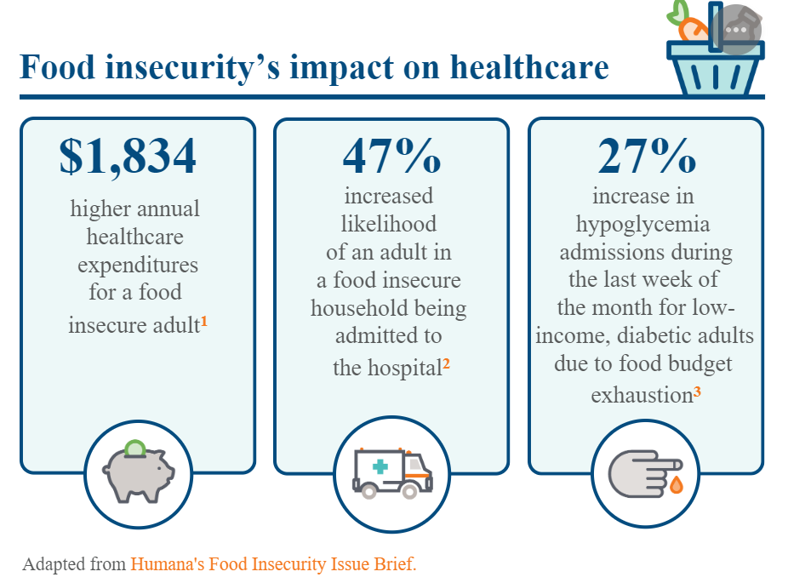
Among cancer survivors:
Increased ED visits
Lower use of preventive services
Increased mortality risk
Sources: The Commonwealth Fund https://www.commonwealthfund.org/publications/2020/jan/chronic-care-act-prompts-some-medicare-advantage-plans-incorporate-social
Zheng Z, Han X, Zhao J, Banegas MP, Tucker-Seeley R, Rai A, Fedewa SA, Song W, Jemal A, Yabroff KR. Financial Hardship, Healthcare Utilization, and Health Among U.S. Cancer Survivors.
Am J Prev Med. 2020 Jul;59(1):68-78. Zheng Z, Zhao J, Shi KS, Hu X, Han X, Banegas MP, Yabroff KR> Associations of cancer history, food insecurity, and nonmedical financial worry
and mortality risk in the US. J Clin Oncol 41, 2023 (suppl 16; abstr 6537)
Notes:
Worries and food insecurity

Slide 20
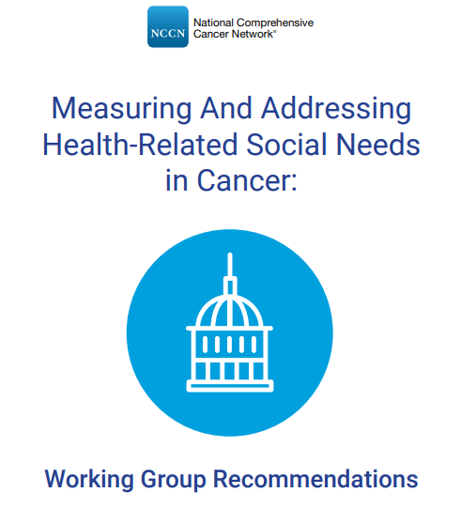
Core Measures for Assessment
and Intervention:
Transportation Access
Housing Security
Access to Healthy Food
Financial Security
Recommendations for integration
in high-quality care:
Practices and Health Systems
Policies
Professional Society Guidelines
SOURCE: https://www.nccn.org/docs/default-source/oncology-policy-program/HRSN-WG-Recommendations.pdf
Notes:
Recommendations for practices in assessment and intervention, including connection with community resourses, guidelines, state and federal policy1. Social support and caregiver support 2. Utility assistance 3. Work support, including employer accommodations and paid sick leave 4. Neighborhood and community safety 5. Health insurance needs 6. Health literacy and health insurance literacy 7. Digital connectivity

Slide 21
Factors at Multiple Levels Affect Equity in Cancer Care and Outcomes
National Health Policy Environment
State Health Policy Environment
Local Community Environment
Organization and/or
Practice Setting
Provider/Team
Employer
Patient and Family
Cancer Prevention, Screening, Treatment, Survivorship, End of Life Care
Notes:
Consideration of multiple levels in identifying and understanding research gaps and financial hardship and intervention opportunities
Add employer level because most health insurance coverage is employer-sponsored and employers can choose to offer or not and the generosity of coverage benefits. Employers can also offer paid sick leave, extended leave, and other workplace accommodations that might be helpful for cancer survivors.

Slide 22


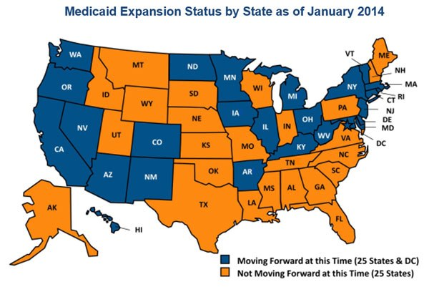
Affordable Care Act
Essential health benefit standards
Elimination of pre-existing condition exclusions
Elimination of life-time and annual coverage limits
2010
Dependent coverage expansion
Elimination of cost-sharing for preventive services
2014
Signed into law
Majority of provisions implemented
Creation of Centers for
Medicare & Medicaid Services
Innovation Center
Notes:
In thinking about state and federal policy, one of the biggest changes since the introduction of the Medicare and Medicaid programs is the passage of the Affordable Care Act. Many people are familiar with the growing body of evidence of the benefits of Medicaid expansion in reducing disparities, including those for cancer care.
identify ways to improve healthcare quality and reduce costs in the Medicare, Medicaid, and Children's Health Insurance Program (CHIP) programs.
In 2014, the majority of the ACA provisions were implemented, including the establishment of Marketplace for purchasing private health insurance, and expansion of Medicaid eligibility to everyone with family income up to 138% of Federal Poverty Level in states that opt in. In states that did not opt in, eligibility is as low as 17% of the federal poverty level for parents.

Slide 23
Expansion of Medicaid Income Eligibility and Cancer Care and Outcomes
Medicaid expansion associated with better
Access to care
Earlier stage cancer diagnosis
Improved survival following cancer diagnosis
Reduced disparities in care and outcomes
As of 2023, 10 states yet to expand Medicaid eligibility
Sources: Han X, Zhao J, Yabroff KR, Johnson CJ, Jemal A. Association Between Medicaid Expansion Under the Affordable
Care Act and Survival Among Newly Diagnosed Cancer Patients. J Natl Cancer Inst. 2022 May 18:djac077. Zhao J, Mao Z,
Fedewa SA, Nogueira L, Yabroff KR, Jemal A, Han X. The Affordable Care Act and access to care across the cancer control
continuum: A review at 10 years. CA Cancer J Clin. 2020 May;70(3):165-181.
Notes:
Large body of research comparing cancer care and outcomes in Medicaid expansion states to care and outcomes in non-expansion states

Slide 24
Medicaid Expansion Spillover Effects:
Reduction in Very Low Food Security
Source: Himmelstein G. Effect of the Affordable Care Act's Medicaid Expansions on Food Security, 2010-2016.Am J Public Health. 2019;
109(9):1243-1248.
Notes:
Research is increasingly showing spillover effects of Medicaid expansion. This graph is from a study that found greater reductions in food insecurity among populations with low-income living in Medicaid expansion states compared with non-expansion states..
Important introduction in thinking about how health insurance coverage can also help address social determinants of health.

Slide 25
Accountable Health
Communities Model
Launched in 2017
28 organizations participating
Connects Medicare and Medicaid beneficiaries with community services to address health-related social needs
Screening, referral and navigation services
Notes:
Accountable Health Communities Model

Slide 26

Medicare Managed Care Flexibilities
Creating High-Quality Results and Outcomes Necessary to Improve Chronic Care (CHRONIC) Act
Plans can offer nonmedical supplemental benefits to address health-related social needs:
• Meals
• Transportation
• Services Supporting Self-Direction (e.g., health literacy education)
• General Supports for Living (e.g., rent subsidies)
Notes:
reasonable expectation of improving or maintaining the health or overall function of 4 the chronically ill enrollee
subsidies for rent or assisted living communities. Plans may also include subsidies for utilities such as gas, electric, and water as part of the benefit.

Slide 27
Medicaid Authorities and Flexibilities
Health home models
Managed care
Section 1115 waivers
SOURCE: Kaiser Family Foundation. https://www.kff.org/medicaid/issue-brief/medicaid-authorities
-and-options-to-address-social-determinants-of-health-sdoh/
Notes:
In January 2021, CMS sent guidance for states on flexibilities related to Medicaid programs. Guidance for states, including waivers, Medicaid managed care flexibility to address a single issue (e.g., housing) or multiple social determinants of health
Currently more than 25 states have at least one program or intiative to address SDoH

Slide 28
35 States Reported Leveraging Medicaid Managed Care to Address Social Determinants of Health in 2020
SOURCE: Kaiser Family Foundation. https://www.kff.org/medicaid/issue-brief/medicaid-authorities
-and-options-to-address-social-determinants-of-health-sdoh/
Notes:
35 States are leveraging Medicaid Managed care to address social determinates of health, including screening for social needs, referrals, partnership, community health workers

Slide 29

Section 1115 waivers
Medicaid value-based
payments to cover
health-related
social needs:
Housing
Interpersonal violence
Food
Transportation
Notes:
States can obtain approval for Section 1115 demonstration waivers that test broad changes in Medicaid eligibility, benefits and cost-sharing, and payment and delivery systems as long as the Secretary determines that the demonstration is furthering the objectives of the Medicaid program. Example of Section 1115 Waiver: North Carolina

Slide 30
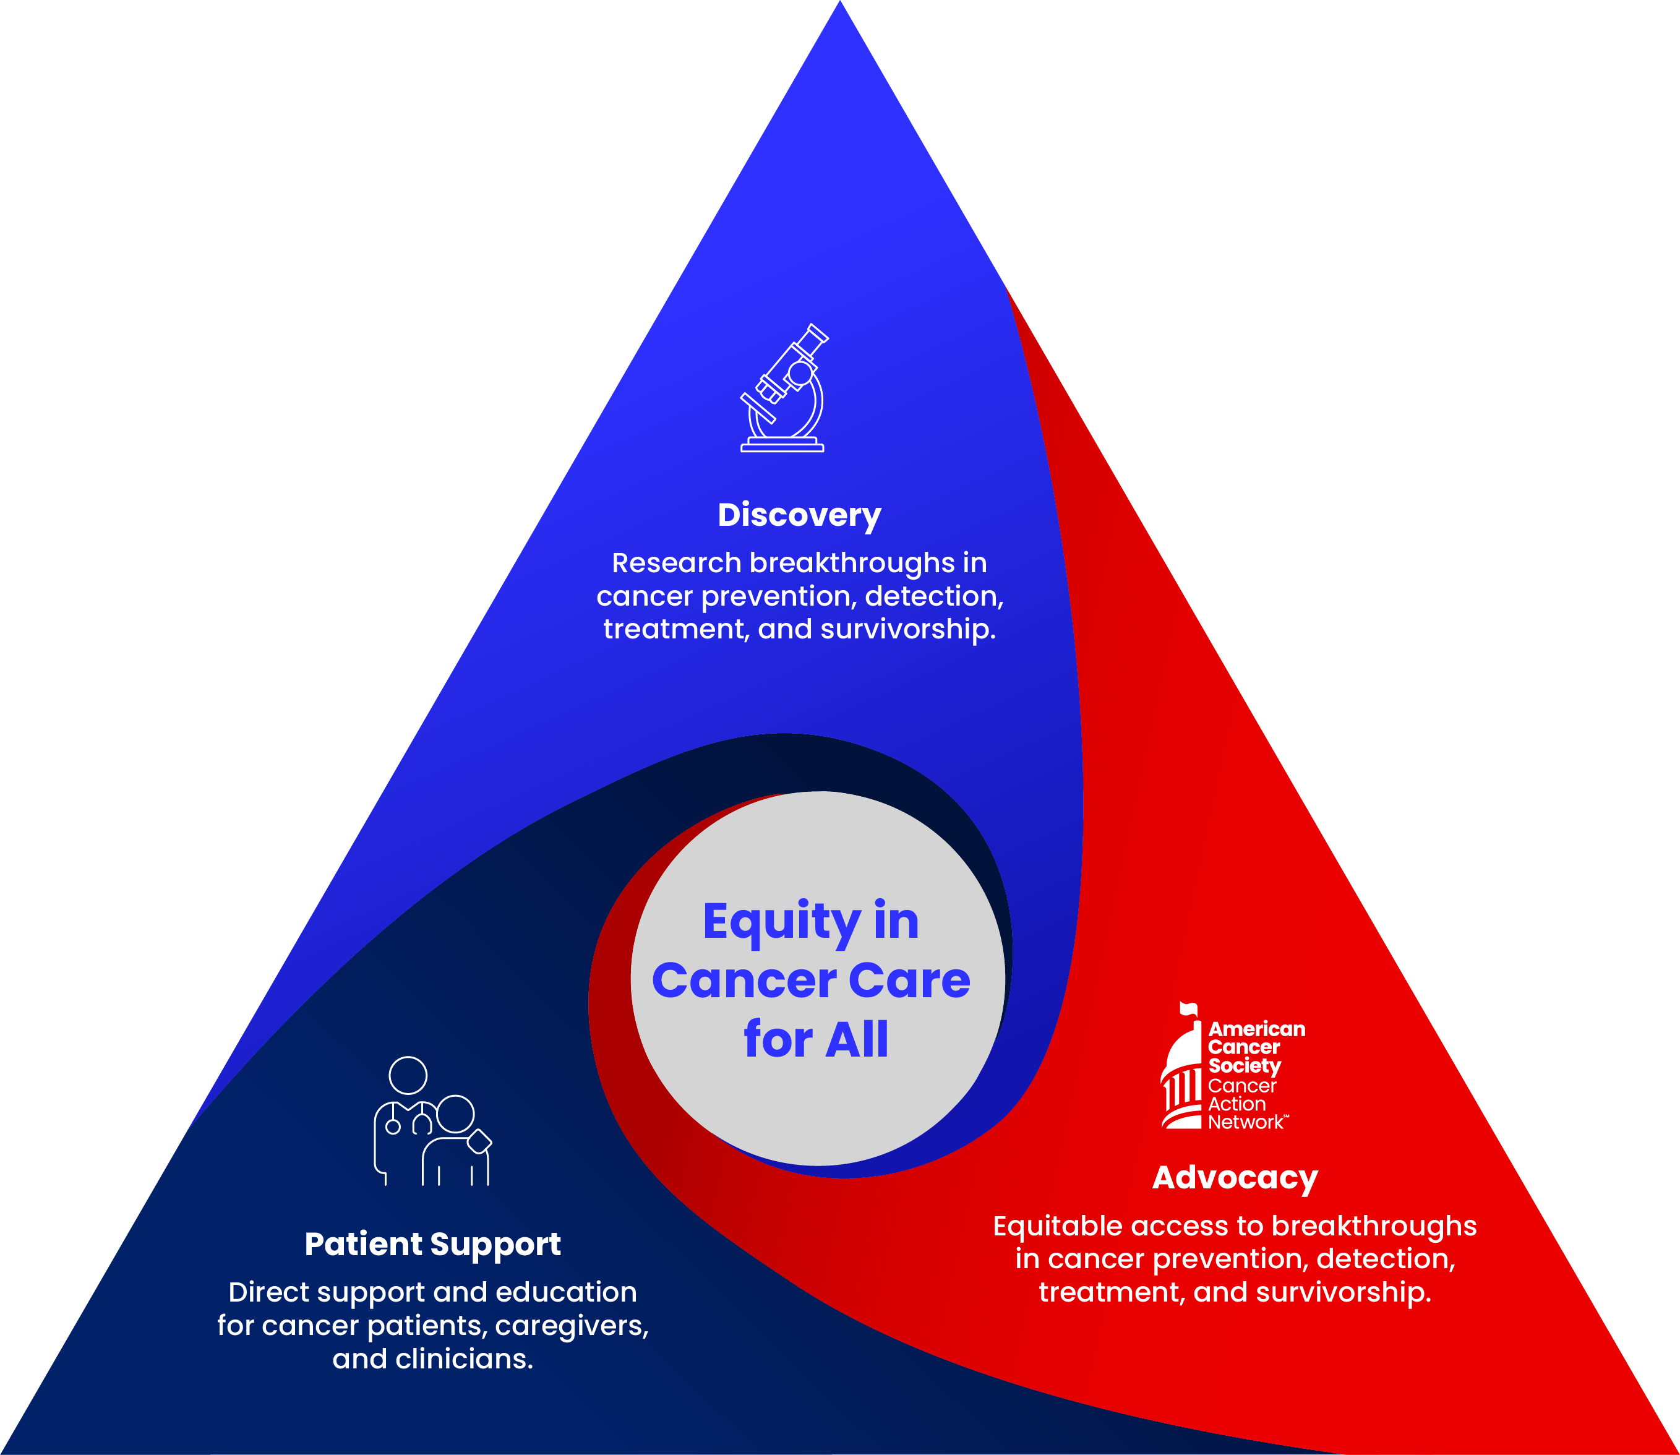
ACS Integrated Approach
Combating cancer through advocacy, research and patient support to impact 55 million lives annually
Discovery
$430M
Largest private, non-profit funder of cancer research in the US
in grants
Advocacy
50 states
Advocacy presence at every level of government
the District of Columbia,
Puerto Rico & Guam
Patient Support
Discovery
20,000+
Direct patient support in prevention, screening, lodging, transportation, navigation, survivorship, education
communities*
*Reflects zip codes touched by patient support programs & services within the U.S. and its territories

Slide 31
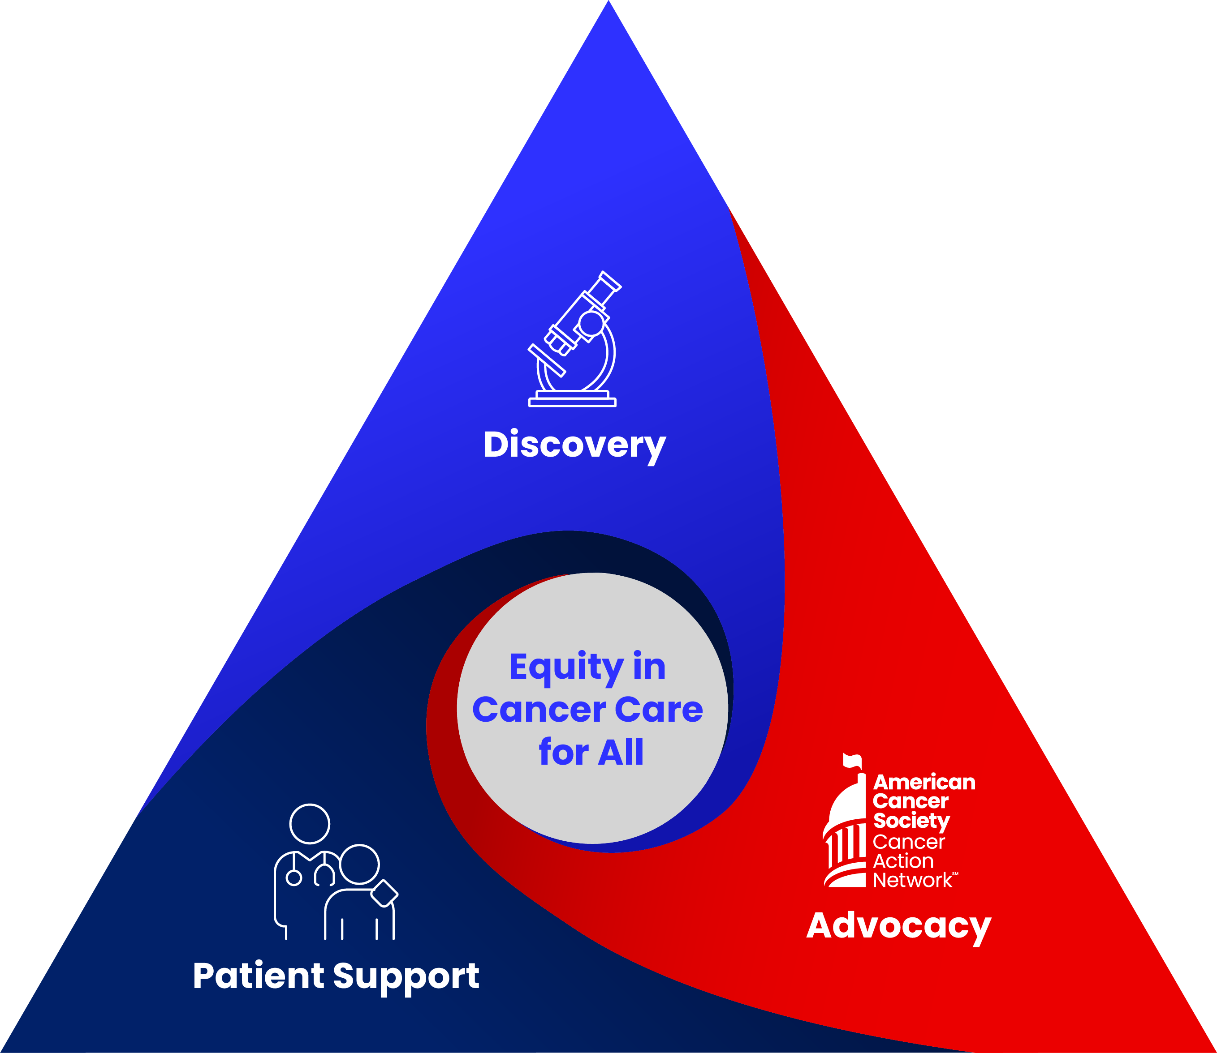
Addressing Health-Related Social Needs
Large portfolio of practice- and policy-relevant research addressing health insurance coverage and benefit design, housing insecurity, transportation barriers to care, food insecurity, and financial insecurity/hardship.
Discovery
Advocacy
Local, state, and federal efforts to improve access
to care and affordability
Patient Support
Resources including Hope Lodge, Ride to Recovery,
Patient, Provider, Caregiver education,
24/7 Call Center
https://www.cancer.org/

Slide 32
Reducing Inequities in Care Across the Cancer Control Continuum
Risk Assessment and Prevention
Screening and Detection
Diagnosis
Treatment
Survivorship
End-of-Life Care
Ensuring everyone has a fair and equitable opportunity
to prevent, detect, treat, and survive cancer
Notes:
Disparities in cancer survival and mortality are a direct result of disparities in reciept of risk assessment and prevention, screening and detection, diagnosis, treatment, survivorship and end of life care.
I am going to use this framework in the three illustrative examples I mentioned earlier.

Slide 33

Thank You!
©2023, American Cancer Society, Inc.

