Slide 1
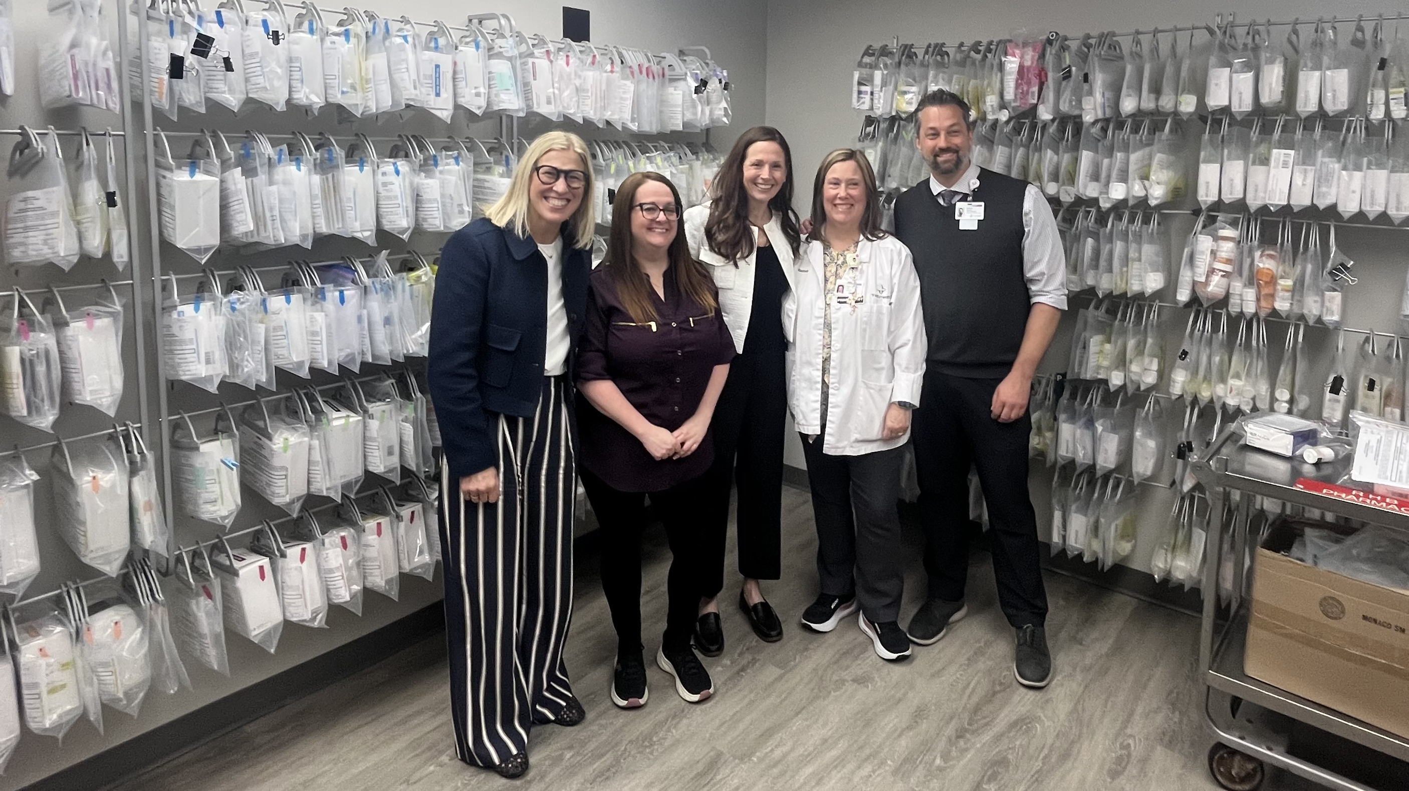

No Patient Should Have to Fight for Cancer Treatment

Slide 2


Long-Standing Problems in Cancer Care
3 out of 4 patients worry about paying for their cancer treatment
$3 billion in cancer medication is thrown away annually in the U.S.

Slide 3


Advances in Cancer Treatment

Slide 4
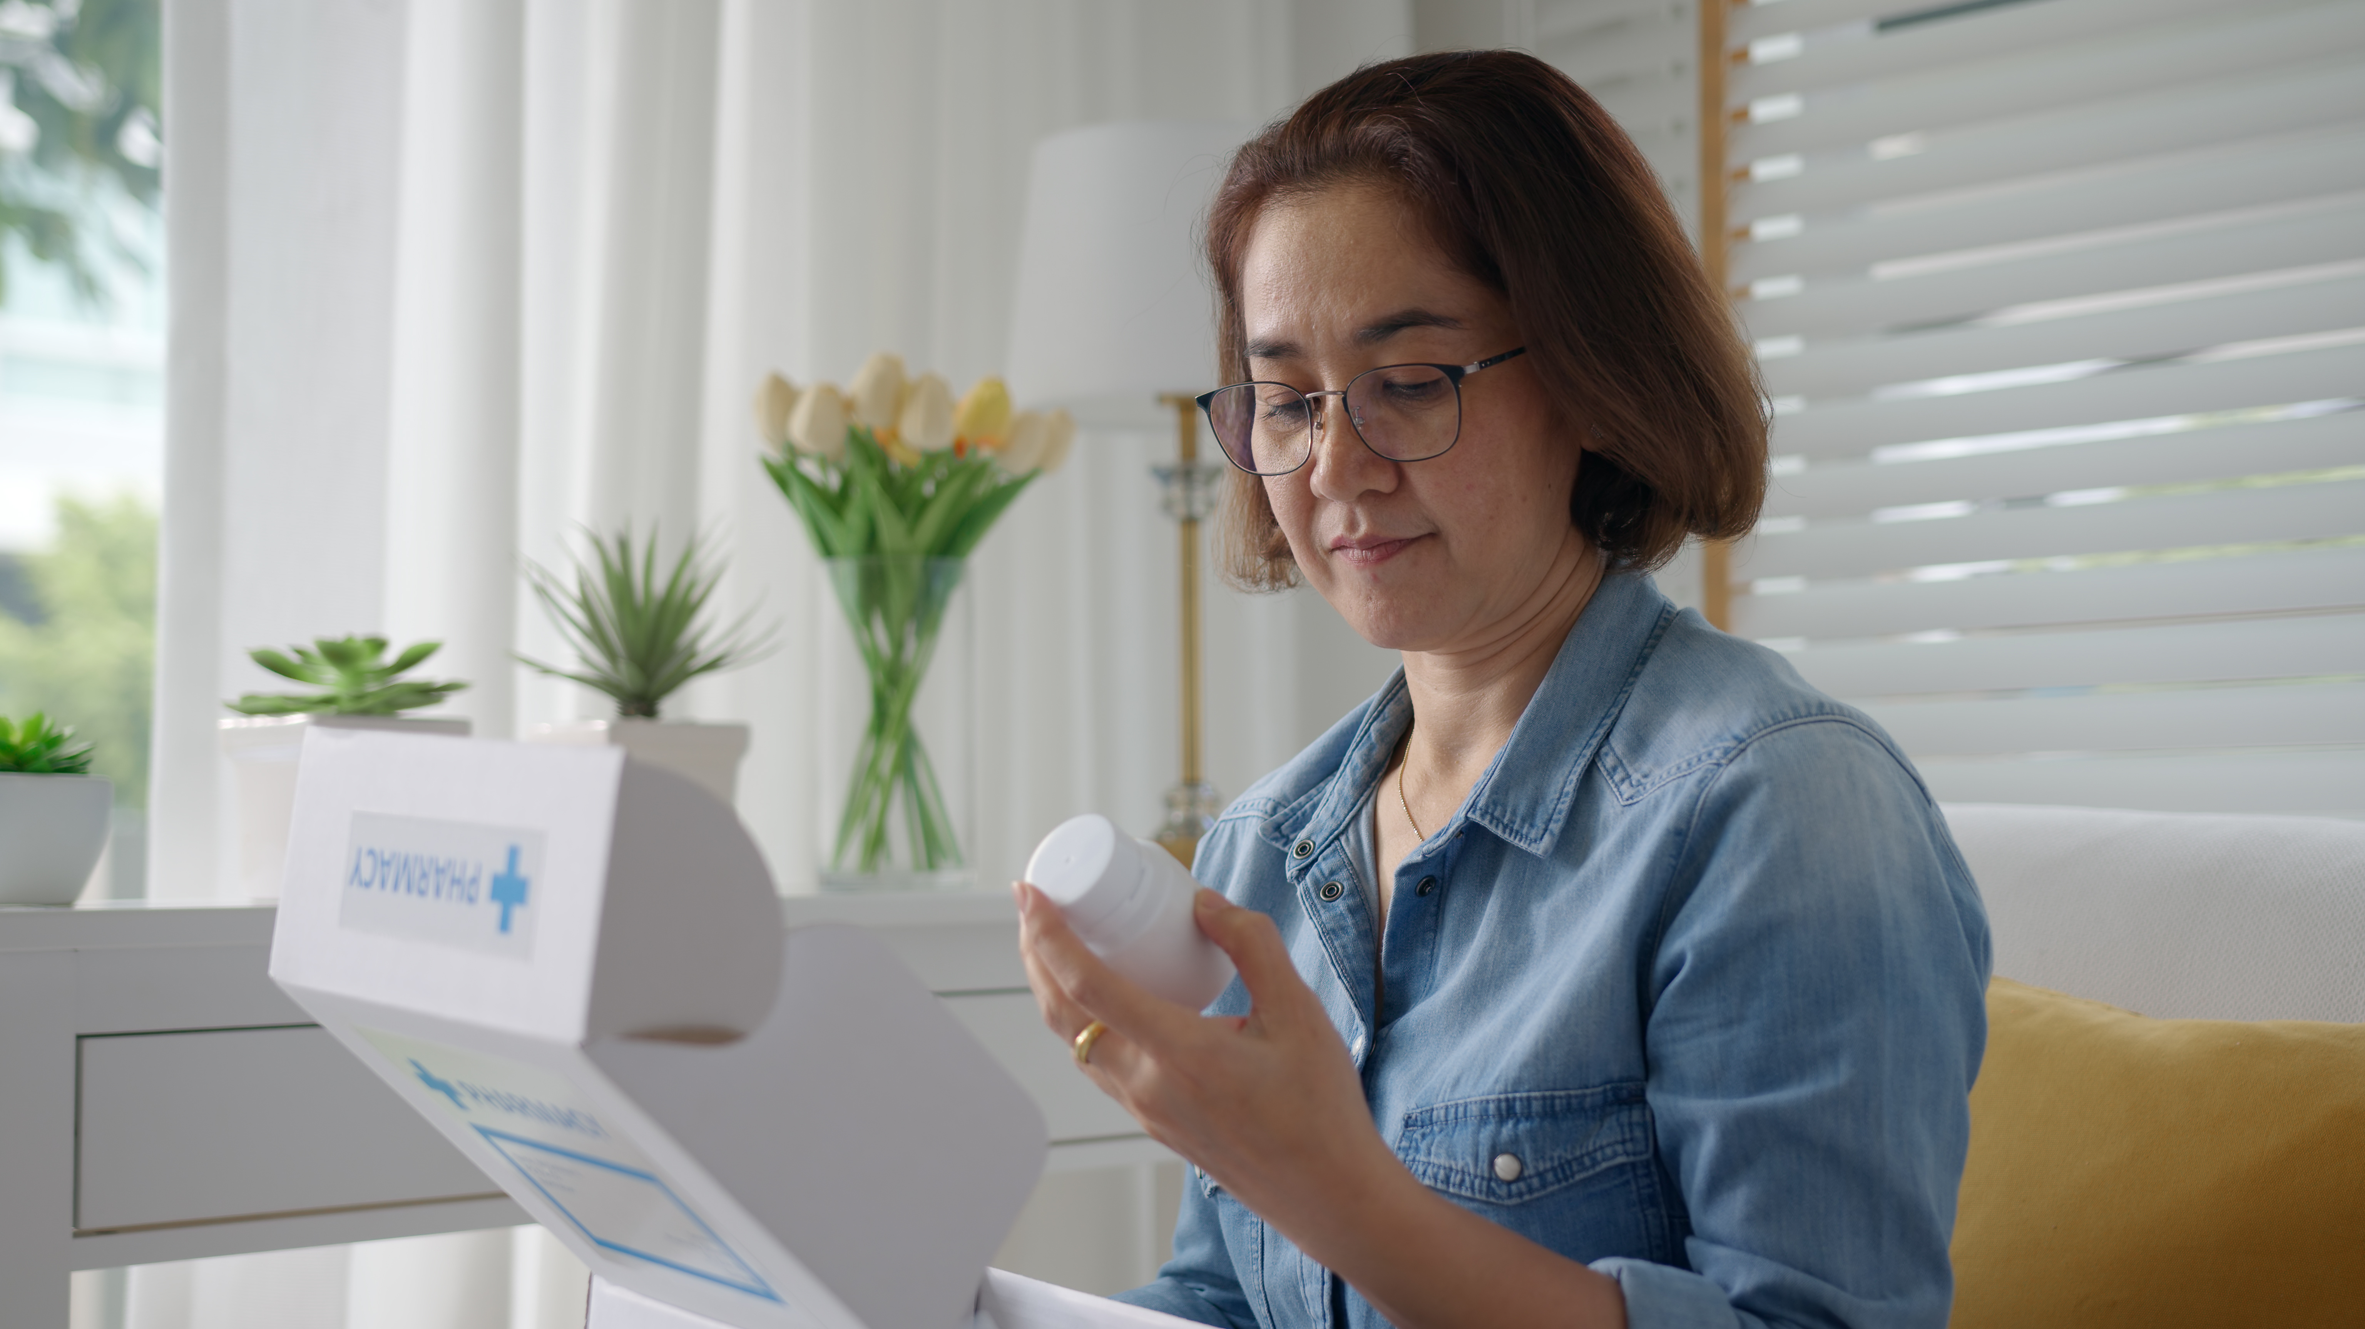
Life-Saving Medication Thrown Away
60 days worth of Ellen’s prescribed cancer medication ships to her home
After 7 days, the side effects cause her doctor to change her medication
$50,000 worth of life-saving treatment
is left unused in Ellen’s home

Slide 5
Repositories Address Waste and Access
Created to reduce cancer medication waste and improve access for vulnerable patients
2000
2026
State Governing Bodies
Board of Pharmacy
Health Department
Licensing and Regulatory Affairs
Legislation Created
Reaches People

Slide 6
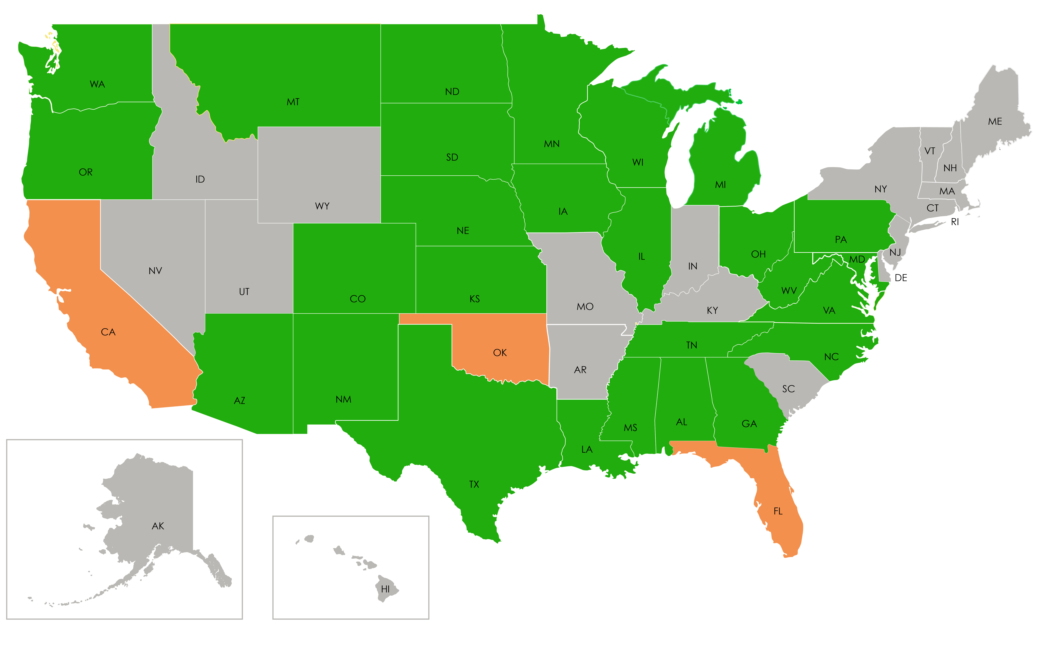
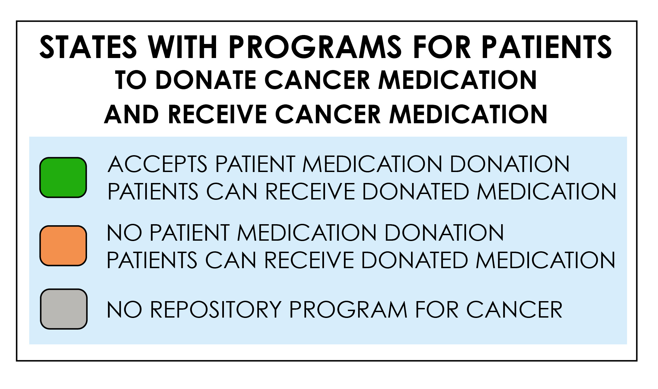
States with Repository Programs for Patients with Cancer

Slide 7
Each State’s Program Type Helps Reach More Patients
CLOSED PROGRAM | OPEN PROGRAM
Providers or institutions can donate unused cancer medication to repository | Individuals can donate unused cancer medication to repository
Limits Donations eliminates medication dispensed to patients | Increases Donations allows for medication taken at home
Reduces Inventory Availability fewer patients can be helped | Enables Inventory Growth able to help more vulnerable patients
Relies on Businesses to Donate Including long term care, pharmacies, clinics, manufacturers | Supports Motivated Donors who want to donate medication and support patients

Slide 8
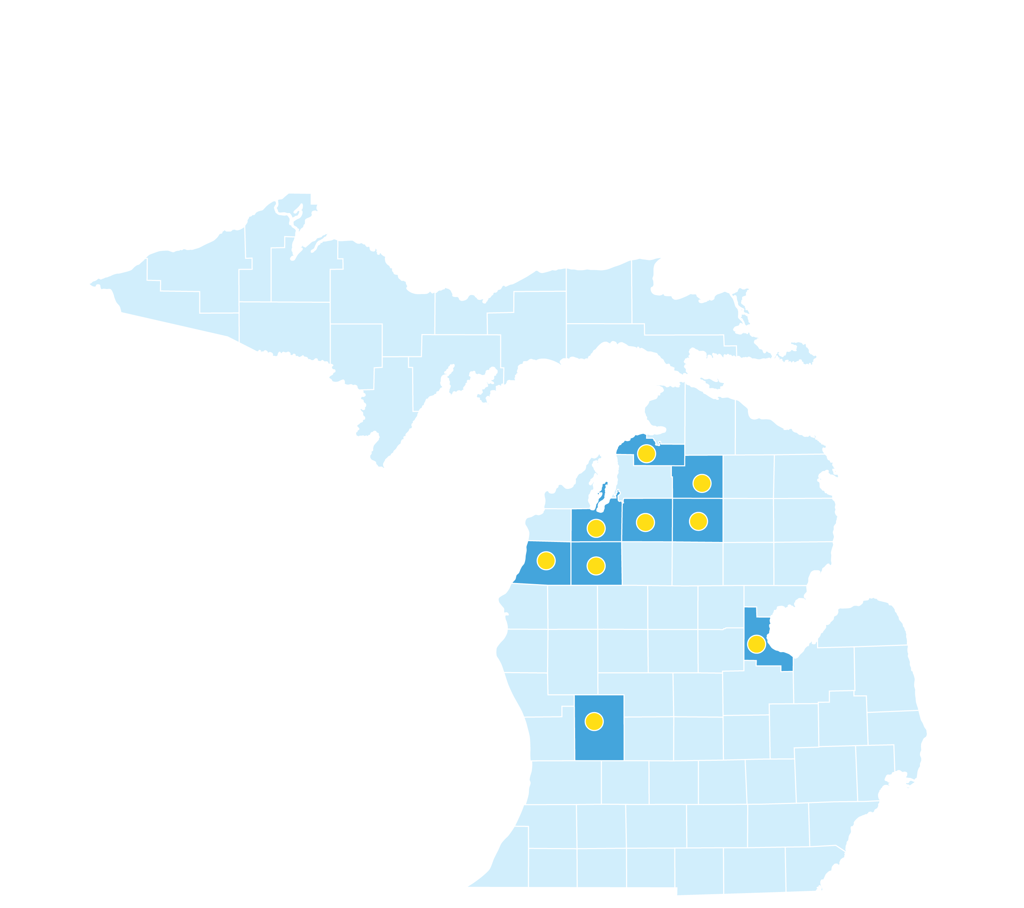

  Created the First of It’s Kind Statewide Network
Statewide Service Organization
Established June 2023
Free support for patients, providers, and communities
Easy ways to safely donate medication
Equitable access to medication inventory for patients in need
Member Site
County Served

Slide 9

  Built the Nation’s Largest Cancer Drug Repository
Interconnected network brings together over 150 sites across Michigan
Equitable access for rural and tribal clinics, community clinics, large health systems
Centralized repository pharmacy supports medication donation from over 10 states
Provider partnerships help put free medication in the hands of thousands annually
Member Site
County Served

Slide 10
  $53 Million in Cancer Medication Donated
Medication Donated
Medication Dispensed

Slide 11

  Delivering Treatment, Preventing Waste, and Protecting Lives
100,000s of Pills Prevented
from entering
land and waterways

Slide 12

  $37 Million in Cancer Medication Put In Patient’s Hands for Free

