Slide 1



Human-Centered Cancer Care in the AI Era
Ravi B. Parikh, MD, MPP
Ravi.bharat.parikh@emory.edu
@ravi_b_parikh

Slide 2
Disclosures
Consultancy/advisory role for: GNS Healthcare, Thyme Care, Main Street Health, and Onc.AI; personal fees from ConcertAI, Cancer Study Group, Mendel.ai, Optinosis, Biofourmis, Archetype Therapeutics, CreditSuisse, G1 Therapeutics, Humana, and Nanology.
Honoraria from: Georgia Society of Clinical Oncology (GASCO), Nebraska Oncology Society, Flatiron Health
Grant/Research funding from: National Institutes of Health, Department of Defense, Prostate Cancer Foundation, NCCN Foundation, Humana, Emerson Collective, Schmidt Futures, Arnold Ventures, Mendel.ai, and Veterans Health Administration
Employee of: Emory Healthcare, Veterans Health Administration
Other remuneration from: Journal of Clinical Oncology

Slide 3
A case: Mr. J
78 yo male, metastatic non-small cell lung cancer
Cancer is progressing on first-line systemic therapy
Major symptoms are fatigue, some bone pain
First visit after progression; his wife asks:
Doc, give it to us straight. How long does he have left?
Epic End of Life Index: 55% chance of mortality within 12 months
Notes:
Mr. J and his wife will travel with us through the talk. The EHR already has an answer to her question: a 55% chance of death within 12 months.

Slide 4
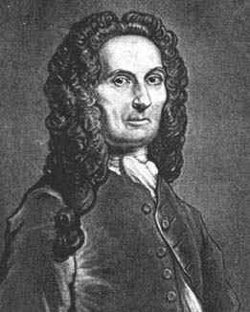
Abraham de Moivre
Born
  26 May 1667
Died
  27 November 1754
Notes:
https://mathshistory.st-andrews.ac.uk/Biographies/De_Moivre/#:~:text=De%20Moivre%2C%20like%20Cardan%2C%20is,He%20was%20right!

Slide 5
It is often related that De Moivre, always interested in number series, had foretold that each day he should need 15 minutes more sleep than on the preceding day, and that his death would occur when the total reached 24 hours.
He predicted his own death from data he tracked himself.
Notes:
De Moivre, a founder of probability theory, tracked his own sleep and used it to predict the date of his death. In effect, an early wearable: patient-generated data making a prediction. We return to him at the end.

Slide 6
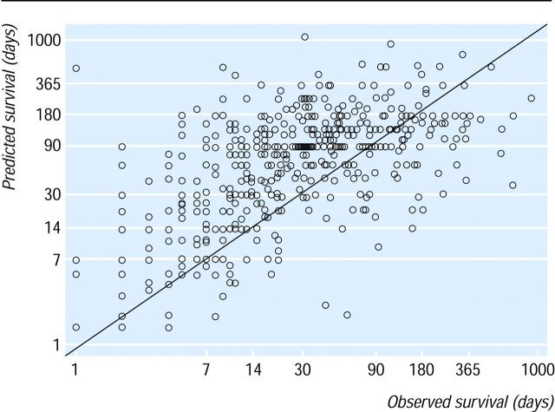
Prognoses are predictions, and predictions are hard
Correlation between predicted and actual survival:
0.28
Only ~30% of predictions were within half to double the actual survival
Christakis and Lamont, BMJ, 2003
Notes:
Cognitive biases lead to underestimated mortality risk
Optimism, avoidance, incentives, …
Design Prospective cohort study. Setting Five outpatient hospice programs in Chicago. Participants A total of 343 physicians provided survival estimates for 468 terminally ill patients at the time of hospice referral.
A key factor underlying these trends is the difficulty of accurately predicting the risk of serious adverse events when initiating chemotherapy.
[1] Side effects of chemotherapy are variable, and influenced by genetics as well as patient-specific comorbidities.
[2] In addition, cognitive biases on part of both physicians and patients lead to underestimated mortality risk. Patients may erroneously believe that their cancer is curable,^{19,20} and physicians are notoriously bad at estimating prognosis in patients with cancer^{23,24}. We also know that overly optimistic estimates can influence patients’ chemotherapy decisions.²⁶⁻³¹
[3] Currently, physicians use randomized trial data to estimate mortality for individual regimens, or online tools based on Surveillance, Epidemiology, and End Results (SEER) data to obtain mortality risk by age, sex, and primary cancer.^{17,35}
While informative, these sources provide estimates for broad populations of patients, and may not offer enough granularity to estimate an individual’s mortality risk.

Slide 7
Three stops, three lessons
STOP 1
STOP 2
STOP 3
In the clinic
At home
In the exam room and the record
Who needs a conversation now?
What happens between visits?
Whose words become the record?
LESSON 1
A prediction needs a response
Pair every prediction with a human action
LESSON 2
The patient's voice is signal and safeguard
Better prediction, fairer targets
LESSON 3
Keep the original
Anchor AI to patients' own words and data
Throughout: the patient's own voice makes AI better and safer
Notes:
The three lessons up front. We will follow Mr. J through three stops in his care, and each stop answers one question. Thesis: AI earns its place in cancer care when it prompts a human response, listens to patients, and keeps an honest record of who they are.

Slide 8
STOP 1 | IN THE CLINIC
Goal
Reality
100%
of patients with cancer
have a documented conversation about their goals, values, and priorities
< 10%
of patients with cancer
have a documented conversation about their goals, values, and priorities
Notes:
Stop 1: the clinic. Conversations about goals and wishes are the goal for every patient with serious cancer; fewer than 1 in 10 have one documented.

Slide 9
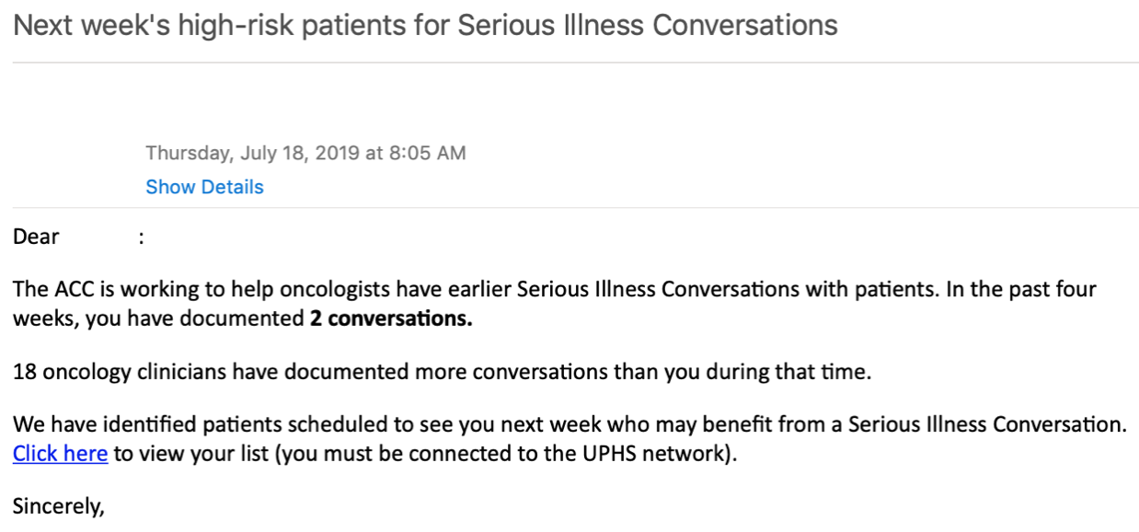
Conversation Connect: a prediction paired with nudges
An algorithm flags high-risk patients; nudges prompt the conversation
Peer Comparison
Performance Report
High-risk patient list
Pre-commitment
Default Text Message
Manz et al, JAMA Oncol, 2020
Notes:
Conversation Connect paired a machine learning mortality prediction with behavioral nudges to oncologists: a weekly list of high-risk patients, peer comparison, performance reports, pre-commitment, and default text-message reminders.

Slide 10
Conversation Connect: effects on end-of-life care
3.6% vs. 15.2%
conversations about goals and wishes, high-risk patients
Intervention
Roll-out Begins
All Practices Receive Intervention
10.4% vs. 7.5%
chemotherapy in the last 14 days of life
$13,747 lower
spending per decedent, last 6 months of life
Usual care vs. intervention
Manz et al, JAMA Oncol, 2020, 2023; Patel et al, NEJM AI, 2024
Notes:
Conversation rates rose as the intervention rolled out. Long-term: less chemotherapy near death and lower spending, driven by systemic therapy and outpatient care.

Slide 11
Larger gains where baseline rates were lowest
Documented conversations about goals and wishes, before vs. after the intervention
 | Before, % | After, % | Change, points
Non-Hispanic White | 3.9 | 14.2 | 10.3
Non-Hispanic Black | 3.6 | 16.9 | 13.3
Other* | 1.2 | 19.5 | 18.3
Larger increases among Black and other-race patients
Manz et al, JAMA Oncol, 2023
Notes:
Rates rose in every group; the largest absolute increases were among Black and other-race patients, who had the lowest baseline rates.

Slide 12
Default referrals in community oncology
Tennessee Oncology | 15 urban and rural clinics | algorithm-triggered, opt-out palliative care referral
Completed palliative care visit
Systemic therapy in last 14 days of life
43.9%
Default referral
8.3%
Usual care
6.5%
Default referral
16.1%
Usual care
Parikh et al, JAMA Netw Open, 2025
Notes:
Cluster randomized trial in a community oncology network. EHR defaults with opt-out increased completed palliative care visits and reduced systemic therapy near death, without new staff.

Slide 13
Clinicians are divided on disclosing predictions
“…we’d have an obligation to disclose it to patients. … Can the disclosure cause harm to the patient? Especially mental harm.”
(MD2, age 58, male, 26 years practicing, no exposure)
“…I wonder if that 75% chance of dying would dissuade me from offering therapy that might help people live longer.”
(MD9, age 36, male, 4 years practicing, no exposure)
[Add citation: clinician qualitative study]
Notes:
Clinicians disagree about whether and how algorithm predictions should reach patients, and worry that a number could change their own treatment recommendations.

Slide 14
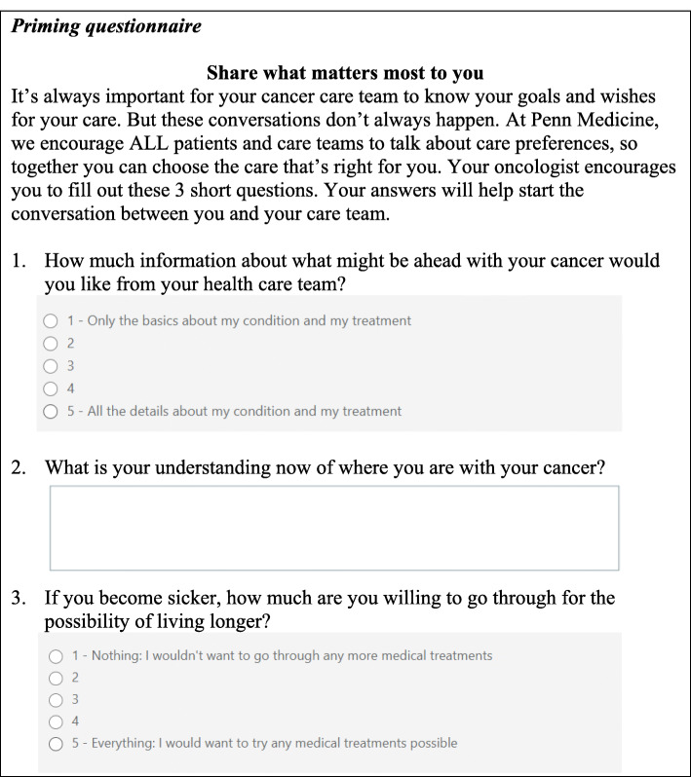
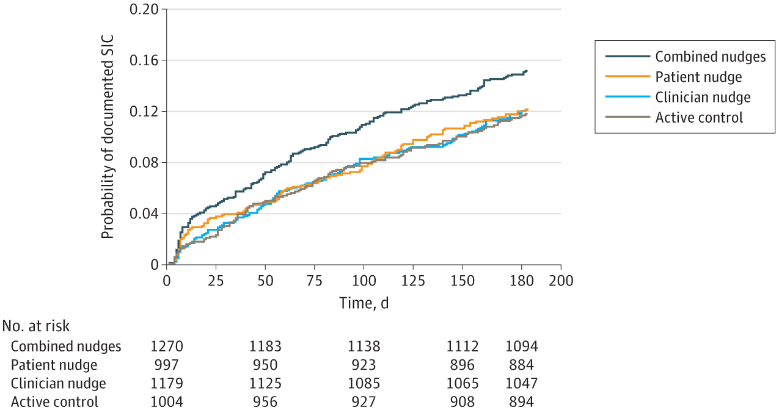
Lesson 1: A prediction needs a response
Clinician + patient nudges together: 14.1% vs. 11.2% with usual care
Neither nudge alone differed significantly from usual care
Takvorian et al, JAMA Netw Open, 2024
Notes:
Factorial trial of clinician and patient nudges. Only the combination increased conversations. In a separate vignette study, showing oncologists an ML survival estimate made them more accurate but did not change their recommendations. A prediction helps only when someone acts on it.

Slide 15
Stop 2: At home
STOP 1
STOP 2
STOP 3
In the clinic
At home
In the exam room and the record
Who needs a conversation now?
What happens between visits?
Whose words become the record?
LESSON 1
A prediction needs a response
Pair every prediction with a human action
LESSON 2
The patient's voice is signal and safeguard
Better prediction, fairer targets
LESSON 3
Keep the original
Anchor AI to patients' own words and data
Between visits, Mr. J walks less and hurts more. Neither appears in the chart.
Notes:
Stop 2. The algorithm in Stop 1 only knew what the chart knew.

Slide 16
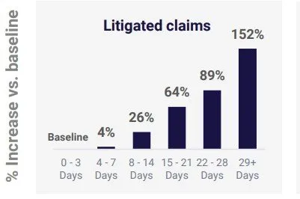
Should we only rely on prognostic models?
Mortality
Time from identification
Notes:
Bridge: the algorithm only knew what the chart knew. A mortality prediction also misses people who are suffering now, which leads to Stop 2.

Slide 17
Three ways the patient's voice protects predictions
Target
What we predict
Outcomes patients experience, not only what is documented
Input
What the model sees
Data that do not depend on a visit, a test order, or a clinician's description
Check
How we catch errors
An independent reference for biased or inaccurate records
Notes:
Patient-generated data do more than improve accuracy. They change what we predict, what the model sees, and give us an independent way to check the record.

Slide 18
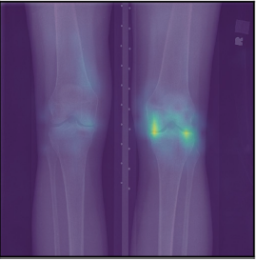
Target: predict what patients experience
Cancer: identifying patients who need supportive care
Knee pain
 | Predicting Mortality Alone | Predicting Mortality OR High Symptom Burden
% Patients Correctly Identified | 11.5% | 55.2%
% Black Patients Correctly Identified | 17.2% | 67.2%
11% → 22%
of Black patients eligible for knee surgery
An algorithm trained on patient-reported pain, rather than radiologist grades, would double eligibility
Pierson et al, Nat Med, 2021
Notes:
Two examples. Adding high symptom burden to the prediction target identified far more patients who need supportive care, especially Black patients. In knee osteoarthritis, training on patients' own pain reports reduced racial disparities that radiologist grades missed.

Slide 19
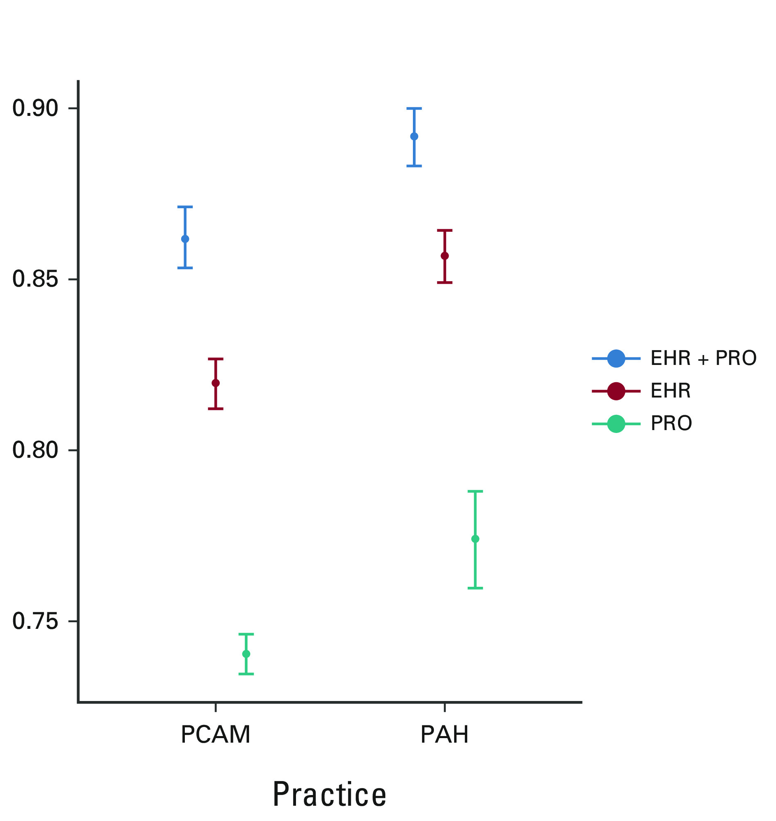
Input: patient reports add what the EHR misses
47.5%
of patients completed symptom surveys
Who is missing?
Prediction accuracy in an academic (PCAM) and a community (PAH) practice: EHR + patient reports (blue) highest in both
Parikh et al, JCO Clin Cancer Inform, 2022
Notes:
12,350 patients. Adding patient-reported symptoms to EHR data improved prediction of 6-month mortality in both academic and community practices. Fewer than half completed the surveys, so equitable collection matters.

Slide 20
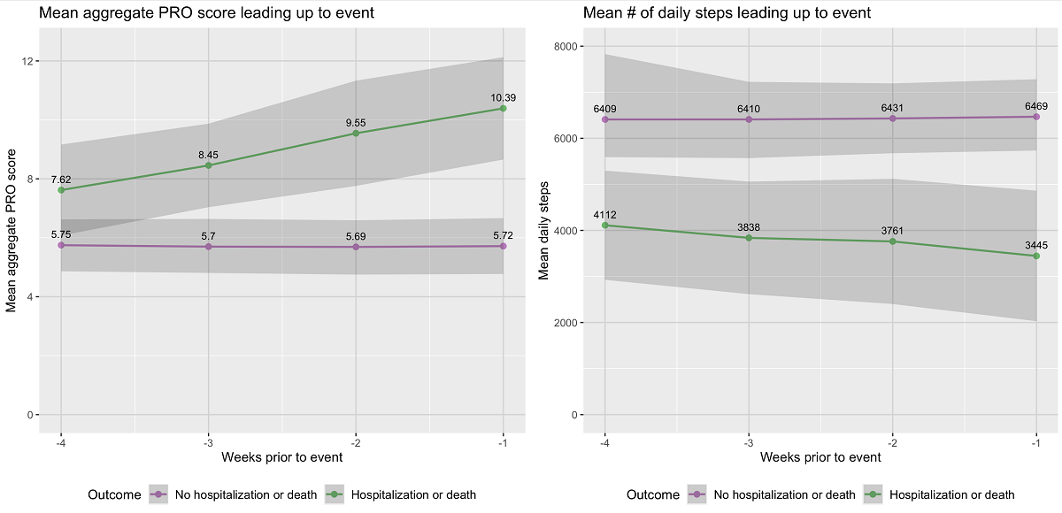
Input: step counts fall before hospitalization
−16%
average daily steps in the week before hospitalization or death
+16%
odds of hospitalization or death per 1,000-step decrease
PROStep: weekly symptom score (left) and daily steps (right) in the weeks before hospitalization or death
Manz et al, J Med Internet Res, 2024
Notes:
PROStep: weekly text-message symptom surveys and a wrist step counter. Symptom scores rose and steps fell in the weeks before hospitalization or death, information that is not in the chart between visits.

Slide 21
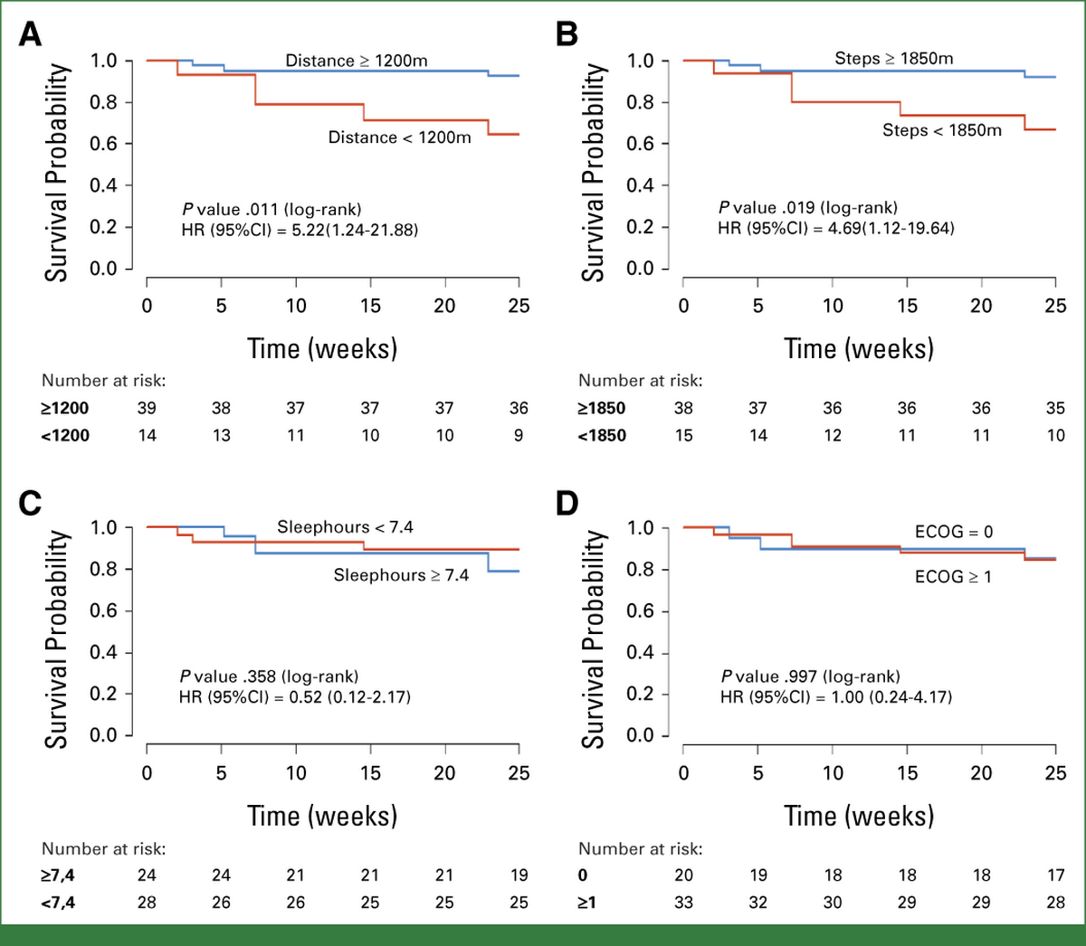
Performance status from the wrist
< 1,200 m
walked per day (about ¾ mile) = poor objective performance status
180-day mortality | Poor | Good
Derivation (Spain) | 82% | 38%
Validation (US) | 36% | 8%
Adjusted HR ≈ 7 in both cohorts
Performance status: a clinician's rating of how well a patient manages daily activities; used to judge fitness for treatment
Ruiz et al, JCO Oncol Pract, 2025
Notes:
ECOG is subjective and often inaccurate. A simple accelerometer threshold, derived in a phase 1 trial population in Spain and externally validated in PROStep, was strongly prognostic. Potential use: trial eligibility and treatment decisions.
Performance status is usually a subjective clinician rating. A simple step threshold, derived in Spain and validated in PROStep, separated survival sharply: about 7-fold higher risk of death.

Slide 22
Lesson 2: The patient's voice is signal and safeguard
Signal
Patient reports improved mortality prediction in academic and community practices
Step counts fell in the weeks before hospitalization or death
Safeguard
Adding symptom burden to the target identified 67% vs. 17% of Black patients needing support
Training on patient-reported pain reduced racial bias in knee pain assessment
Both depend on equitable collection: 47.5% of patients completed symptom surveys
Parikh et al, JCO Clin Cancer Inform, 2022; Manz et al, J Med Internet Res, 2024; Pierson et al, Nat Med, 2021
Notes:
Two roles for patient-generated data: a better signal for prediction, and a safeguard against bias in what we choose to predict. Lesson 1 still applies: in PROStep, a symptom dashboard alone did not change patients' sense of being understood. The data need a response.

Slide 23
Stop 3: In the exam room and the record
STOP 1
STOP 2
STOP 3
In the clinic
At home
In the exam room and the record
Who needs a conversation now?
What happens between visits?
Whose words become the record?
LESSON 1
A prediction needs a response
Pair every prediction with a human action
LESSON 2
The patient's voice is signal and safeguard
Better prediction, fairer targets
LESSON 3
Keep the original
Anchor AI to patients' own words and data
Mr. J's oncologist asks whether an AI scribe may document the visit.
Notes:
Stop 3. What happens when AI listens to the visit and writes the record?

Slide 24
Show of hands
Would you want your oncologist to use an AI scribe?
Yes
No
It depends
Notes:
Post-lunch energy reset, and a callback to enthusiasts vs. skeptics. Ask again at the end of this section.

Slide 25
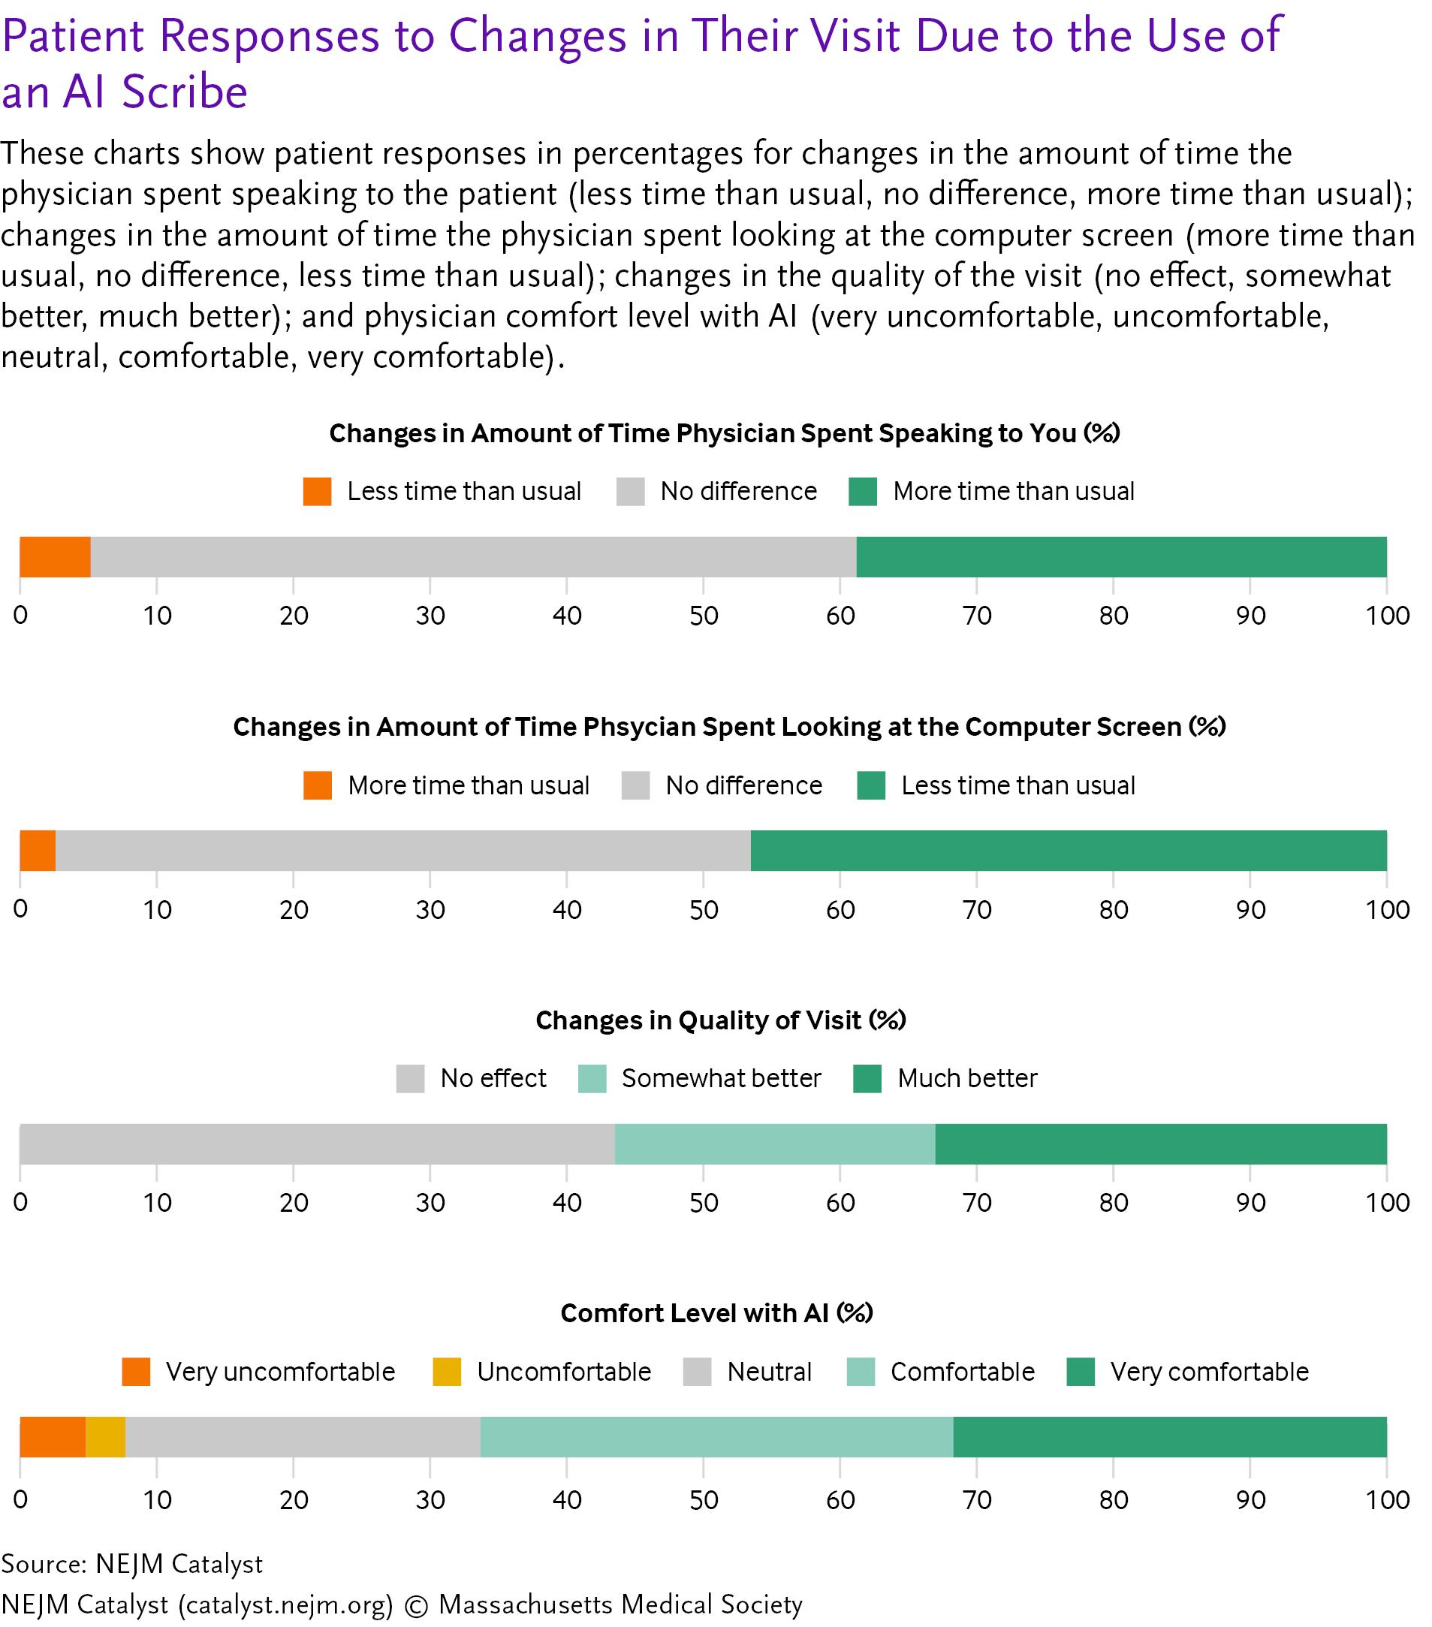
Ambient scribes: what patients and clinicians report
Patients (survey)
~1 in 2
said the physician looked at the screen less
~4 in 10
said the physician spent more time talking with them
<1 in 10
reported the opposite
Clinicians
3,442 adopted in 10 weeks; RCTs: lower burnout, up to ~10% less documentation time
Patient values approximated from published figure
Tierney et al, NEJM Catalyst, 2025; Lukac et al, NEJM AI, 2025; Afshar et al, NEJM AI, 2025
Notes:
Patients reported more attention and less screen time. Two randomized trials found reduced burnout and modest time savings; inaccuracies occurred occasionally. No trial has yet measured patient communication outcomes directly.

Slide 26
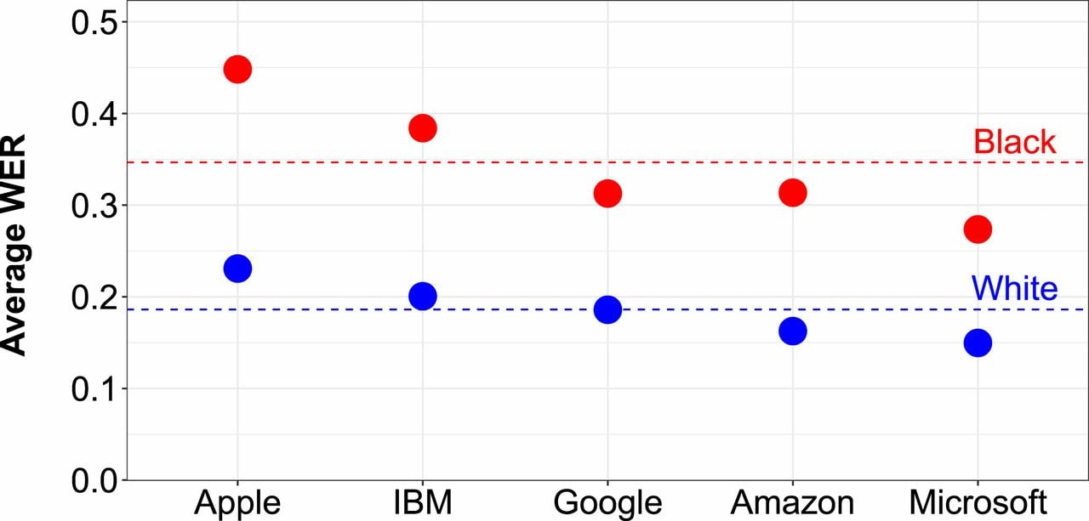
The scribe does not hear everyone equally
35%
Black speakers
19%
White speakers
Word error rate: share of words transcribed incorrectly, across 5 commercial systems
Koenecke et al, PNAS, 2020; Wolfe & Welsh, Cureus, 2026
Notes:
The scribe is only as good as what it hears. Speech recognition underlying ambient tools has nearly double the error rate for Black speakers, and interpreted visits are often excluded.
Speech recognition underlying ambient tools misrecognized about 1 in 3 words for Black speakers vs. 1 in 5 for White speakers, across all five vendors. Early scribe rollouts also tend to focus on English-language, non-interpreted visits.

Slide 27
The record is already biased
2.54×
odds of a negative descriptor (“noncompliant,” “resistant”) in notes about Black vs. White patients
How bias shows up in notes
Questioning patient credibility
Disapproving of reasoning or self-care
Portraying the patient as difficult
AI drafts can reproduce this language, and add occasional errors, in fluent text
Sun et al, Health Aff, 2022; Park et al, JAMA Netw Open, 2021
Notes:
Ambient AI drafts notes modeled on the notes we already write. Those notes carry stigmatizing language unevenly by race. A scribe can reproduce that language in polished prose, or flatten what the patient actually said.

Slide 28
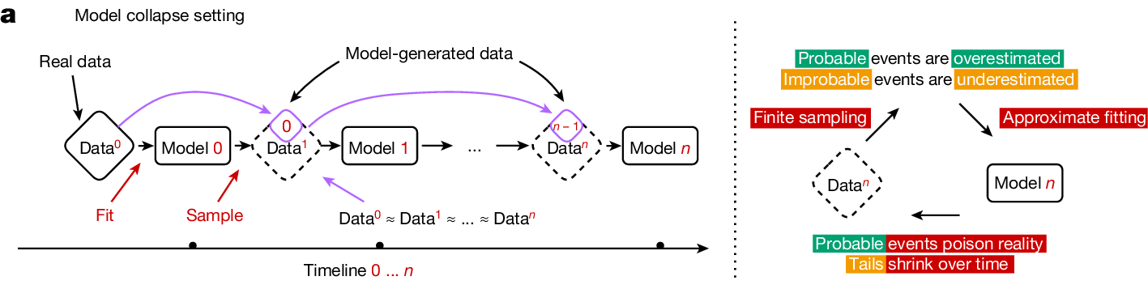
Model collapse: a photocopy of a photocopy
Model collapse: when AI is trained on content generated by other AI, rare and unusual cases are progressively lost
Shumailov et al, Nature, 2024
Notes:
When models are trained on model-generated data, the tails of the distribution disappear first. In medicine, the tails are patients with uncommon presentations or poorly documented care.

Slide 29
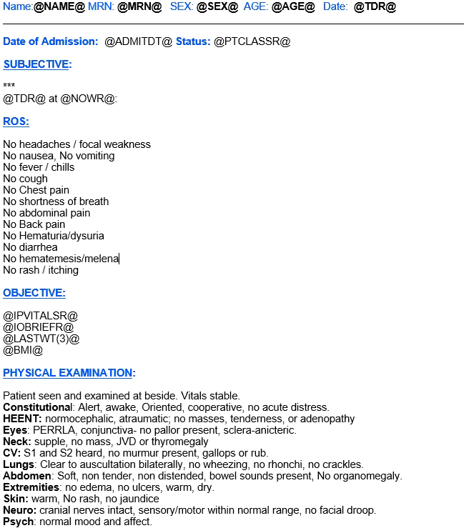
Electronic health records are a set-up for model collapse
Highly templated notes
Low information density
Routine use of biased and perjorative language (disheveled, noncompliant, complaining, etc.)
High use of copy/paste
Low prevalence of rare cases
McCoy et al, NEJM, 2024

Slide 30
Check: patient reports can flag errors in AI drafts
AI-drafted note
“Patient denies pain.”
Patient report, same morning
Pain: 7 / 10
Discrepancy flagged for clinician review before signing
Proposed safeguard; requires prospective evaluation
Notes:
A design idea, not yet tested: use structured patient reports as an independent check on AI-drafted notes. A testable research question for health systems and vendors.

Slide 31
Lesson 3: Keep the original
Conversation
Bias enters
Next model
AI-drafted note
EHR
Rare cases lost
Those most likely to be erased are those the record already disadvantages
Patient-reported and sensor data are original data, not copies
Shumailov et al, Nature, 2024
Notes:
This closes the loop back to Part 1. The algorithms we celebrated were trained on human-written notes. The next generation will be trained on AI-written notes. Bias enters at the scribe; tails disappear at retraining; and even good models drift once deployed.
Today's notes train tomorrow's models. Bias can enter at the scribe; rare cases are lost at retraining. As AI-generated text spreads, data from real patients become more valuable, not less.

Slide 32
Three stops, three lessons
STOP 1
STOP 2
STOP 3
In the clinic
At home
In the exam room and the record
Who needs a conversation now?
What happens between visits?
Whose words become the record?
LESSON 1
A prediction needs a response
Pair every prediction with a human action
LESSON 2
The patient's voice is signal and safeguard
Better prediction, fairer targets
LESSON 3
Keep the original
Anchor AI to patients' own words and data
Throughout: the patient's own voice makes AI better and safer
Notes:
Recap of the three lessons.

Slide 33
Hope in action: shared responsibilities
Clinicians & health systems
Pair each prediction with a defined response
Check AI drafts against patient reports
Patients & advocates
Ask how AI is used in your care
Expect informed consent before recording
Payers
Pay for outcomes, not AI use
Support collection of patient-reported data
Policymakers
Require labeling of AI-generated text
Require post-market monitoring (1.6% of FDA-cleared AI devices reported RCT data)
Next session: the same principles apply to AI in prior authorization
Parikh & Helmchen, NPJ Digit Med, 2022; Lin et al, JAMA Health Forum, 2025
Notes:
One ask for each stakeholder in the room. Hand off to the prior authorization session: AI is already on both sides of prior auth, and the same principles apply.

Slide 34

Mr. J, revisited
Clinic
A conversation about his goals took place
Home
A decline in steps and symptoms prompted a call
Exam room
His oncologist looked at him, not the screen
Record
His note reflected his own report
More of his remaining time went to what mattered to him and his wife
Notes:
Return to Mr. J and his wife's question. Each stop, done well, returns time to the people in the room.

Slide 35
Abraham de Moivre
Born
  26 May 1667
Died
  27 November 1754
Notes:
https://mathshistory.st-andrews.ac.uk/Biographies/De_Moivre/#:~:text=De%20Moivre%2C%20like%20Cardan%2C%20is,He%20was%20right!

Slide 36
He suffered partial loss of sight and hearing; his body required more rest and his mind, greater respite. Although he came to need twenty hours sleep, he spent the remaining three or four hours taking his only meal of the day and talking with his friends.
Even the man who predicted his own death spent his last hours talking with friends.
Notes:
Close the bookend. The prediction mattered less than how he spent the time he had left.

Slide 37
Thank you!
  Ravi.bharat.parikh@emory.edu
  www.haclab.org
  @ravi_b_parikh

Slide 38
Backup
Additional data for discussion

Slide 39
Conversation Connect
An algorithm flags patients at high risk of death within 6 months
Oncologists receive the list, peer comparisons, and reminders
Goal: earlier conversations about goals and wishes
Manz et al, JAMA Oncol, 2020
Notes:
Conversation Connect paired a machine learning mortality prediction with behavioral nudges to oncologists: a weekly list of high-risk patients, peer comparison, and default reminders.

Slide 40
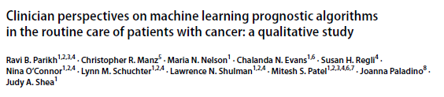
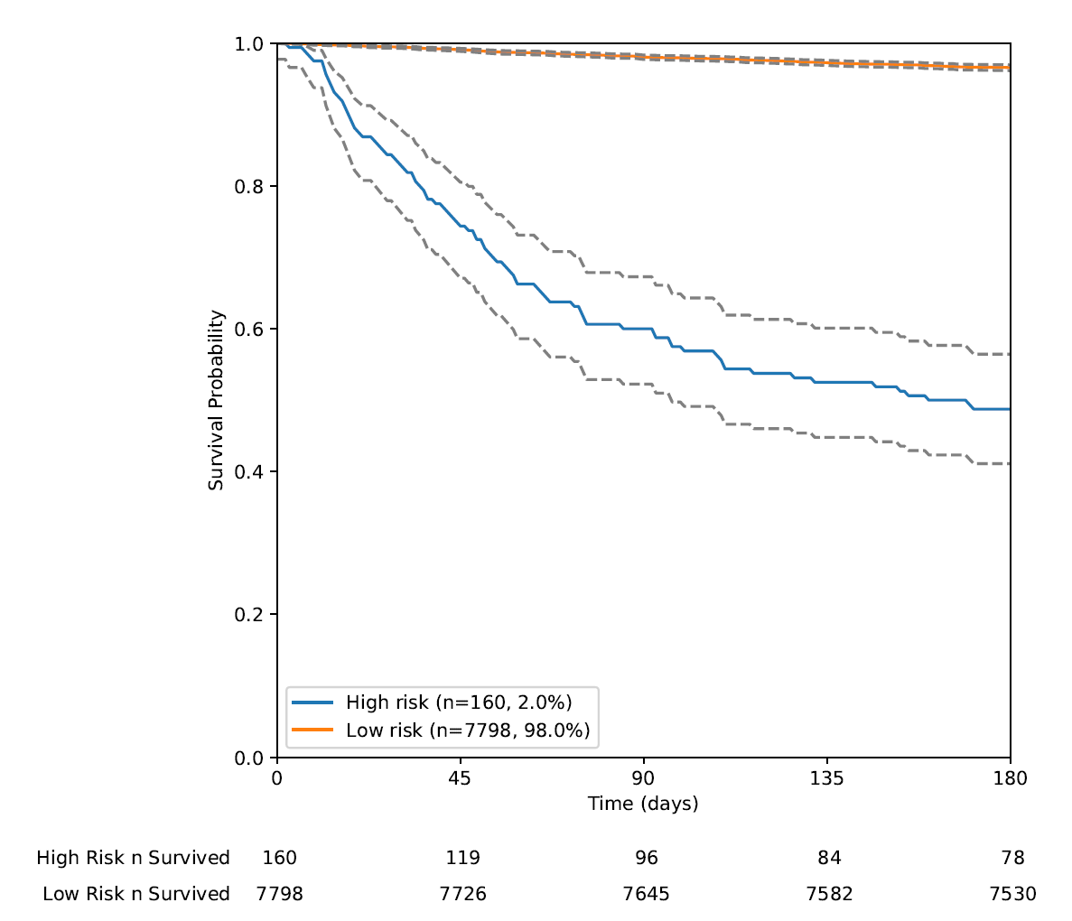
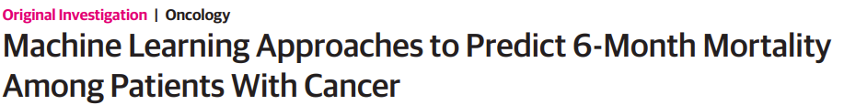

Algorithm development and validation
Variables | Examples | Features
Demographics | Age, Gender
Comorbidities | 33 Elixhauser comorbidities | Total count Recent*
Cancer-specific | Stage, tumor markers | Total count First/last value Min/Max Proportion ordered STAT
Laboratories | CMP, CBC, LDH
Recent utilization | Outpatient visit number

Slide 41
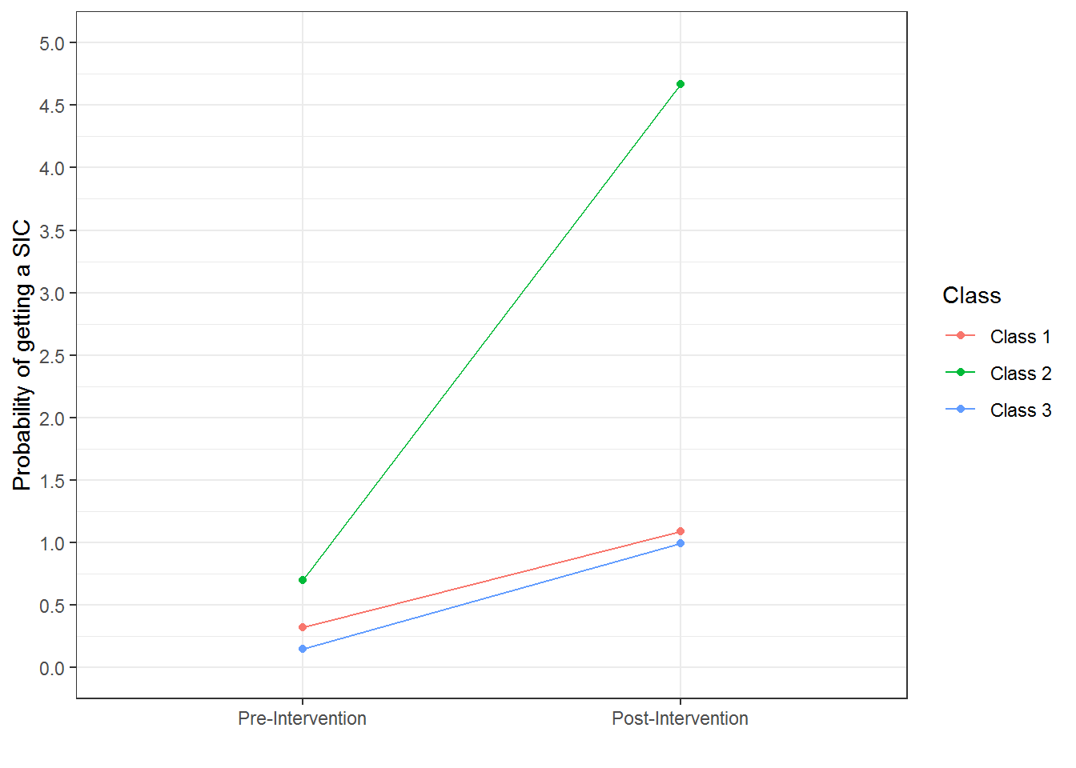
Clinicians don’t respond to AI in the same way
Lower-volume oncologists are more likely to respond to a machine learning nudge
Phenotyping clinicians can help refine AI interventions
High-volume specialists
High-bandwidth specialists
High-volume generalists
@ravi_b_parikh
Li et al, PLOS One, 2022

Slide 42
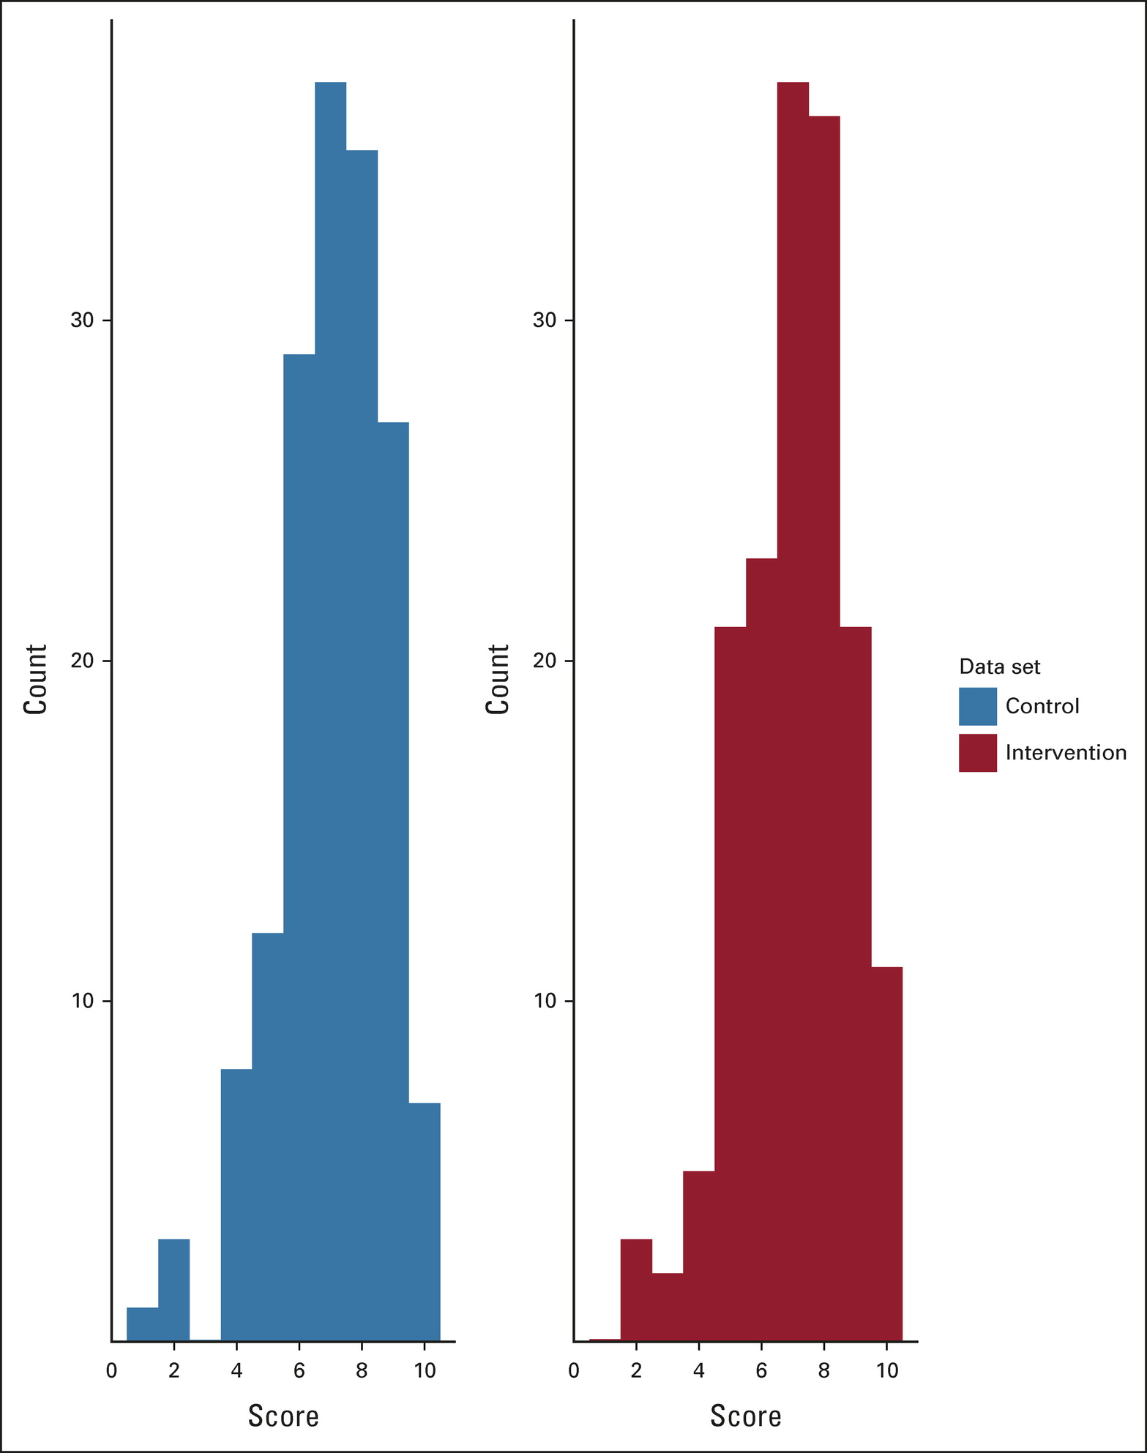
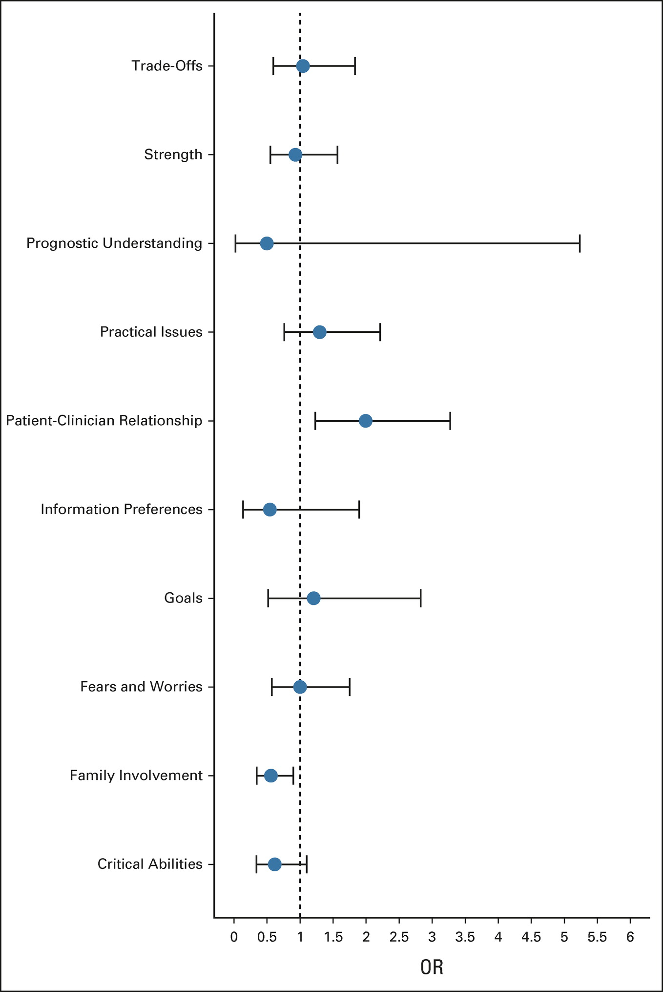
Nudges did not impact quality of conversations

Slide 43
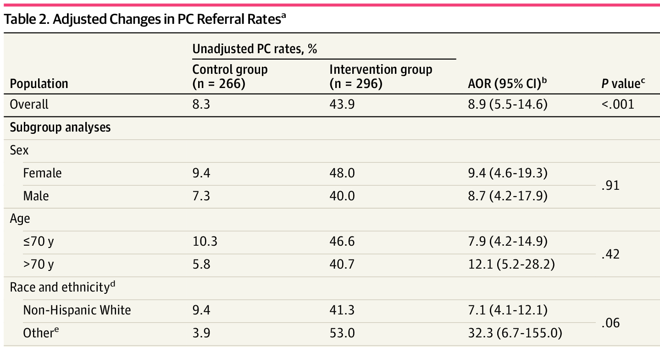
Do we need clinicians in the loop?
Parikh et al, JAMA NO, 2025

Slide 44
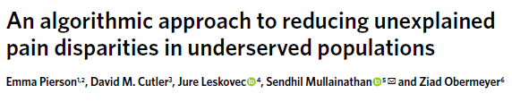
Bias Mitigation in Pain Assessment
Using AI based on patient-reported pain rather than clinical or radiologist criteria would double the percentage of Black individuals who qualify for knee surgery (11% → 22%)
Pierson et al, Nat Med, 2021

Slide 45
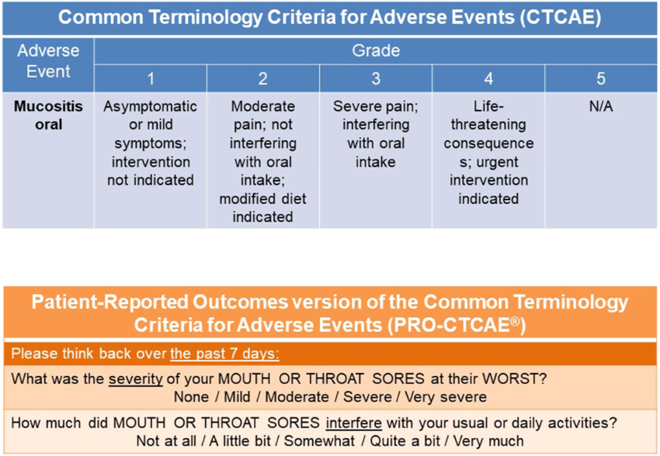
What if we used the right outcomes?
 | Predicting Mortality Alone | Predicting Mortality OR High Symptom Burden
% Patients Correctly Identified | 11.5% | 55.2%
% Black Patients Correctly Identified | 17.2% | 67.2%

Slide 46
PROs add what the EHR misses
Parikh et al, JCO Clin Cancer Inform, 2022

Slide 47
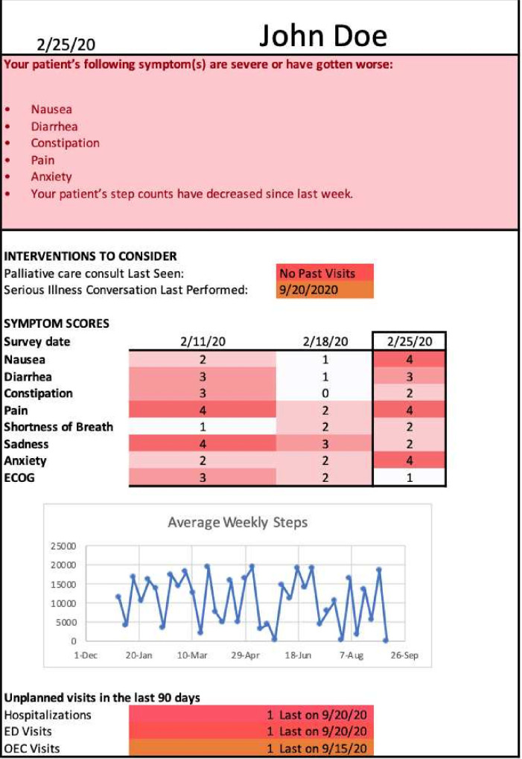
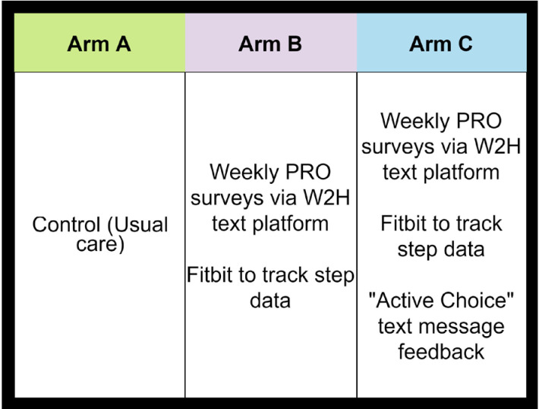
PROStep: Capturing symptoms and steps between visits
Parikh et al, BMJ Open, 2022
Notes:
PROStep paired patient-reported symptoms with passive step counts and put both in front of the oncology team before each visit. One arm also nudged patients to bring up worsening symptoms.

Slide 48
Steps are a vital sign
−16%
daily steps in the week before hospitalization or death
+16%
odds of hospitalization or death per 1,000-step drop
+20%
Odds of hospitalization/death per 1-point rise in weekly symptom score
Manz et al, J Med Internet Res, 2024
Notes:
Secondary analysis of PROStep. Step counts drifted down for weeks before a hospitalization or death, and symptoms (pain, low activity, dyspnea, sadness) were independently associated with these events. Wearables can see trouble coming before the next visit.

Slide 49
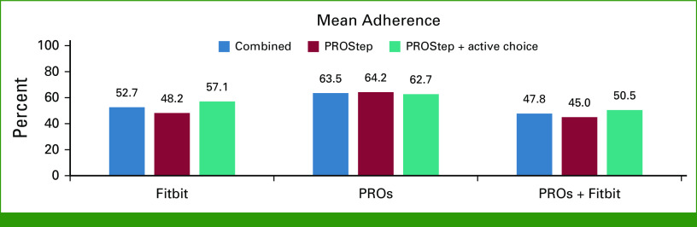
Data alone isn't communication
4.5 vs 4.5
patient-rated team understanding of symptoms (1–5 scale)
Patient-generated data must trigger action, not just fill a dashboard
Parikh et al, JCO Oncol Pract, 2023
Notes:
Honest null. PROStep did not change patients' perception of how well their team understood their symptoms; ratings were already high in both arms (ceiling effect). Patients found it low-burden, but adherence waned. The lesson mirrors Part 1: data needs a workflow attached.

Slide 50
Next: wearables inside the care pathway
PACE-70
Guardrails
Device and broadband access
Patient burden
Data ownership and privacy
Who pays for monitoring?
Adults ≥70 starting palliative-intent therapy | 3 community practices
Geriatric assessment in the EHR
Automated alert + guideline-based actions
Fitbit steps + CT body composition
Predict toxicity, falls, hospitalization
Aleixo et al, J Geriatr Oncol, 2026
Notes:
Where this is going: patient-generated data embedded in a care pathway with automatic, guideline-based actions, in community practices. Guardrails matter for payers and policymakers: access, burden, data ownership, and who pays for monitoring.

Slide 51

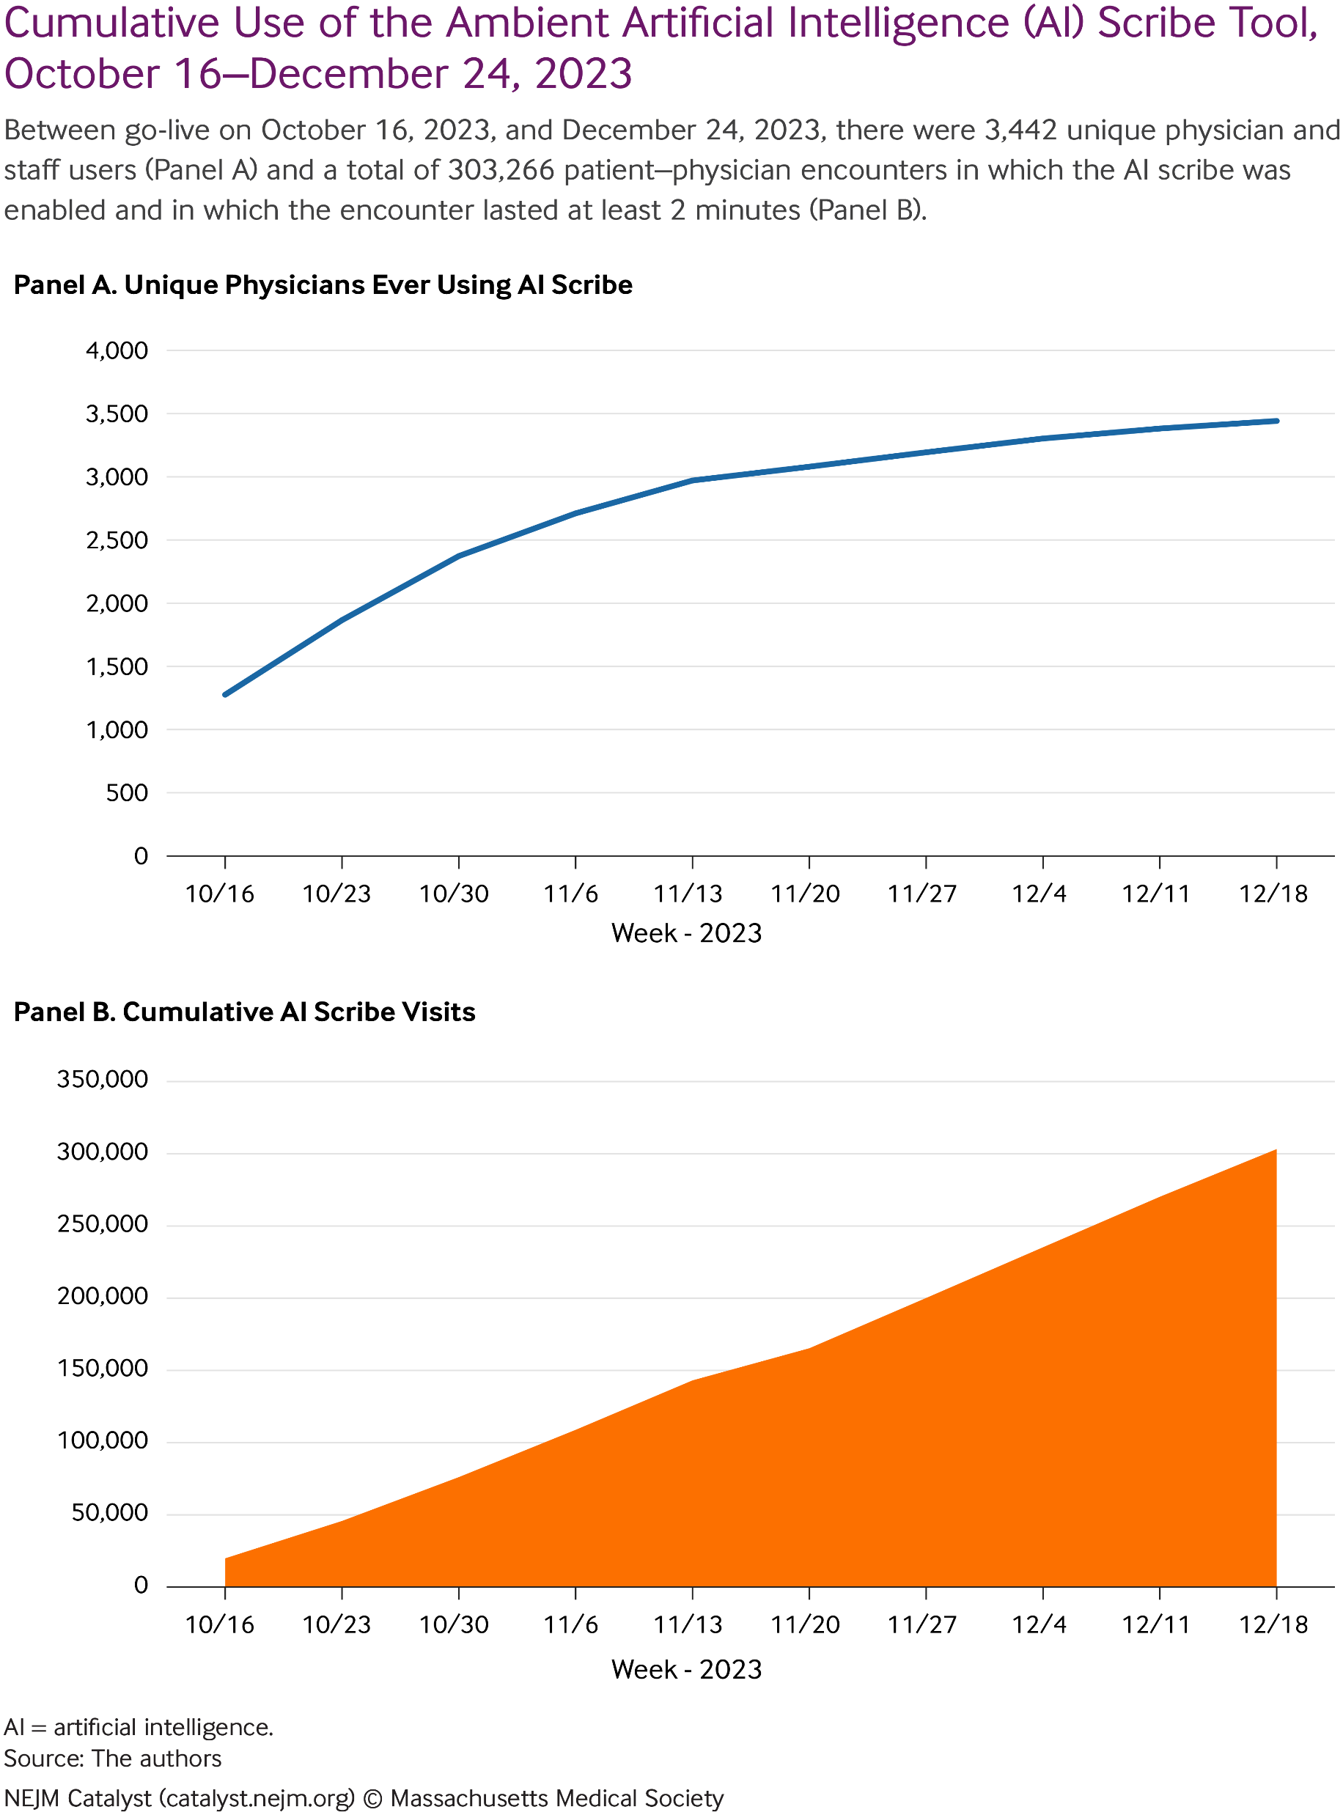
AMBIENT AI SCRIBING
Permanente Medical Group, Oct to Dec 2023
3,442
unique physician users in 10 weeks
303,266
patient encounters using AI scribe
Trust + low-stakes use case = rapid clinical adoption
Tierney et al, NEJM Catalyst, 2025
WINSHIP CANCER INSTITUTE OF EMORY UNIVERSITY
@ravi_b_parikh
NCI Designated Comprehensive Cancer Center

Slide 52
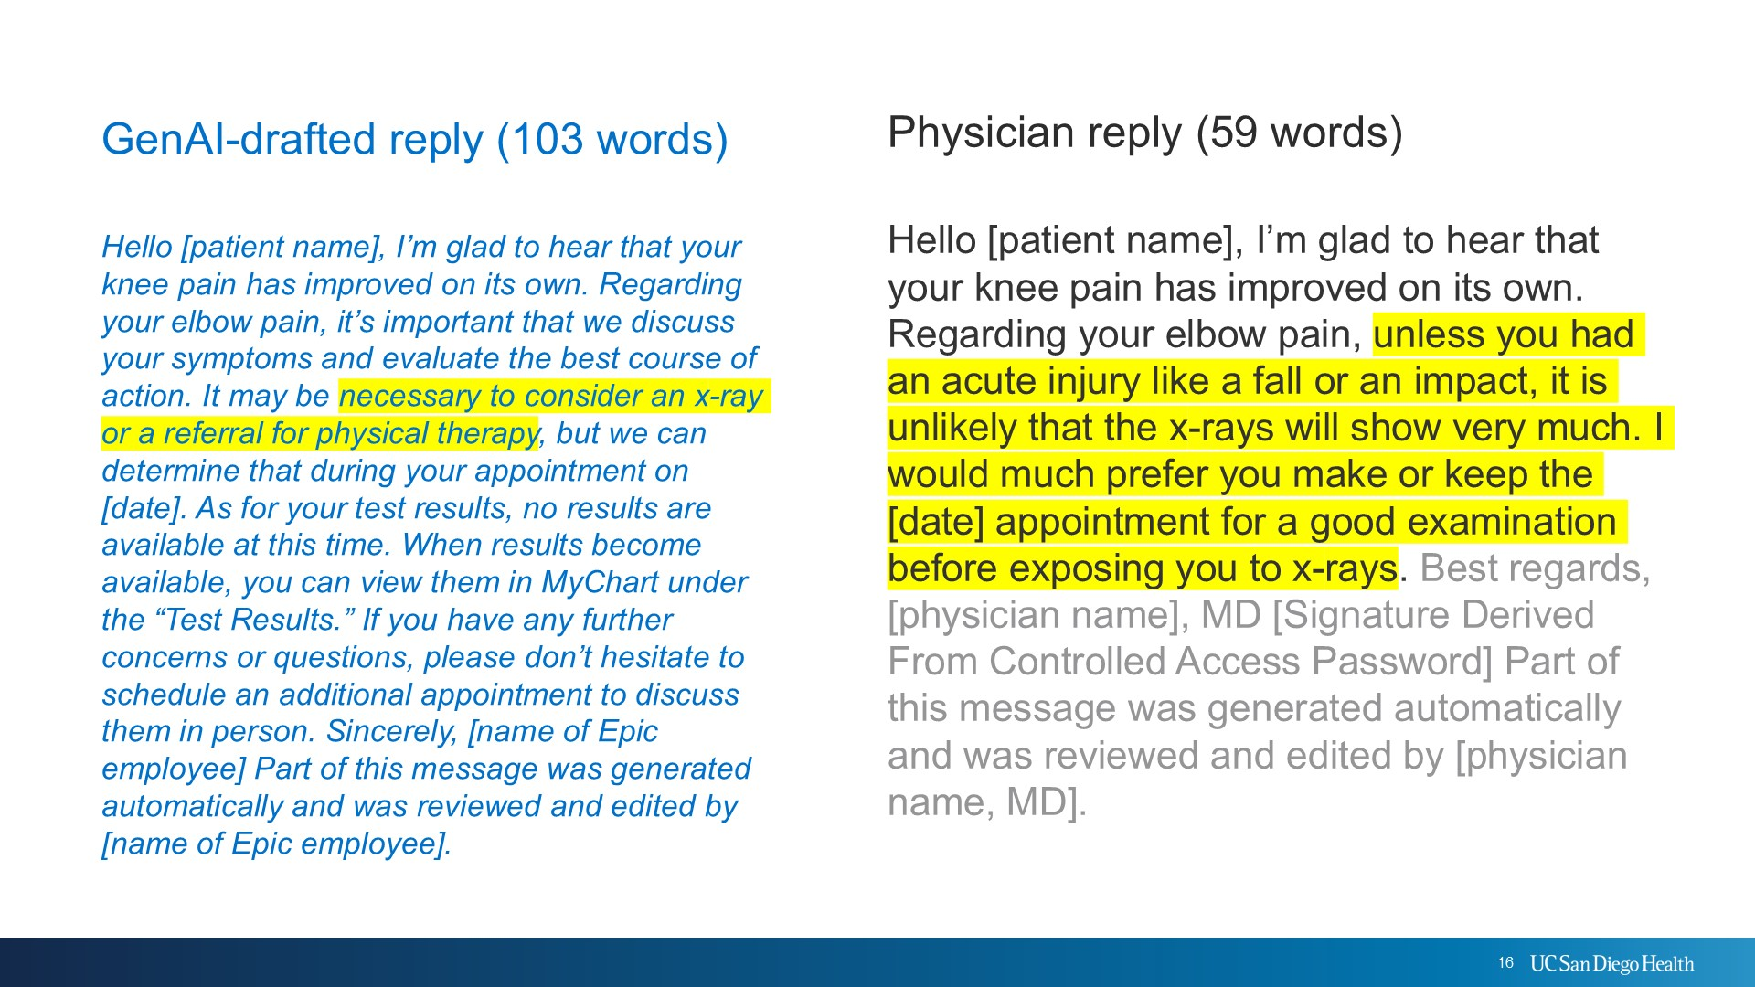
PHYSICIAN AUTO-REPLY
Greater length of reply – whether from AI or physician – is associated with greater patient satisfaction
WINSHIP CANCER INSTITUTE OF EMORY UNIVERSITY
@ravi_b_parikh
NCI Designated Comprehensive Cancer Center

Slide 53
Peril 3: LLMs are a setup for Model Collapse
Model collapse is a degenerative process affecting generations of learned generative models, in which the data they generate end up polluting the training set of the next generation.
Shumailov et al, Nature, 2024

Slide 54
Guardrails for the record
Label AI-authored text
Provenance on every note
Keep human anchors
PROs, wearables, and source audio as ground truth
1
2
Audit the scribe
Accuracy by race, language, and dialect
Monitor deployed models
Drift, errors, and equity, continuously
3
4
Notes:
Four practical guardrails any health system can adopt now.

