Slide 1
REGENT--Prostate
Remote Comprehensive Germline Genetic Testing
HICOR Trials Expansion
Hiba M Khan, MD MPH
Assistant Professor
University of Washington/Fred Hutch Cancer Center
VCC Summit
October 27, 2026

Slide 2
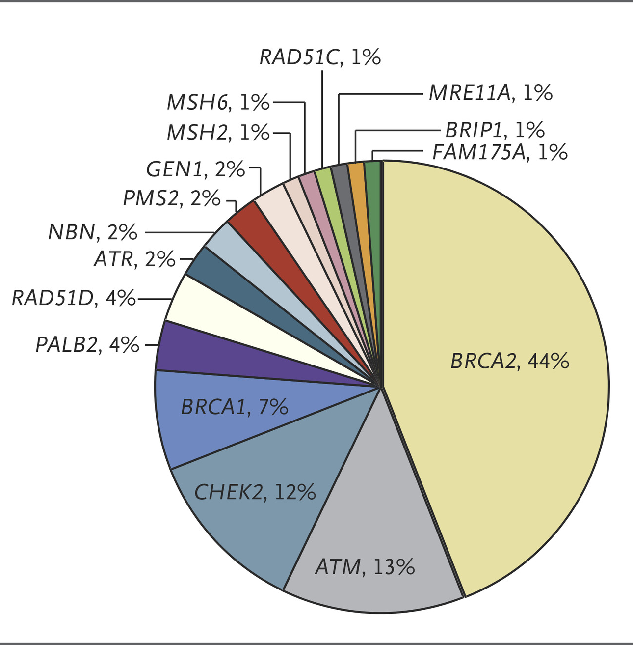
Background
About 10% of men with metastatic prostate cancer (mPC) have germline pathogenic variants (PVs) in DNA damage response genes (gDDR)¹⁻²
IMPACT:
  Precision therapy³⁻⁴(PARP inhibitors, immune checkpoint inhibitors)
  Prognosis⁵
  Familial cancer risk
  Cancer screening and prevention implications
National guidelines recommend germline genetic testing for all men with mPC⁶
Pritchard, et al NEJM 2016
1. Pritchard CC, et.al,. N Engl J Med. 2016;375(5):443-453. 2.Robinson D, et al. Cell. 2015 Jul 16;162(2):454]. Cell. 2015;161(5):1215-1228. 3. de Bono J, et al. N Engl J Med. 2020;382(22):2091-2102. 4. Abida W, et al. Clin Cancer Res. 2020;26(11):2487-2496. 5. Castro E et al. J Clin Oncol. 2013;31(14):1748-1757. 6. Schaeffer E,, et al. J Natl Compr Canc Netw. 2021;19(2):134-143.
Notes:
By way of background, I’m sure we’re all aware that approximately 10% of men with metastatic prostate cancer have pathogenic variants in germline DNA damage response genes. As displayed in the graph, the most common ones being BRCA2, ATM, CHEK2, and BRCA1.
The impact of having pathogenic variants in these genes is broad and significant. The presence of certain pathogenic variants, germline or somatic, expands treatment options, including PARP inhibitors and immunotherapy, and opens up clinical trial options.
Emerging data also indicates that patients with pathogenic variants are more likely to have metastatic or aggressive prostate cancer, impacting their prognosis.
Just as importantly, identifying patients with pathogenic variants in germline DNA damage response genes provides valuable information about familial cancer risk (next) and has major implications for screening and early detection for prostate cancer, and risk reduction for other cancers.
Given these important reasons, national guidelines now recommend germline genetic testing for all men with metastatic prostate cancer.

Slide 3
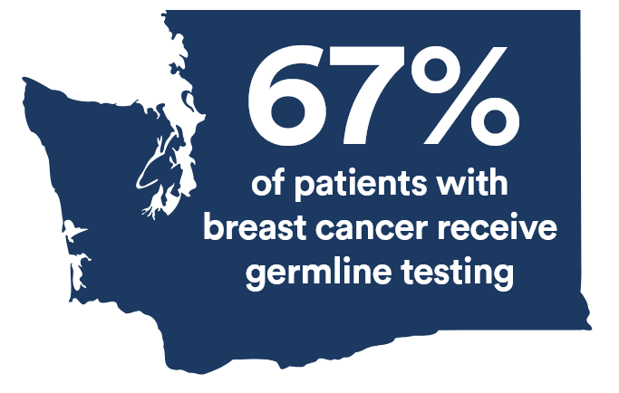
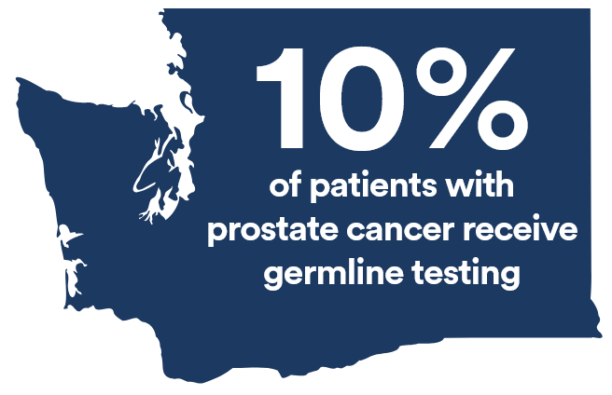
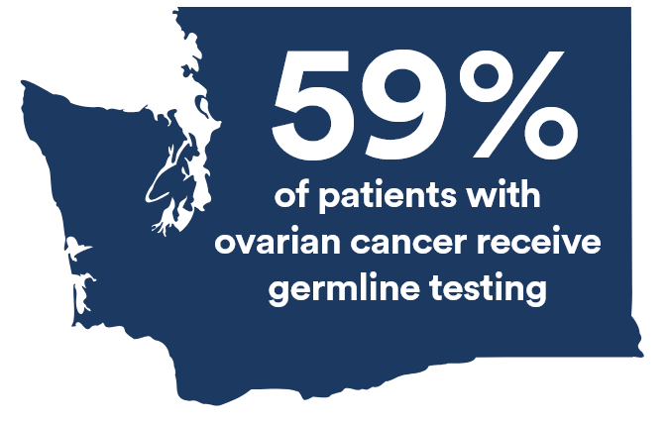
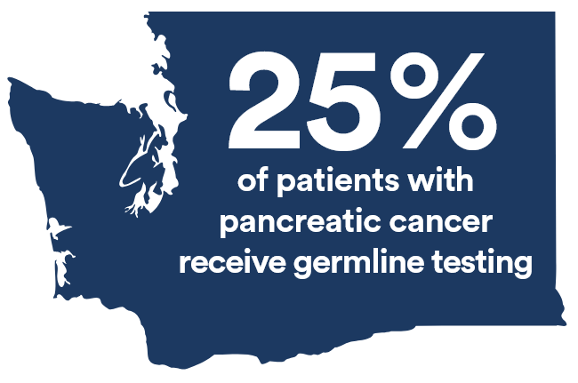
Germline genetic testing (Community Cancer Report 2019-2021)
Notes:
Here are our results. Despite the fact that brca ½ testing has long been recommended in breast cancer, we find that only 66% of women with breast cancer who meet criteria for testing received it. Only 58% of women with ovarian cancer received germline testing. The numbers are lower for pancreatic and prostate cancer, with only 20% and 8% of pts tested respectively. Even accounting for the time in takes to implement guidelines into clinical practice, we would argue these numbers are quite low when a reasonable expectation should be that at least 80% of eligible patients get tested.

Slide 4
Germline Genetic Testing (GIFTS)
Exploratory, population-based study of patients with prostate cancer to understand trends and identify disparities in germline genetic testing in Western WA state
Offer free germline genetic testing for interested patients
Of all respondents who had any genetic testing (prior and GIFTS), 7% (9/128) of them had pathogenic variant identified, including in ATM (1), BRCA2 (3), BRIP1 (1), CHEK2 (1), PALB2 (1), and PMS2 (2)
11%
41%
Notes:
From our data, we are able to see that of our total population of 409 individuals with met prostate cancer in our community, 11% of them had completed germline genetic testing prior to involvement in GIFTS. We do note that this proportion is likely an under-estimation, as we have no way of knowing if the participants who declined study involvement had completed testing.
The community rate of germline genetic testing completion improved to 41% after GIFTS involvement. Of all participants who indicated an interest in genetic testing by responding to our questionnaire, the rate of completion of genetic testing was 88%.
Read bullet 4 .

Slide 5
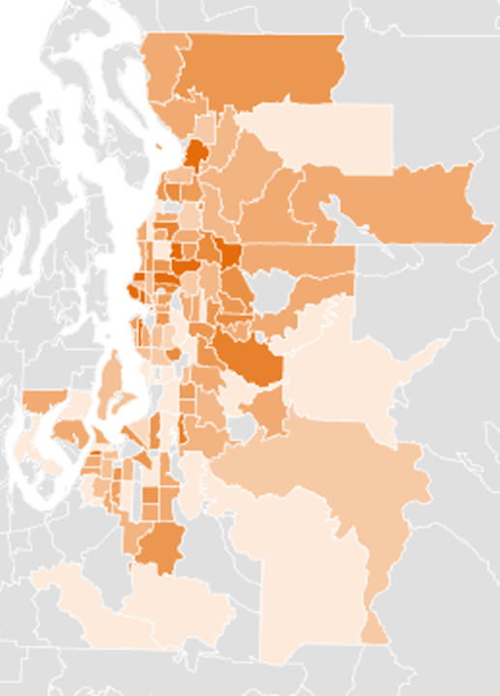
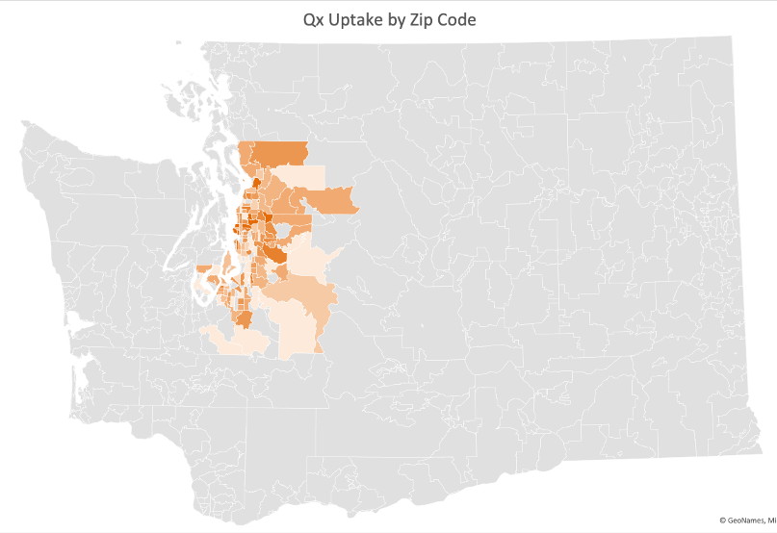
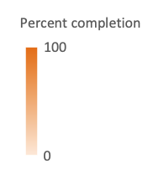
Zip Code Distributions by Request of Questionnaire
Notes:
So again, this image represents our western WA catchment area (next). This zoomed in image is a visual representation of the response to our study, based on their geographic zip code. The darker orange areas represent zip codes where a higher proportion of invited participants responded to the questionnaire, with the lighter orange areas representing zip codes with lower response rates. It is noted that as we move further from the central urban area of Seattle, we do see a lesser proportion of response.

Slide 6
Expanding Trials Program
Vision
Fred Hutch Cancer Center is a national leader in developing new and sustainable strategies to engage communities in clinical trials aimed at improving cancer care
Talk with clinics in WA state to identify cancer care challenges and priorities
Leveraging Fred Hutch expertise and infrastructure, partner with clinics to develop research studies tailored to clinic workflow, patient population and research goals
Secure study funding and launch new trials within the state
How We Work:
The Community Collaboration Process

Slide 7
REGENT--Remote comprEhensive Germline gEnetic Testing
Goal: To eliminate barriers limiting guideline-directed germline genetic testing
  Remove genetic counselors as gatekeepers (workforce shortage)
  Eliminate cost barrier
  Reduce time burden for busy oncologists
  Provide result resources to oncologists (tumor board)

Slide 8
REGENT—Study Aims
To assess utilization and acceptability of a fully remote, comprehensive germline genetic testing program, from patient and provider perspective
To determine if the intervention increases rates of guideline-directed germline genetic testing for patients with metastatic prostate cancer receiving care in their communities
Will be recruiting 50 patients and 2-3 referring clinicians
Aims assessed through patient pre/post intervention surveys and provider semi-structured interviews

Slide 9
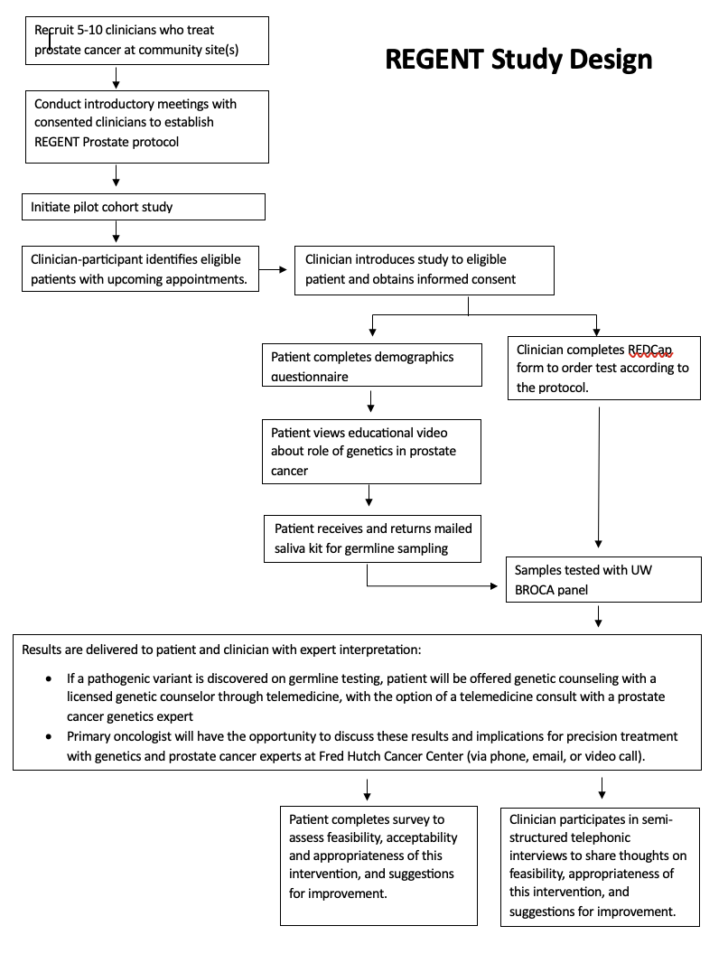

Slide 10
REGENT—Community Site Support
  Payment of $5000 is provided AND per-patient cost reimbursement for community oncology sites to:
  Identify and consent eligible patients
  Hand off consented patients to the team at Fred Hutch who will deliver the intervention

Slide 11
Thank you hibakhan@uw.edu hkhan@fredhutch.org

