Slide 1


FRED HUTCH
CANCER CENTER
Hope in Action
Building Better Care
in Times of Constraint
Ann W. Jackson, PT, DPT, MPH Executive Director of Center for Food Equity in Medicine
October 26th, 2026
11th Annual Value in Cancer Care Summit
01
Notes:
Opening: Welcome the room. Briefly introduce yourself in your own words and share why this conversation matters to you. Event name and title supplied by the user.

Slide 2
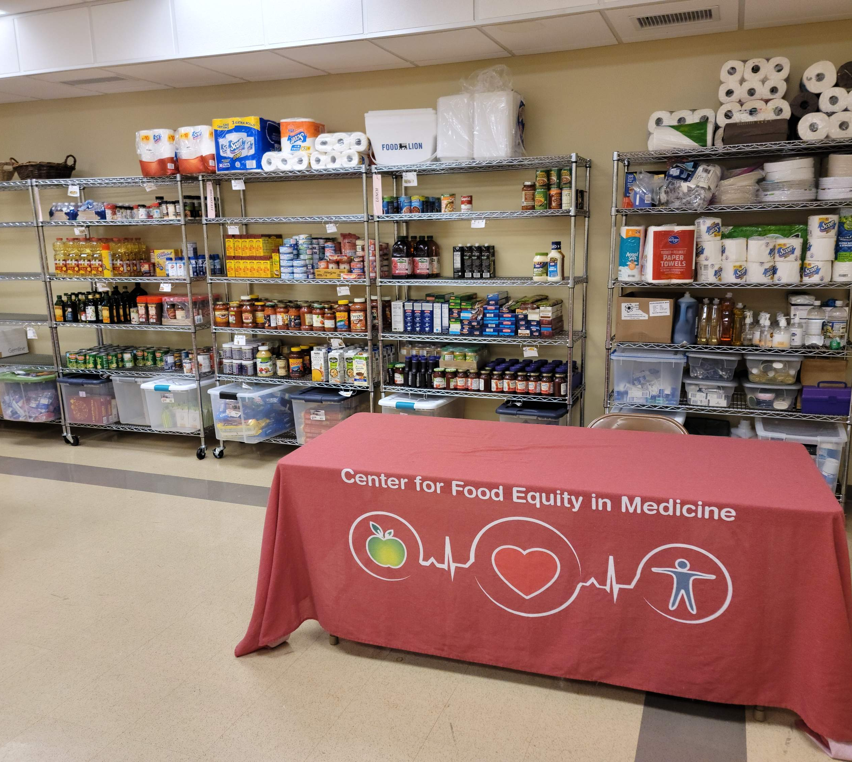
Presenter Disclosure
I have no personal or professional disclosers to declare.

Slide 3
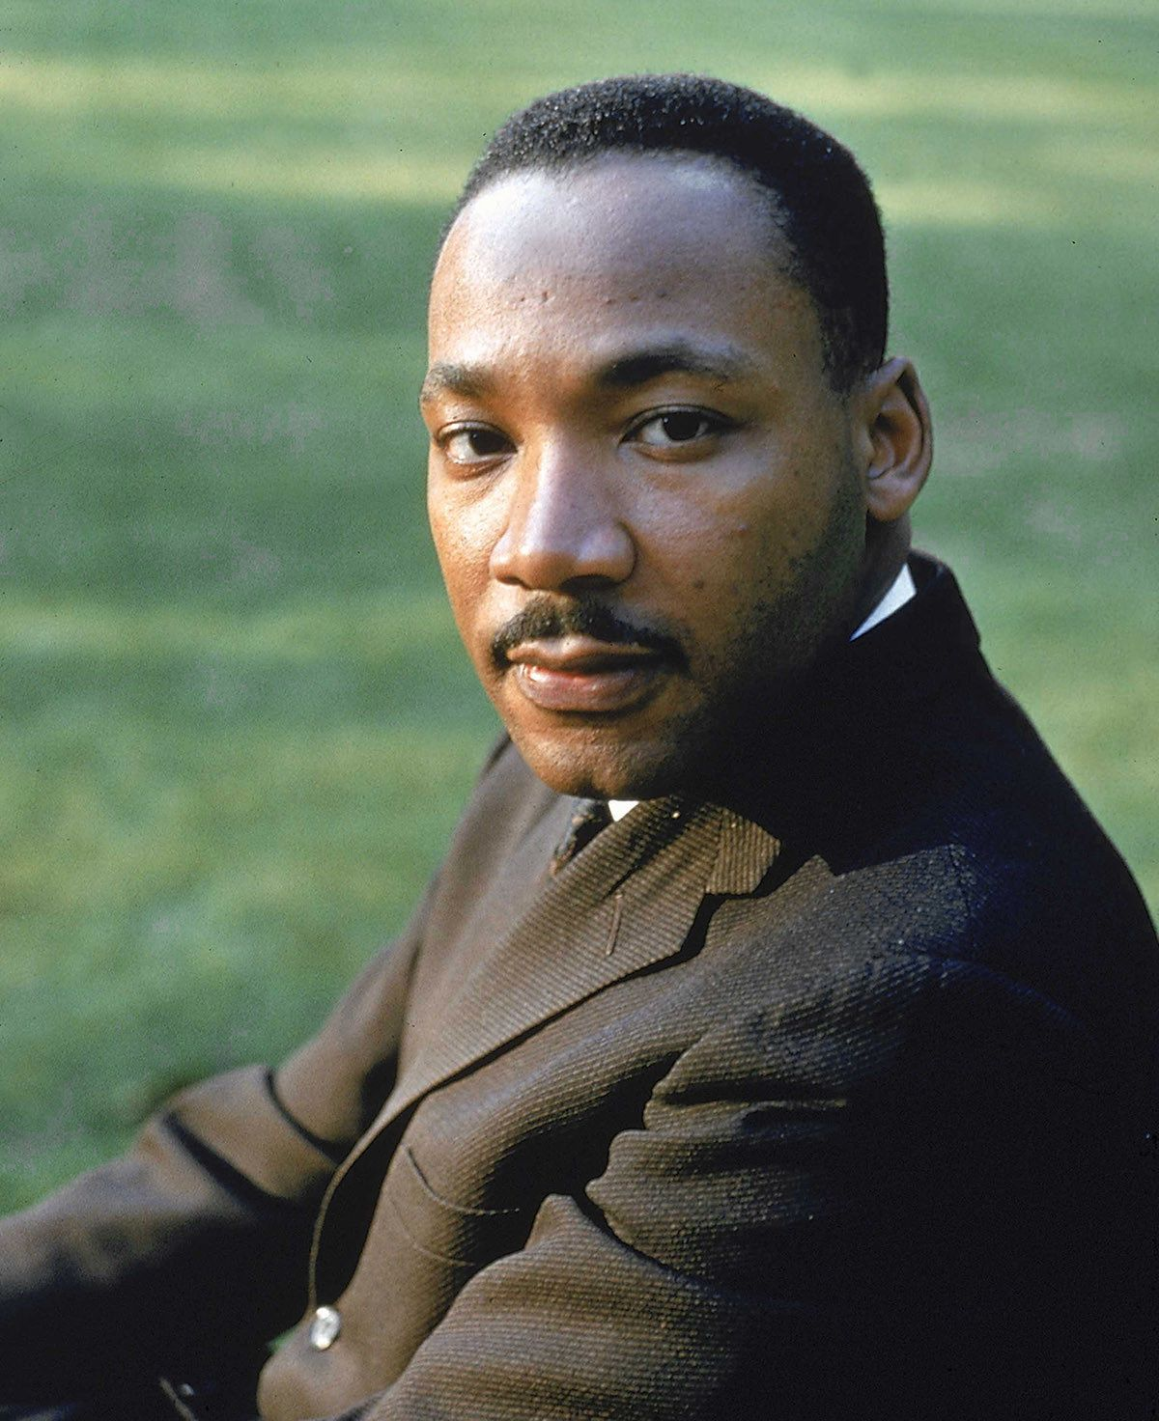
Where do we go from here: Chaos or Community?
In 1967, as MLK wrote the final manuscript of his life, he calls for America to be better to all of her citizens. Do we strive for Chaos and Despair or Community and Hope?
In the book he writes:
“Let us be those creative dissenters who will call our beloved nation to a higher destiny, to a new plateau of compassion, to a more noble expression of humanness.”

Slide 4
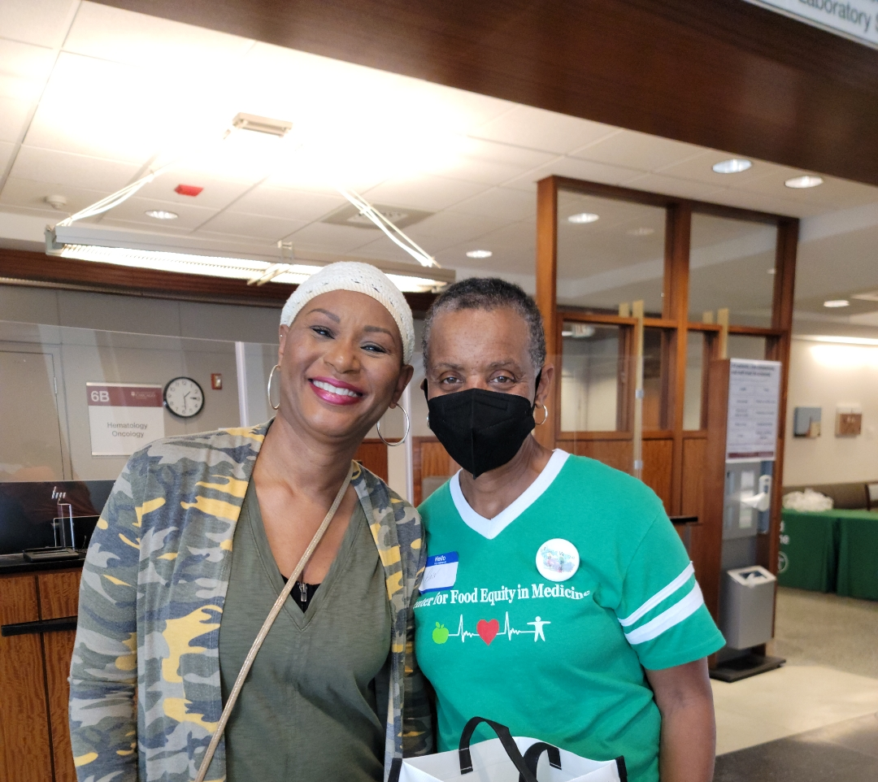
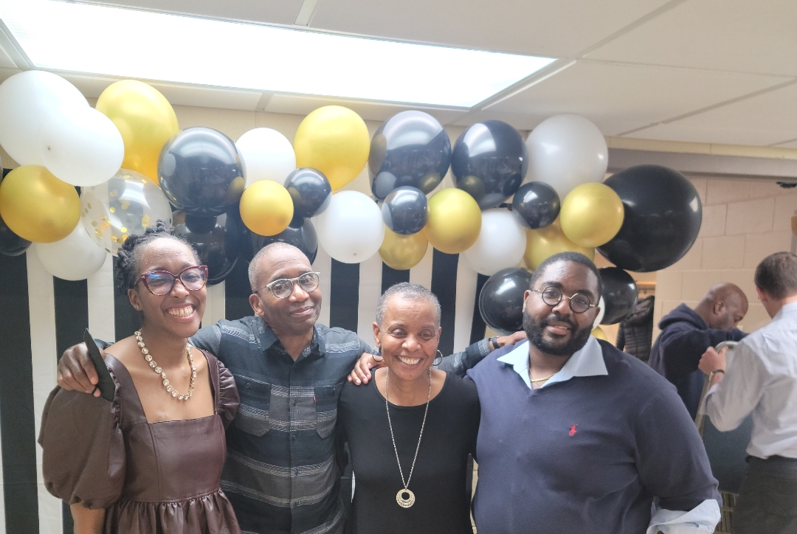
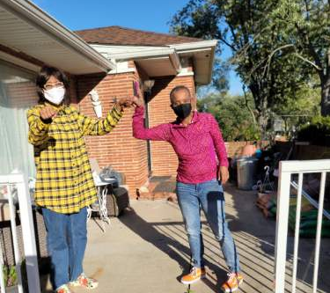

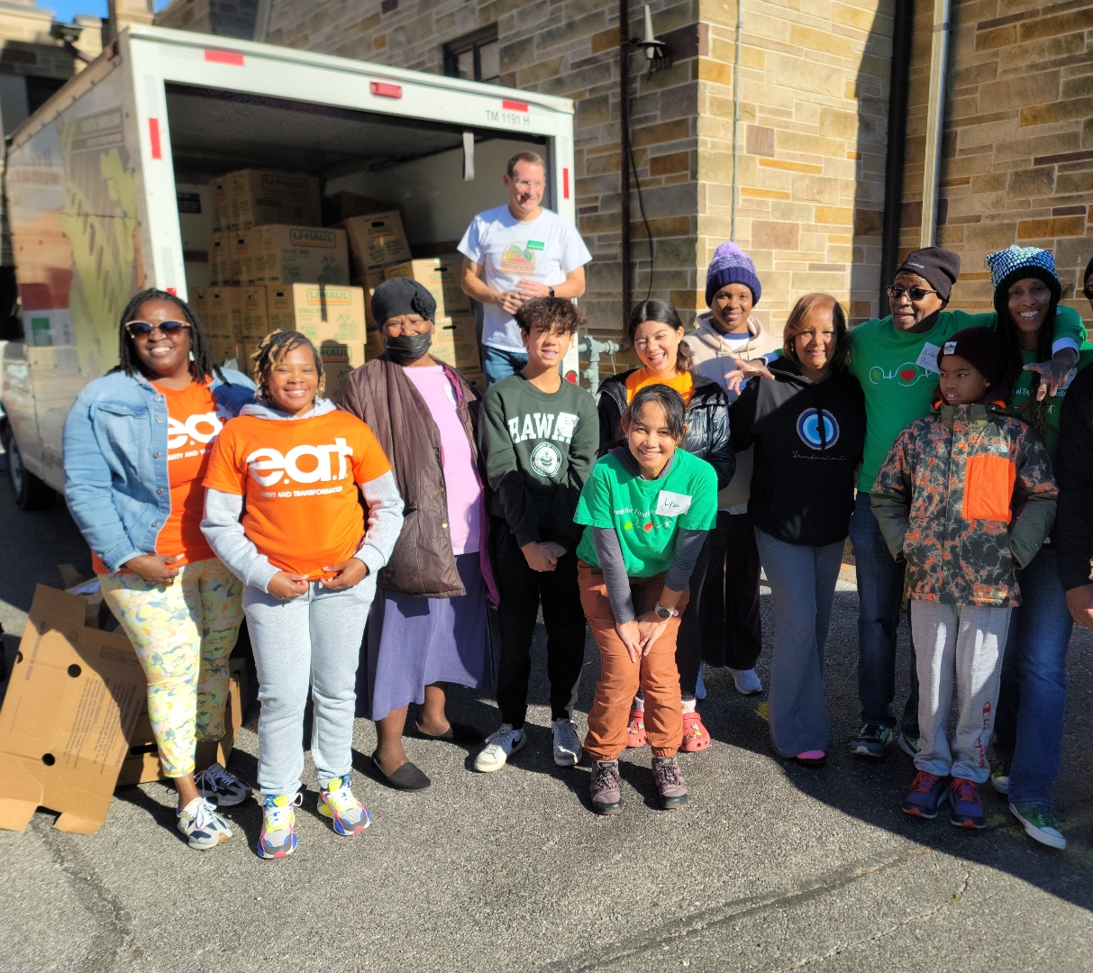
“What are we called to choose today?”
I am a daughter, sister, Mom, wife, friend, an aunt, a Physical Therapist, a Clinical Medical Ethicist, Mourner of Lives lost, a Foundation Founder, a Joy Seeker and a Post Cancer Diagnosis Thriver of 11 years, 1 month and 8 days .
Growing up in family where community and food were valued, where people and their stories were cherished and hope existed, no matter what.

Slide 5
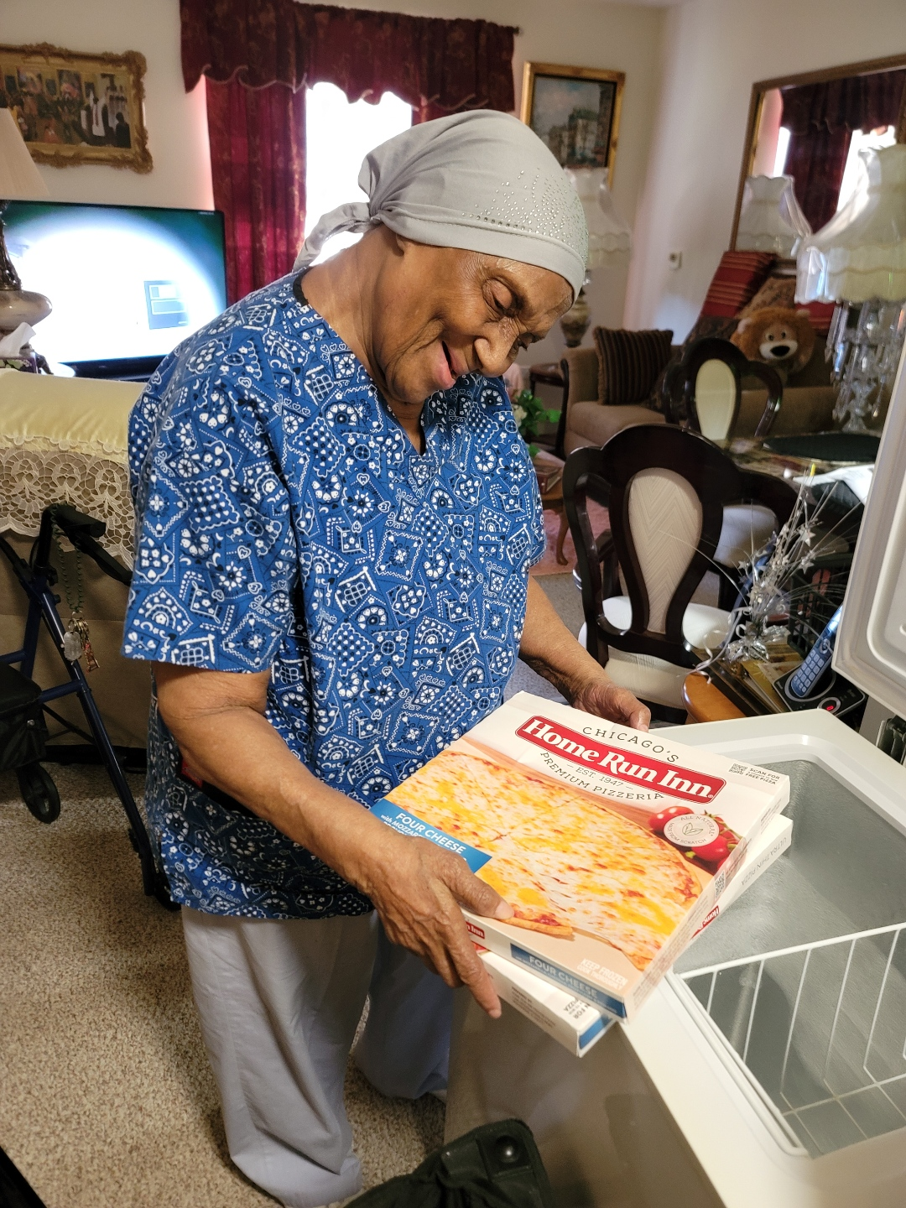
Is hope evading us in this time of unprecedented constraint? It depends on which team you play on.
Together, let us consider:
  Where do I/you/we find hope?
  How do I/you/we ignite hope?
  How and why should I/you/we share hope?
"The most creative works are often born from the strictest limitations, as they force the mind to find pathways that would otherwise remain undiscovered and ignored.“ author unknown
We are all in this together, no matter which team you play for.

Slide 6

Greatest of Hope Seekers: Those Living Beyond a Cancer
In 2025, an estimated 2,041,910 new cases of cancer were expected, which averages to roughly 5,600 diagnoses per day in the United States. Here in Washington state it’s slightly lower than national averages with 441 per 100,000 people being diagnosed as compared to the national average of 453 per 100,000 people.
Cancer Statistics - NCI

Slide 7
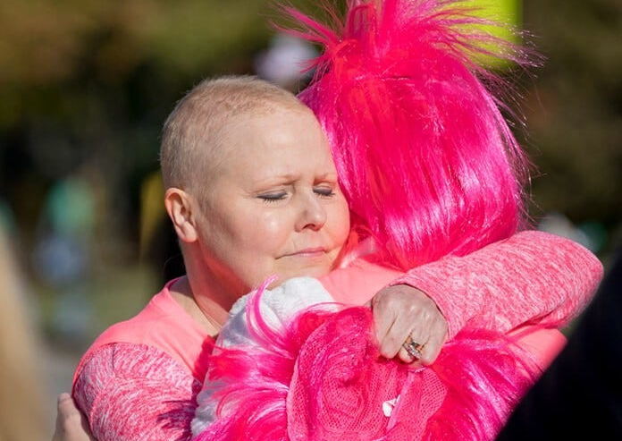
When thinking of hope
Verb
: to cherish a desire with anticipation : to want something to happen or be true
Noun
: desire accompanied by expectation of obtaining what is desired or belief that it is obtainable
HOPE Definition & Meaning - Merriam-Webster

Slide 8
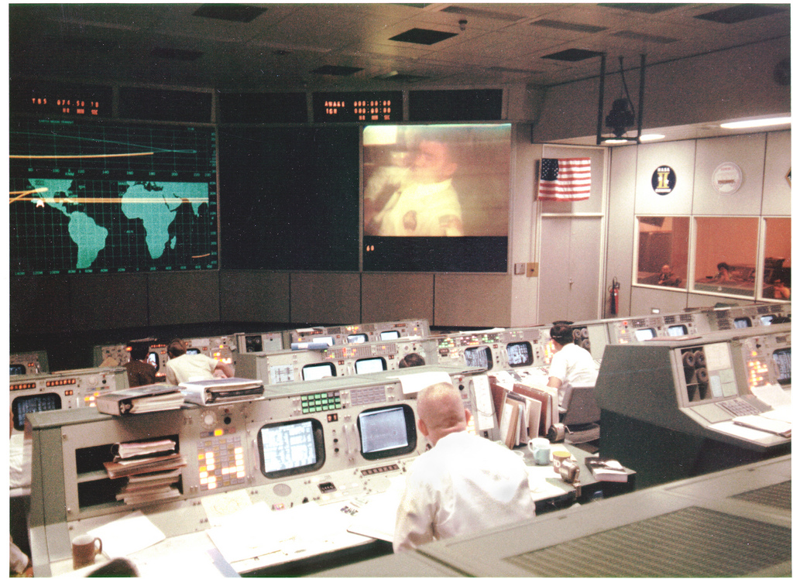
I took my action-oriented hope, to recognize there were problems facing myself and others living beyond a cancer diagnosis.
What can one person do, when you see a need around you?
What influenced my decision to move my hope into tangible action?
My own experience(9-15)
Dr. Stacy Lindau(7-17)
Pastor Chris Harris(11-17)

Slide 9
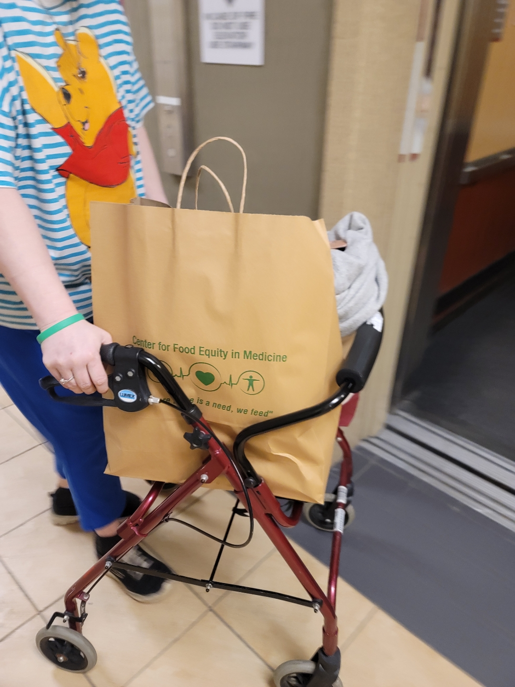
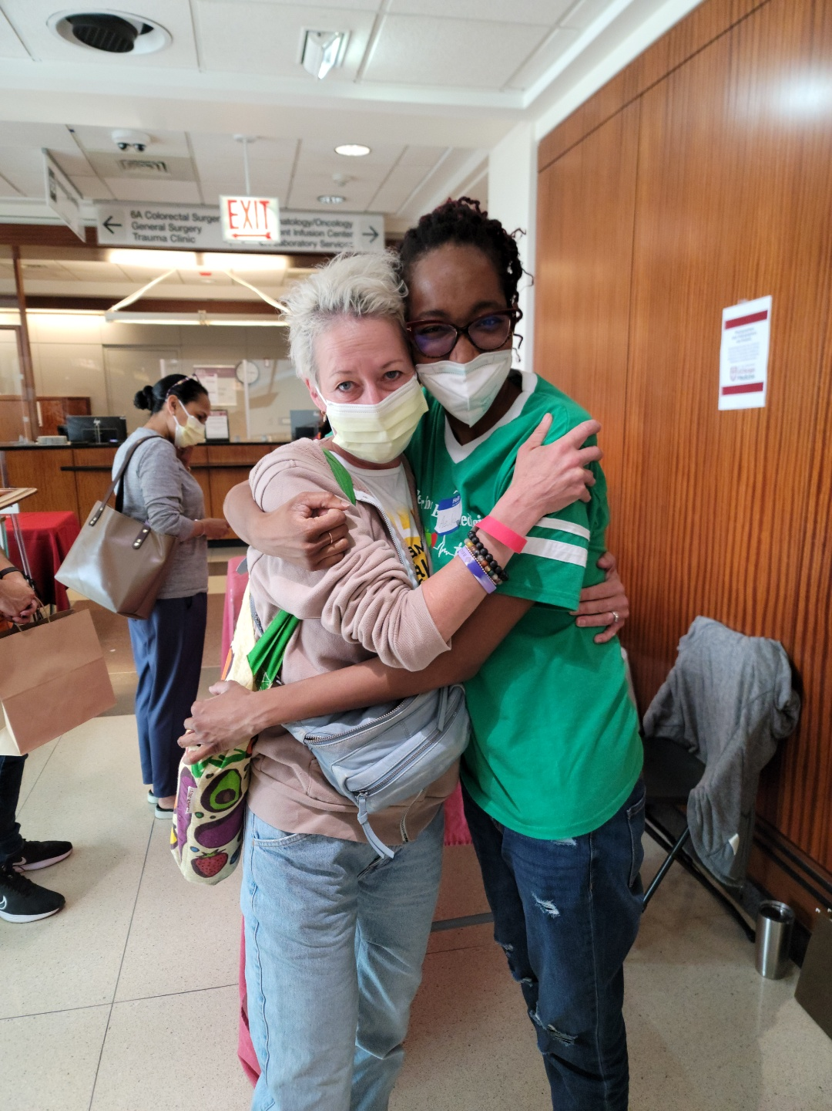
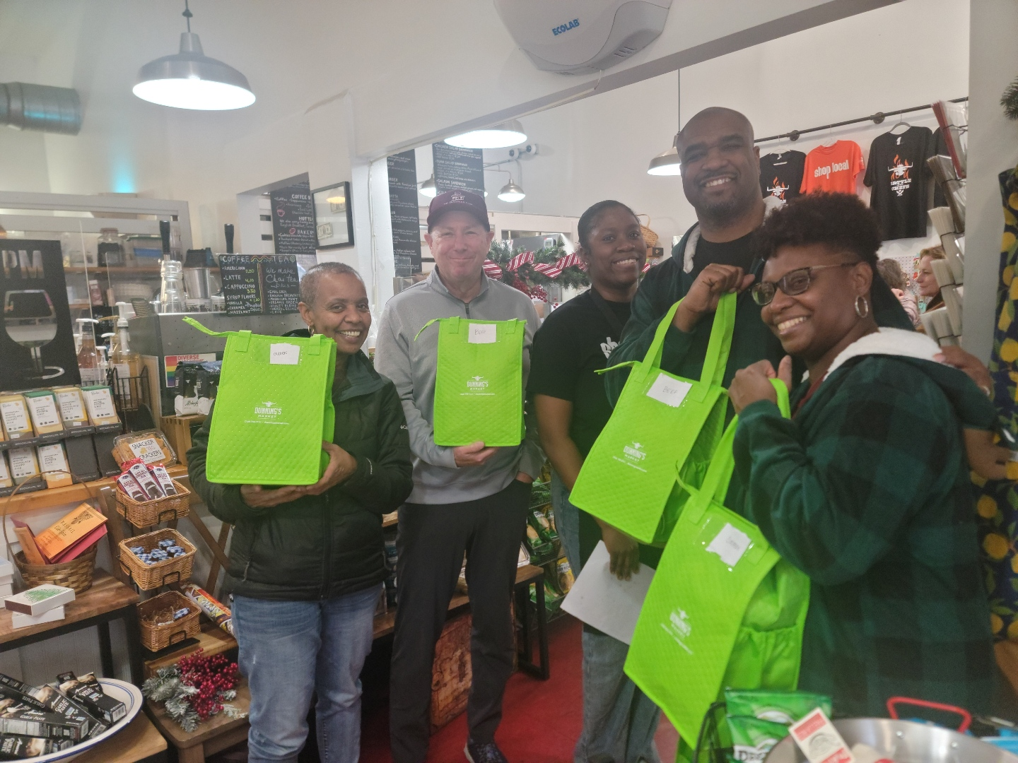
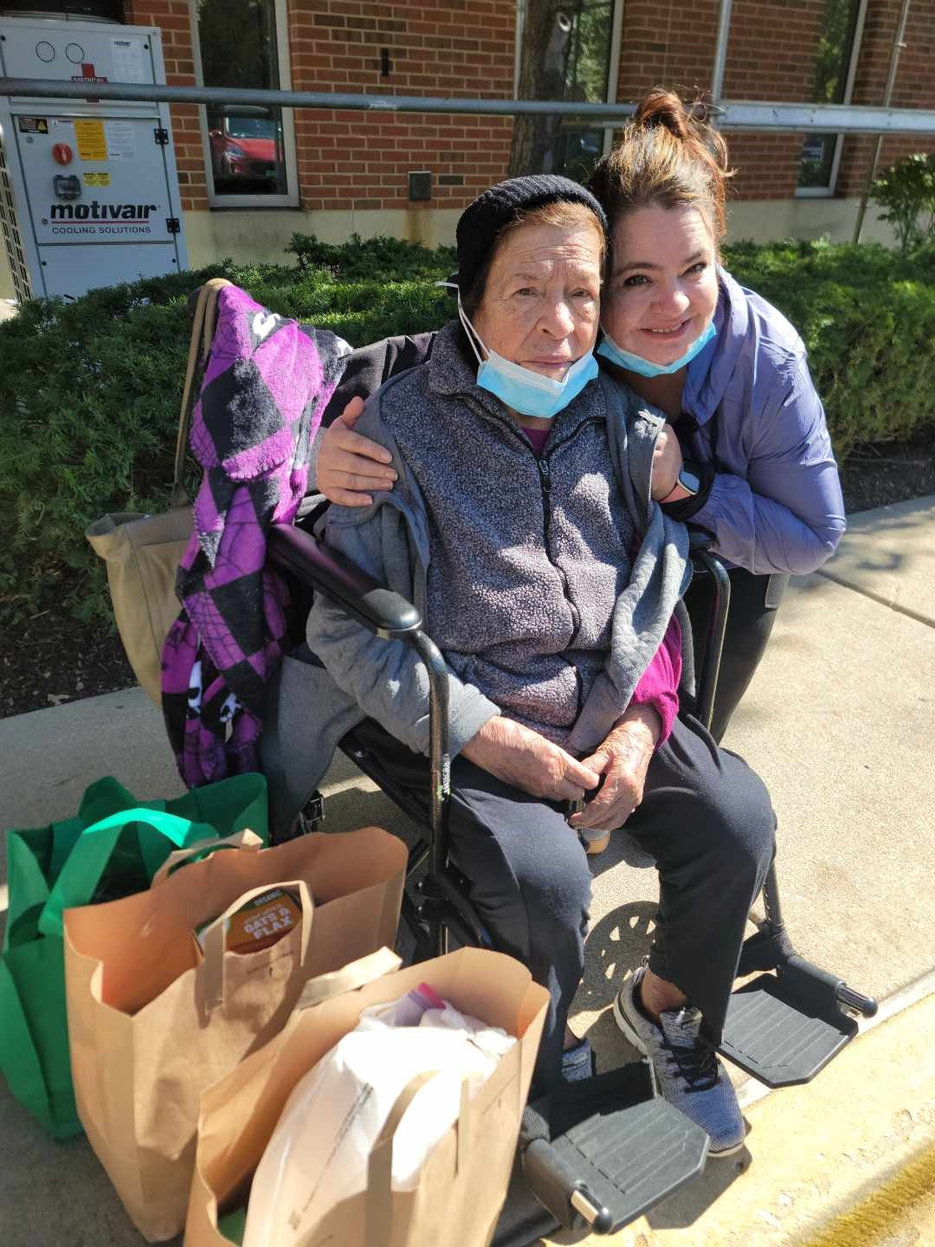
Where does your hope come from?
My Everyday Hope
For some, hope comes from being what appears to be an unsolvable situation and finding a solution.
For some, becoming uncomfortable with a situation they find themselves in.
A young man from Watts California was speaking to Martin Luther King, Jr. when President Lyndon B. Johnson signed the Voting Rights Act in August of 1965, said “We won because we made them pay attention to use.”

Slide 10
Prioritizing Food Security among those with cancer:
Putting my/our hope to work, I became a community scientist and an agitator, then asked others to join me.
Asked for assistance from a team of experts
Learned what best practice was on Food Insecurity
Identified a valid tool to evaluate the potential problem
Used available opportunities to gather data, as often as possible in as many ways as possible
Analyzed the data
Shared the findings
Now ask cancer centers around the country to join us

Slide 11
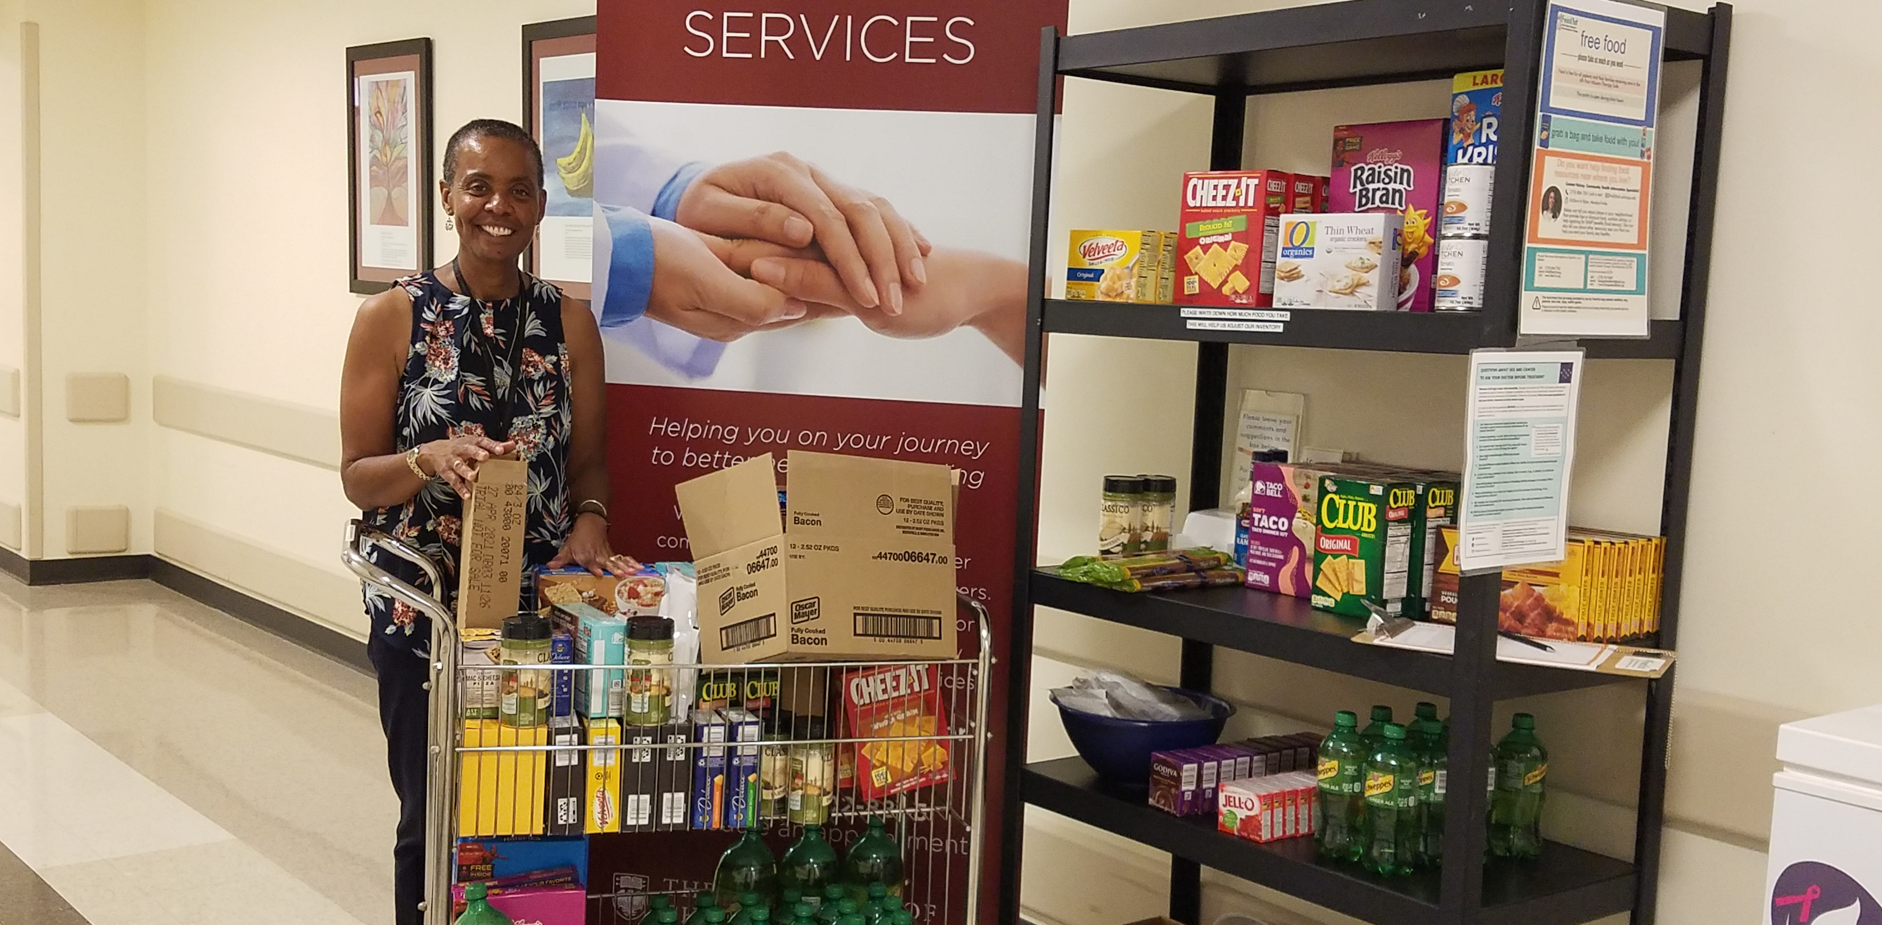
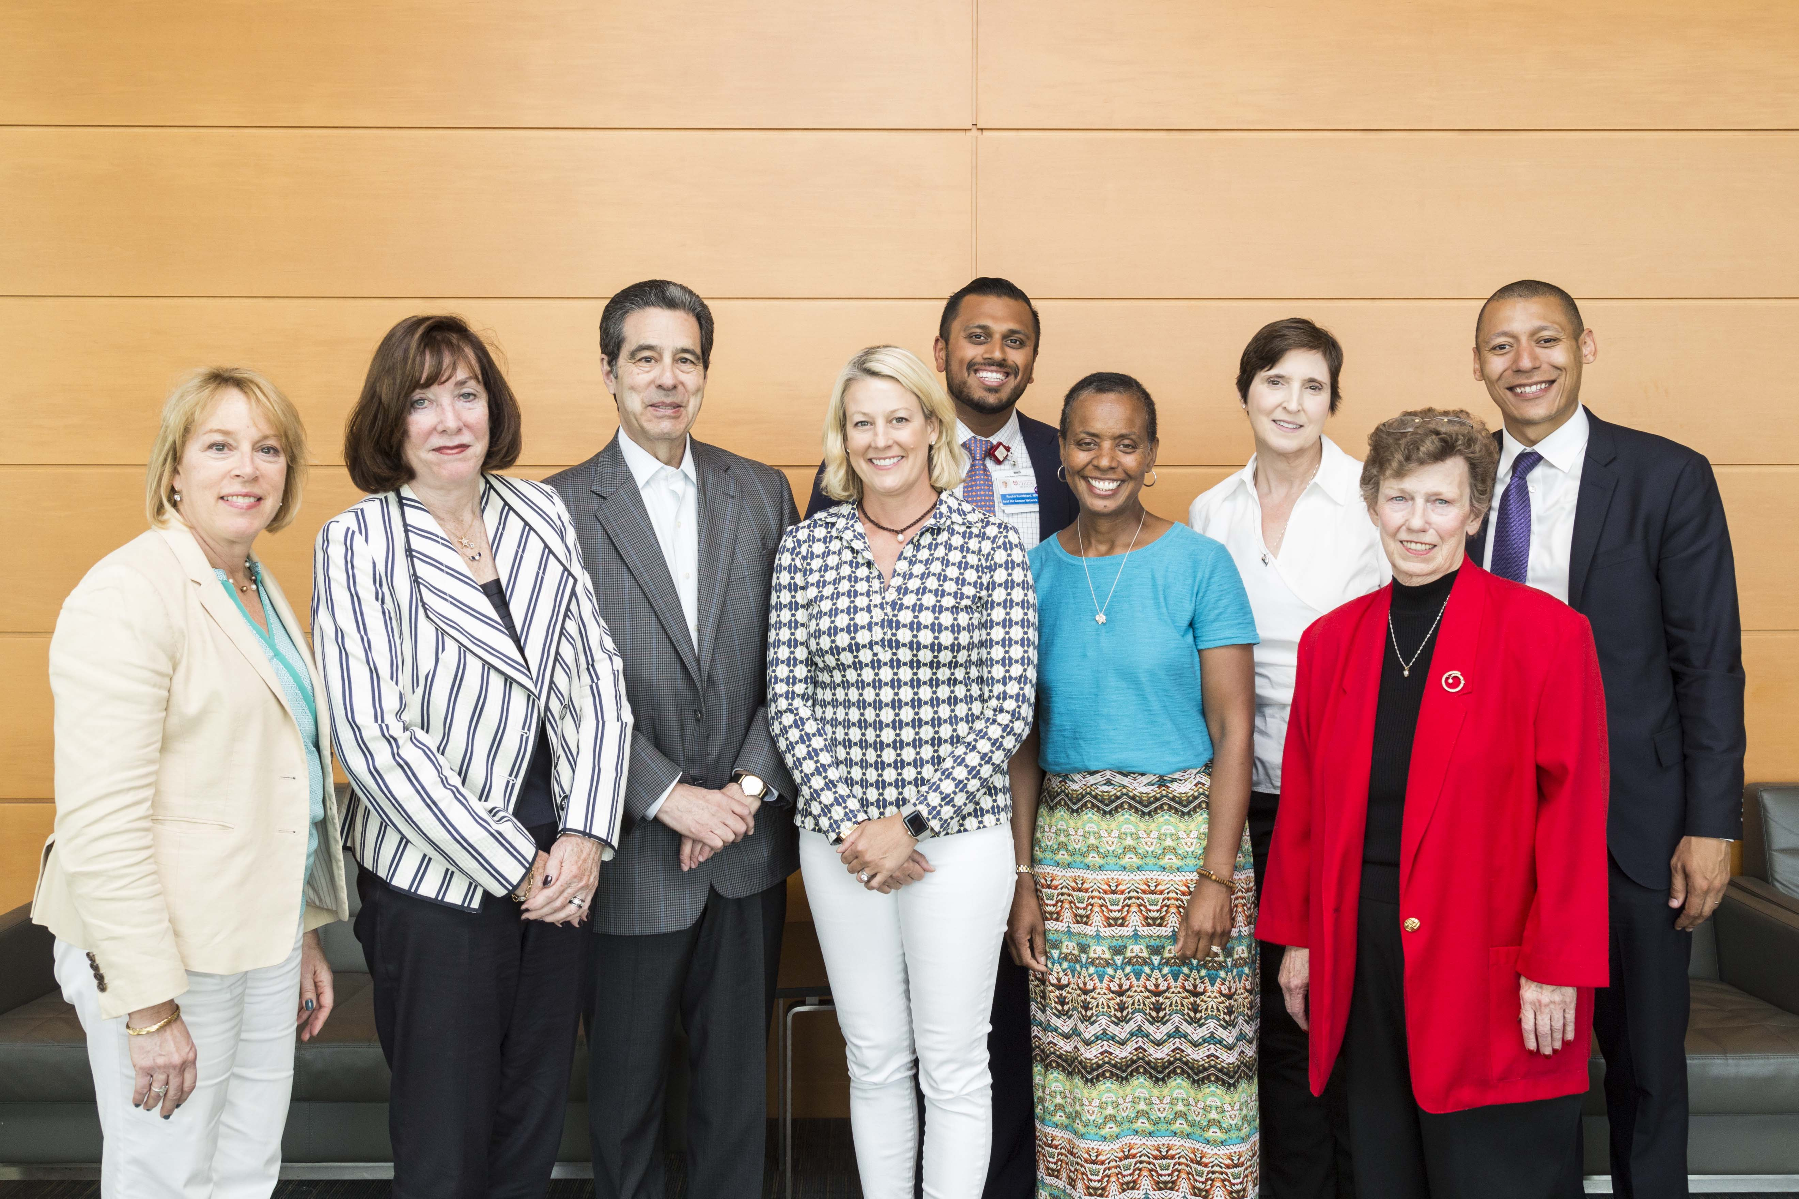
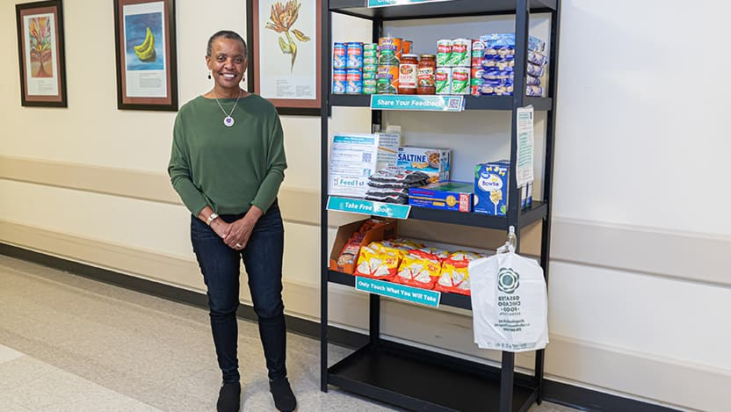
Food Pantry Opened November 2017
An estimation of those served in November 2017:
40 households were served and 151 individuals

Slide 12

Getting
through
something
What helped you take
the next step?
09
Notes:
Personal story space: Choose a difficult experience you feel comfortable sharing. Name the uncertainty without resolving it too quickly. Describe the support or small action that helped. Avoid implying that attitude determines cancer outcomes.

Slide 13
Why should we share hope?
1. Cancer patients need your help right now. Some people do not have a long time for “you” to figure it out, we need action that is relevant, flexible and accessible.
2. When holistic care is not provided, the cancer burden is greater and in extreme cases may impact longevity of life.
3. No one asked for a diagnosis, so all people presenting for care should be treated with dignity and respect.
4. You must dream with those entrusted to your care, if you cannot see them beyond this moment or a path forward-how will they?
5. History tells us that a spark can ignite a movement.

Slide 14
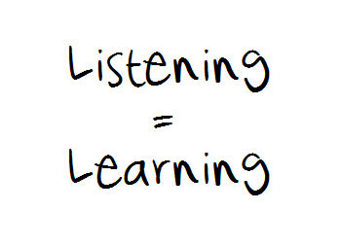

How do we share hope?
What has changed in the last 9 years for CFFEIM?
This Photo by Unknown Author is licensed under CC BY-SA
This Photo by Unknown Author is licensed under CC BY-NC

Slide 15
Hope helped us stay, no matter the challenges.
What can help you to
keep showing up?
A person
A promise
A purpose
A possibility
13
Notes:
Tell a brief story of persistence or companionship. What helped on an ordinary day when progress was hard to see? Recognize that rest, accepting help or changing course can also be meaningful responses. Hope should never become an obligation to appear strong.

Slide 16
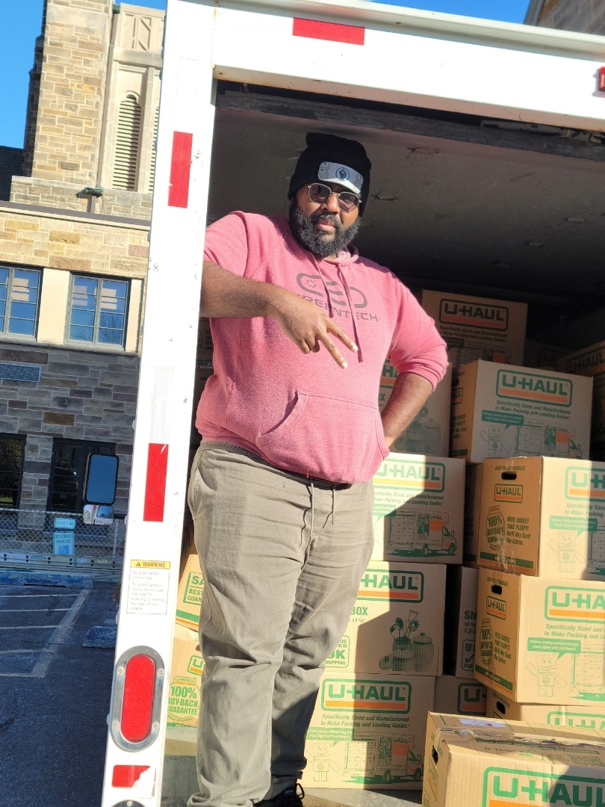
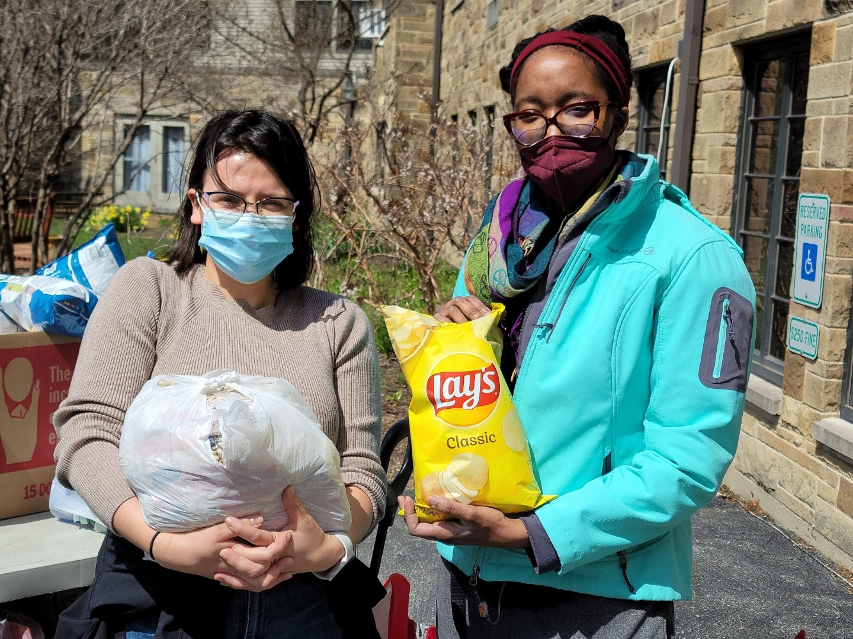
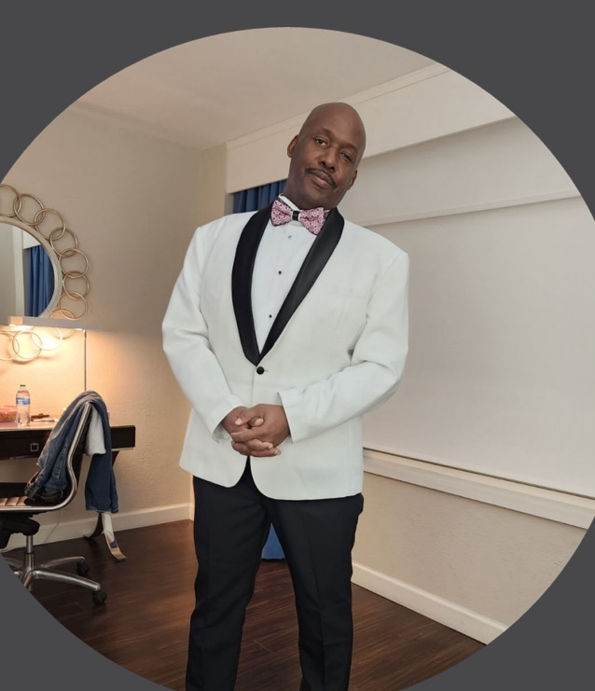
When hope changed shape
What did you hope for then?
What mattered most next?
14
Notes:
Personal story space: If it fits your experience, describe a time when your hopes changed. Allow uncertainty and mixed feelings to remain in the story. In cancer care, never imply that a different hope means someone has given up or failed.

Slide 17

THE MOMENT BEFORE US
What are we
called to do now?
This Photo by Unknown Author is licensed under CC BY-NC-ND
17
Notes:
Bring the personal story into the shared purpose of the summit. Ask what our sources and experiences of hope call us to do for one another in this moment.

Slide 18
Movement is caused by a desire to move toward a stimulus that gives pleasure or away from stimuli that causes pain
Hope is Moving Us!
CFFEIM has been moved to:
1. Provide monthly groceries to those in need.
2. Create special holiday sharing experiences for those we serve.
3. Create programs to address the needs of the whole person, we ask “How far do you want us to walk it out with you?”
4. Serve families in 7 states outside of IL. , including the state of Washington.
5. To create a national conference: Ready, Set, Go: Empowering Cancer Patients.
6. Creating the Aj2 Memorial Fund to honor Ashaun and Aesha.
7. Encourage every cancer center we meet to open a Complimentary Nutrition Station.

Slide 19
What does hope in action look like for you?
Are you ready to create pathways to foster active listening?
“What matters most to you right now?”
Are you ready to look upon those seeking care as experts in their care?
“What do you know about me that’s not in my chart?”
Are you ready to stop asking “May I help you?”
Offer a specific list of what can be done?
Are you ready to address the needs of patients with innovative and creative tools?
“No one ever asked me about that before; I am glad you did”

Slide 20
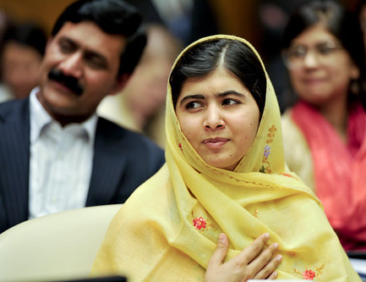
Why must we?
“I raise up my voice-not so that I can shout, but so that those without voice can be heard…we cannot all succeed when half of us are held back.”
Malala Yousafzai
This Photo by Unknown Author is licensed under CC BY-NC-ND

Slide 21
You choose?
Chaos and Despair
Or
Community and Hope

Slide 22
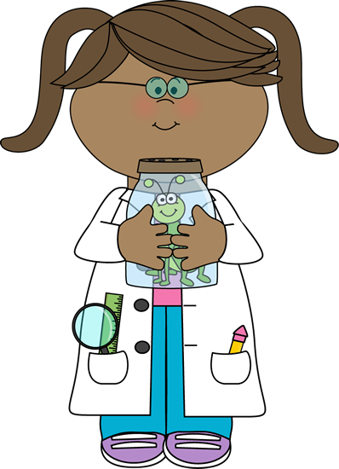
I choose hope every time.
This Photo by Unknown Author is licensed under CC BY-SA
Notes:
Close with the question and allow a pause. Thank the audience and HICOR. Hand the conversation back to the summit.

Slide 23

Thank you for your attention
Contact information
Ann W. Jackson, PT, DPT, MPH
awjackson@foodequityinmedicine.org
312-261-8502

