Slide 1




Value in Cancer Care Summit
2026
Hope in Action: Building Better Care in Times of Constraint
Scott Ramsey, MD, PhD and Veena Shankaran, MD
Bell Harbor Conference Center, Seattle, WA
October 27, 2026
Fred Hutchinson Cancer Center

Slide 2

Notes:
Scott

Slide 3
2026 Value in Cancer Care Steering Committee
Kristine Rinn, MD | Cancer Care Northwest
Erica Harrington | Compass Oncology
Julie Smith, MD | Confluence Health
Karin Larson-Pollock, MD | Fred Hutch Cancer Center
Janet Freeman-Daily, MS, Eng | GrayConnections.net
Eric Chen, MD | Kaiser Permanente
Yarrow McConnell, MD | MultiCare Regional Cancer Center
Blair Irwin, MD, MBA | MultiCare Regional Cancer Center,
Sibel Blau, MD | Northwest Medical Specialties
Susanne Quistgaard, MD | Premera Blue Cross
Perry Soriano, MD | Providence Regional Cancer Partnership
Nicole Saint Clair, MD | Regence
Kelly Mardesich, MHA, BSN, RN | Skagit Regional Health
Sara Grethlein, MD, MBA | Swedish Cancer Institute
Ashwani Rajput, MD | Swedish Cancer Institute
Nancy Thompson, RN, MSN, AOCNS | Swedish Cancer Institute
Joseph Rosales, MD | Virginia Mason Franciscan Health
Drew Oliveira, MD | Washington Health Alliance
Heather Schultz, MD | Washington State Health Care Authority
Richard McGee, MD | Washington State Medical Oncology Society (WSMOS)
Notes:
Scott

Slide 4

To Patients, Advocates, and Community Partners
Patients, advocates, caregivers and patient partners have contributed to the Summit and to HICOR’s research program!
Special welcome to those who are with us for the first time today.
Notes:
Scott

Slide 5



Thank You, Summit Sponsors!
CONNECTION
Notes:
Scott: Read these names!!

Slide 6







Thank You, Summit Sponsors!
ACCESS
GOLD
SILVER
NETWORK BREAK
American Cancer Society
Puget Sound Oncology Nursing Society
Notes:
Scott: Don’t read these sponsor names!

Slide 7
What we hope you will do today
Engage with us
  Ask questions
  Share your story (briefly, so others can too!)
Meet someone new
  Take advantage of the opportunity to talk to someone with a different perspective
Celebrate our unique and special cancer care community
  Happy hour is on us!
Notes:
Scott

Slide 8


Community Cancer Care Report 2026
fredhutch.org/cancer-care-report

Slide 9
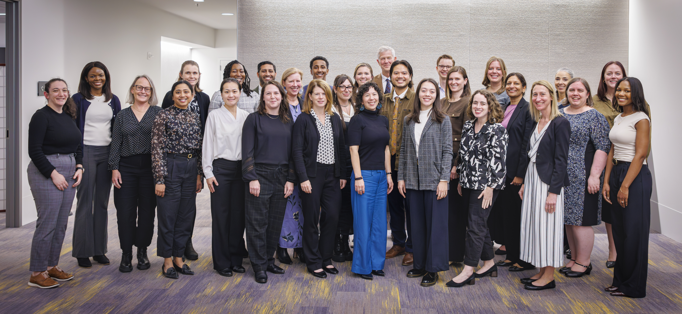
The HICOR team is here to support you!
Notes:
Scott
Describe briefly what HICOR is
Note that HICOR Staff can help you throughout the day. You’ll see their nametags are dark blue (rather than white of the attendees name tag)

Slide 10
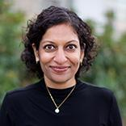
Hope in Action:
Building Better Care in Times of Constraint
Veena Shankaran, MD
Notes:
Scott introduce Veena

Slide 11




The Changing Landscape
of Cancer Care
Cancer treatment has become
dramatically more effective
Better screening, targeted
therapies, supportive care, and survival
Benefits of those advances depend on whether people can access, afford, navigate, and complete care
Burden increasingly falls on patients and families

Slide 12








Operational and Clinical Landscape
Financial Strain on
Community Practices
Workforce Shortages
Increased Economic Strain on Patient Population
Medication Access & Cost
Digital Technology Demands
Prior Authorization
Burden
Biomarker Data
Integration
Insurance Contractions
ACA, Medicaid
12

Slide 13



What Does Cancer Care Ask of Patients?
Navigation & Logistics
Daily Living
Social & Emotional Well-being
Administration & Financials
Finding the right care, complex choices, coordinating travel, appointments, and caregivers.
Navigating insurance, prior
authorizations, and managing
care costs.
Securing essential
resources like food and
transportation while
managing household needs.
Managing symptoms,
uncertainty, and overall health.
Managing cancer care is a full-time commitment that extends far beyond clinical appointments.

Slide 14



We Can Impact This Challenging Landscape
We are here to identify what can be changed and
imagine systems that make it possible.

Slide 15
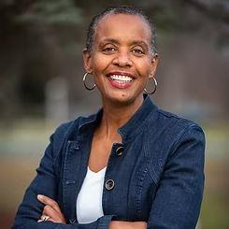
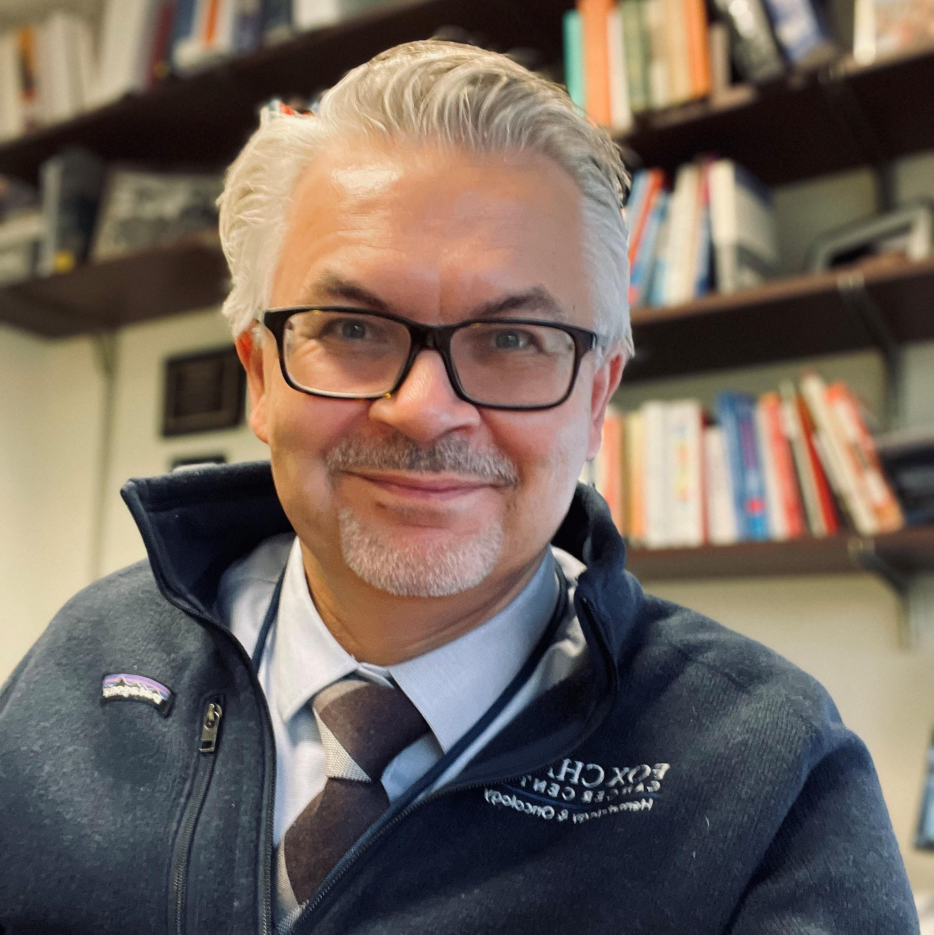
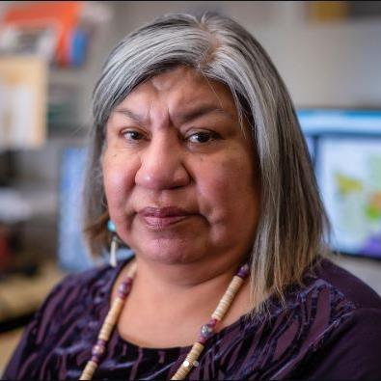
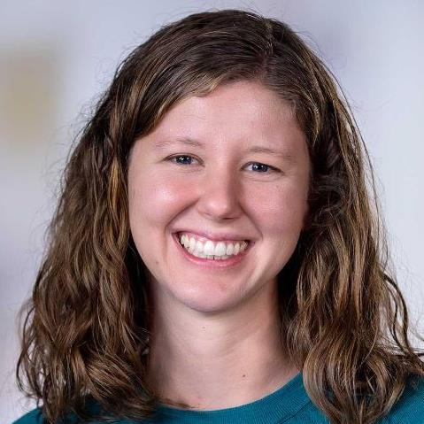
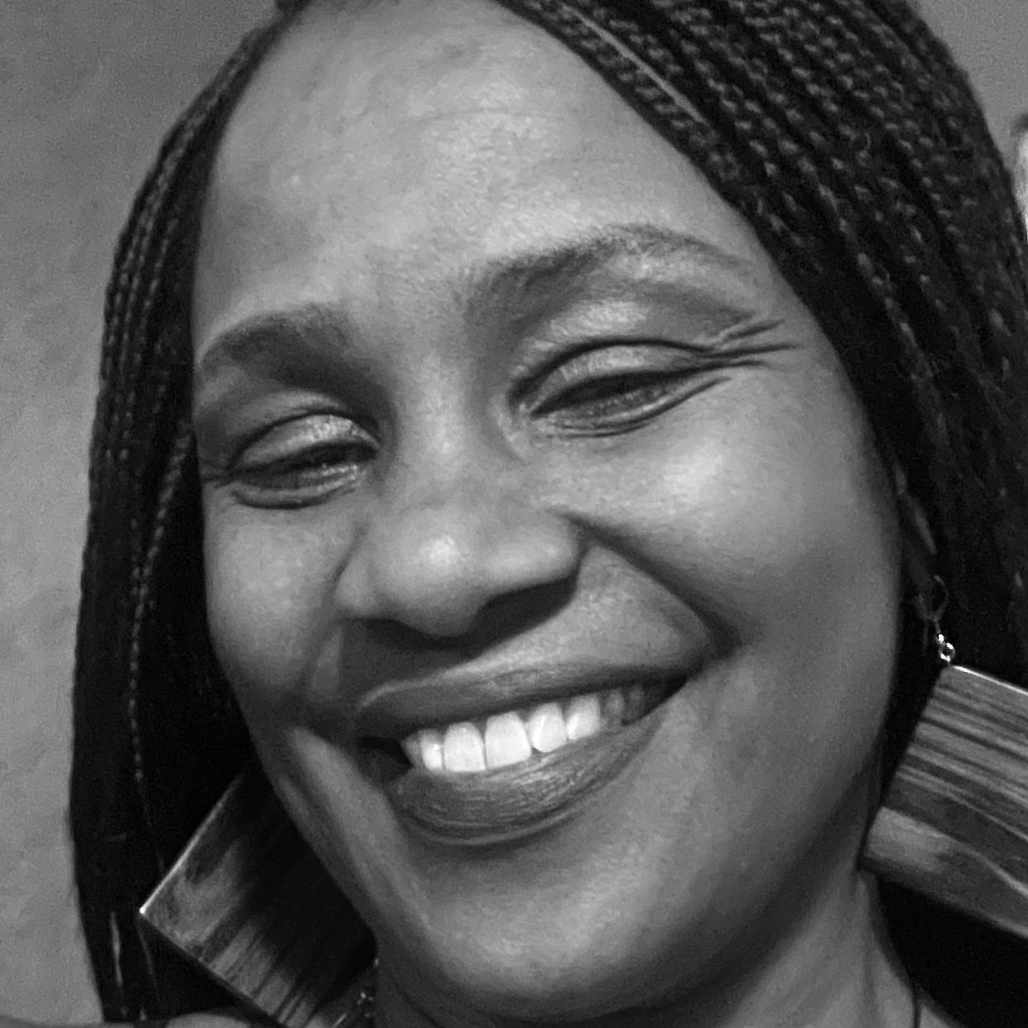
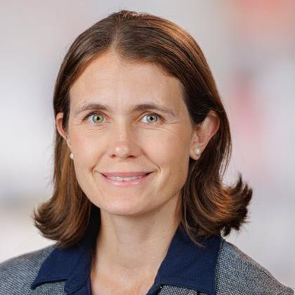
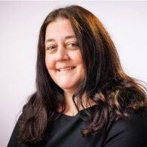
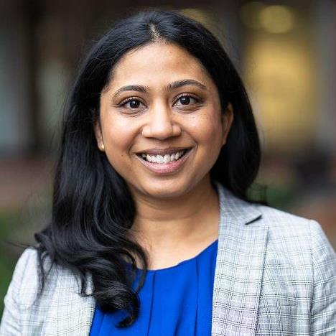
2026 Perspective: Building Solutions Together
Community Partnerships to Address Food Insecurity
Addressing Patient and Caregiver Burdens in Healthcare
Ann Jackson, PT, DPT, MPH
The Center for Food Equity in Medicine
Marcin Chwistek, MD, FAAHPM
Fox Chase Cancer Center
Patient Centered Strategies to Improve Care
Action, Expansion, and Evidence for New Models of Care
Lenora Starr
Fred Hutchinson Cancer Center
Megan Shen, PhD
Fred Hutchinson Cancer Center
Erin Gillespie, MD, MPH
Fred Hutchinson
Cancer Center
Joy Moody
FARMore WA
Erica Karlovits
Fred Hutchinson Cancer Center
Hiba Khan, MD, MPH
Fred Hutchinson Cancer Center

Slide 16
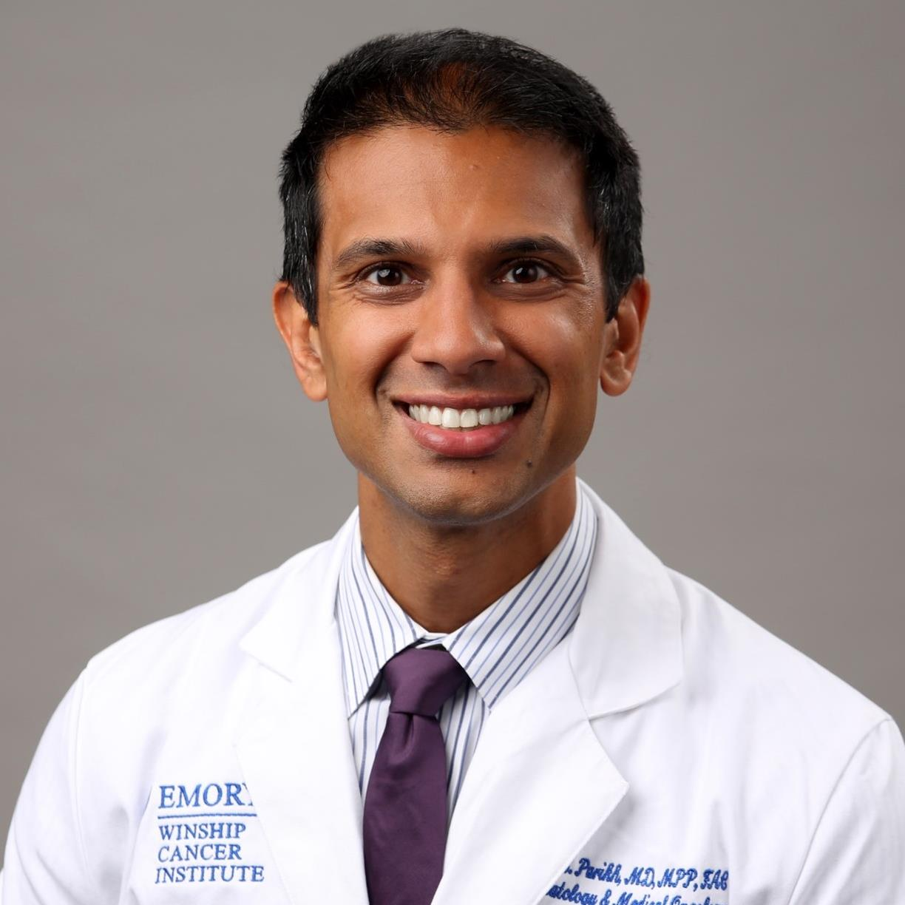
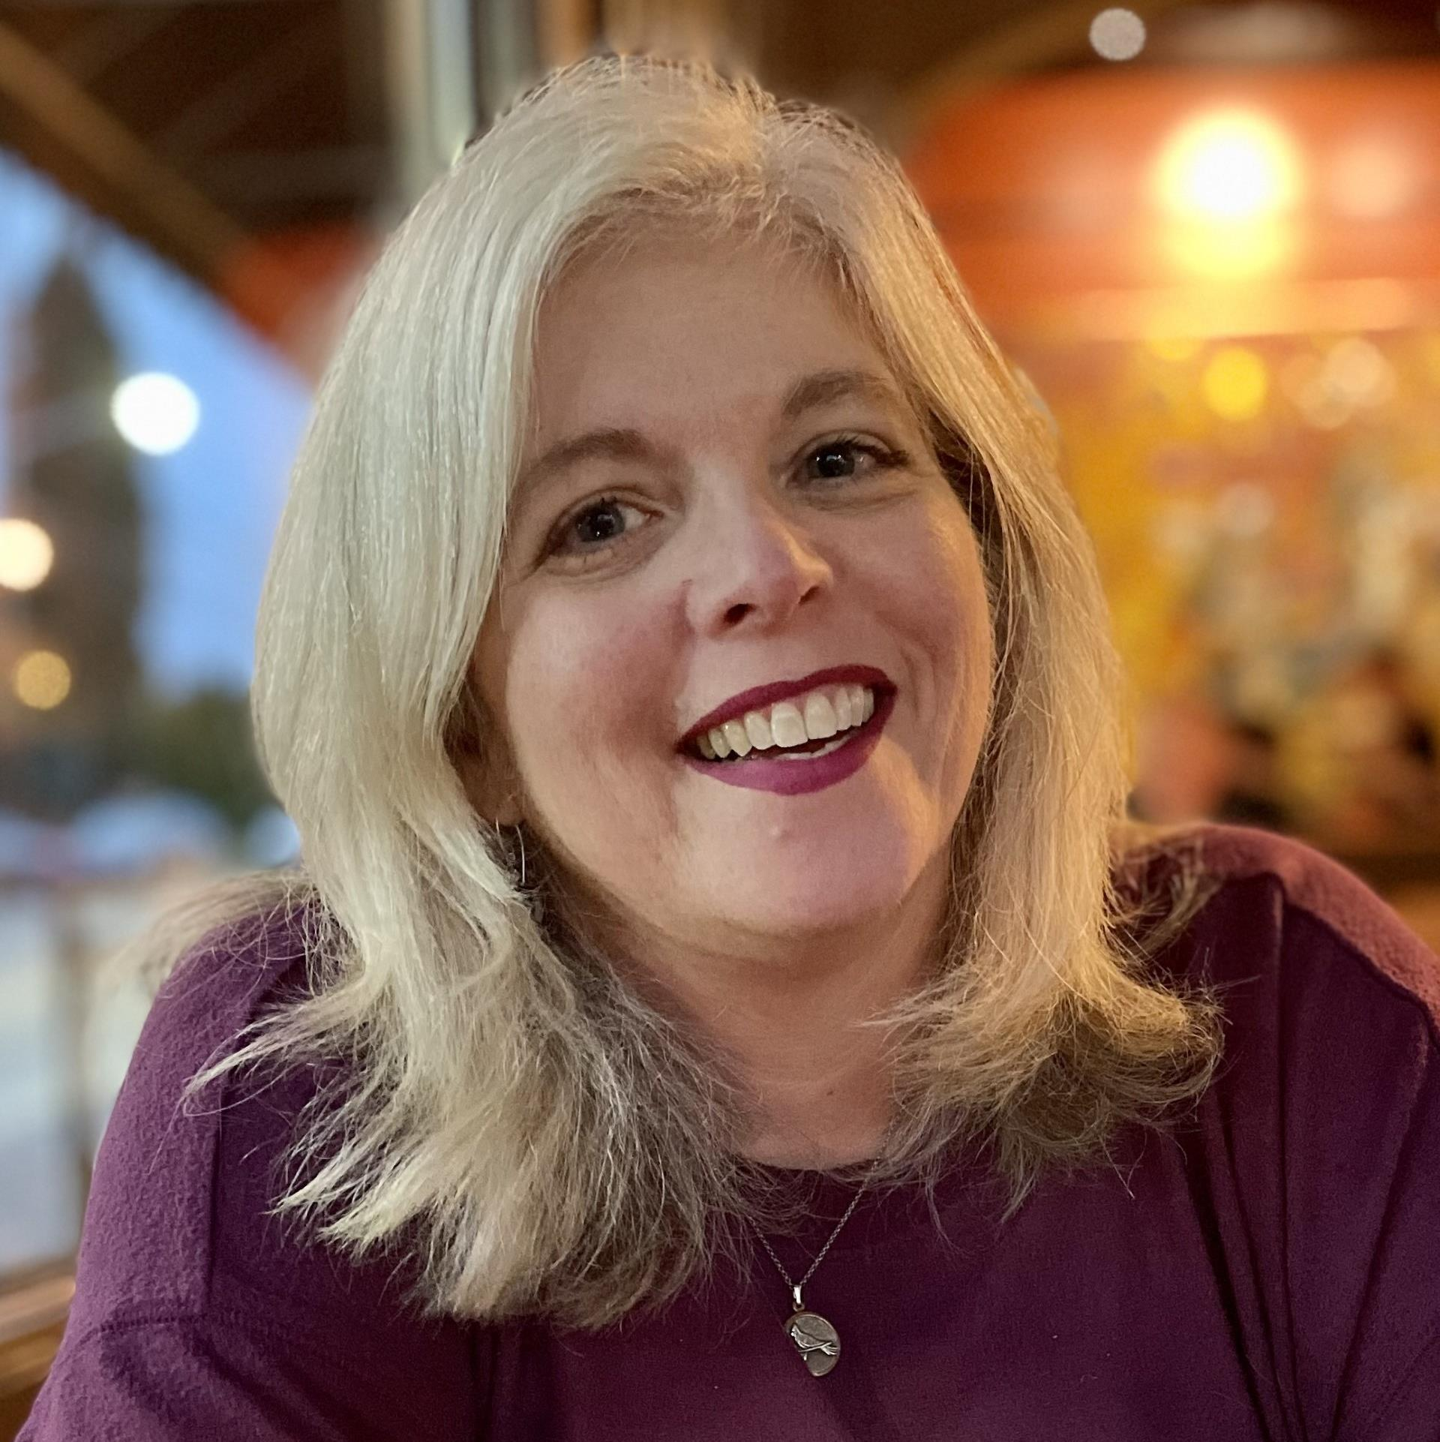
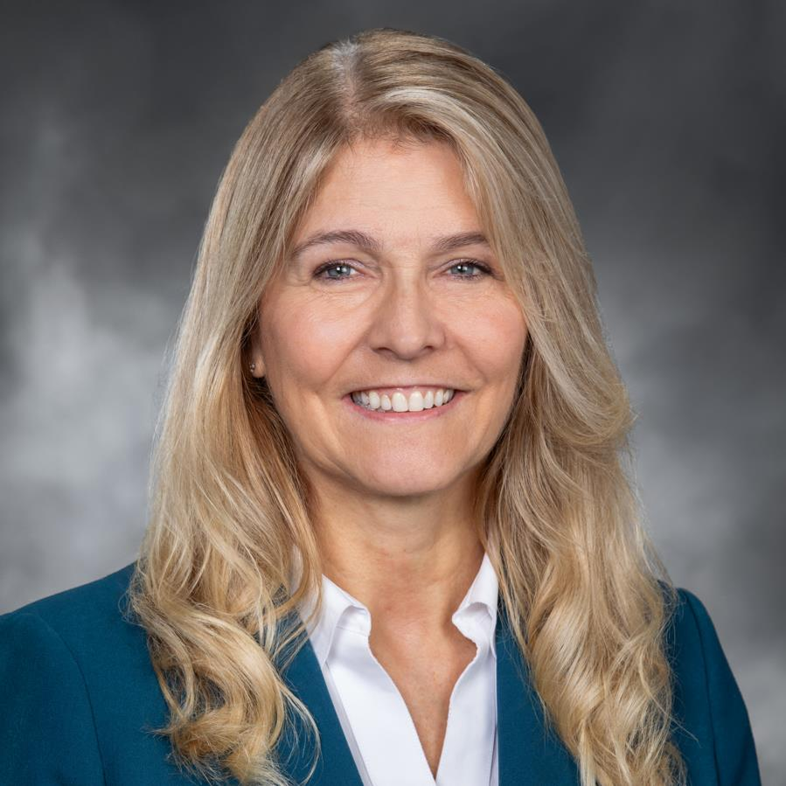
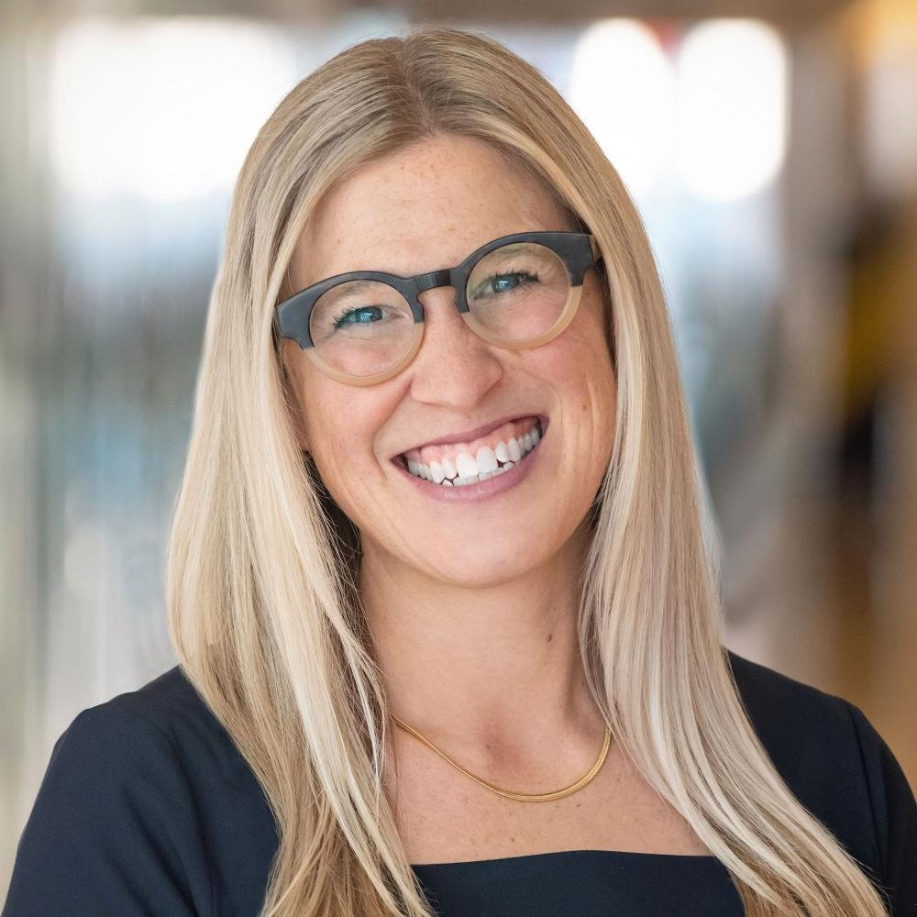
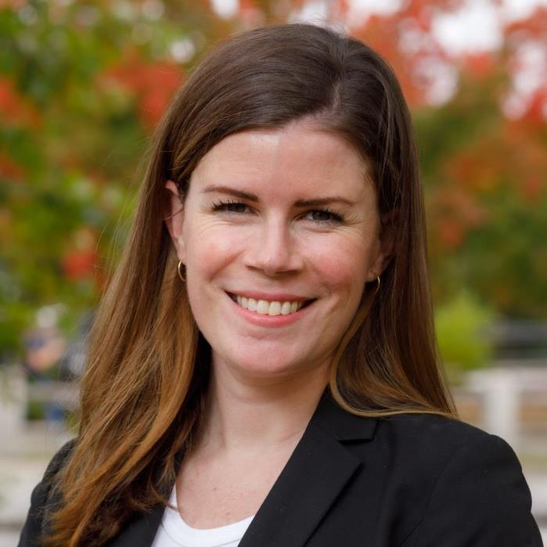
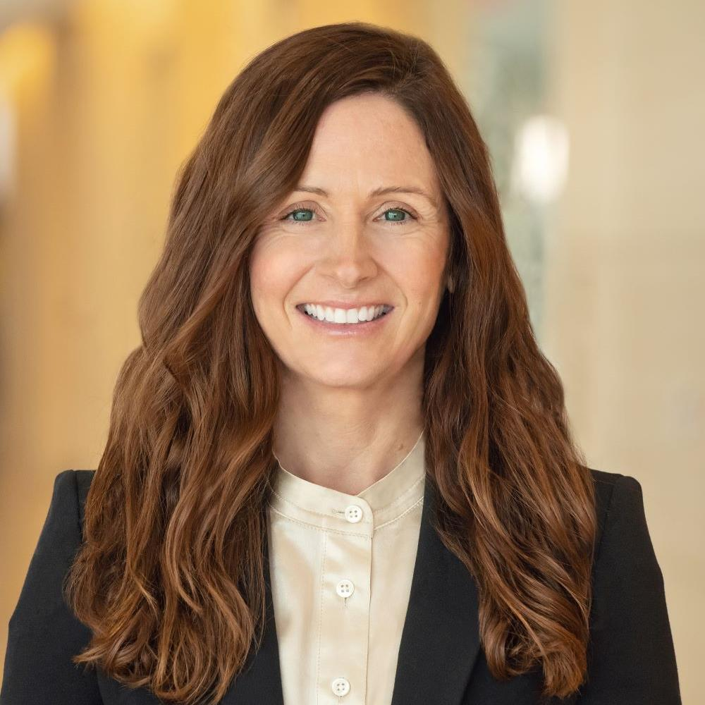
2026 Perspective: Building Solutions Together
Prioritizing Human-Centered Cancer Care in a Digital Era
Navigating Prior Authorizations in Oncology Care
Ravi Parikh, MD, MPP, FACP
Winship Cancer Institute of Emory University
Carolyn Rohrs, PharmD
Regence
Novel Community Solutions to Improve Patient Access to Medicine
Senator Tina Orwall
Washington House of Representatives
Emily Mackler, PharmD, BCOP
YesRx
Michael Anne Kyle, PhD, RN
University of Pennsylvania
Siobhan Norman
YesRx

Slide 17
“Once you choose hope, anything’s possible.”
— Christopher Reeve

