Slide 1

Survival Analysis using a 5-STAR Approach in Randomized Clinical Trials
Devan V. Mehrotra* and Rachel Marceau West
Biostatistics and Research Decision Sciences
* devan_mehrotra@merck.com
ID-PRISM seminar
Fred Hutchinson Cancer Research Center
Sep 30, 2020

Slide 2
Outline
Introduction
Motivating example
Logrank test
Alternatives to logrank test
Proposed 5-STAR approach
Other examples
Simulation results
Conclusions

Slide 3
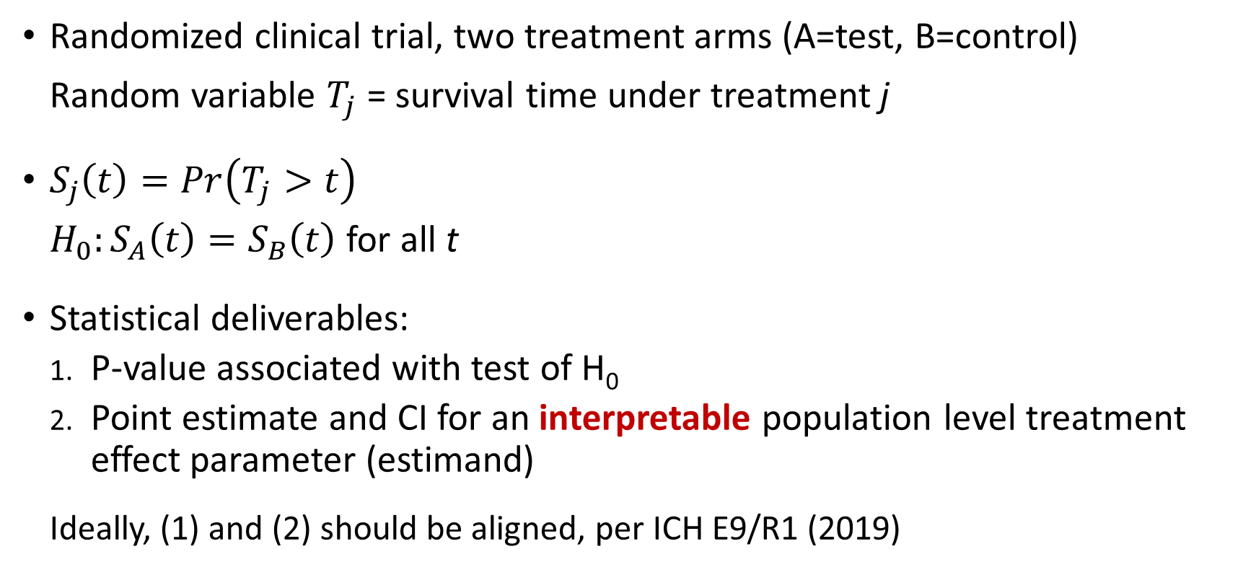
Introduction
Randomized clinical trial, two treatment arms (A=test, B=control)
Random variable $T_{j}$ = survival time under treatment j
$S_{j}\left(t\right)=Pr\left(T_{j}>t\right)$
$H_{0}:S_{A}\left(t\right)=S_{B}\left(t\right)$for all t
Statistical deliverables:
P-value associated with test of H₀
Point estimate and CI for an interpretable population level treatment effect parameter (estimand)
Ideally, (1) and (2) should be aligned, per ICH E9/R1 (2019)

Slide 4
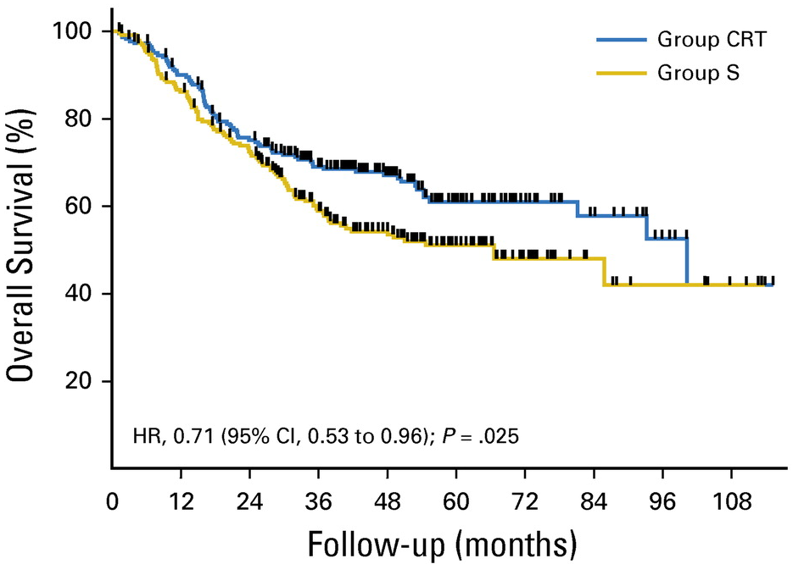


Logrank Test – Popular Analysis in RCTs
NEJM
2018
JCO
2018
Lancet Oncology
2015
JAMA
2016
2

Slide 5
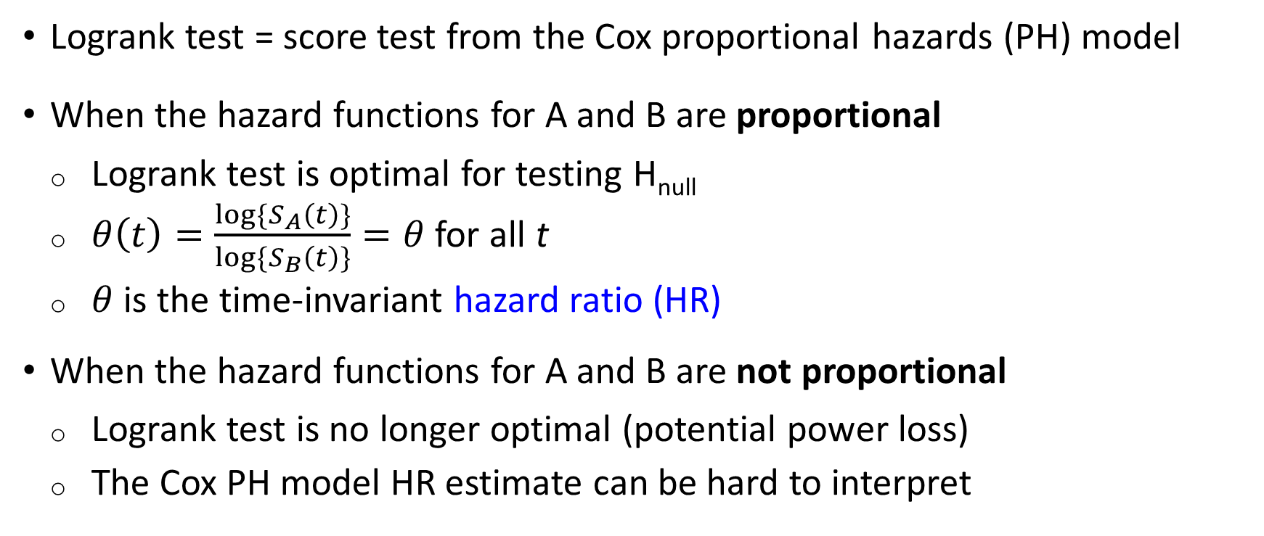
Logrank Test (continued)
Logrank test = score test from the Cox proportional hazards (PH) model
When the hazard functions for A and B are proportional
Logrank test is optimal for testing H_{null}
$θ\left(t\right)=\frac{{log\{S}_{A}\left(t\right)\}}{log\{S_{B}\left(t\right)\}}=θ$ for all t
$θ$is the time-invariant hazard ratio (HR)
When the hazard functions for A and B are not proportional
Logrank test is no longer optimal (potential power loss)
The Cox PH model HR estimate can be hard to interpret

Slide 6
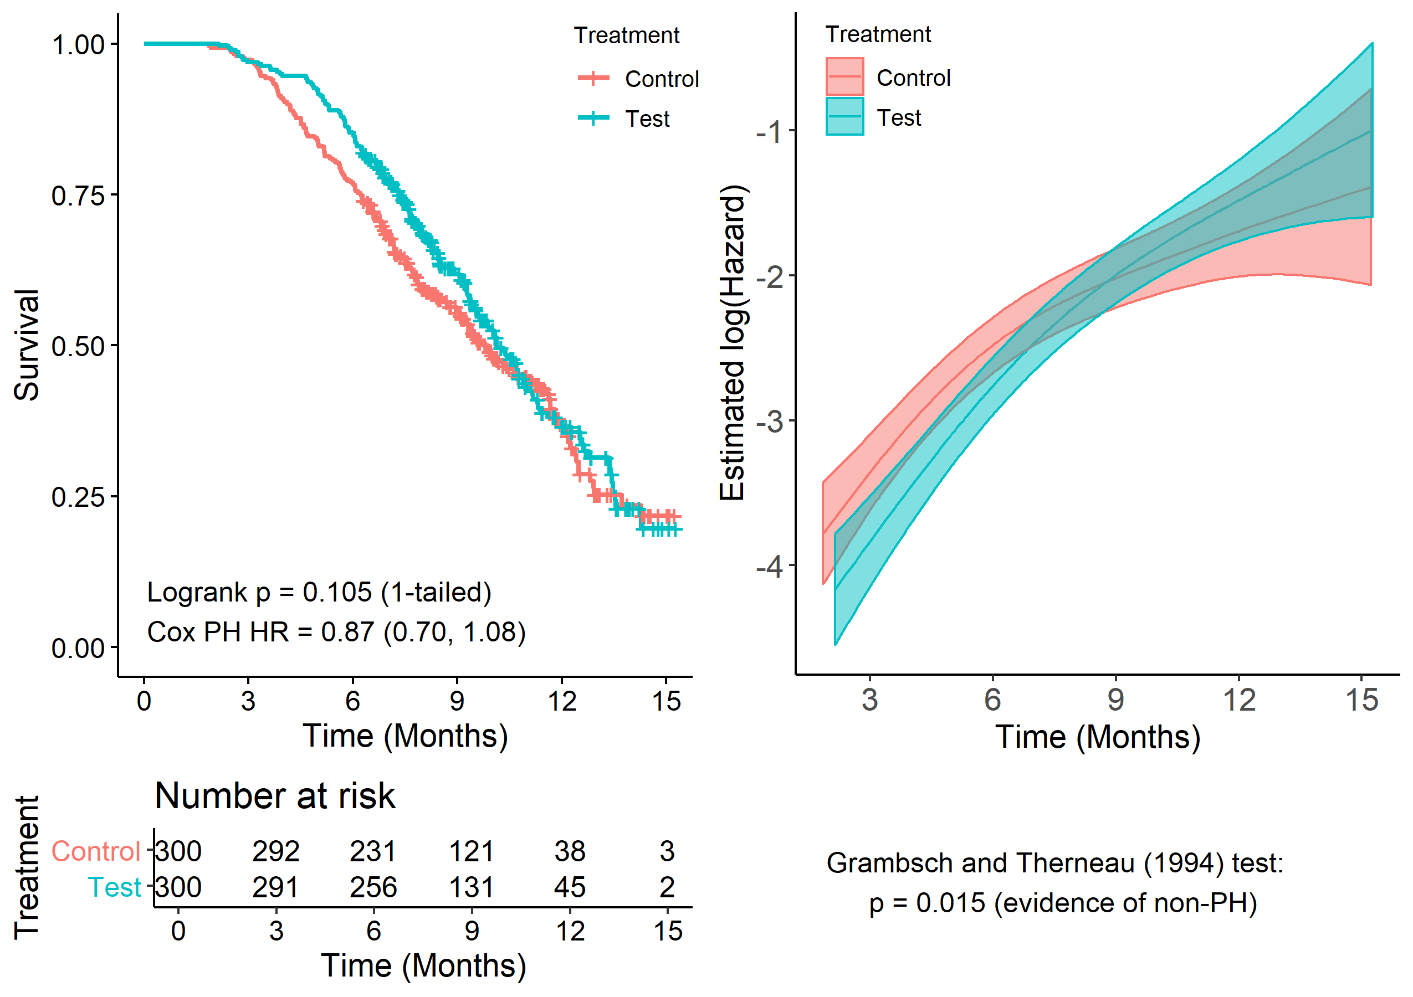

Motivating Example Treatments: A = test, B = control
simulated data

Slide 7
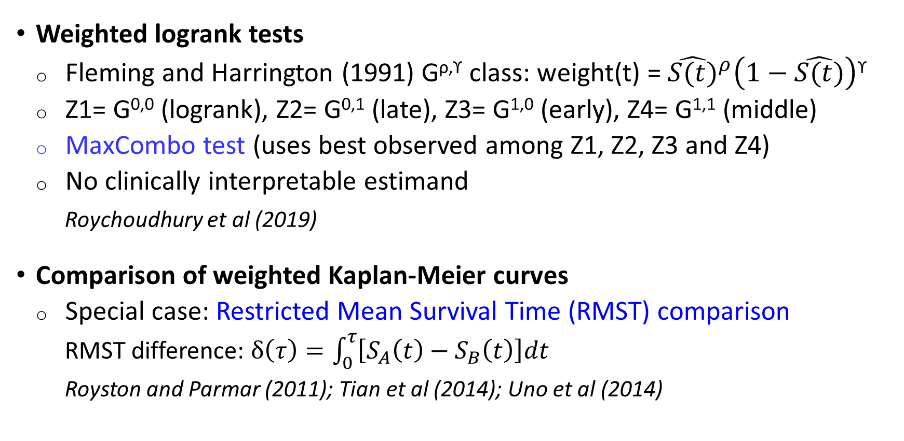
Alternatives to the Logrank Test
Weighted logrank tests
Fleming and Harrington (1991) G^{ρ,ϒ} class: weight(t) = ${\hat{S(t)}}^{ρ}\left(1−\hat{S(t)}\right)$^{ϒ}
Z1= G^{0,0} (logrank), Z2= G^{0,1} (late), Z3= G^{1,0} (early), Z4= G^{1,1} (middle)
MaxCombo test (uses best observed among Z1, Z2, Z3 and Z4)
No clinically interpretable estimand
Roychoudhury et al (2019)
Comparison of weighted Kaplan-Meier curves
Special case: Restricted Mean Survival Time (RMST) comparison
RMST difference: $δ\left(τ\right)=\int_{0}^{τ}{\left[S_{A}\left(t\right)−S_{B}\left(t\right)\right]dt}$
Royston and Parmar (2011); Tian et al (2014); Uno et al (2014)

Slide 8
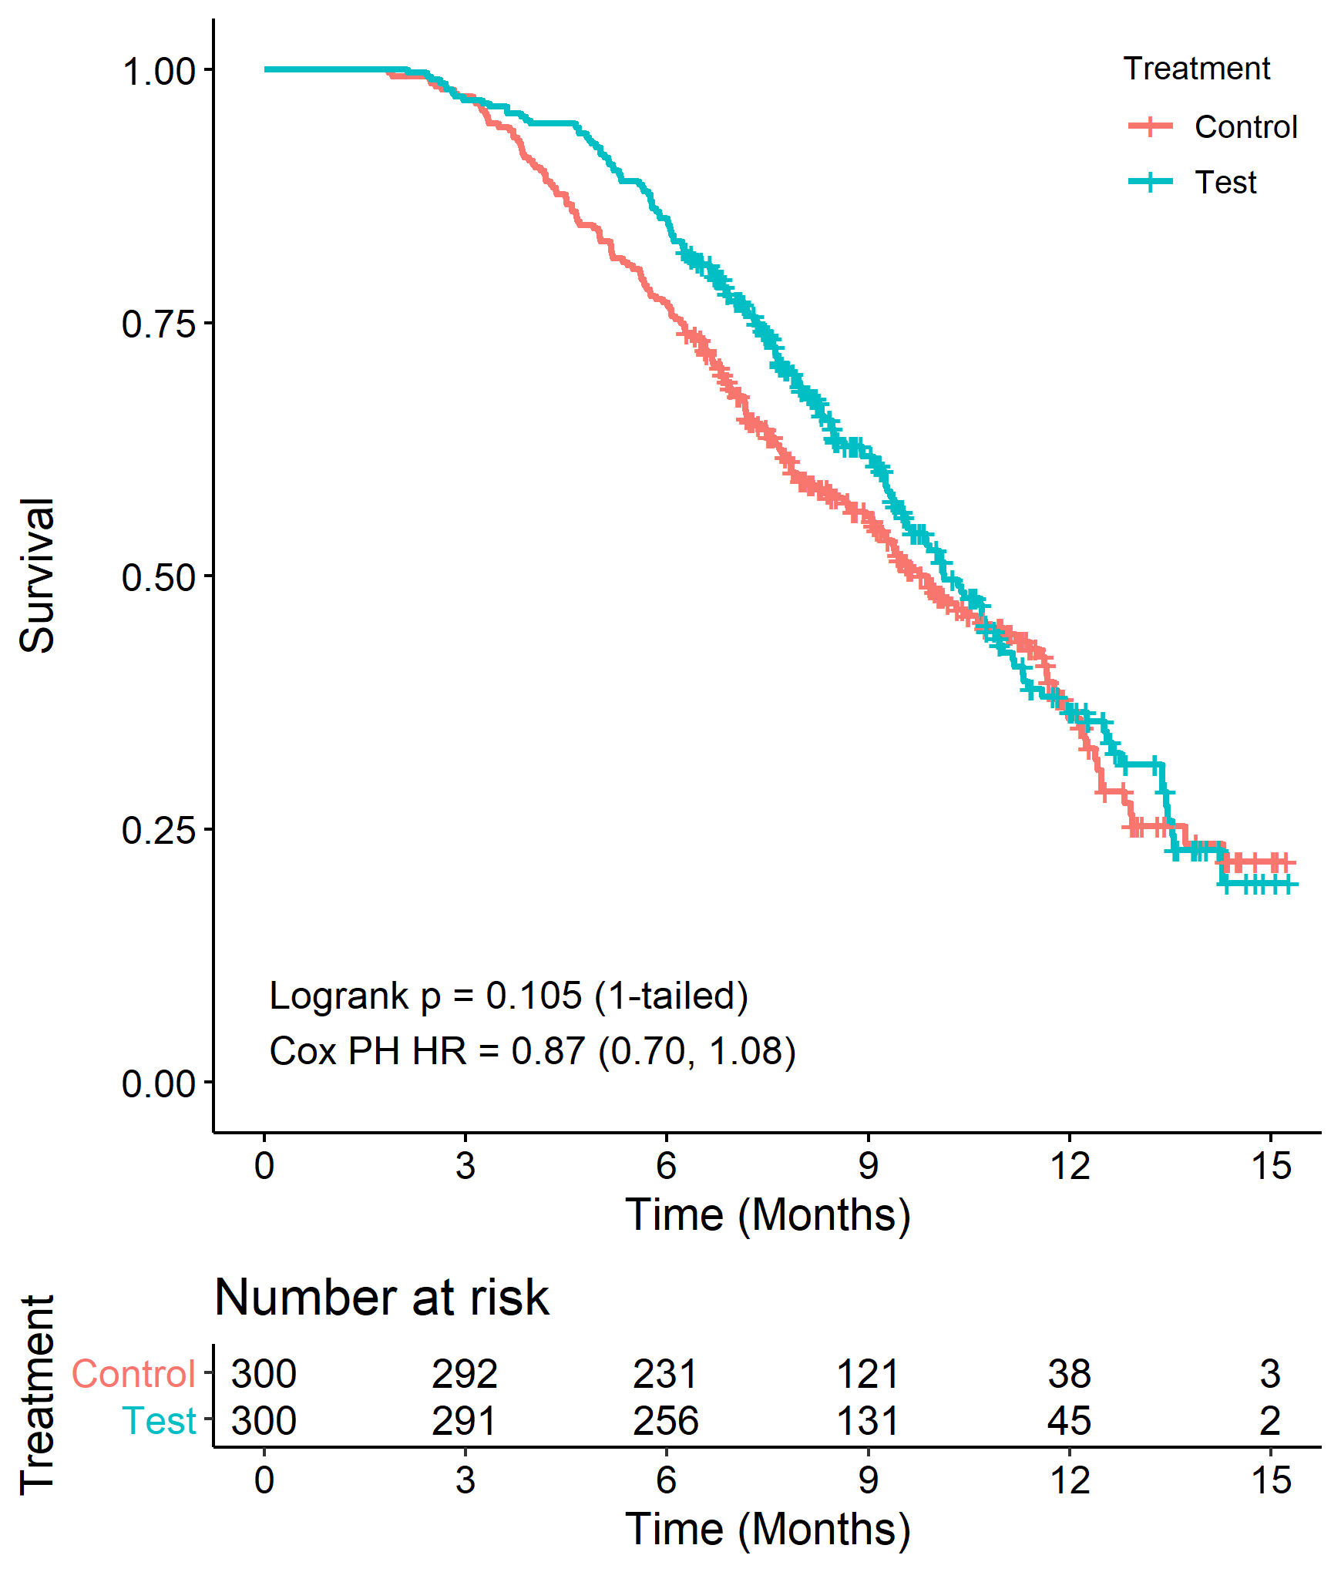
Motivating Example (continued)
Analysis Method | 1-tailed p-value
Logrank | 0.105
MaxCombo | 0.057
RMST | 0.082
No treatment effect “signal” using standard approaches
Correct conclusion for this dataset?
No … shown later

Slide 9







Proposed 5-STAR Approach
Detection of a treatment effect should be easier in a clinically homogeneous rather than a heterogeneous patient population
5-step Stratified Testing and Amalgamation Routine (5-STAR)
Overall
Population
Subpopulations
(risk strata)
Treatment Comparison
}
A vs. B
Amalgamate (combine) for overall inference
A vs. B
A vs. B

Slide 10
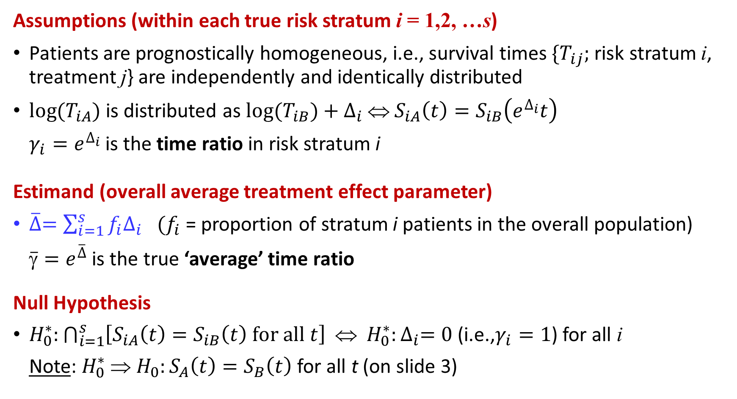
Problem Set-Up: Assumptions, Estimand, Null Hypothesis
Assumptions (within each true risk stratum i = 1,2, …s)
Patients are prognostically homogeneous, i.e., survival times $\{T_{ij};$risk stratum i, treatment j} are independently and identically distributed
${log⁡(T}_{iA})$ is distributed as ${log⁡(T}_{iB})+∆_{i}$ ⇔ $S_{iA}\left(t\right)=S_{iB}\left(e^{∆_{i}}t\right)$
$γ_{i}=e^{∆_{i}}$is the time ratio in risk stratum i
Estimand (overall average treatment effect parameter)
$\overline{∆}=\sum_{i=1}^{s}{f_{i}∆_{i}}$ ${(f}_{i}$= proportion of stratum i patients in the overall population)
$\overline{γ}=e^{\overline{∆}}$ is the true ‘average’ time ratio
Null Hypothesis
$H_{0}^{∗}:\bigcap_{i=1}^{s}{\left[S_{iA}\left(t\right)=S_{iB}\left(t\right) for all t\right]}$ ⇔ ${H_{0}^{∗}:∆}_{i}=0$(i.e.,$γ_{i}=1$) for all i
Note: $H_{0}^{∗} ⇒ H_{0}:S_{A}\left(t\right)=S_{B}\left(t\right)$for all t (on slide 3)

Slide 11
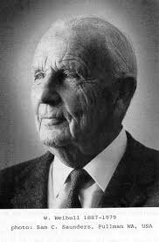
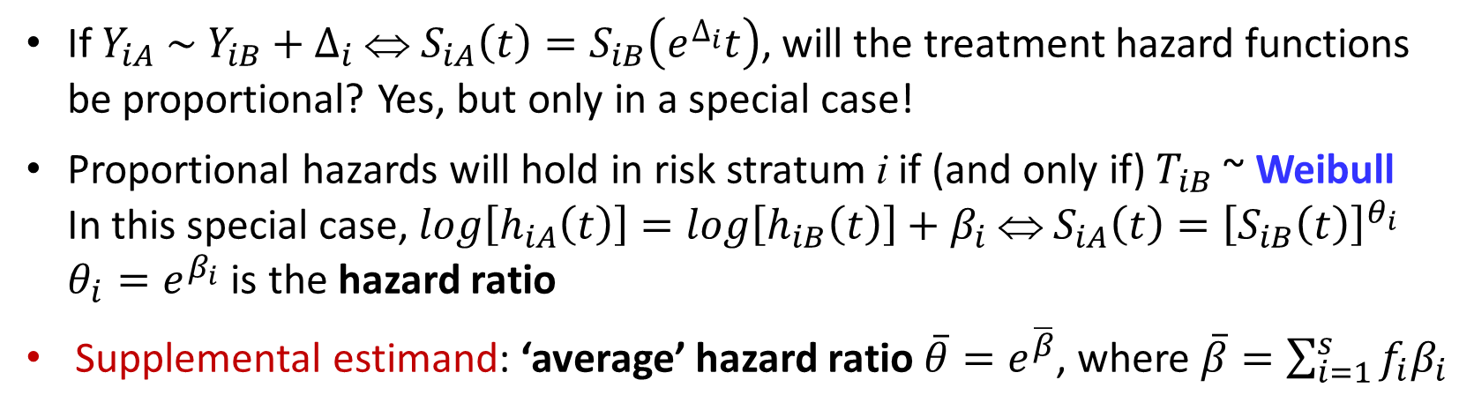
Problem Set-Up: What About Hazard Ratios?
If $Y_{iA} \sim Y_{iB}+∆_{i}$ ⇔ $S_{iA}\left(t\right)=S_{iB}\left(e^{∆_{i}}t\right)$, will the treatment hazard functions be proportional? Yes, but only in a special case!
Proportional hazards will hold in risk stratum i if (and only if) $T_{iB}$~ Weibull In this special case, $log\left[h_{iA}\left(t\right)\right]=log\left[h_{iB}\left(t\right)\right]+β_{i}$⇔ $S_{iA}\left(t\right)={\left[S_{iB}\left(t\right)\right]}^{θ_{i}}$
$θ_{i}=e^{β_{i}}$ is the hazard ratio
Supplemental estimand: ‘average’ hazard ratio $\overline{θ}=e^{\overline{β}}$, where $\overline{β}=\sum_{i=1}^{s}{f_{i}β_{i}}$
Survival times from many RCTs are well-described by a mixture of Weibull distributions
A flexible parametric survival model for fitting time to event data in clinical trials
Jason Liao, Frank Liu. Pharmaceutical Statistics. 2019;18:555–567 [Weibull mixtures]
Waloddi Weibull
1887-1979

Slide 12
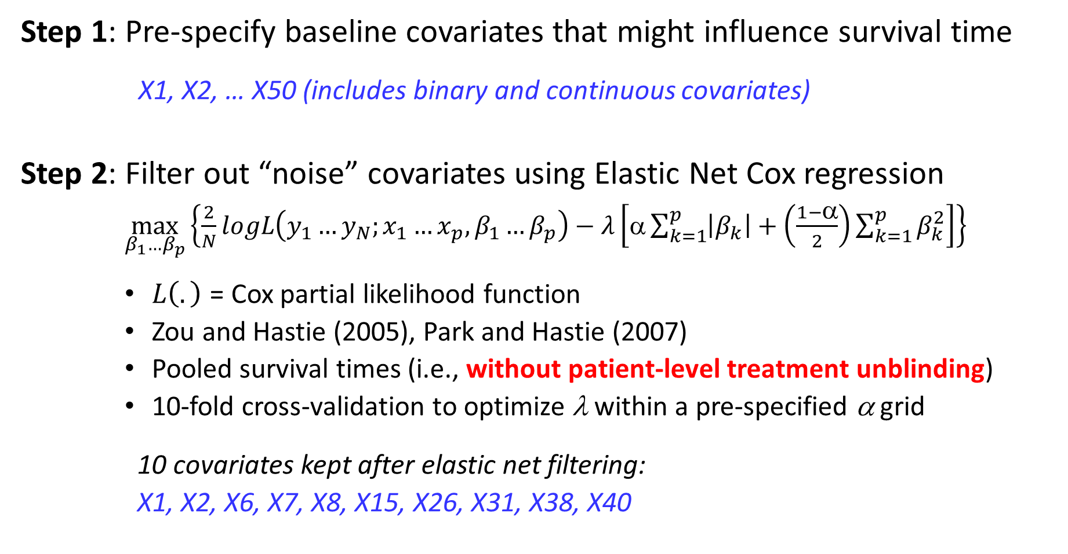
Motivating Example (continued): 5-STAR application
Step 1: Pre-specify baseline covariates that might influence survival time
X1, X2, … X50 (includes binary and continuous covariates)
Step 2: Filter out “noise” covariates using Elastic Net Cox regression
$\max_{β_{1}…β_{p}}\left\{\frac{2}{N}logL\left(y_{1}…y_{N};x_{1}…x_{p},β_{1}…β_{p}\right)−λ\left[α\sum_{k=1}^{p}{\left|β_{k}\right|}+\left(\frac{1−α}{2}\right)\sum_{k=1}^{p}{β_{k}^{2}}\right]\right\}{ }$
$L\left(.\right)$ = Cox partial likelihood function
Zou and Hastie (2005), Park and Hastie (2007)
Pooled survival times (i.e., without patient-level treatment unblinding)
10-fold cross-validation to optimize λ within a pre-specified α grid
10 covariates kept after elastic net filtering:
X1, X2, X6, X7, X8, X15, X26, X31, X38, X40

Slide 13
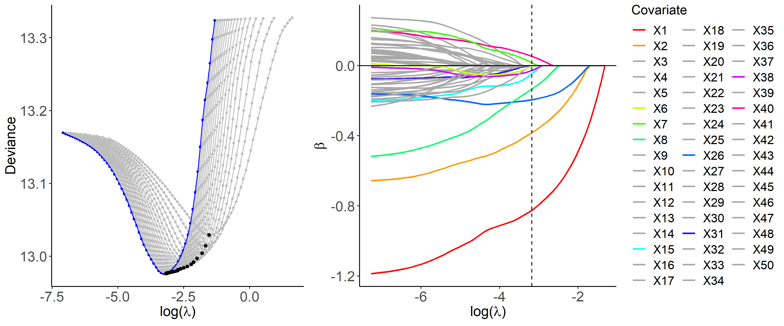
Motivating Example (continued): 5-STAR application
Optimization of α and λ
ENET solution path with α_{opt} = 0.95
-3.22 = log(0.04)

Slide 14

Motivating Example (continued): 5-STAR application
Step 3: Form risk strata using Conditional Inference Tree algorithm (Hothorn et al; 2006) without patient-level treatment unblinding
3A Form preliminary risk strata
Input: covariates which passed step 2
3B Re-run CTree with ordered risk stratum membership from step 3A as a covariate (final risk strata)
Preliminary Strata:
pS1: X1 = 0, X26 ≤ 0.35
pS2: X1 = 0, X2 = 0, X26 > 0.35 pS3: X1 = 1, X2 = 0, X26 $≤$ 0.35
pS4: X1 = 0, X2 = 1, X26 > 0.35
pS5: X1 = 1, X2 = 1
pS6: X1 = 1, X2 = 0, X26 > 0.35
Final Strata:
S1: X1 = 0, X26 ≤ 0.35
S2: X2 = 0, {(X1 = 0, X26 > 0.35) or (X1 = 1, X26 ≤ 0.35)}
S3: X1 = 0, X2 = 1, X26 > 0.35
S4: X1 = 1, {(X2 = 1) or (X2 = 0, X26 > 0.35)}

Slide 15
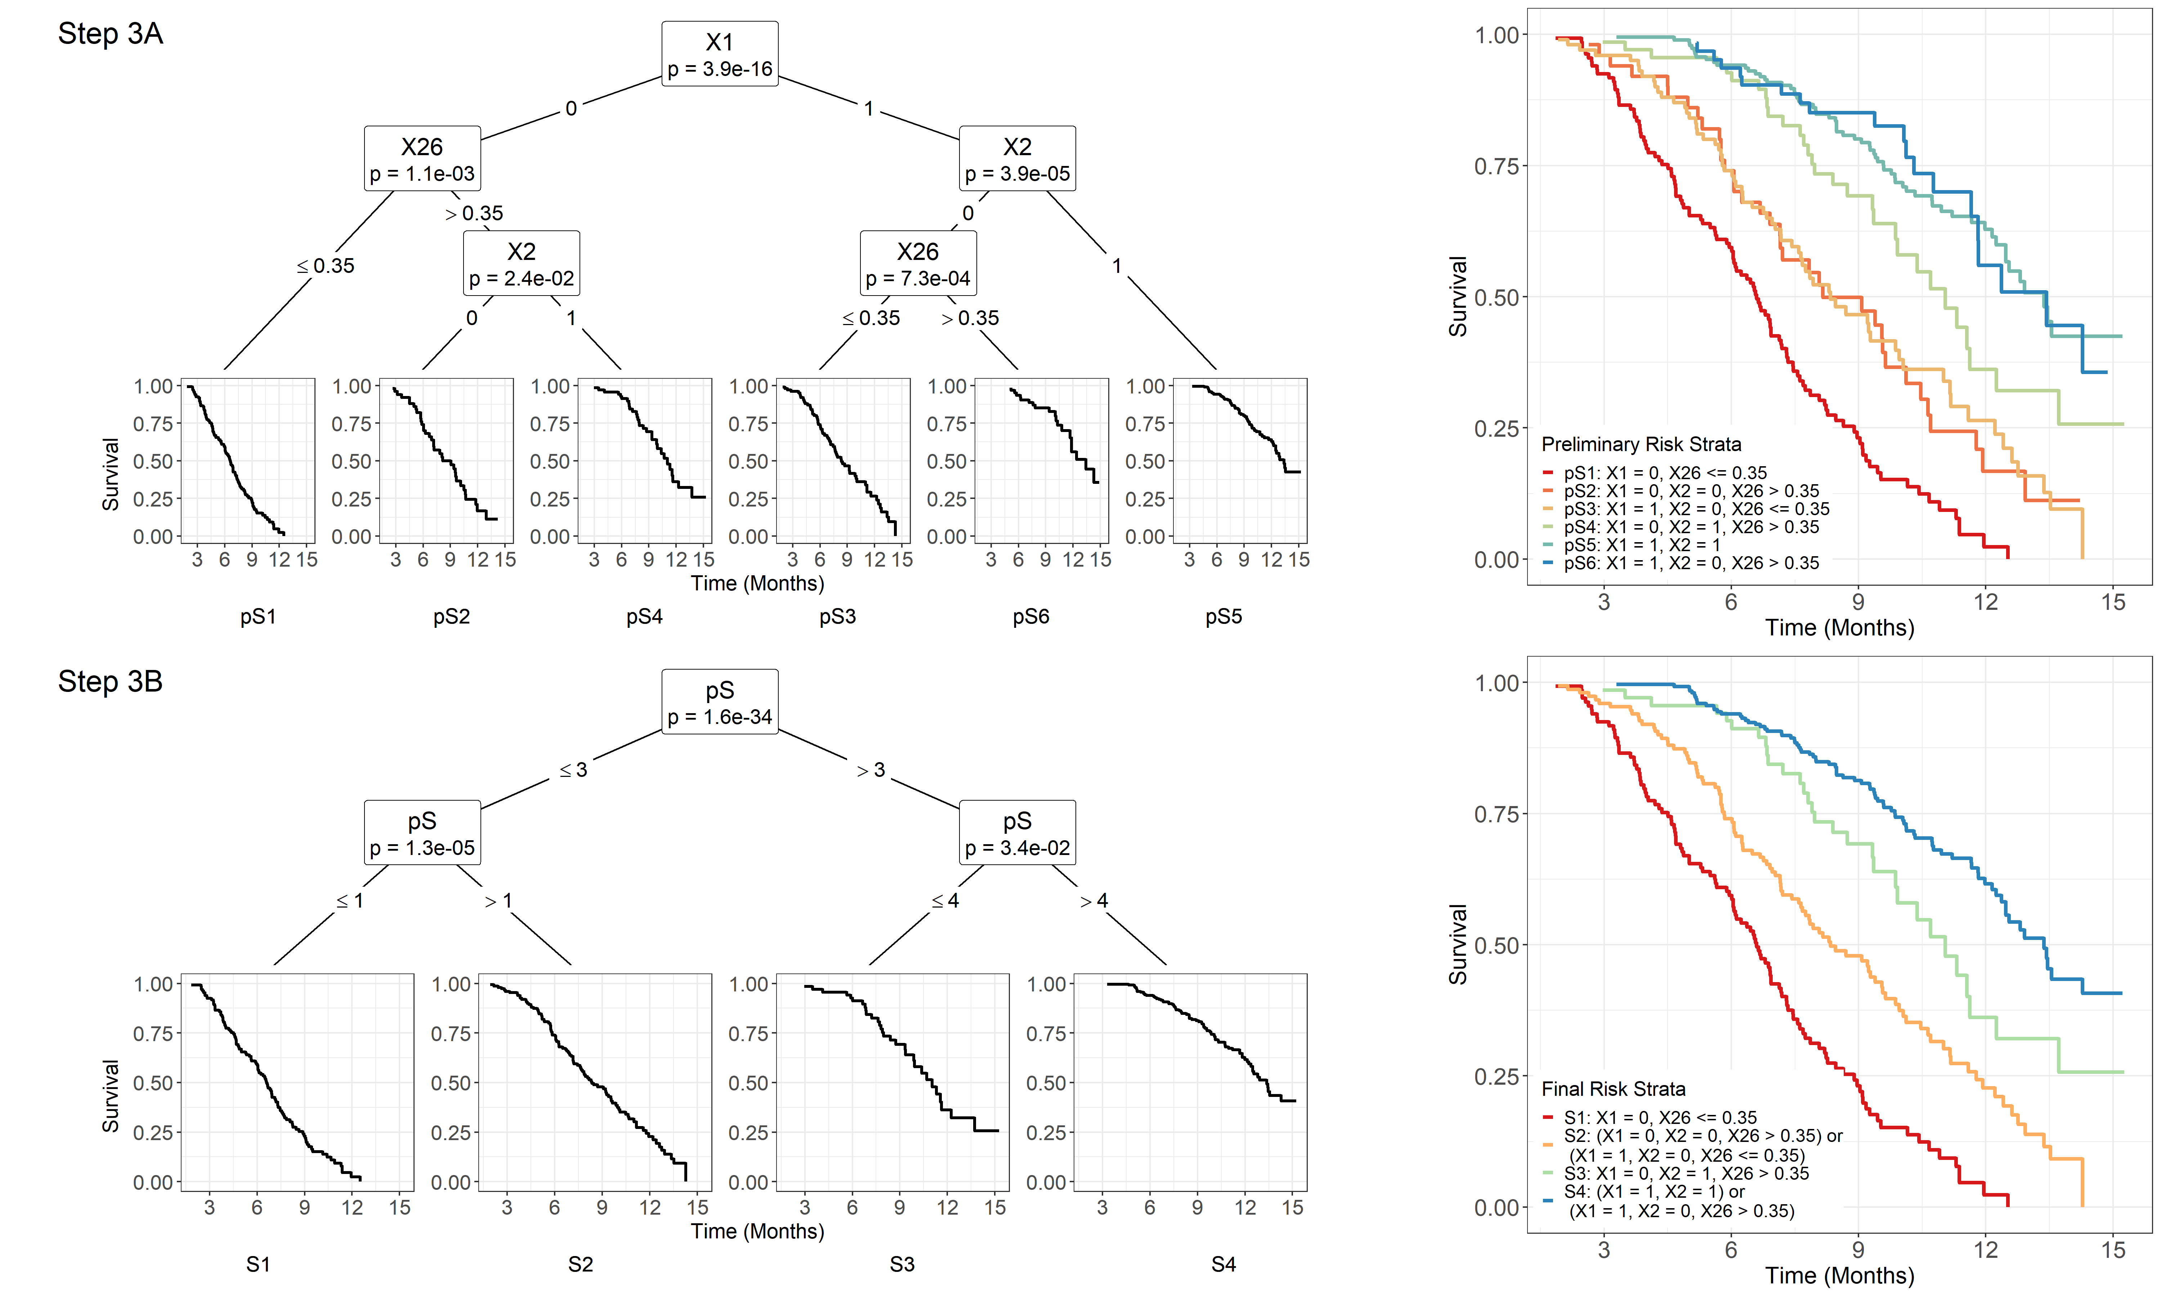

Slide 16
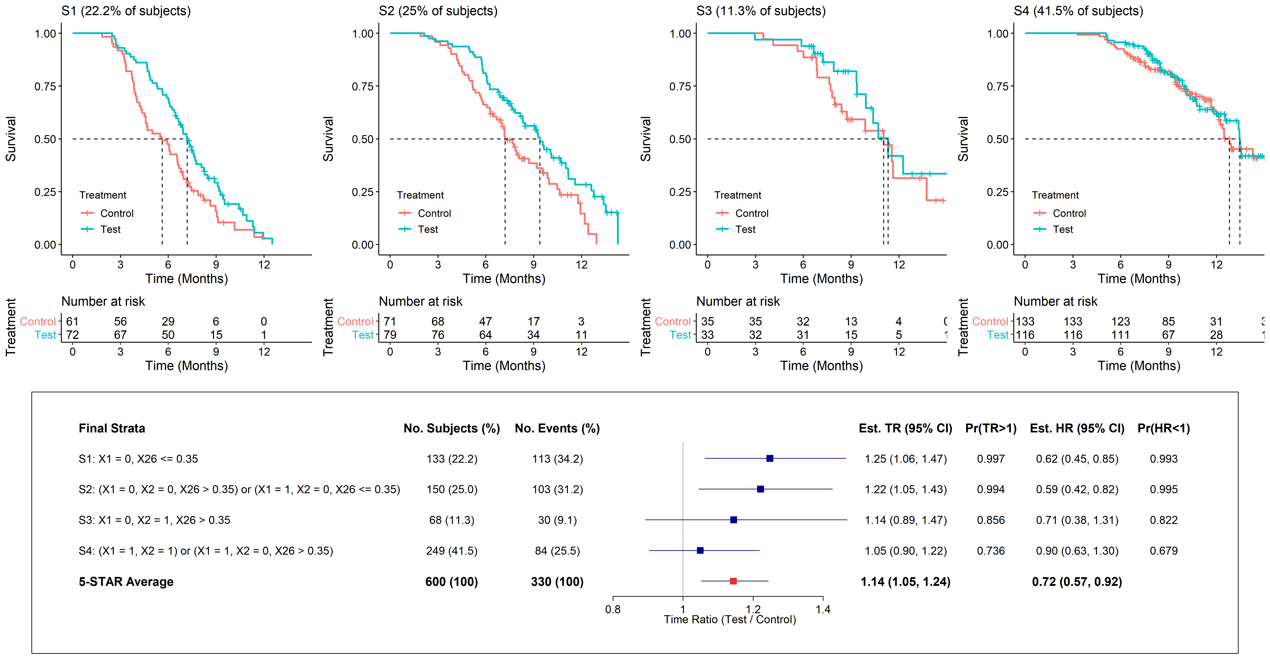

Motivating Example (continued): 5-STAR application
Step 4: Estimate treatment effect within each formed risk stratum
Treatment effect in formed risk stratum q
Primary: $δ_{q}=E\left[log\left(T_{qA}\right)\right]−E\left[log\left(T_{qB}\right)\right], γ_{q}=exp\left(δ_{q}\right)$ (Time Ratio; TR)
Supplemental: $β_{q}=log⁡\left[−logS_{qA}\left(t\right)/−logS_{qB}\left(t\right)\right] assuming PH;{ θ}_{q}=exp\left(q\right)$ (Hazard Ratio; HR)
TR: 1.22 (1.05, 1.43)
TR: 1.14 (0.89, 1.47)
TR: 1.05 (0.90, 1.22)
TR: 1.25 (1.06, 1.47)
HR: 0.59 (0.42, 0.82)
HR: 0.71 (0.38, 1.31)
HR: 0.90 (0.63, 1.30)
HR: 0.62 (0.45, 0.85)

Slide 17

Motivating Example (continued): 5-STAR application
Step 4: primary analysis within formed risk stratum q (=1,2, … c)
Analysis model: $log\left(T_{qjk}\right)=μ_{q}+δ_{q}I_{qk}+σ_{q}ε_{qjk}$ for formed strat q, trt j, subj k
$I_{qk}$=1[0] for treatment A[B], $δ_{q}=E\left[log\left(T_{qAk}\right)\right]−E\left[log\left(T_{qBk}\right)\right]$
Three parametric fits (T_{ijk}∼ Weibull, log-normal, log-logistic) → model averaging
Obtain${ \hat{δ}}_{q,m}$, $V_{q,m}$= $V$(${ \hat{δ}}_{q,m}$), ${AIC}_{q,m}$from parametric model fit m
$w_{q,m}=\frac{e^{−0.5{AIC}_{q,m}}}{\sum_{m=1}^{M}{e^{−0.5{AIC}_{q,m}}}}$
${\hat{δ}}_{q}=\sum_{m=1}^{M}{w_{q,m}{\hat{δ}}_{q,m}}$
$V_{q}={\left[\sum_{m=1}^{M}{w_{q,m}\sqrt{V_{q,m}+{\left({\hat{δ}}_{q,m}−{\hat{δ}}_{q}\right)}^{2}}}\right]}^{2}$
95% CI for Time Ratio (TR) in formed risk stratum q: exp{${\hat{δ}}_{q}∓1.96\sqrt{V_{q}}\}$

Slide 18
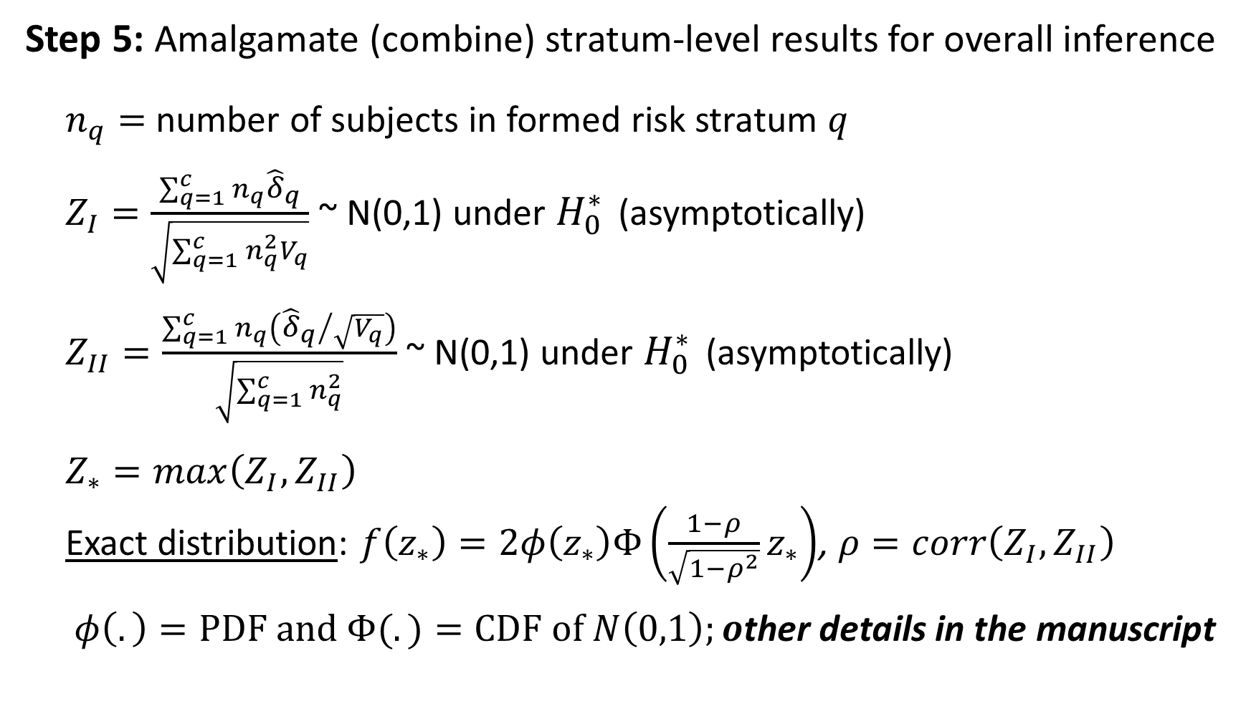
Motivating Example (continued): 5-STAR application
Step 5: Amalgamate (combine) stratum-level results for overall inference
$n_{q}=$ number of subjects in formed risk stratum $q$
$Z_{I}=\frac{\sum_{q=1}^{c}{n_{q}{\hat{δ}}_{q}}}{\sqrt{\sum_{q=1}^{c}{n_{q}^{2}V_{q}}}}$~ N(0,1) under $H_{0}^{∗}$ (asymptotically)
$Z_{II}=\frac{\sum_{q=1}^{c}{n_{q}\left({{\hat{δ}}_{q}}/{\sqrt{V_{q}}}\right)}}{\sqrt{\sum_{q=1}^{c}{n_{q}^{2}}}}$~ N(0,1) under $H_{0}^{∗}$ (asymptotically)
$Z_{∗}=max\left(Z_{I},Z_{II}\right)$
Exact distribution: $f\left(z_{∗}\right)=2φ\left(z_{∗}\right)Φ\left(\frac{1−ρ}{\sqrt{1−ρ^{2}}}z_{∗}\right)$, $ρ=corr\left(Z_{I},Z_{II}\right)$
$φ\left(.\right)=PDF and Φ(.)=CDF of N\left(0,1\right);o$ther details in the manuscript

Slide 19
Motivating Example (continued): 5-STAR application
Analysis Method | 1-tailed p-value
Logrank | 0.105
MaxCombo | 0.057
RMST | 0.082
5-STAR [TR] | 0.001
5-STAR [HR] | 0.004
Detailed results for each identified risk stratum
Primary
Supplemental

Slide 20
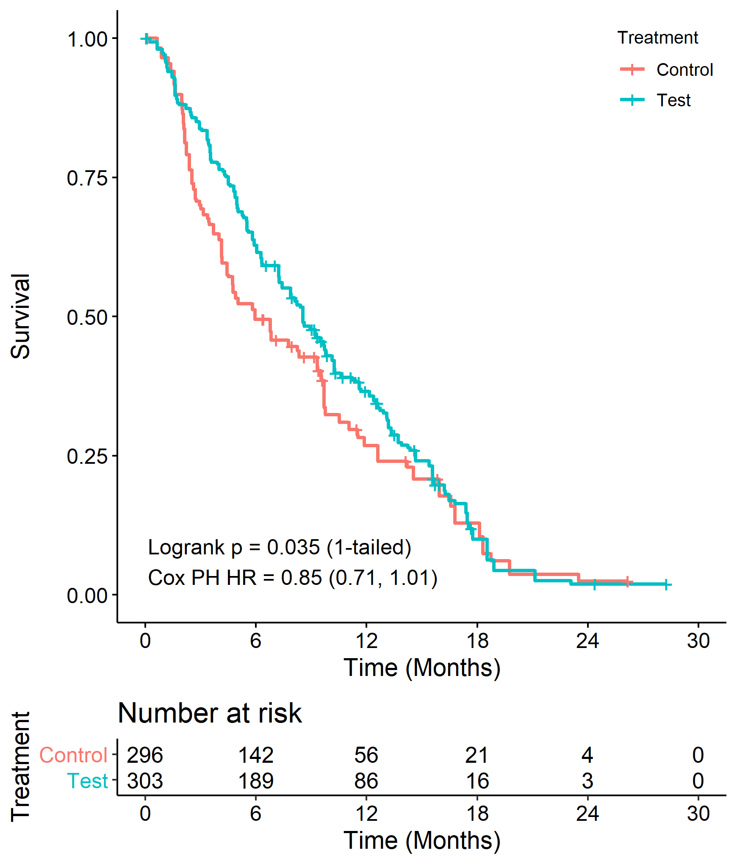
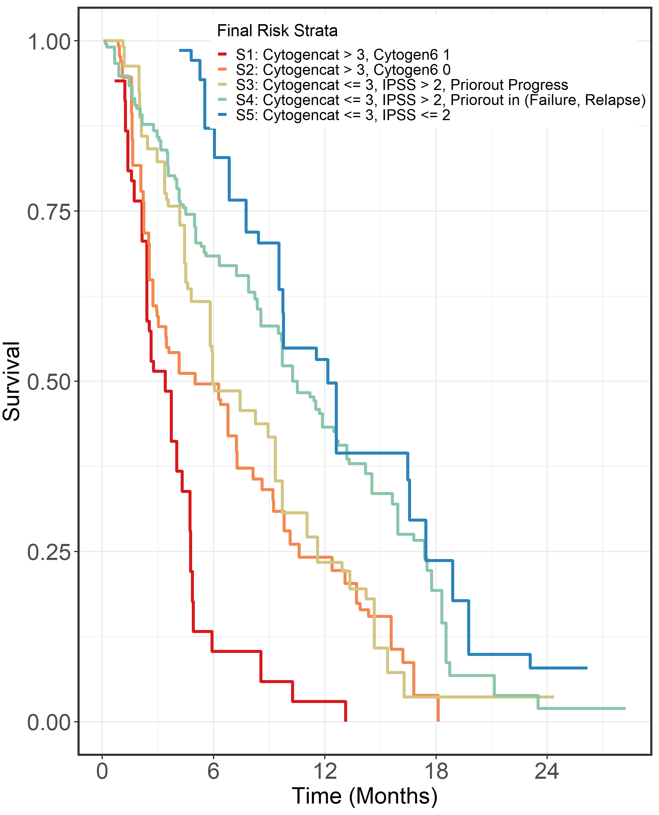
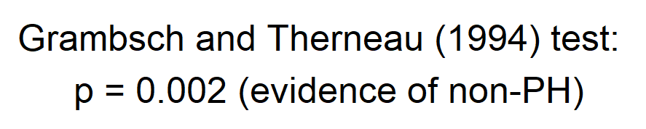
Example #2 (oncology, N=599)
5-STAR
Step 1: 14 covariates in candidate set
Step 2: 7 covariates advance to step 3
Step 3: 5 risk strata formed based on 4 covariates (below)
No pre-specified strata
Analysis Method | 1-tailed p-value
Logrank | 0.035
MaxCombo | 0.004
RMST | 0.014
Analysis Method | 1-tailed p-value
5-STAR [TR] | 0.001
5-STAR [HR] | 0.018

Slide 21
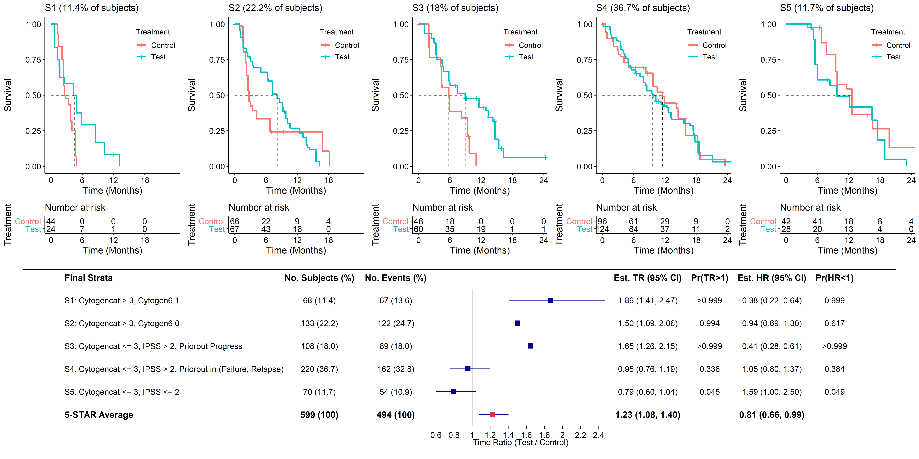
Example #2 (continued)
Primary
Supplemental

Slide 22
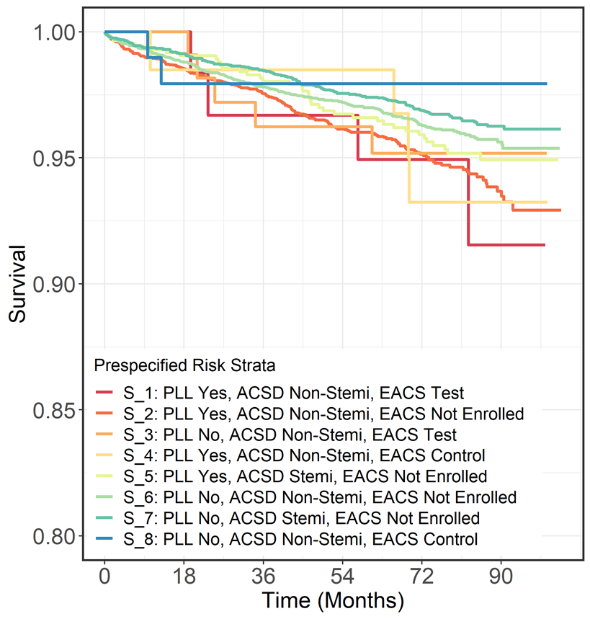
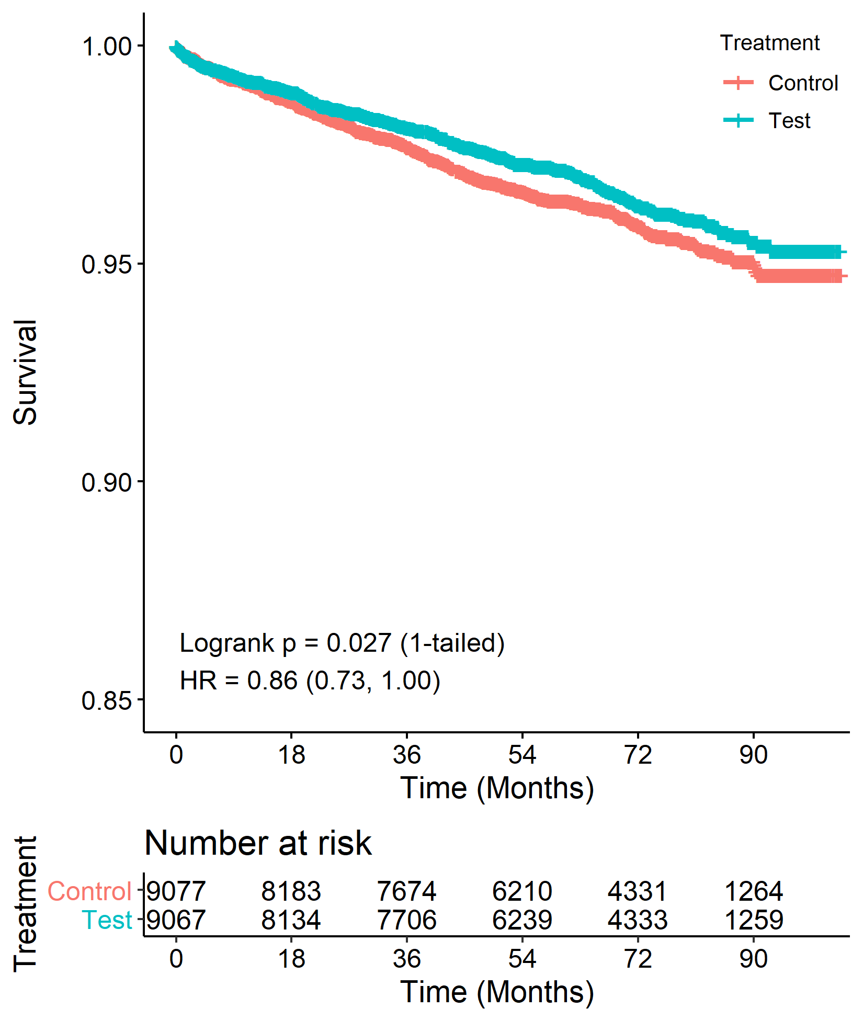
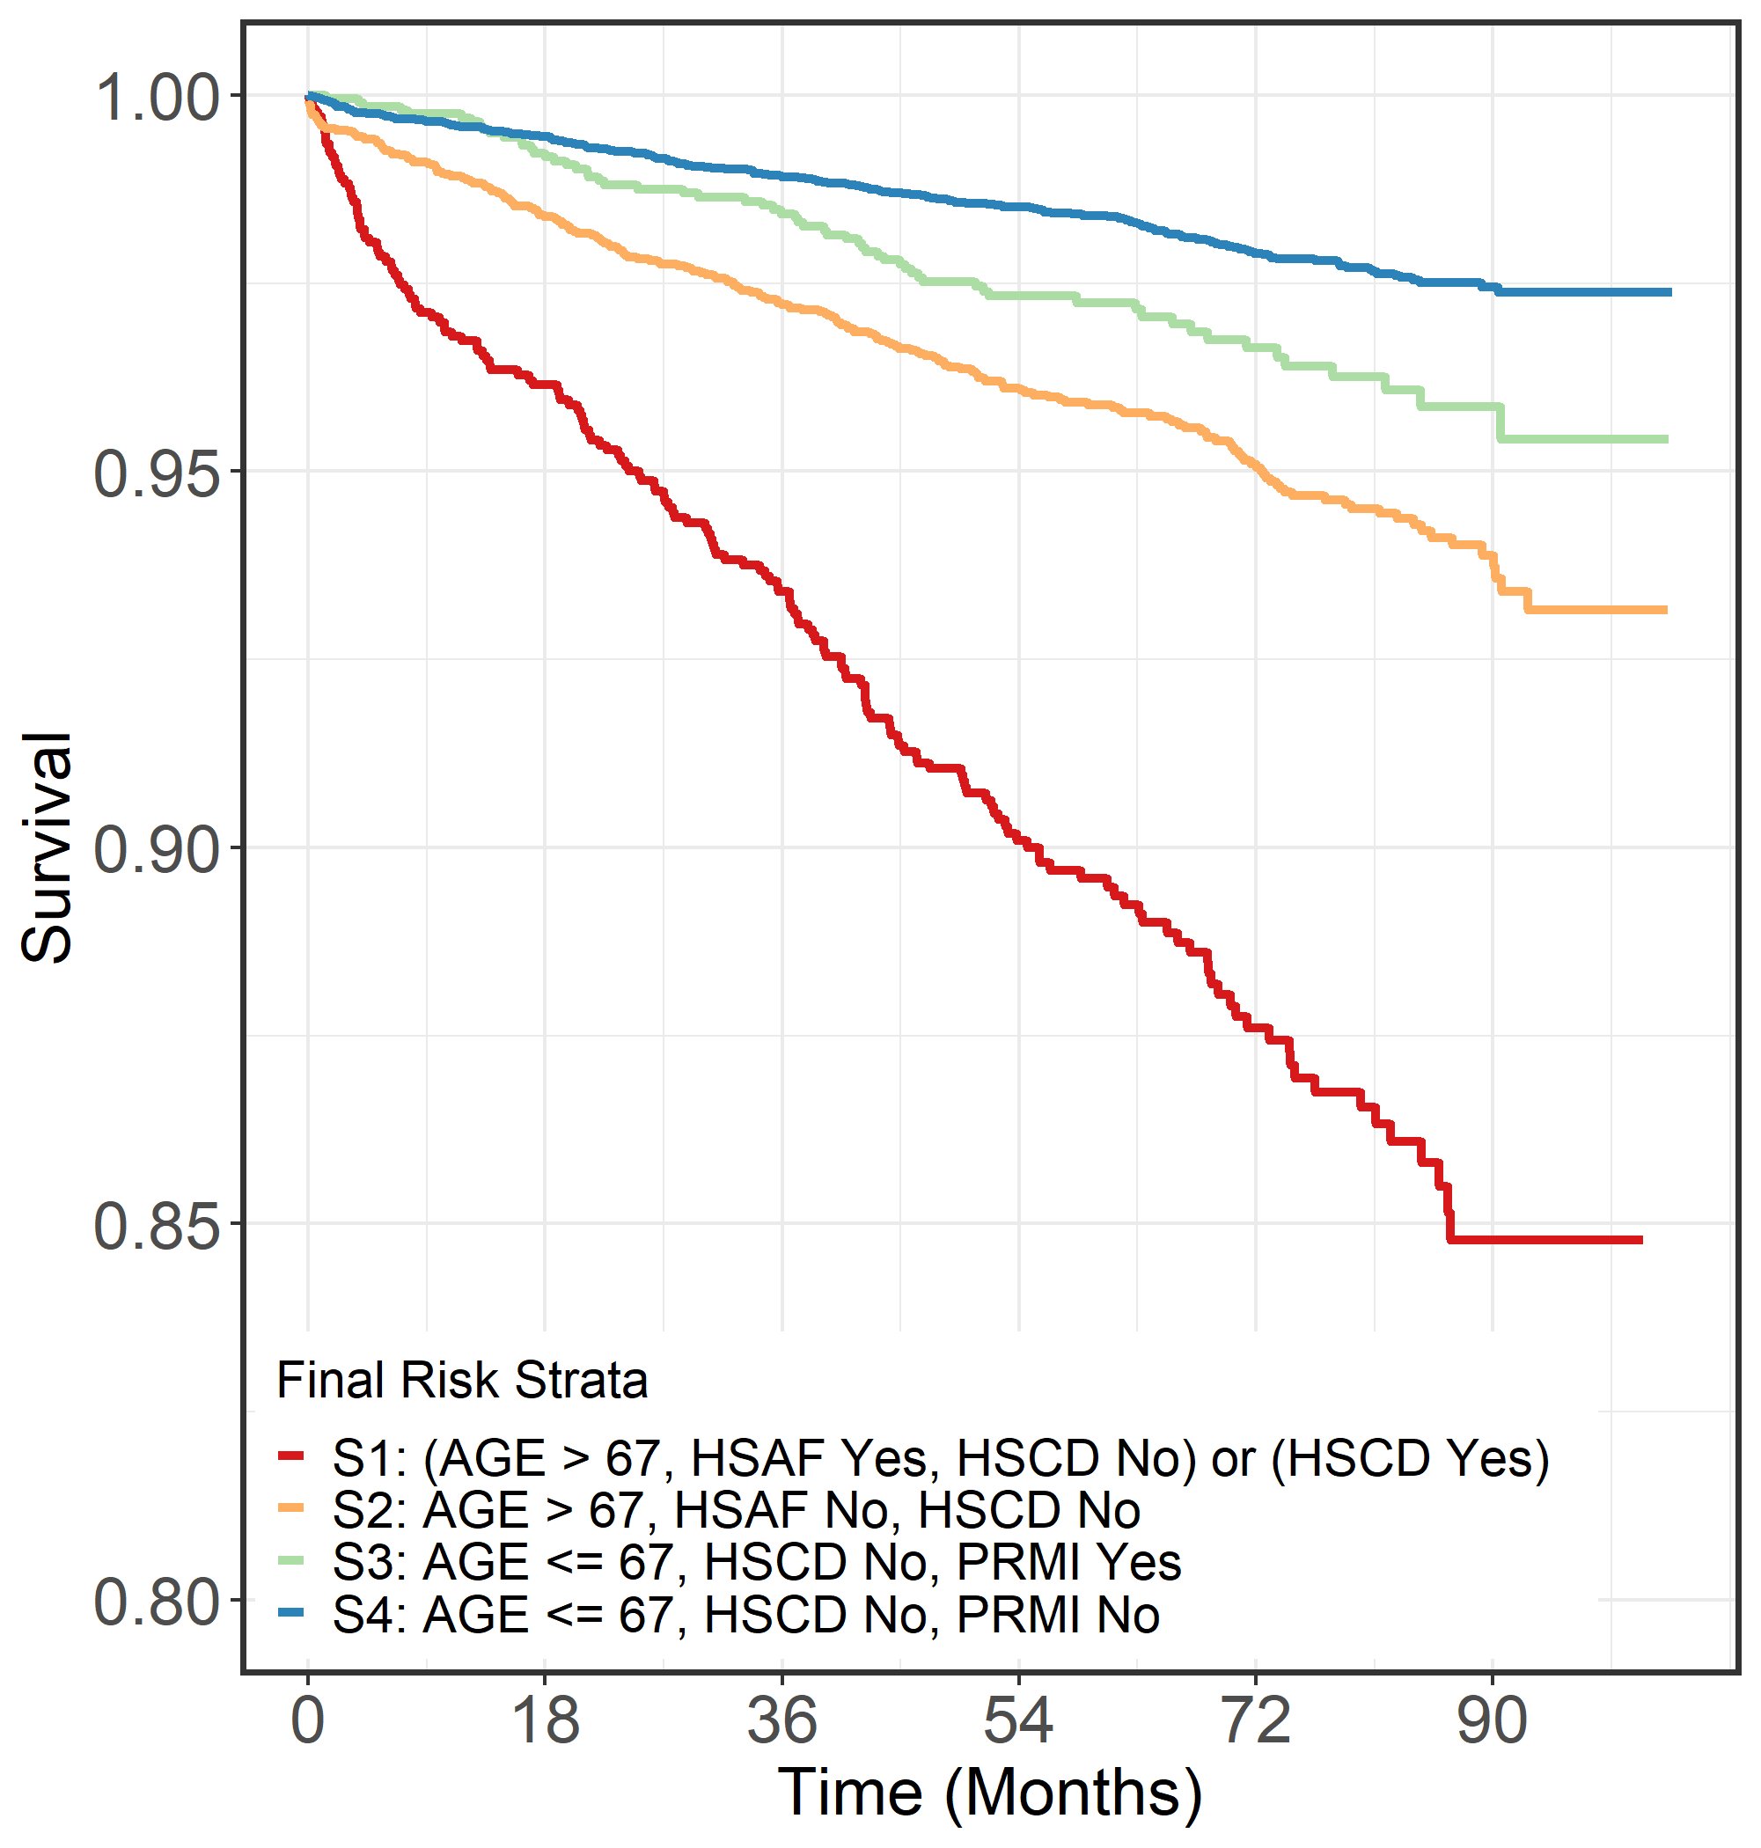
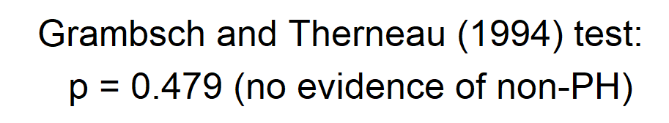
Example #3 (cardiovascular; N=18,144)
5-STAR
Pre-specified strata
Step 1: 46 covariates in candidate set
Step 2: 21 covariates advance to step 3
Step 3: 4 risk strata formed based on 4 covariates: age (≤/> 67 yrs), HSAF (yes/no), HSCD (yes/no), PRMI (yes/no)
Analysis Method | 1-tailed p-value
Logrank | 0.027
Stratified logrank | 0.027
MaxCombo | 0.039
RMST | 0.024
Analysis Method | 1-tailed p-value
5-STAR [TR] | 0.010
5-STAR [HR] | 0.011

Slide 23
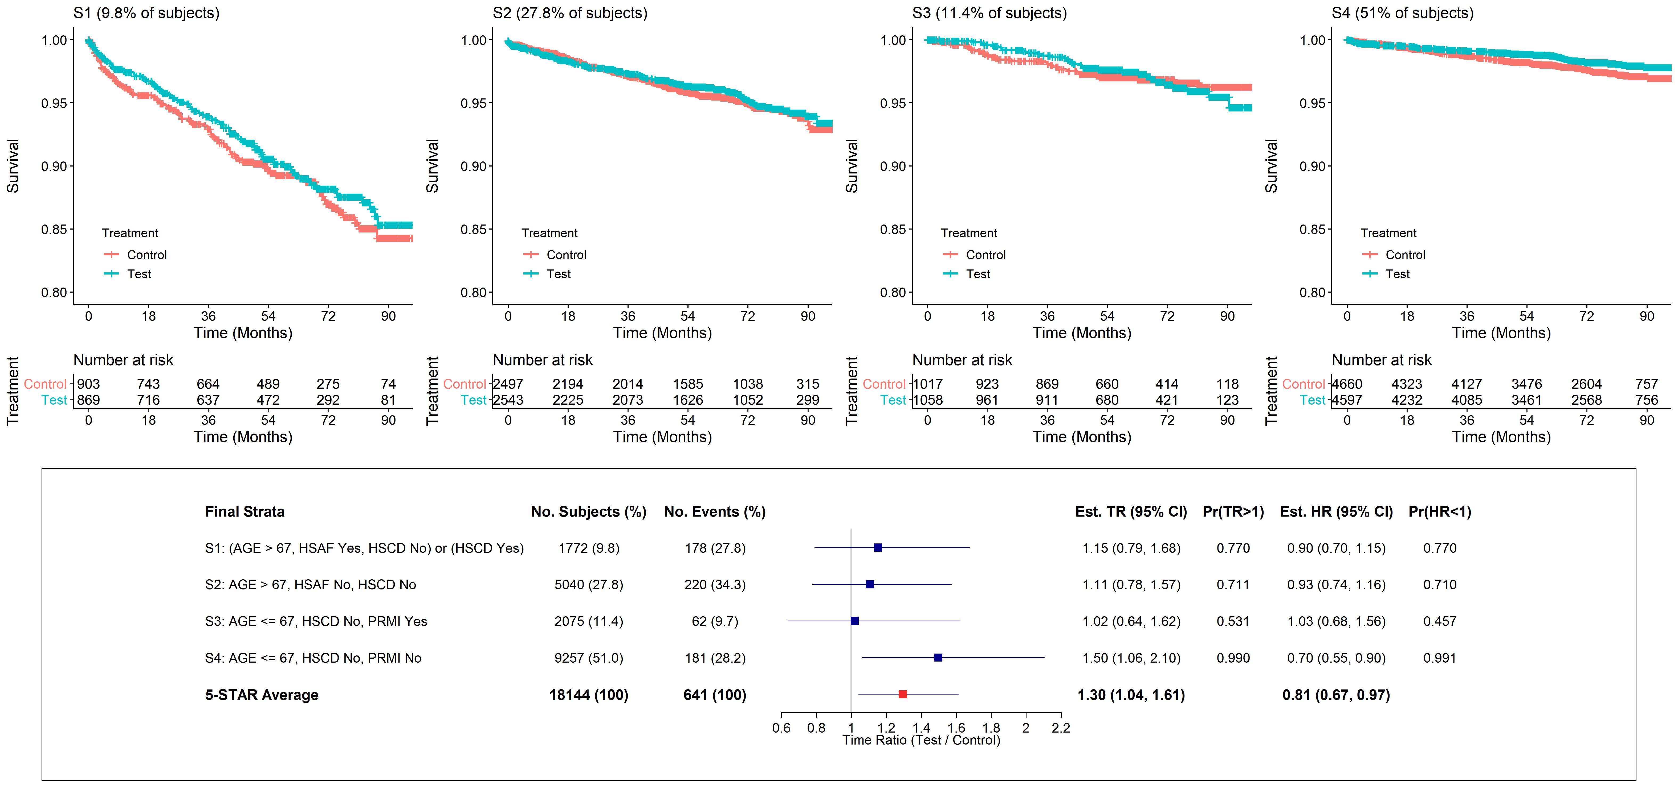
Example #3 (continued)
Primary
Supplemental

Slide 24
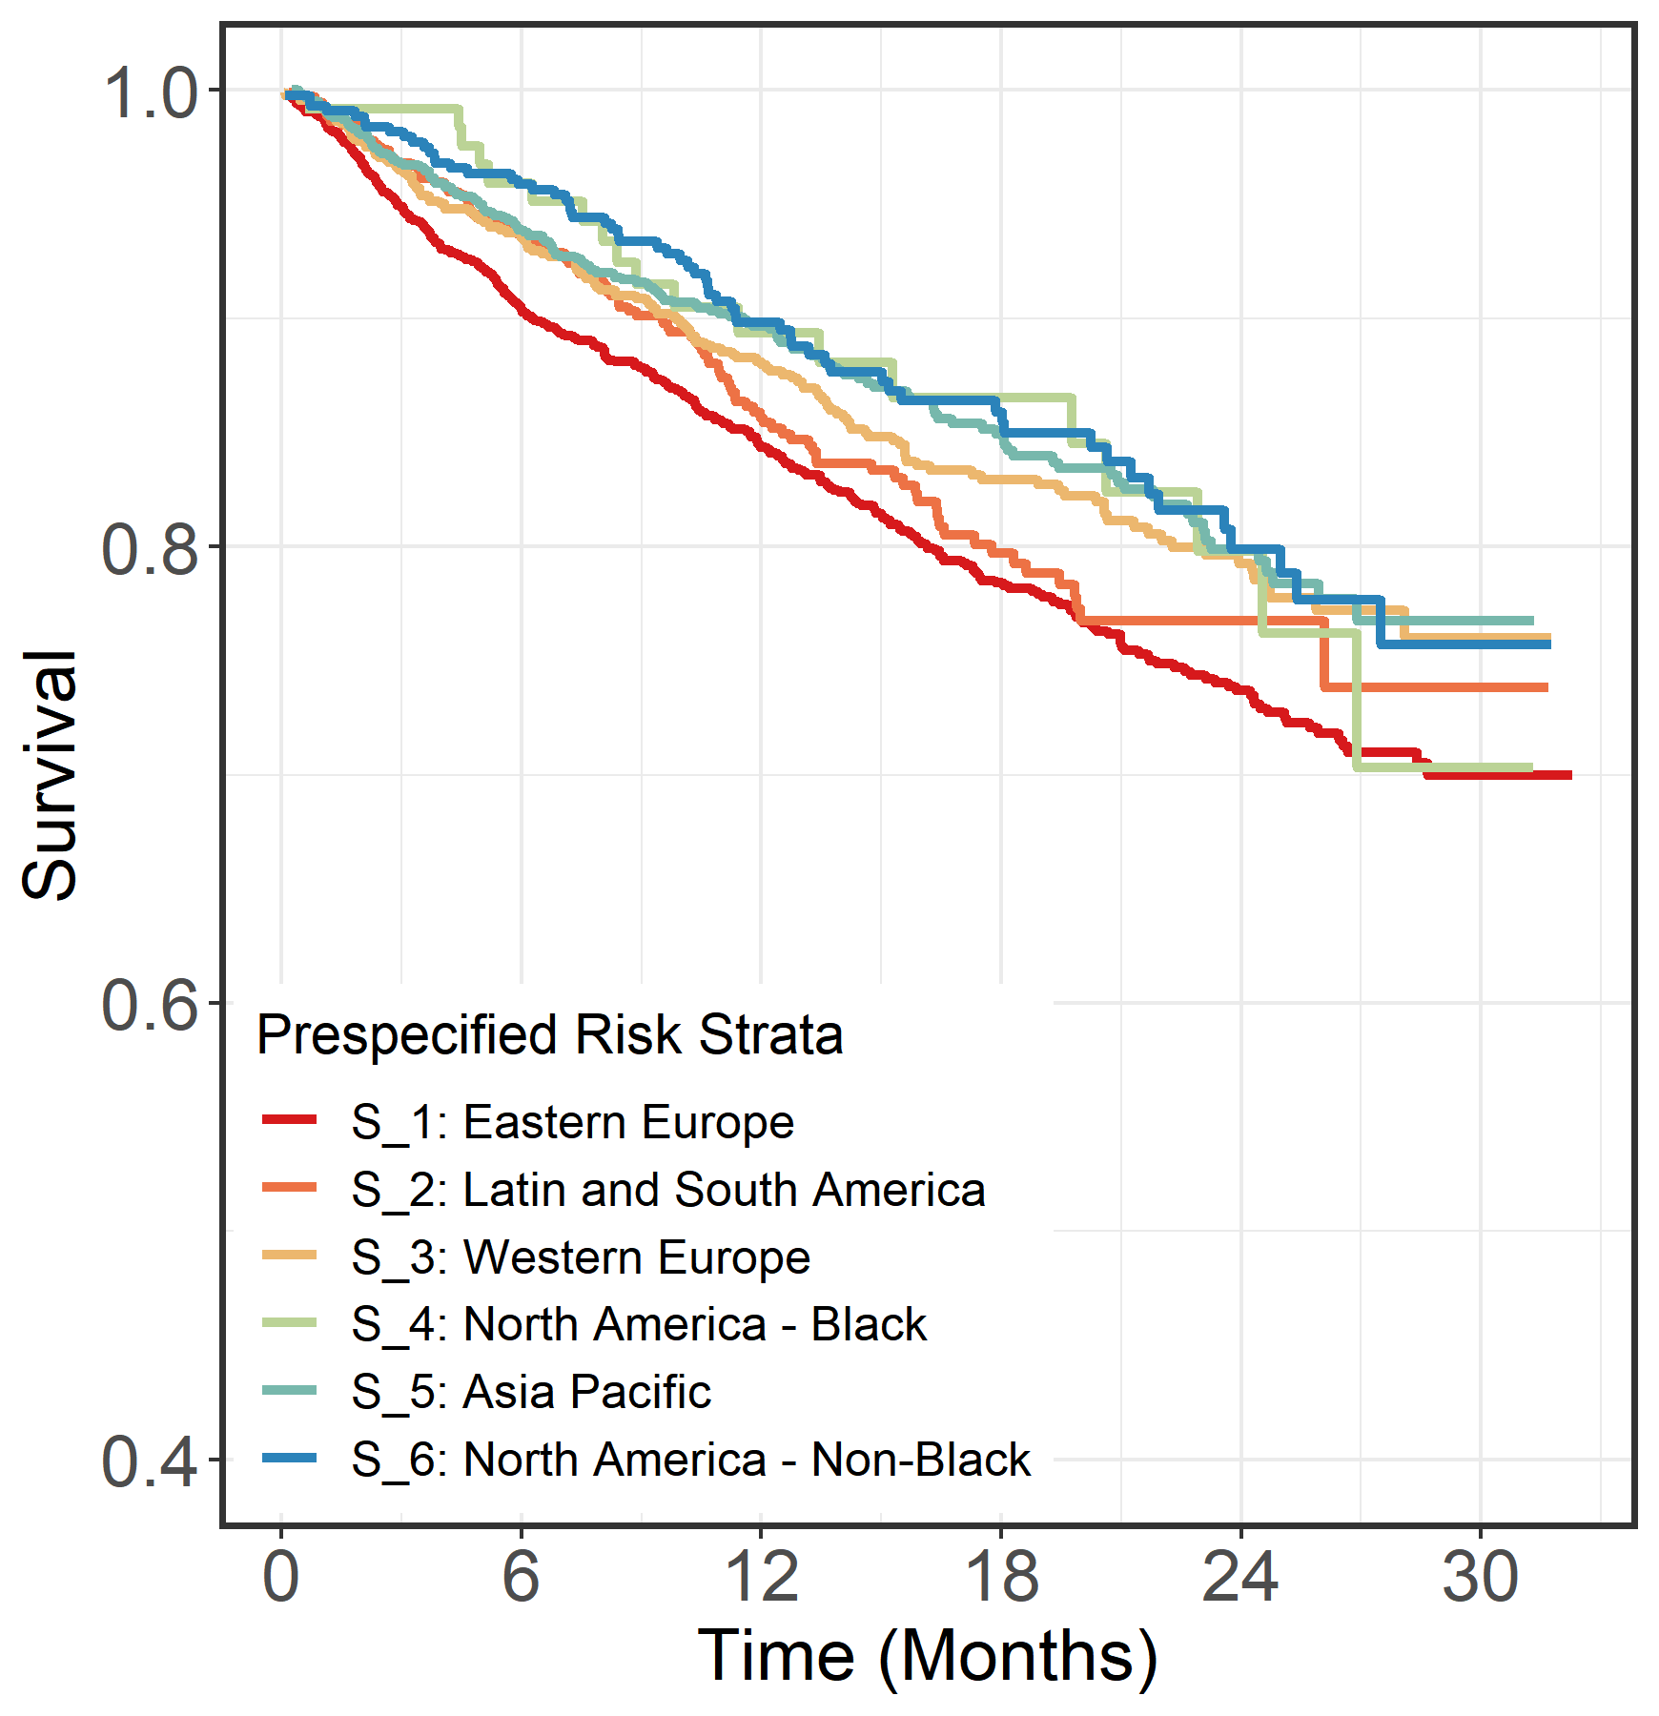
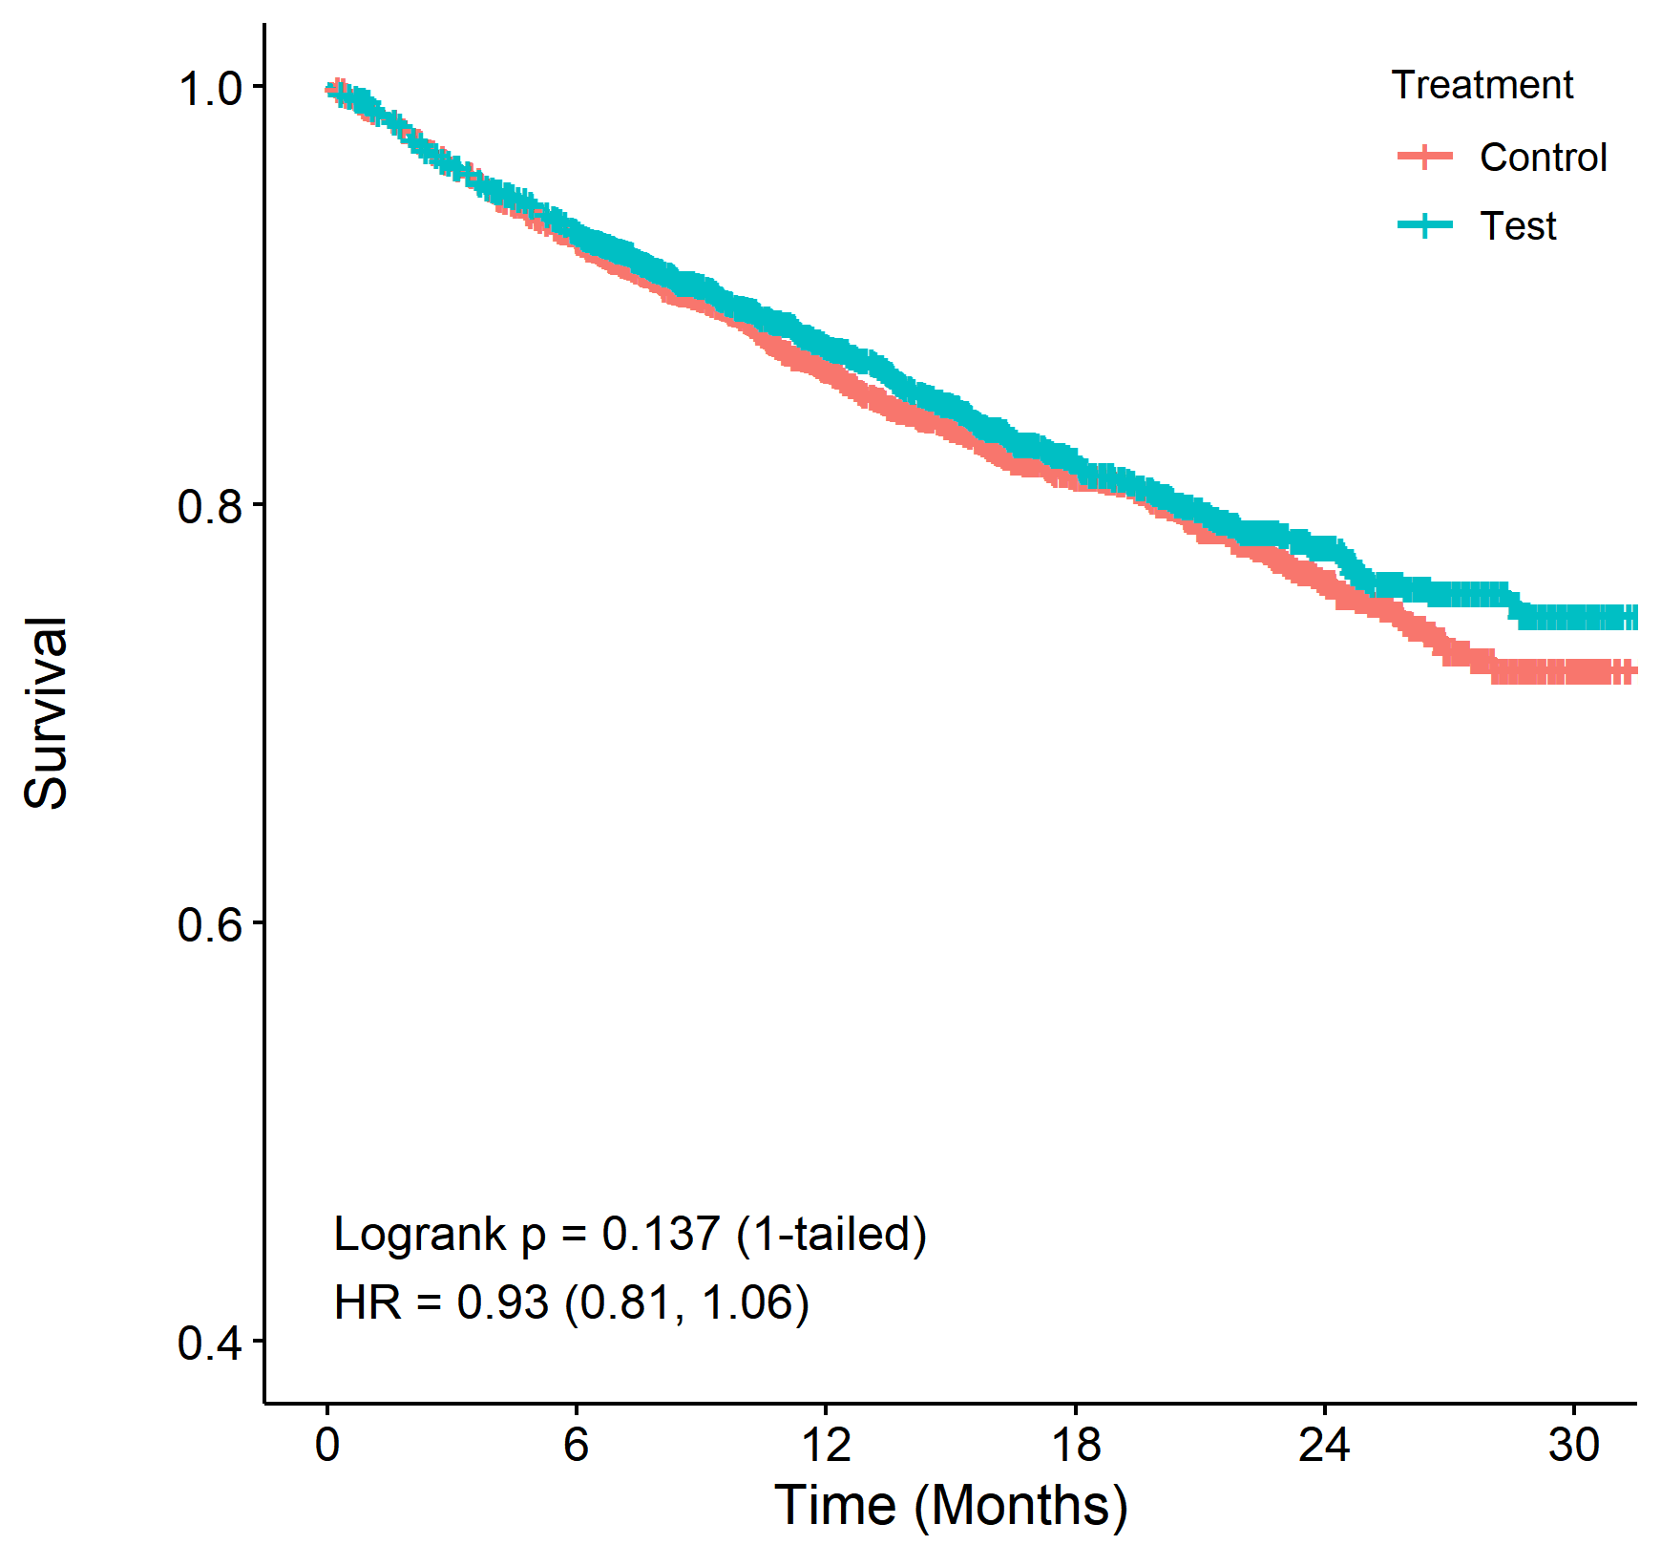
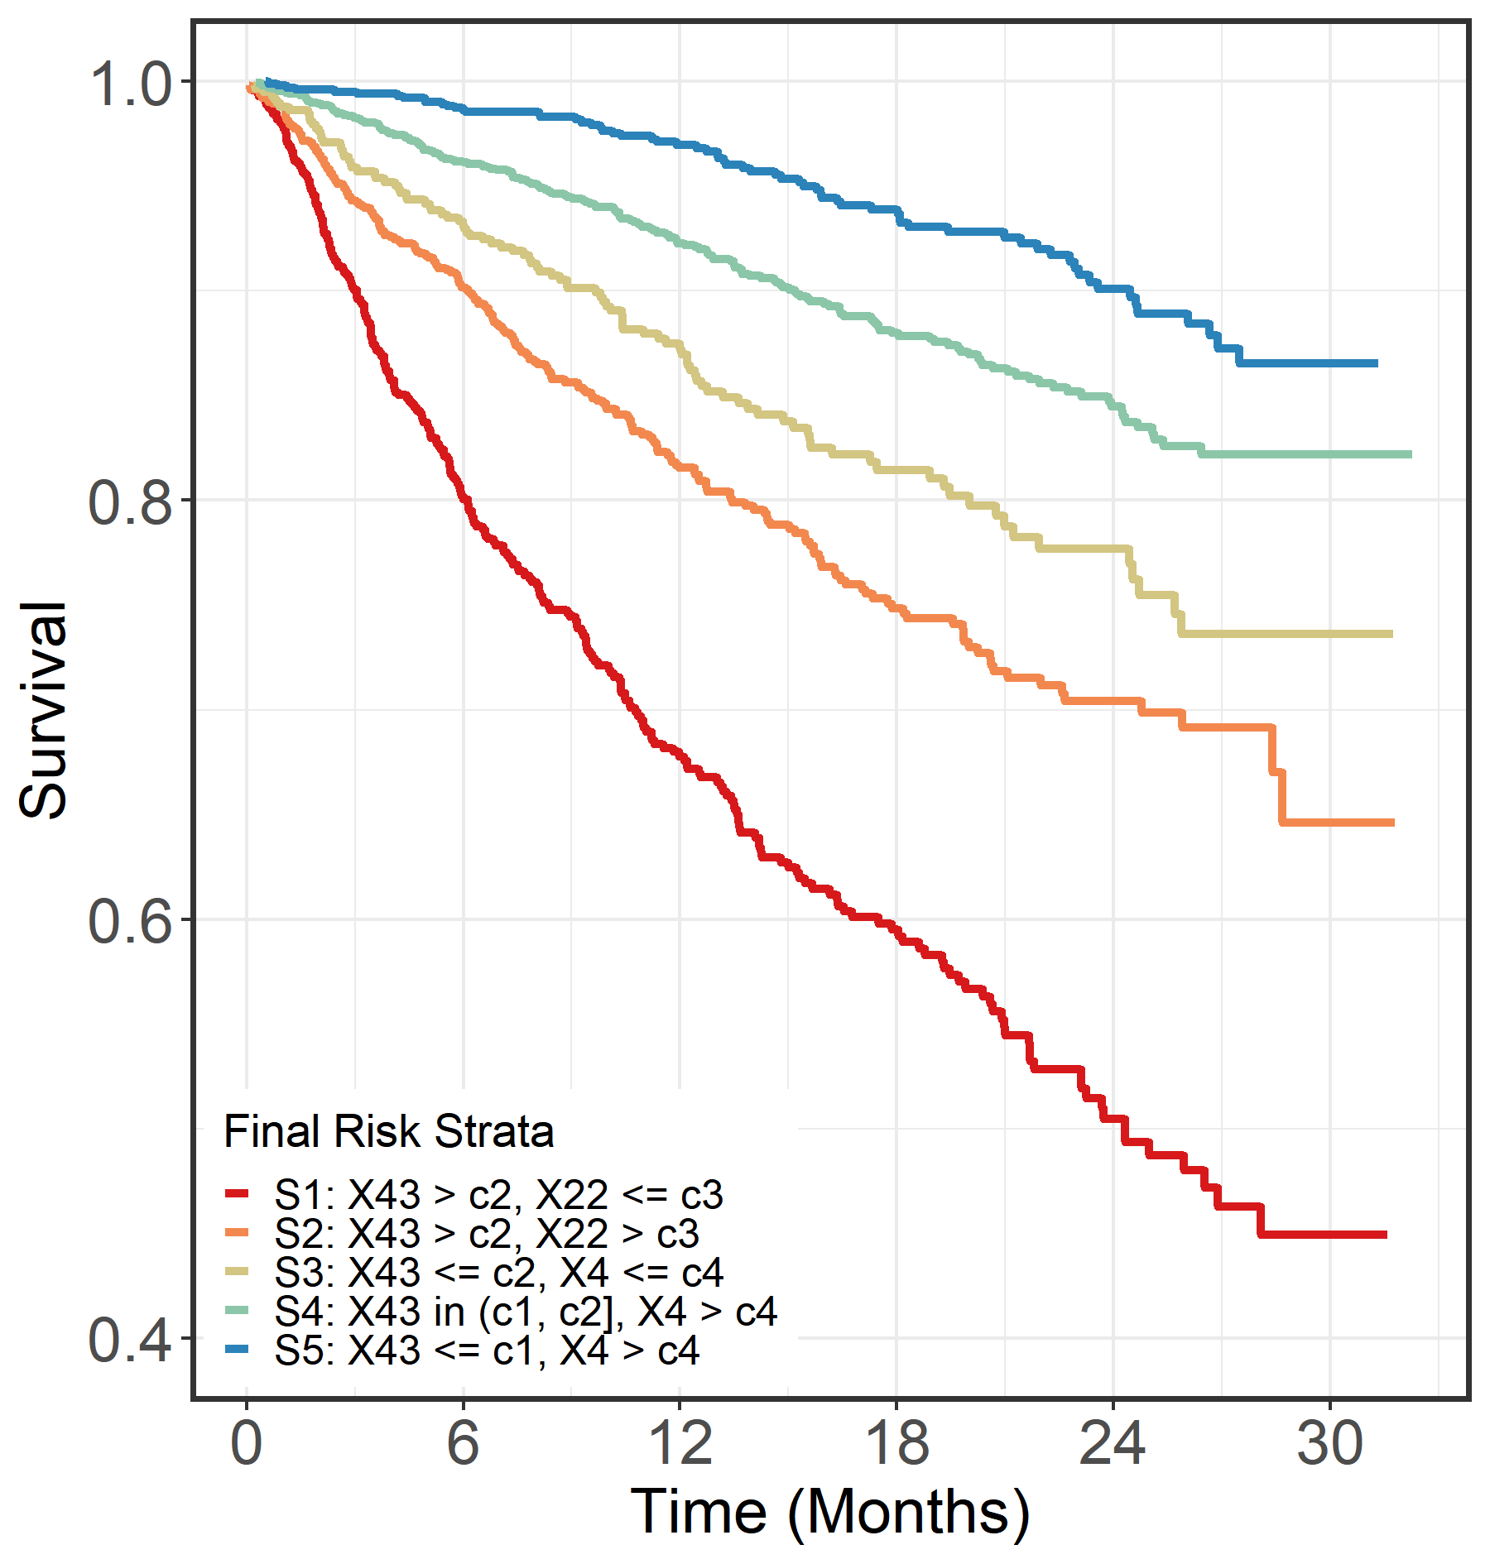
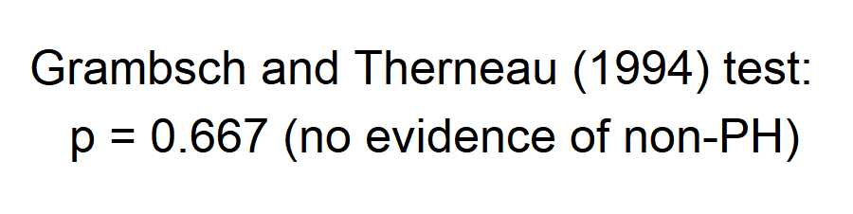
Example #4 (real data; N > 5,000)
5-STAR
Pre-specified strata
Step 1: 65 covariates in candidate set
Step 2: 27 covariates advance to step 3
Step 3: 5 risk strata formed based on 3 covariates: X43 (<=c1/c1-c2/>c2), X22 (<=c3/>c3), X4 (<=c4/>c4)
Analysis Method | 1-tailed p-value
Logrank | 0.137
Stratified logrank | 0.134
MaxCombo | 0.182
RMST | 0.137
Analysis Method | 1-tailed p-value
5-STAR [TR] | 0.023
5-STAR [HR] | 0.018

Slide 25
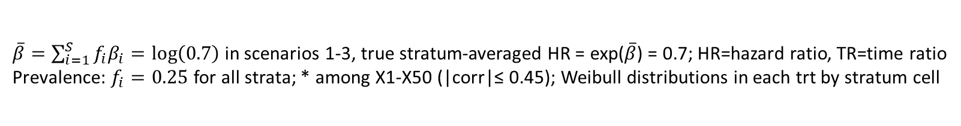
Simulation Study
N=300/trt, target number of events = 330 Truth: 4 risk strata based on (X1, X2, X26>0.4)* |  |  |  |  | Simulation Scenarios
 |  |  |  |  | Null HR=1,TR=1 |  | Alt 1 Equal HRs |  | Alt 2 Increasing HRs |  | Alt 3 Decreasing HRs
Risk Stratum | X1 | X2 | X26 | Median surv. (trt B; control) | HR | TR | HR | TR | HR | TR | HR | TR
S1 (highest risk) | 0 | 0 | ≤ 0.4 | 6.0 months | 1 | 1 | 0.70 | 1.15 | 0.42 | 1.42 | 0.95 | 1.02
 | 0 | 1 | ≤ 0.4
S2 | 0 | 0 | > 0.4 | 8.4 months | 1 | 1 | 0.70 | 1.13 | 0.70 | 1.13 | 0.86 | 1.05
 | 1 | 0 | ≤ 0.4
S3 | 0 | 1 | > 0.4 | 10.8 months | 1 | 1 | 0.70 | 1.11 | 0.86 | 1.04 | 0.70 | 1.11
 | 1 | 1 | ≤ 0.4
S4 (lowest risk) | 1 | 0 | > 0.4 | 13.2 months | 1 | 1 | 0.70 | 1.09 | 0.95 | 1.01 | 0.42 | 1.24
 | 1 | 1 | > 0.4
$\overline{β}=\sum_{i=1}^{S}{f_{i}β_{i}}=log\left(0.7\right)$ in scenarios 1-3, true stratum-averaged HR = exp($\overline{β}$) = 0.7; HR=hazard ratio, TR=time ratio
Prevalence: $f_{i}=0.25$ for all strata; * among X1-X50 (|corr|≤ 0.45); Weibull distributions in each trt by stratum cell

Slide 26
Simulation Results 20,000 simulated trials
Analysis Method | Type I Error (target α=2.5%) | Power (%)
 |  | Alt 1 Equal HRs | Alt 2 Inc. HRs | Alt 3 Dec. HRs
Logrank | 2.56 | 71 | 82 | 50
Stratified logrank* | 2.49 | 77 | 90 | 48
MaxCombo | 2.60 | 67 | 83 | 54
RMST | 2.51 | 71 | 84 | 48
5-STAR [TR] | 2.49 | 84 | 93 | 67
5-STAR [HR] | 2.52 | 84 | 90 | 73
* analysis based on 2 (of 3) correct and 1 incorrect stratification factors
TR = time ratio, HR = hazard ratio

Slide 27

Conclusions
Our proposed 5-STAR approach for survival analysis in RCTs:
Boosts power by separating patients into unbiased risk strata and combining stratum-level treatment comparisons for overall inference
Does not require a PH assumption within risk strata or overall
Delivers “transparency” in overall inference thru stratum-level results
Is a promising alternative to current survival analysis methods
Is easy to implement (R package) https://github.com/rmarceauwest/fiveSTAR

