Slide 1
Grade 2018

Slide 2
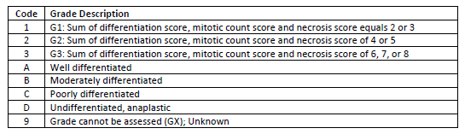
Practice
Example 1:
Lt thigh resection = Intermediate grade sarcoma, NOS (8800/3).
  The FNCLCC grade (score) is not given/cannot be calculated.
  Grade Table 10 (Soft Tissues Trunk and Extremities) is the applicable Grade Table:
  “Intermediate grade” is not listed, but codes A-D are.

Slide 3
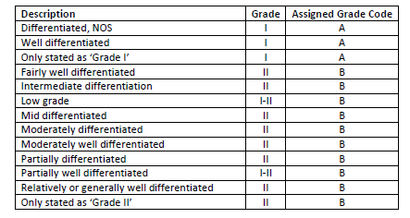
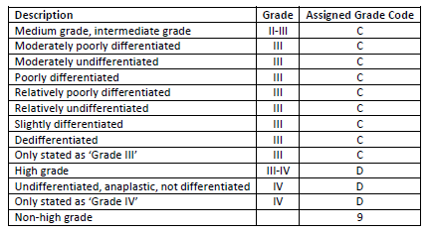
Practice
Generic Grade Categories Table:
Lt thigh resection = Intermediate grade sarcoma, NOS.
Use the Generic Grade Categories Table.
Answer: Intermediate grade is equivalent to Code C.

Slide 4
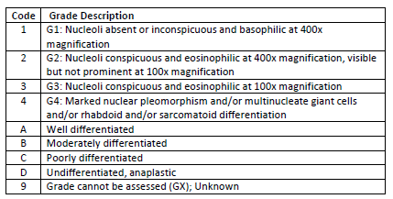
Practice
Example 2:
Rt nephrectomy = High grade renal medullary carcinoma (8510/3).
  The WHO/ISUP grade is not given.
  Grade Table 18 (Kidney) is the applicable Grade Table:
  “High grade” is not listed, but codes A-D are.

Slide 5
Practice
Generic Grade Categories Table:
Rt nephrectomy = High grade renal medullary carcinoma.
Use the Generic Grade Categories Table.
Answer: High grade is equivalent to Code D.

Slide 6
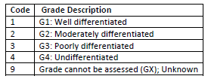
Practice
Example 3:
Sigmoid colectomy = Low grade adenocarcinoma (8140/3).
  Grade Table 2 is the applicable Grade Table:
  “Low grade” is not listed.
  Codes A-D are not listed.
  Can we use the Generic Grade Categories Table?

Slide 7
Practice
Generic Grade Categories Table:
NO!
The Generic Grade Codes A-D do not apply to the colon. Only the Preferred Grade System can be coded.

Slide 8
SEER*Educate Has More Practice
Adrenal Gland | Neuroendocrine Tumors (NET)
Anus | Ocular Adnexal Lymphoma
Bladder | Ovary, Primary Peritoneal Carcinoma, and Fallopian Tube
Bone | Pancreas
Brain | Parathyroid
Breast | Prostate
Colon and Rectum | Retinoblastoma
Corpus Uteri | Soft Tissue Sarcoma
Esophagus/GE Junction | Stomach
Gastrointestinal Stromal Tumors (GIST) | Table 09
Kidney Parenchyma | Table 98
Lacrimal Gland | Thyroid
Liver | Uveal Melanoma
Lung
140 Exercises
Print out the May 2019 Registrar PIP Reader’s Digest Version – Grade for 2018+ Cases for reference.
The proper use of the Generic Grade Categories Table has proven to be one of the most difficult concepts nation-wide per the May 2019 SEER Advanced Coding Workshop.

