Slide 1


Sean Munson · smunson.com · @smunson
From Personal Data to Personal Health:
Designing for Goals and Collaboration

Slide 2
Notes:
Many chronic conditions – these often involve diagnosis based on everyday behaviors and outcomes and monitoring of self-care and symptoms outside of the clinical setting.

Slide 3

Self-monitoring and self-regulation
!
Notes:
In this work, we’ve found it helpful to move away from instantaneous models of self-regulation

Slide 4


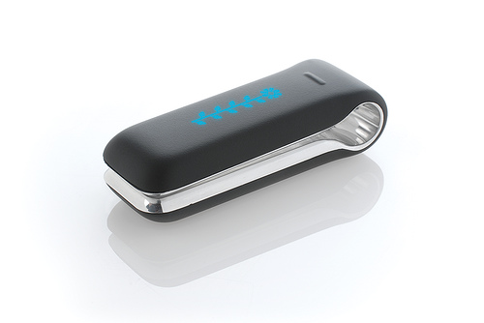

Personal Informatics:
how can technology facilitate each of these steps?
Walk in park instead of watching TV
M
T
W
Th
F
Sa
Su
M
T
M
T
W
Th
F
Sa
Su
M
T
Preparation
Collection
Integration
Reflection
Action
Li I., Dey A., Forlizzi J. CHI 2010.
“A Stage-Based Model of Personal Informatics Systems”
Notes:
Lots of great work has been based on how we make each of these steps easier – better tools for collecting data, through sensing and low-burden self report, better toosl for bringing that together, and better toosl for scaffolding reflections based on these data and planning that into action.

Slide 5
Walk in park instead of watching TV
M
T
W
Th
F
Sa
Su
M
T
M
T
W
Th
F
Sa
Su
M
T
Preparation
Collection
Integration
Reflection
Action
What’s missing – a deep understanding of goals:
Why are people doing this?
What do they want to get from it?
Li I., Dey A., Forlizzi J. CHI 2010.
“A Stage-Based Model of Personal Informatics Systems”
Notes:
But what I’m going to argue today is that design and research have underemphasized learning about people’s goals and tailoring the entire process to those goals.
This is a bigger and harder question than “what does it give people the feedback they need?” or “what feedback is motivating?”

Slide 6
goals
What people hope to achieve from health tracking
support behavior change,
gaining general awareness,
answering a question,
proving something to themselves, their family, or their health providers,
instrumental gains, such as lower insurance premiums
How people want to track
how much burden will they accept
how much certainty they require in their answers
The Importance of Starting With Goals in N-of-1 Studies. (2020).

Slide 7
designing for goals
Sources of goal misalignment in health tracking and health collaboration
Techniques for eliciting goals & scaffolding health interventions based
on them

Slide 8
Sources of goal misalignment

Slide 9
Tools (and their designers)

Slide 10
misalignment pattern:
Tracking A implies goal B

Slide 11
misalignment pattern:
Tracking menstruation implies trying to conceive
Examining Menstrual Tracking to Inform the Design of Personal Informatics Tools. Epstein et al., 2015.
Notes:
Menstrual tracking implies trying to conceive.
Since this work, many platforms have made fertility predictions something users can disable, but it’s an important reminder to ask where your designs might be assuming a goal for a user.

Slide 12
misalignment pattern:
Goal A should be operationalized according to measure B.

Slide 13
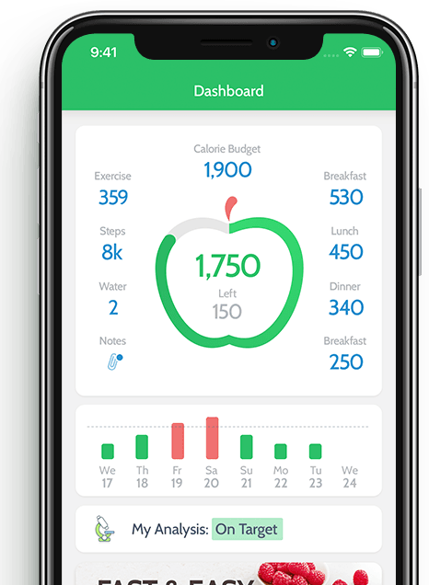
misalignment pattern:
Healthy eating should be operationalized according to calories.
Barriers and negative nudges: Exploring challenges in food journaling. Cordeiro et al., 2015.
Notes:
Also steps for physical activity

Slide 14
misalignment pattern:
If unsure of goals, track all the things.
Notes:
Continuing in heathy eating,

Slide 15
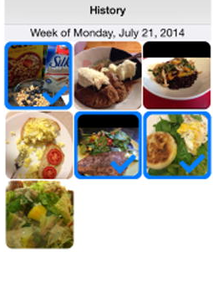
misalignment pattern:
If unsure of goals, track all the things.
Crumbs: lightweight daily food challenges to promote engagement and mindfulness. Epstein et al. 2016.
Notes:
we’ve seen improvements in mindful eating by asking people to track just one daily picture of a food that satisfies a prompt, rather than an exhausting catalog of everything they have eaten. People report more positive experiences and much lower burden too.

Slide 16

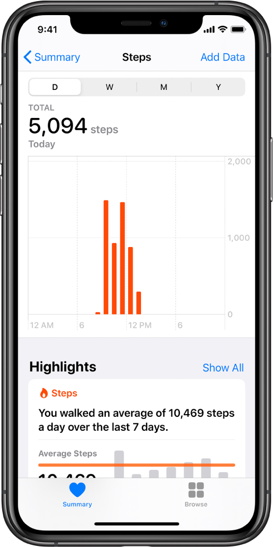
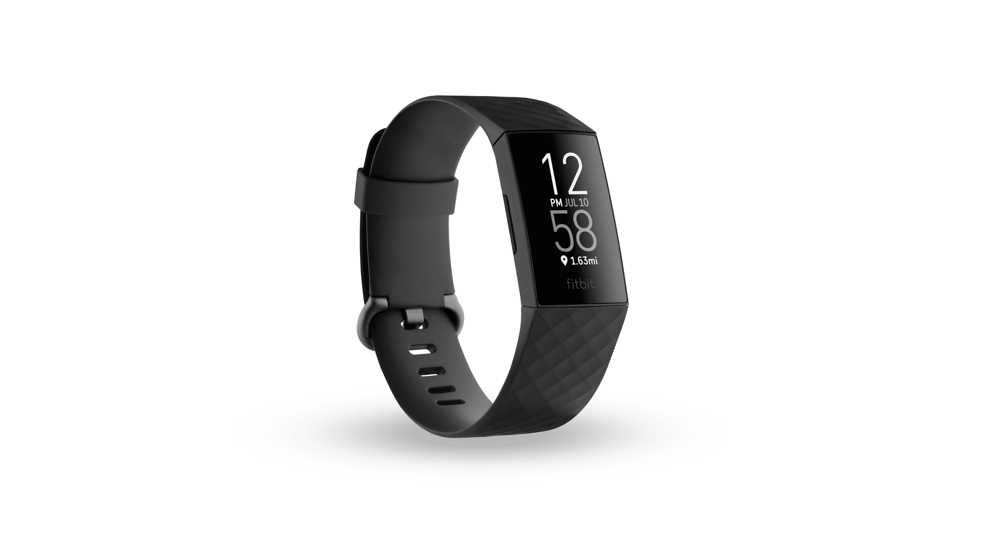
misalignment pattern:
Accuracy is always important.
Notes:
In many cases, accuracy requires

Slide 17



People

Slide 18
Misalignments in desired outcomes between patients and providers

Slide 19
Misalignments in desired outcomes between patients and providers
Provider treating Irritable Bowel Syndrome (IBS):
Minimize symptom severity and frequency
One person with IBS:
Reduce symptom severity & frequency, while still enjoying favorite foods
Another person with IBS:
Understand relationship between foods and symptoms to make tradeoffs
Boundary Negotiating Artifacts in Personal Informatics: Patient-Provider Collaboration with Patient-Generated Data. Chung et al. 2016.

Slide 20
Misalignments in desired outcomes between patients and providers
Provider treating migraine:
Minimize symptom severity and frequency
Person with migraine:
Reduce symptom severity & frequency, and in the meantime, predict migraines to limit effects on life
Examining Self-Tracking by People with Migraine: Goals, Needs, and Opportunities in a Chronic Health Condition. Schroeder et al. 2018.

Slide 21
Misalignments in how and what to track, or in expectations about who will review the data
Rigor
Standardization
Ease of review in clinic
Balance rigor with tracking burden
Ongoing review

Slide 22
Approaches to aligning goals

Slide 23
#1: Ask them

Slide 24
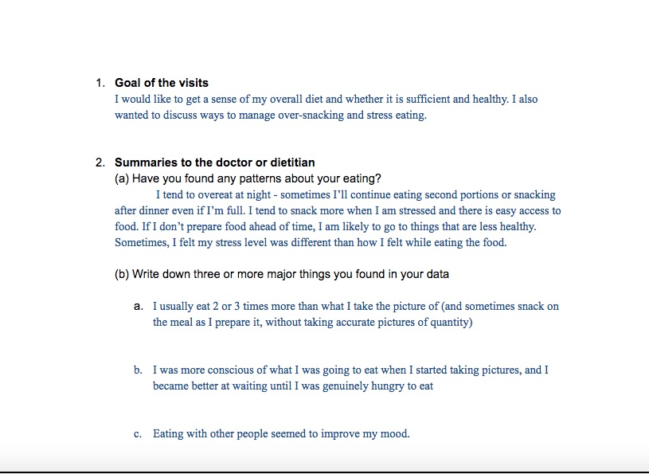
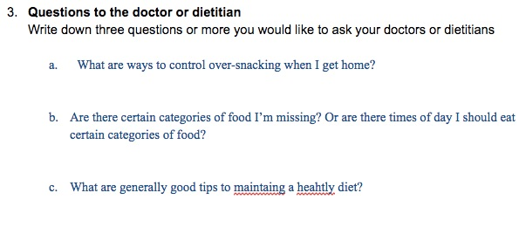
Ask them
Pre-visit notes to encourage explicit communication about goals
Goal
Summary
Questions
Identifying and Planning for Individualized Change: Patient Provider Collaboration Using Lightweight Food Diaries in Healthy Eating and Irritable Bowel Syndrome. Chung et al. 2019.

Slide 25
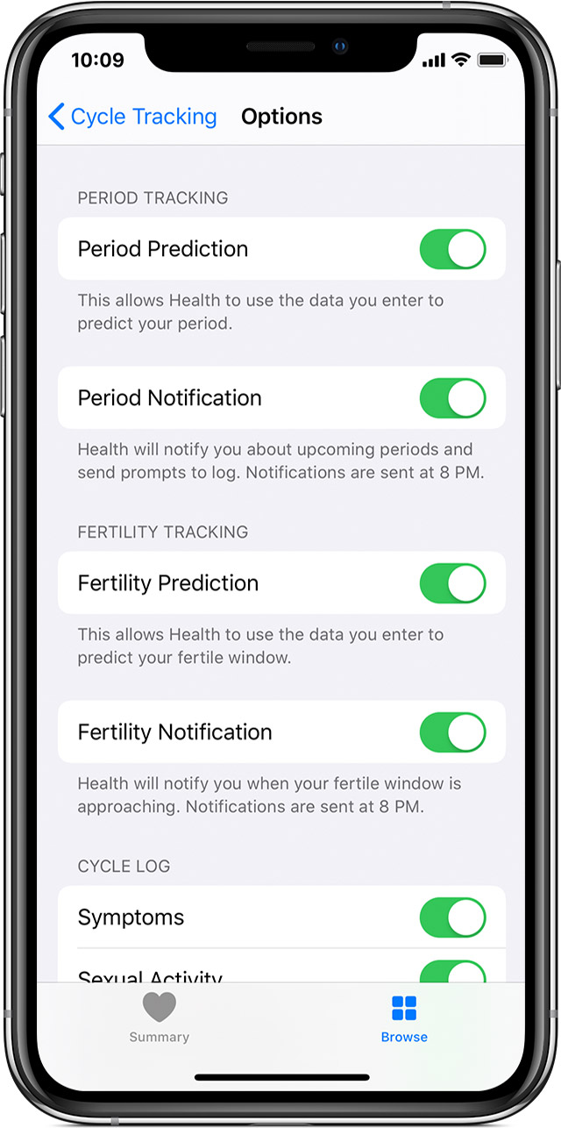
Ask them & use responses to configure the tool
The cycle tracking section of Apple’s Health app provides basic toggles for what kinds of information someone wants to view and log.
Notes:
This process facilitates getting the patient, provider, and tool all aligned.
It also can provide some educational content about what kinds of goals may be achievable, as well as what kinds of tracking can support those goals.

Slide 26
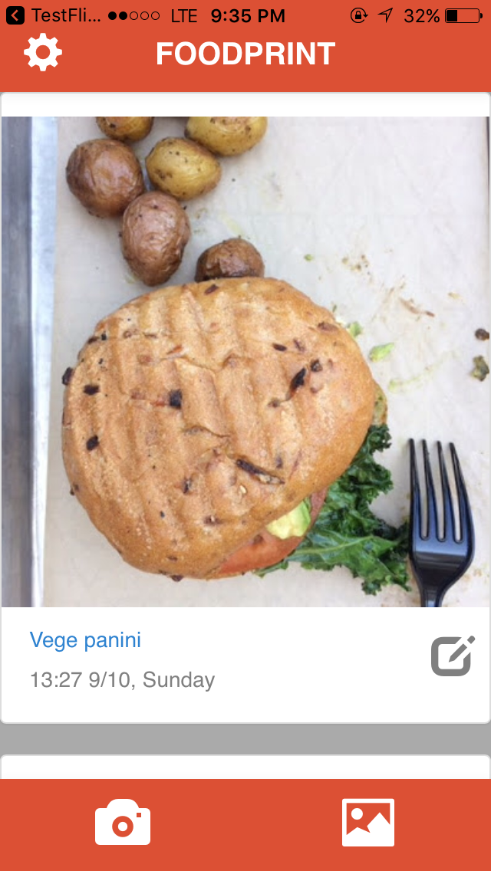
FoodPrint:
A mobile, photo-based food journal, designed for flexible goals and collaboration.
Ask them & use responses to configure the tool
Identifying and Planning for Individualized Change: Patient Provider Collaboration Using Lightweight Food Diaries in Healthy Eating and Irritable Bowel Syndrome. Chung et al. 2019.
Notes:
This process facilitates getting the patient, provider, and tool all aligned.
It also can provide some educational content about what kinds of goals may be achievable, as well as what kinds of tracking can support those goals.

Slide 27
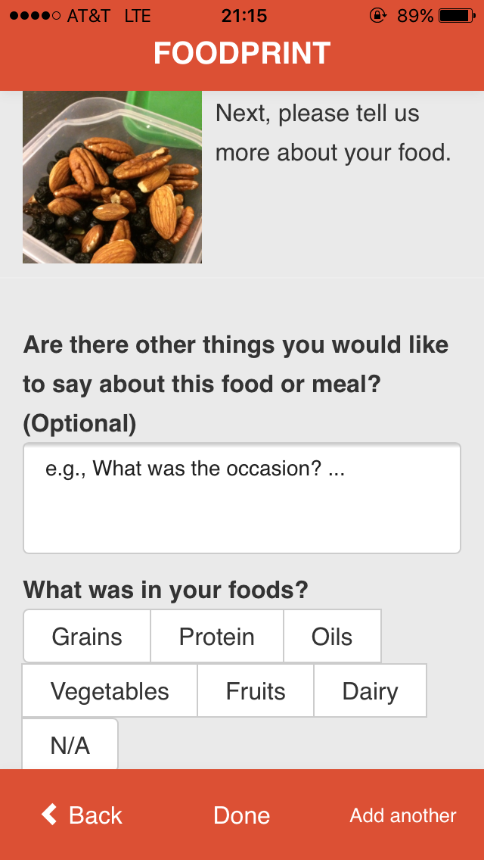
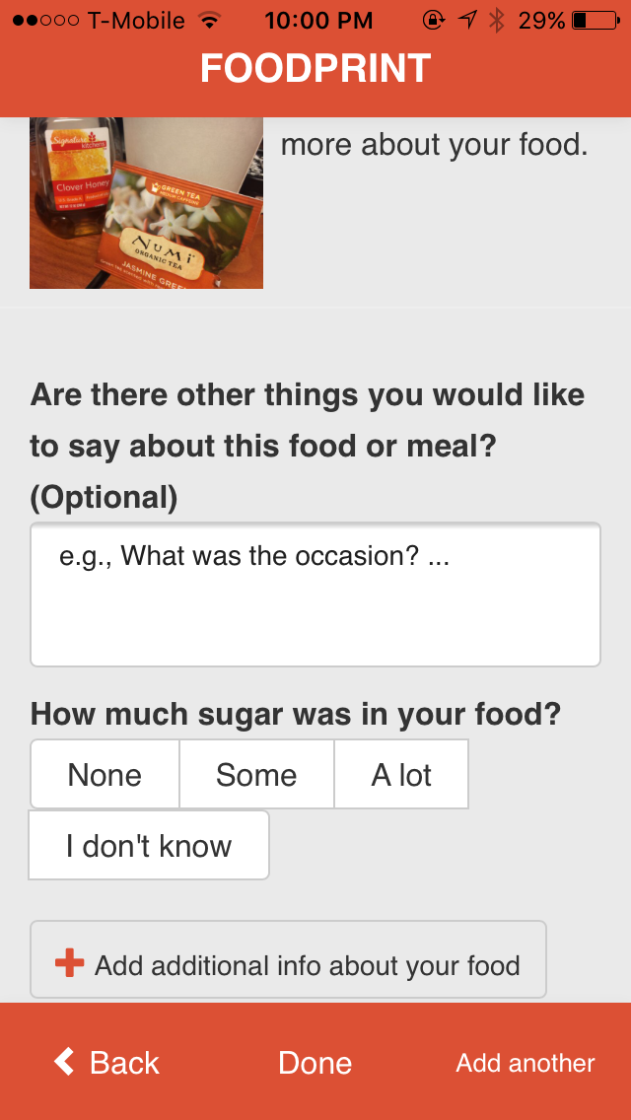
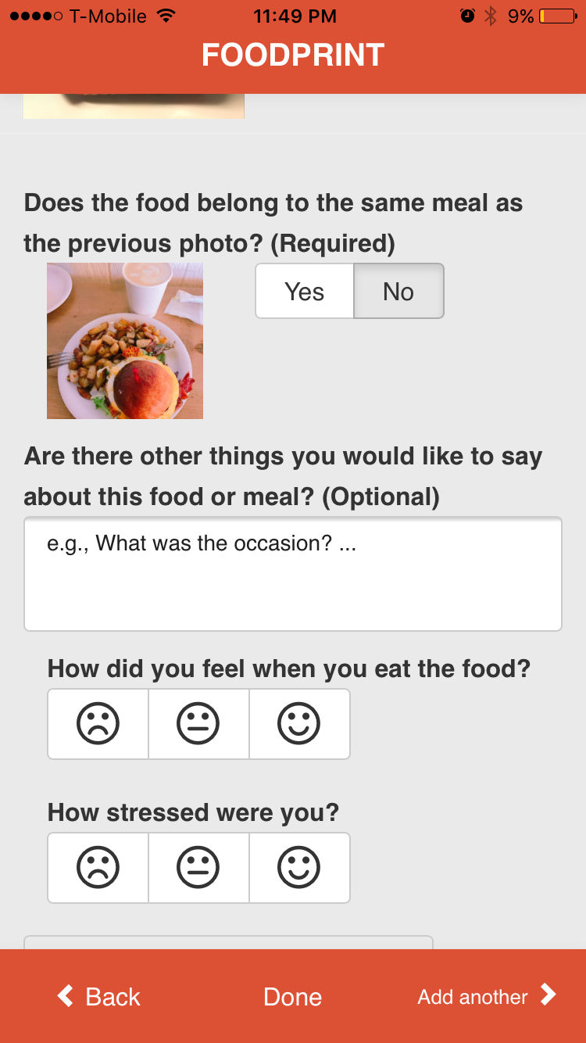
Different goals lead to different trackers
Ask them & use responses to configure the tool
Balanced Diet
Ingredient monitoring
Stress & mood
Notes:
This process facilitates getting the patient, provider, and tool all aligned.
It also can provide some educational content about what kinds of goals may be achievable, as well as what kinds of tracking can support those goals.

Slide 28
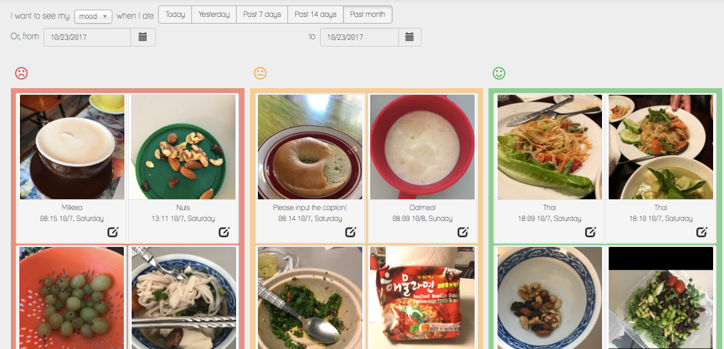
Ask them & use responses to configure the tool
Food eaten
in a bad mood
Food eaten
in an okay mood
Food eaten
in a good mood
And corresponding ways of reviewing the data

Slide 29
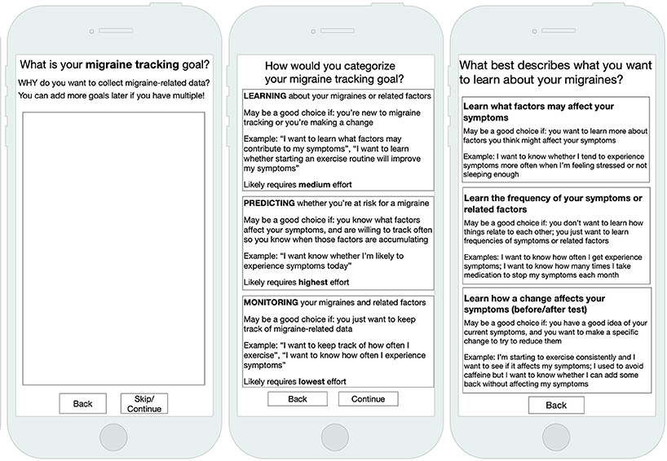
Ask them & use responses to configure the tool
Examining Opportunities for Goal-Directed Self-Tracking to Support Chronic Condition Management. Schroeder et al. 2019.
Notes:
We can also do mor elaborate configuration, such as what we are working on in migraine.
This process facilitates getting the patient, provider, and tool all aligned – what will they track, how often and how will they track it, how long, and how will they review it, including appropriate statistical analyses.
It also can provide some educational content about what kinds of goals may be achievable, as well as what kinds of tracking can support those goals.

Slide 30
Design for changing goals
A Lived Informatics Model of Personal Informatics. Epstein et al. 2014.

Slide 31
Design for changing goals
A goal may temporarily or permanently cease to be someone’s priority.
Designs should respect this!
Reconsidering the Device in the Drawer: Lapses as a Design Opportunity in Personal Informatics. Epstein et al. 2016.
Notes:
Maybe they met their goal and they are done. Maybe something else took priority in life.

Slide 32
Design for changing goals
When someone comes back to tracking, their goal may have changed.
Check in again.
Can the tool adapt to changes?
If the tool can’t adapt, can you point them to another tool and let them bring their data?

Slide 33
Design for changing goals
Different tools for different tasks
When someone comes back to tracking, their goal may have changed.
Check in again.
Can the tool adapt to changes?
If the tool can’t adapt, can you point them to another tool and let them bring their data?
Track food
& symptoms
Photo-based food journal, capture as much as practical in a low burden way, sacrificing some rigor.
Formulate Hypotheses
Iterate
Test
Hypothesis
App to scaffold designing, conducting, and analyzing self-experiments to test one nutrient with high rigor.
Interpret Results
The Importance of Starting With Goals in N-of-1 Studies. (2020).

Slide 34
Goal misalignments
Can be (partially) addressed by
Result from tool selection, tool designers, and people.
Misalignments can occur about
the long-term health goal and
how to use tracking to achieve that goal.
Asking people and
prompting communication about goals,
using the responses to enable or disable specific features, or
using responses to scaffold selection, configuration, and use of health tracking tools
Designing for changing goals
Requires knowledge & expertise in tracking, the health conditions, and the lived experience.

Slide 35






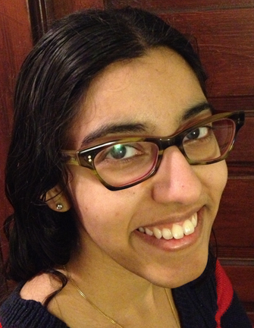

Human Centered Design & Engineering
Julie
Kientz
Susanne
Kirchner
Nicole
Lee
Sam Kolovson
Arpita
Elena
Agapie
Christina Chung
Computer Science & Engineering
James
Fogarty
Daniel Epstein
Jessica Schroeder
Ravi
Karkar
Jane Hoffswell
Laura
Pina
Jennifer
Kang
Medicine
Information
Many of these collaborators have moved to the next steps in their careers!
Sonali
Mishra
Jasmine
Zia
Allison
Cole
Roger
Vilardaga
Natalia
Murinova
Qiaosi
Wang
Notes:
We're part of a research group tackling problems and opportunities that emerge from the ecosystem of tools people can now use to track their personal data, with a particular focus on health.
Who else: Kai, me

Slide 36
Sean Munson · smunson.com · @smunson
From Personal Data to Personal Health:
Designing for Goals and Collaboration
AHRQ# 1R21HS023654
PCORI# 4322-UOW
NSF# OAI-1028195, IIS-1344613, IIS-1553167, IIS-1813675, DGE-1256082
NIH NLM# R01 LM012810, NIH NCATS UL1 TR002319
University of Washington Innovation Award
Intel Science and Technology Center for Pervasive Computing
Robert Wood Johnson Foundation
Notes:
TO DO PCORI

