Slide 1



Use of Mobile Technologies for Randomized Trials of eHealth and Other HIV Prevention Interventions
August 29th, 2018
Patrick S. Sullivan, PhD
Rollins School of Public Health

Slide 2
mHealth Interventions
mHealth Interventions leverage:
Mobile phones
Website games
Social media
Internet
Wireless networks
Geolocation data
eHealth intervention do:
Reach broad scale
Reach remote clients
Provide rich media
Offer tailoring
Reminders
Engagement
Link interventions together

Slide 3
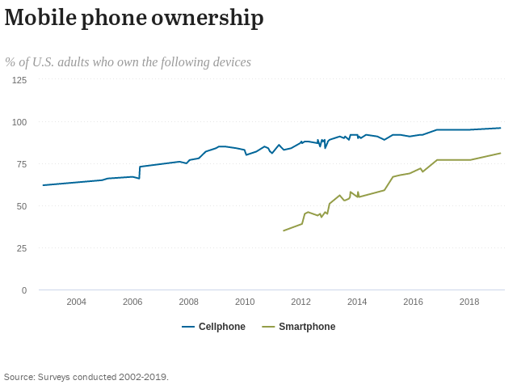
Mobile phone ownership among US adults

Slide 4
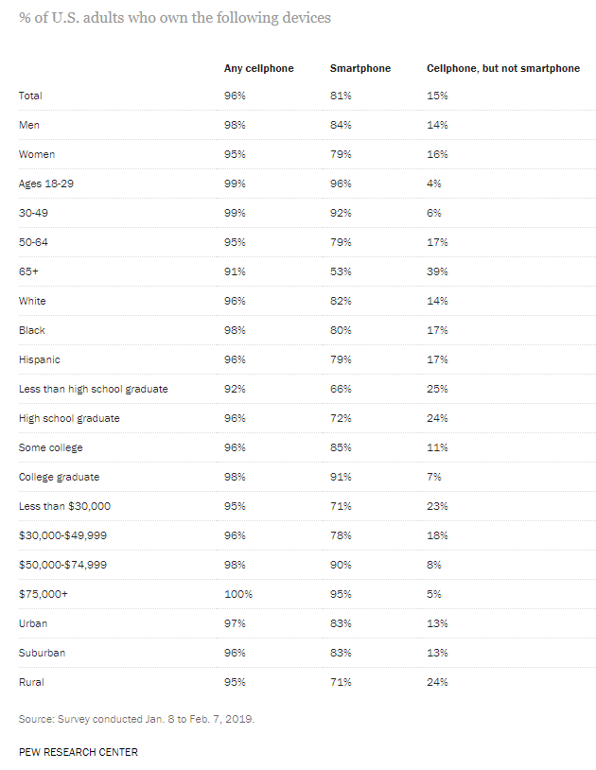

Slide 5
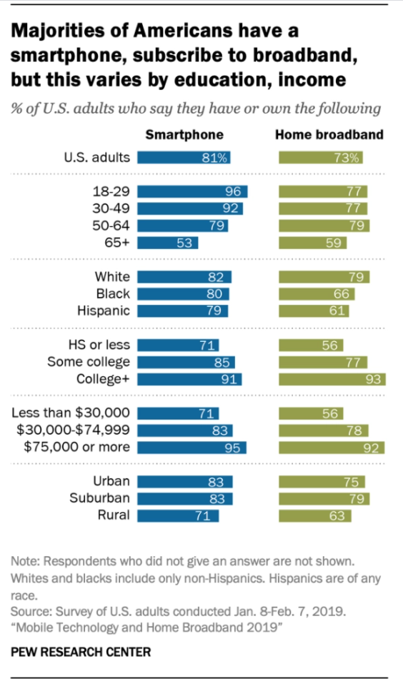
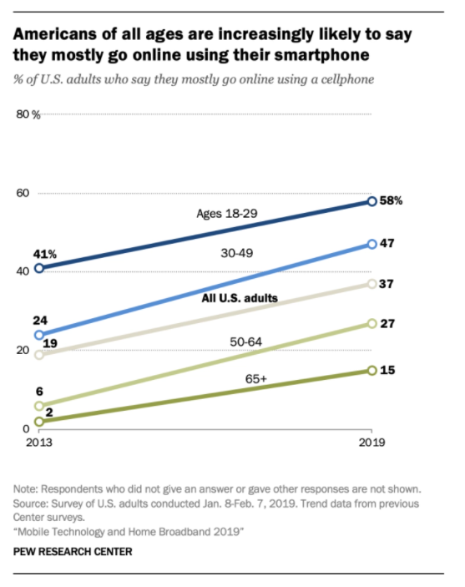
The digital divide(s)

Slide 6
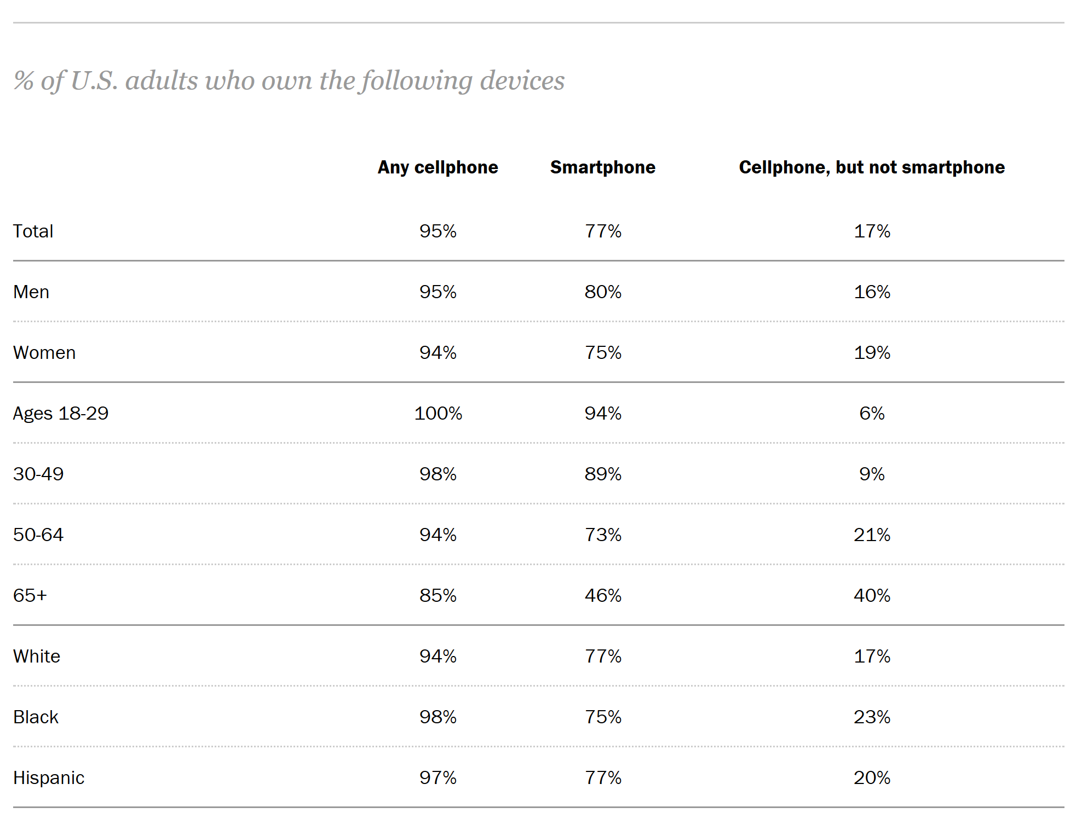
Pew Research Center, Mobile phone fact sheet, February 2018

Slide 7
Use of Prevention Services Among Rural vs Urban MSM, 2012
1.00
0.83*
0.83*
0.86*
0.72*
0.70*
McKenney et al, AIDS and Behavior, 2018

Slide 8
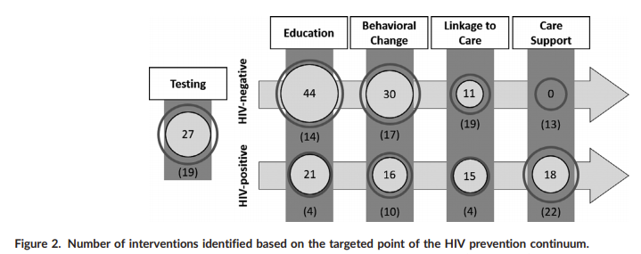

Where have existing eHealth interventions for HIV prevention focused?

Slide 9
How can mobile technologies play a role in RCTs of eHealth and ?
Providing a baseline level of access to services (SOC)
Providing intervention content to participants
Tailoring services to increase their relevance
Communicating with participants
Improving retention in research studies
Notes:
HealthMindr
Keep It Up
Get Connectect
iTech

Slide 10
Providing a baseline level of access to services (SOC)

Slide 11

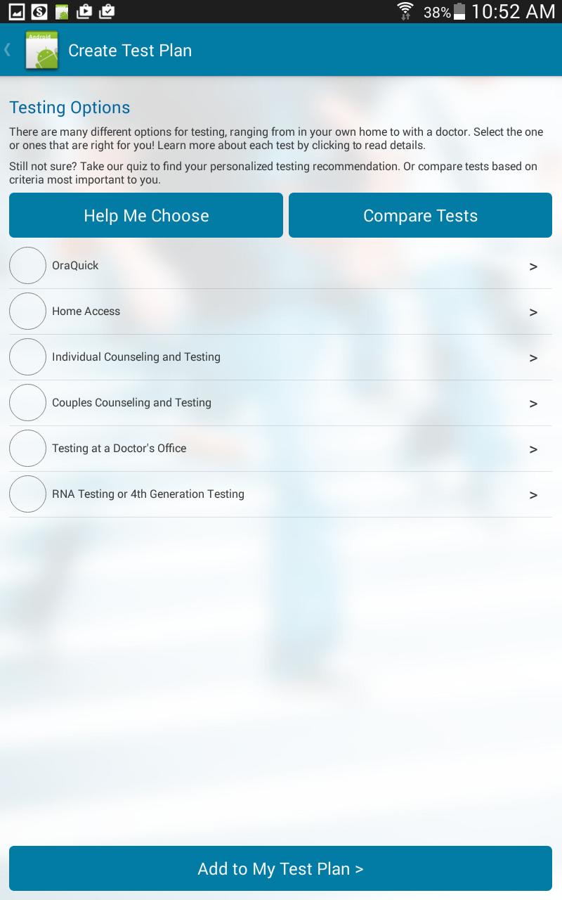
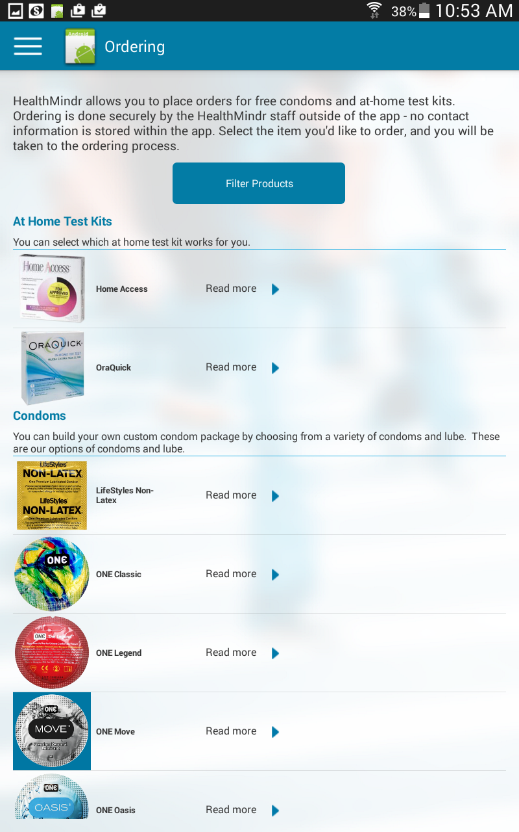

Slide 12
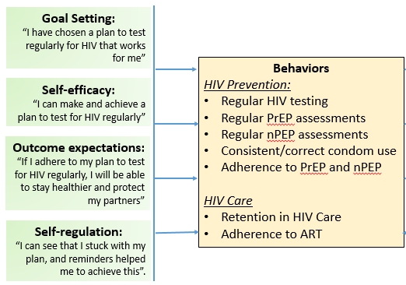

Theoretical basis for HealthMindr: Social Cognitive Theory

Slide 13
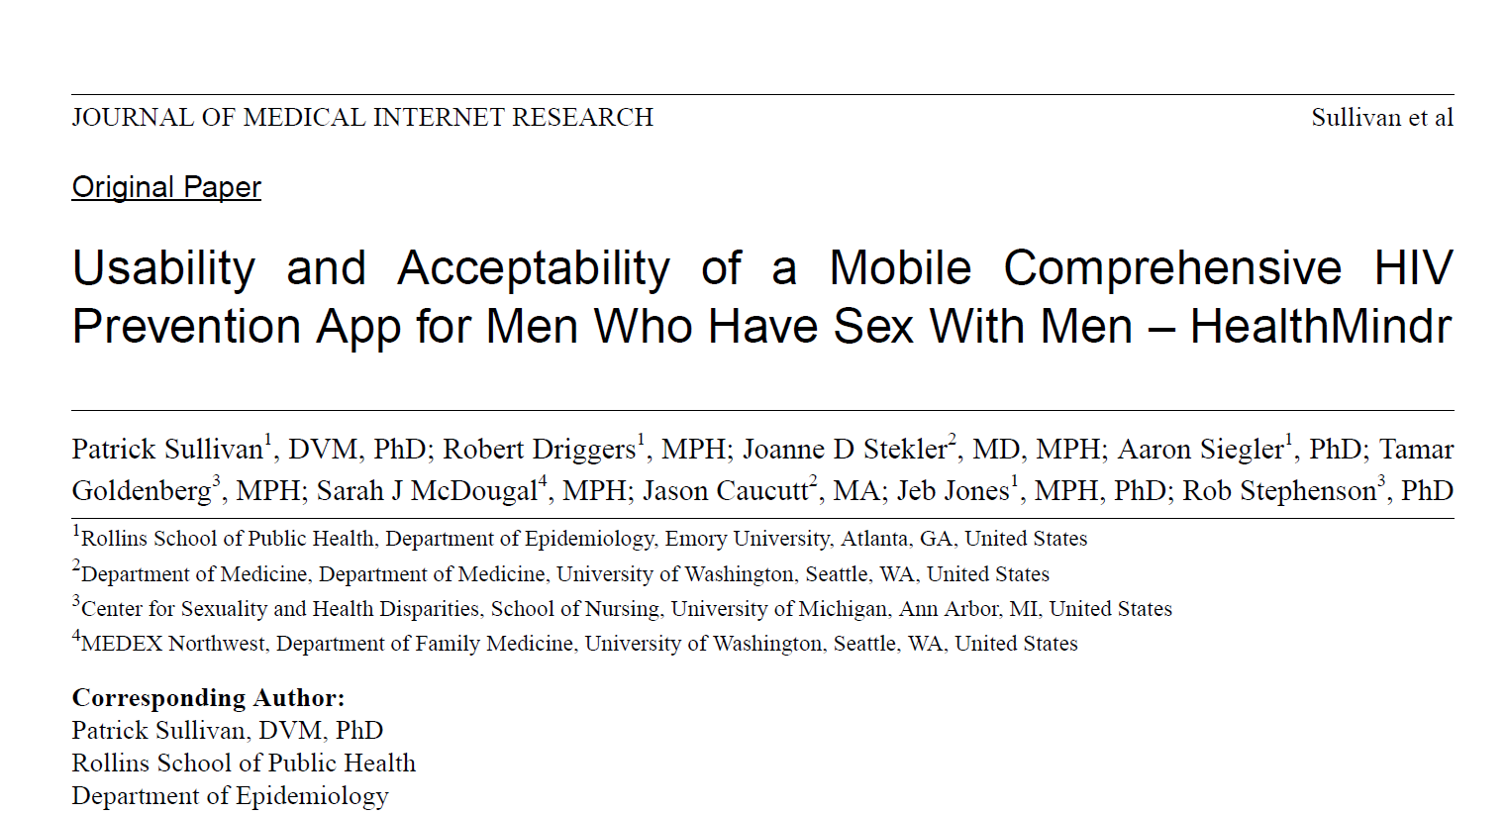
Source: Sullivan et al, JMIR 2017

Slide 14
HealthMindr Pilot Study
Participants
121 MSM enrolled
72 in Atlanta, GA
49 in Seattle, WA
18+ years
Never tested HIV positive
Only available to Android users
4 month study
Recruited from May-Aug
Finish in December
98 have Final Evaluation
Notes:
Monthly assessments

Slide 15
Testing plans in MSM before and after app use, Atlanta and Seattle, 2014
All Men (98)
Had an HIV Testing Plan (52)
Did not have an HIV Testing Plan (46)
Developed an HIV Testing Plan (30)
Did Not Develop a Plan (16)

Slide 16
Other Evaluation Results (n=98)
78% of those reported dissatisfied with current condoms ordered new condoms
87% report using the ordered condoms
53% ordered an at-home HIV test kit
2/3 of HIV test kit orderers were not planning on being tested soon
At study end, 83% of all MSM had a plan for regular testing
9% of PrEP-eligible men started PrEP

Slide 17




N=2100
Comparative Effectiveness Study
Ends: 08/2021
N=1200 + messages RCT
End: 01/2020
N=672 + PrEP Content RCT
Ends: Fall 2022
N=115 Adolescents Pilot Study
+STI
+STI
+STI
+STI
M^3: PI: Sullivan, PO: Mansergh; HealthMindr: PI Sullivan, PD J. Jones; MyChoices PIs Biello/Mayer; iSTAMP PIs: Sullivan, Hightow-Weidman, Stephenson, PO: Macgowan

Slide 18
Providing intervention content to participants Tailoring services to increase their relevance

Slide 19
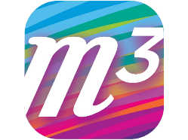
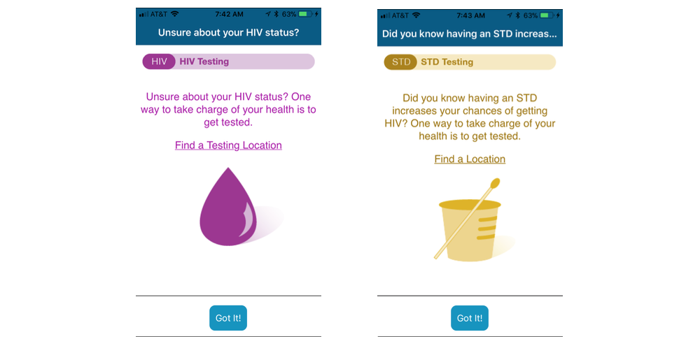
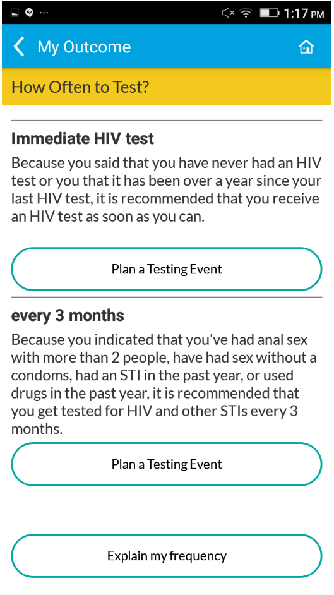
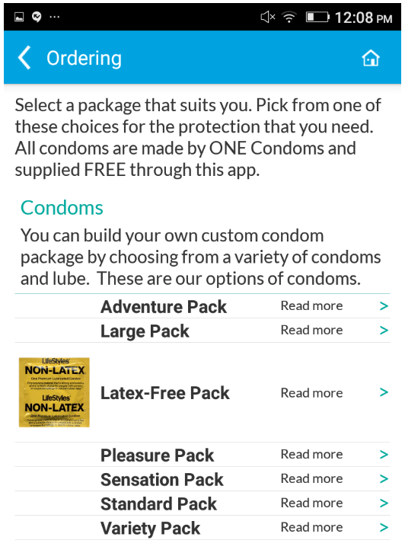
M-Cubed App
Built on Social Cognitive Theory
Healthmindr app: demonstrated
acceptability and usability
Prevention messages
Four domains: Condoms, PrEP, STIs, HIV Care
Two formats: Infographic panels, short videos
Core services
Establish HIV testing frequency and plan
Risk screening for PrEP and nPEP
Service locators for PrEP, HIV testing and HIV care
Information about HIV prevention, STIs, HIV care
Commodity ordering
Condoms and condom-compatible lubricant
HIV self-test kits
STI specimen self-collection kits
Notes:
Cumulative reported COVID-19 cases in adults through October 30, 2020 were 6,769,219, suggesting that about one in six (17%; 95% Crl: 15.2%-19.8%) of SARS-CoV-2 infections had been reported as a COVID-19 case through the end of October (reported fraction).

Slide 20

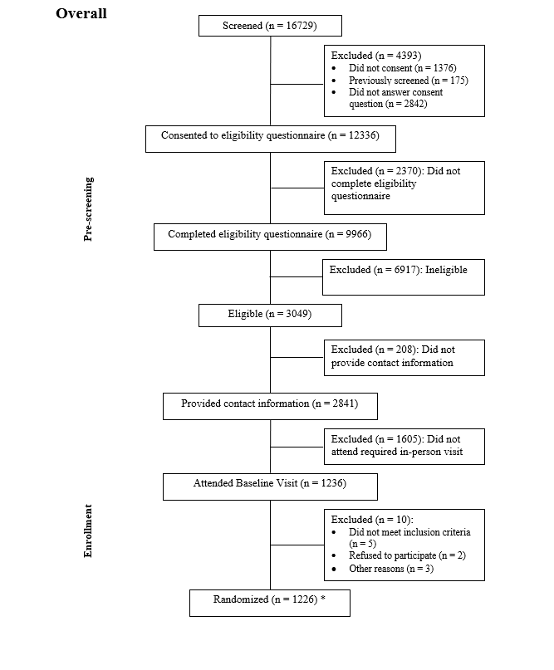
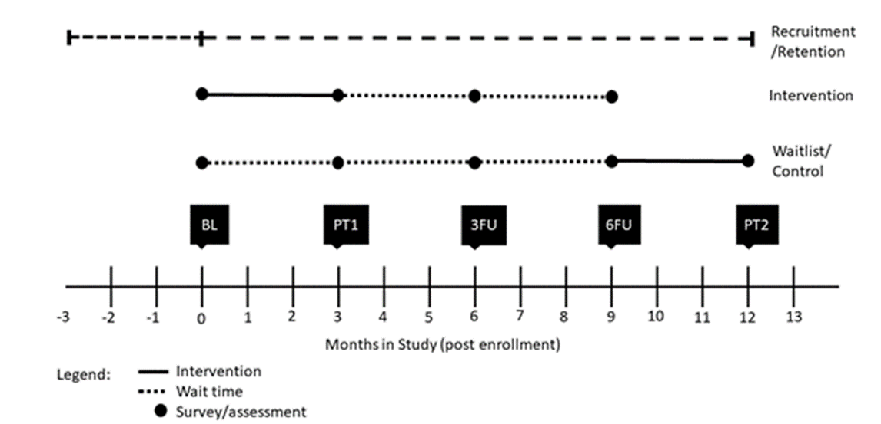
Study Design/Enrollment
Stratified randomization and analysis
Lower-risk/LR HIV-negative
Higher-risk/HR HIV negative
Living with HIV
1:1 app to delayed onset app access
Outcomes
LR Neg: HIV and STI testing, UA, PrEP use/adher, condom use
HR Neg: HIV and STI testing, UAI, PrEP use/adher, condom use
Living with HIV: STI testing, ART use/adherence, condom use
Retention: 3 mon 87%, 6 mon 85%, 9 mon 80%

Slide 21
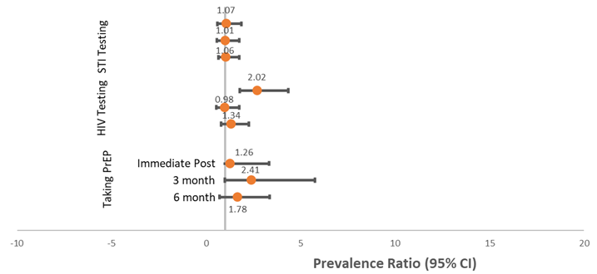
Results
Enrollment: Atlanta, Detroit, New York City
1220 overall: 427 HR NIH-, 410 LR HIV-, 383 Living with HIV
Higher risk HIV negative
Increase HIV testing immediate post
Increased PrEP use 3 months post
Lower risk HIV negative
No significant effects
Living with HIV
No significant effects

Slide 22
Communicating with participants Improving retention in research studies

Slide 23

Study Management and Retention System (SMART)
Web-based participant management system
SMART 3.0 (launching Summer 2021)
Participant management
Secure messaging
SMS and text integration
HIPPA-compliant document transfer
Scheduling
Reminders
Mobile app
Available at cost-recovery through Emory CFAR Prevention Sciences Core (www.cfar.emory.edu)

Slide 24
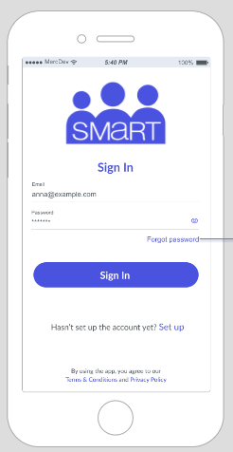
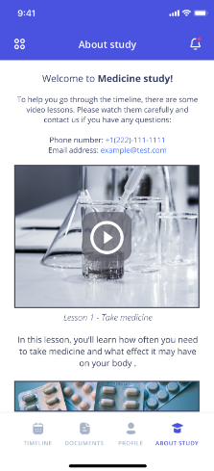
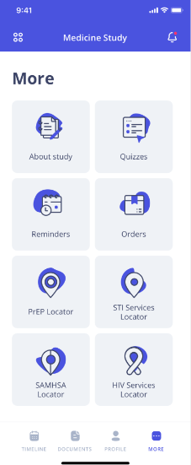
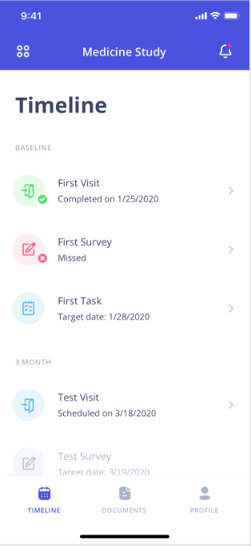
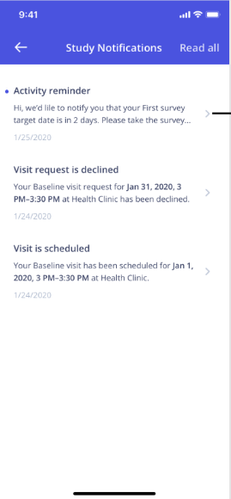
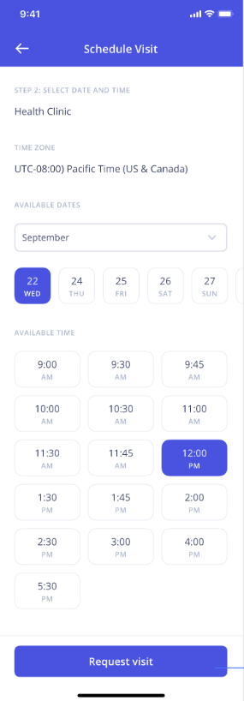

Slide 25
SMART Results
Used to manage 3,894 participants
4,597 person-years on study
47,512 emails and 32,782 text messages to participants
Study retention
Pre-SMART (n=2): 60% at 12 months (n=2354) and 77% at 12 months (n=1489)
Post-SMART (n=3): 88% at 12 months (n= 1200); 97% at 12 months (n= 800); 85% at 15 months (n=600)
Likely mechanisms:
Reminders
Integrated messaging
Self-monitoring of progress

Slide 26
Conclusions
eHealth interventions have a unique opportunity to reach critical groups (young people, rural residents, homebound people) for research and programs
Mobile applications can provide critical functions both in delivering health interventions, and in managing research studies
Platforms exist that can shorten the development cycle for mHealth interventions
SMART is a study management platform that has been associated with increased retention in online health studies and is available at low cost for participant management functions

Slide 27
Thanks:
Aaron Siegler
Travis Sanchez
Rob Stephenson
Joanne Stekler
Jeb Jones
Rob Driggers
Robin MacGowan
Brian Mustanski
Jeff Parsons
Lisa Hightow-Weidman
Jose Bauermeister
Acknowledgements
Emory CFAR: P30AI050409
Centers for Disease Control and Prevention
National Institutes of Health
PRISM Health Research Group
Contact information:
Patrick Sullivan
pssulli@emory.edu

