Slide 1
NINE YEARS OF DESIGN AND TESTING OF THE FIRST SMARTPHONE APP PROVEN EFFICACIOUS FOR SMOKING CESSATION
Jonathan Bricker, PhD
Public Health Sciences, Fred Hutchinson Cancer Research Center
Psychology Department, University of Washington
Seattle, Washington, USA

Slide 2
Smartphone Applications: High Reach + Low Efficacy
490 Applications for Quitting Smoking
4 Million Downloads Per Year
2019 Cochrane Review: Risk Ratio: 1.00 (95% CI, 0.66-1.52; I² = 59%; N = 3079)
4% to 18% quit rates
2020 Surgeon General Report Concludes: “Evidence is inadequate”

Slide 3
A New Behavior Change Model Has Promise: Acceptance & Commitment Therapy (ACT)
Being Willing + Acting on Values = Effective Life Choices

Slide 4
Standard Methods to Quit Smoking (USCPG) vs. ACT
 | Clinical Differences
Domain | USCPG |  | ACT
General | Avoidance: “How can you avoid your urges?” |  | Acceptance: “How willing are you to have an urge?”
Urges | Avoid places, distract, keep busy |  | Be Present: Urges on a moving stream
Thoughts | Restructure: Replace irrational with rational thoughts |  | Defuse: Carry cards with thoughts
Motivation | Expectancies: Benefits of quitting; risks of smoking |  | Values: “Deep down, what matters to you?”

Slide 5
Our Technology Intervention Design Process
Learn from our trials, interviews, & surveys: What do they need?
Develop new content to address unique needs
Focus groups to determine receptivity & gain new insights
Finalize program content & develop prototype app
Optimize app through iterative usability testing & diary study

Slide 6
Learning from Past Trial Results

Slide 7
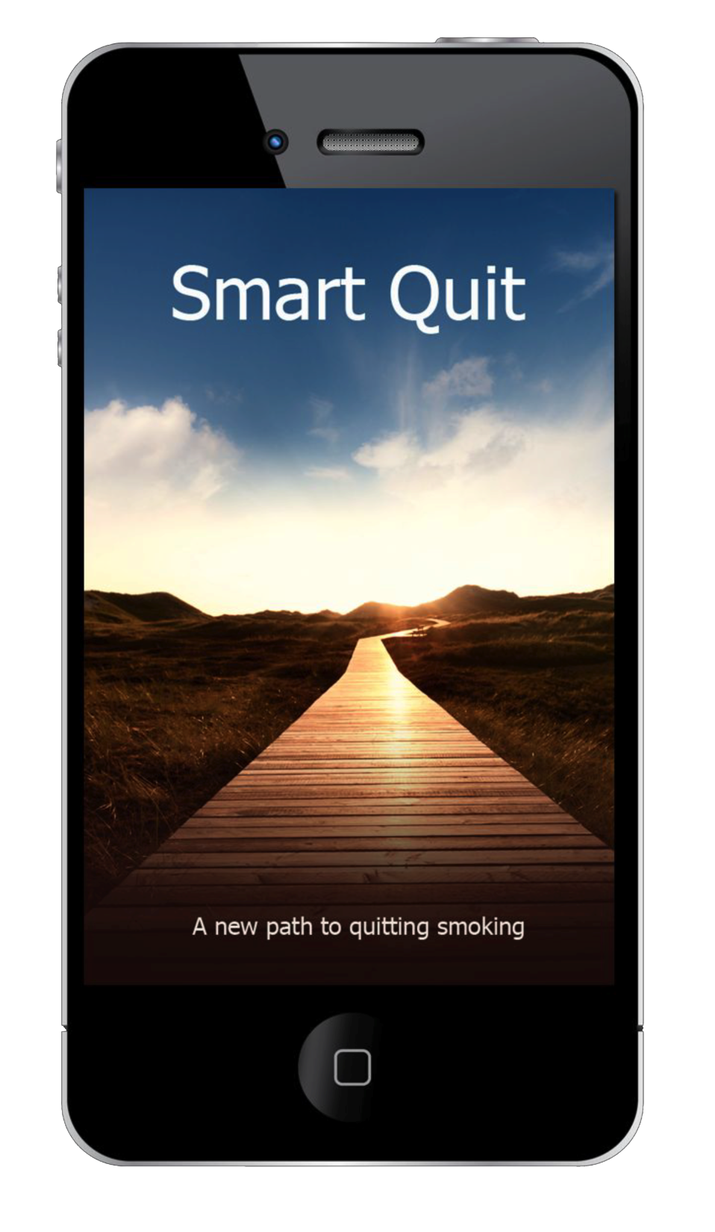
SmartQuit 1.0: 2012 to 2014

Slide 8
SmartQuit 1.0 RCT Experimental Design and Retention
Screened: 738
Eligible: 400
Consented: 340
Confirmed by phone: 205
Randomized: 196
Smart Quit: 98
Quit Guide: 98
70-day
Follow-up: 80
70-day
Follow-up: 84

Slide 9
SmartQuit 1.0 Top 5 SmartQuit Features
Most Popular
Most Predictive
ACT vs. CBT | Feature | # users | p (OR)
CBT | Viewed quit plan overview | 76 | .03 (11.1)
CBT | Viewed progress in calendar | 65 | .17 (2.8)
CBT | Opened sharing page | 64 | .23 (2.5)
CBT | Viewed progress in chart | 64 | .44 (1.7)
ACT | Tracked acceptance | 61 | .03 (10.5)
ACT vs. CBT | Feature | # users | p (OR)
ACT | Tracked ACT skills practice | 43 | .01 (16.4)
CBT | Viewed quit plan overview | 76 | .03 (11.1)
ACT | Tracked acceptance | 61 | .03 (10.5)
ACT | Viewed Staying Motivated video | 15 | .06 (4.1)
ACT | Viewed Handling Urges video | 15 | .06 (4.1)
(Heffner, Vilardaga, Mercer, Kientz, & Bricker, AJDAB, 2015)

Slide 10
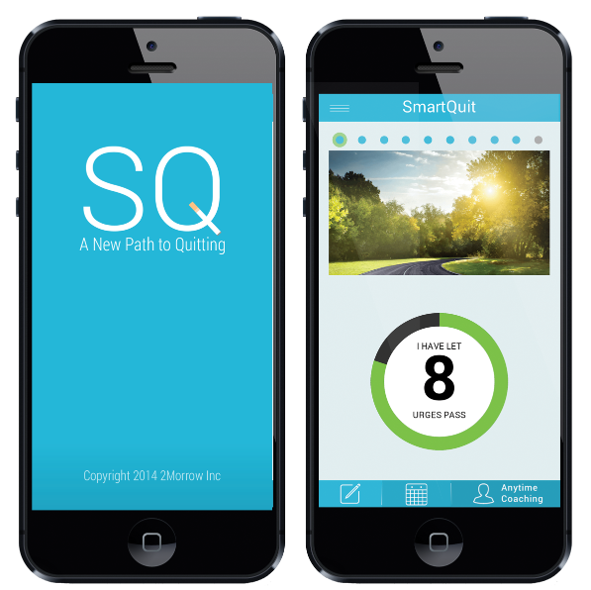
SmartQuit 2.0: 2014 to 2016

Slide 11
SmartQuit 2.0 Trial CONSORT Diagram
Screened: 443
Eligible: 347
Consented: 221
Confirmed by email: 161
Smart Quit: 99
70-day
Follow-up: 80
70-day
Follow-up: 84

Slide 12
Cessation & Reduction: 2.0 vs. 1.0
70-Day Follow-up | 2.0 | 1.0
Reduced Smoking | 75% | 32%

Slide 13
SmartQuit 2.0 Completion Predicts Cessation
Completion Measure |  | 7-day PPA
Full Completion of the Program: 24% of All | OR | 4.45
 | 95% CI | 1.13, 17.45
 | p-value | 0.032
Depth of Completion
Number of Quit Plan views | OR | 2.00
 | 95% CI | 0.92, 4.34
 | p-value | 0.078
Each ACT Module Completed | OR | 1.27
 | 95% CI | 1.01, 1.60
 | p-value | 0.042
Each Urge Passed Tracked | OR | 1.02
 | 95% CI | 1.00, 1.03
 | p-value | 0.043
Number of Anytime Coaching uses | OR | 0.97
 | 95% CI | 0.87, 1.09
 | p-value | 0.624
(Zeng, Heffner, Copeland, Mull, & Bricker., 2016; Addictive Behaviors)
Notes:
Full Adherence = Viewing Quit Plan, Completing core 8 ACT modules, Tracking letting urges pass at least 10 times, Accessing Anytime Coaching

Slide 14
From SMARTQUIT to ICANQUIT: 2016 to 2021

Slide 15
UX Design Research Findings: 7 New Engagement Features
• Show progress indicators
• Simple tracking of smoking and urges passed
• Gamification of pre vs post quit levels
• Advanced peer as a digital coach
• Storytelling to teach coping skills and motivate
• On-demand urge help
• Medication use and compliance

Slide 16
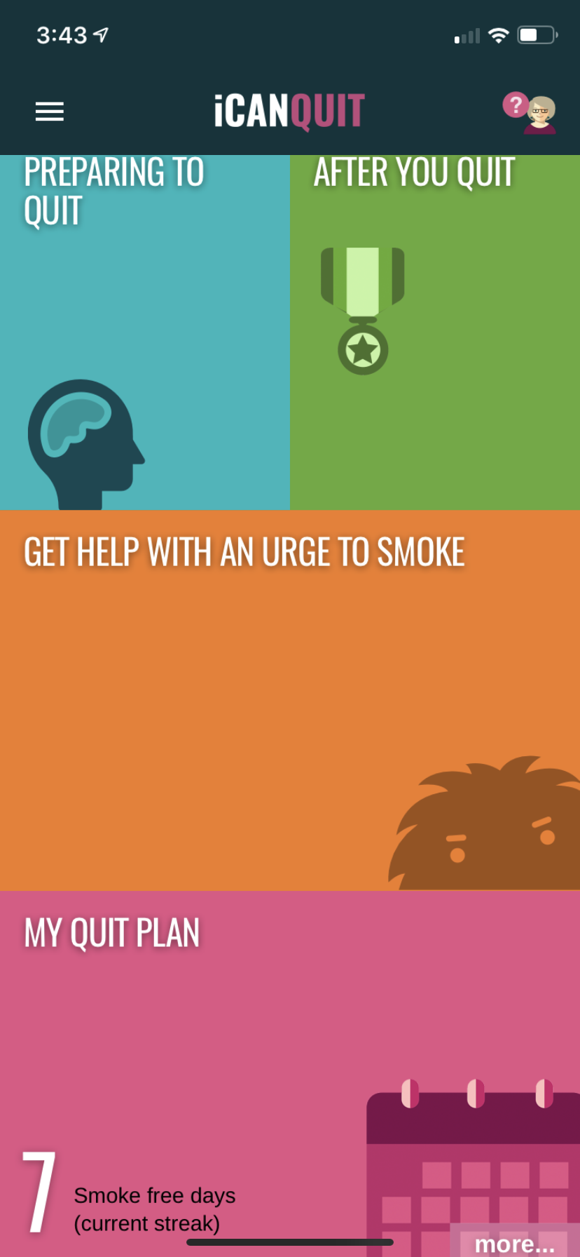
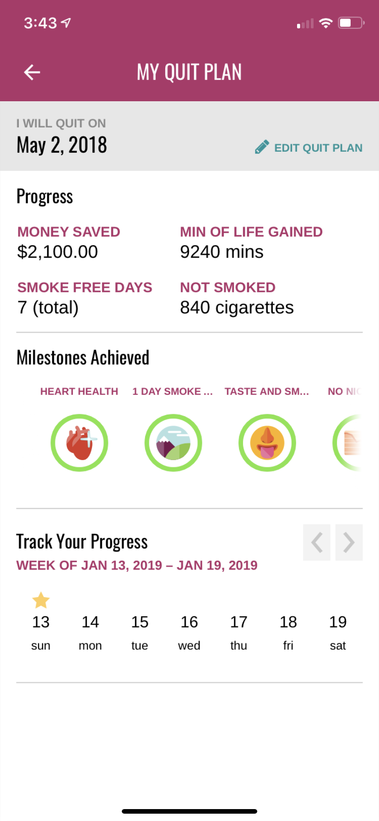
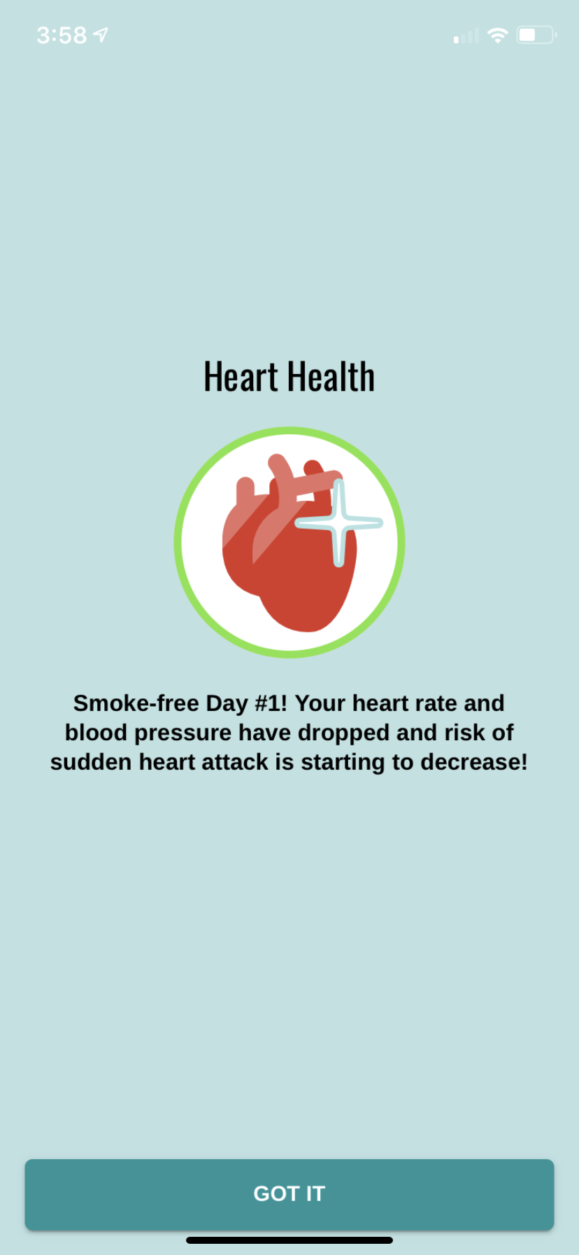
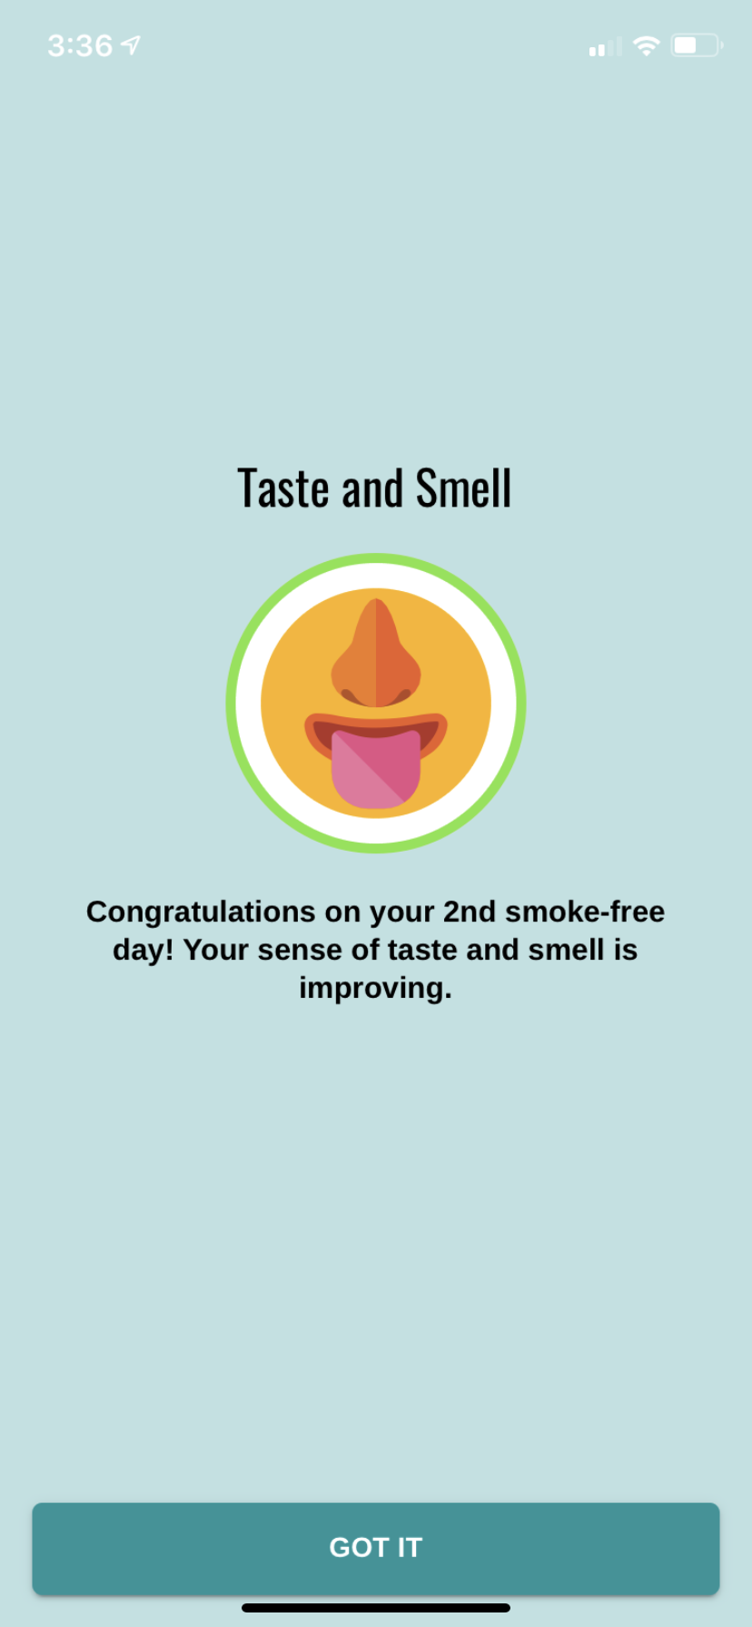
Implementation of Progress Indicators: Streaks and Badges

Slide 17
Preparing to Quit
Gamified Levels Train Awareness of Urges & Willingness to Have Cravings
Digital Peer Coach (“Nancy”) Trains Perspective Taking & Coping Skills Via Storytelling

Slide 18
After You Quit
“Nancy” Trains Smoke-Free Life: Values-Guided Vision & Actions
Gamified Levels Reinforce 4 Post-Quit Weeks of Relapse Prevention Skills Training

Slide 19
iCanQuit Full Scale Randomized Trial
©2016 Fred Hutchinson Cancer Research Center

Slide 20
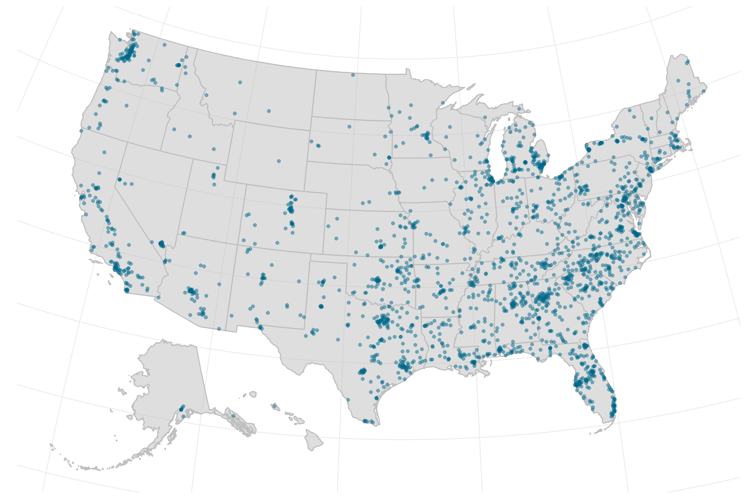
Geographic Locations of Randomized Participants

Slide 21
Baseline Demographic Variables

Slide 22
Baseline Smoking Variables

Slide 23
iCanQuit RCT Experimental Design and Retention
Screened: 12881
Eligible: 6559
Randomized: 2415
iCanQuit: 1214
Quit Guide: 1201
3 Month: 86%
3 Month: 87%
3 Month: 87%
6 Month: 87%
6 Month: 90%
12 Month: 86%
12 Month: 89%

Slide 24
Outcomes at 12 Month Follow-Up (JAMA IM; Sept 2020)
Outcome | Quit Guide | iCanQuit | p-value
30-Day Quit Rate (Complete Case) | 21% | 28% | <0.001
30-Day Quit Rate (Multiple Imputation) | 21% | 28% | <0.001
Prolonged Abstinence | 8% | 14% | <0.001
30-Day Quit Rate of All Tobacco (including e-cigarettes/vaping) | 16% | 24% | <0.001
Bricker JB, Watson NL, Mull KE, Sullivan BM, Heffner, JL (2020), JAMA Internal Medicine.

Slide 25
Efficacy X Reach = Public Health Impact
30%
Individual
iCanQuit 28% (2020)
Group
20%
Telephone
Efficacy (% Quit at 12 months)
Text
App
10%
1m
2m
3m
4m
5m
US Reach (# of million using modality annually)
Notes:
A

Slide 26
Conclusions
• Nine years of treatment development research, spanning three iterations of smartphone-delivered ACT for smoking cessation.
• iCanQuit: The first smartphone proven effective for smoking cessation in a full scale randomized trial.
• Digital behavioral health interventions have great potential but the rigorous development research is needed.

Slide 27
Medication Impact on 12 Month Outcome 30-Day Quit Rate
Subgroup | Quit Guide | iCanQuit | p-value
Used any medication by 3M | 17% | 37% | 0.001
Did not use medication by 3M | 23% | 28% | 0.031

Slide 28
Tailored, On-Demand Urge Help
Library of 300 Tips Tailored to 8 Common Triggers

Slide 29
Medication Planning & Reminder
Reminder Tool Addresses Compliance
Education on Selecting FDA Medication & Addressing Concerns

