Slide 1
April 8, 2021
The power of individual-level data to accelerate health impact
Fred Hutch mHealth Symposium
Emily Carnahan, Monitoring, Evaluation, and Learning Manager, PATH
Andrew Secor, Monitoring & Evaluation Officer, PATH
Notes:
We both work in monitoring & evaluation at PATH – so we sit at the intersection of data, programming, and impact.
We're going to talk about the power of individual-level data in the context of our work to introduce electronic immunization registries in sub-Saharan Africa.

Slide 2
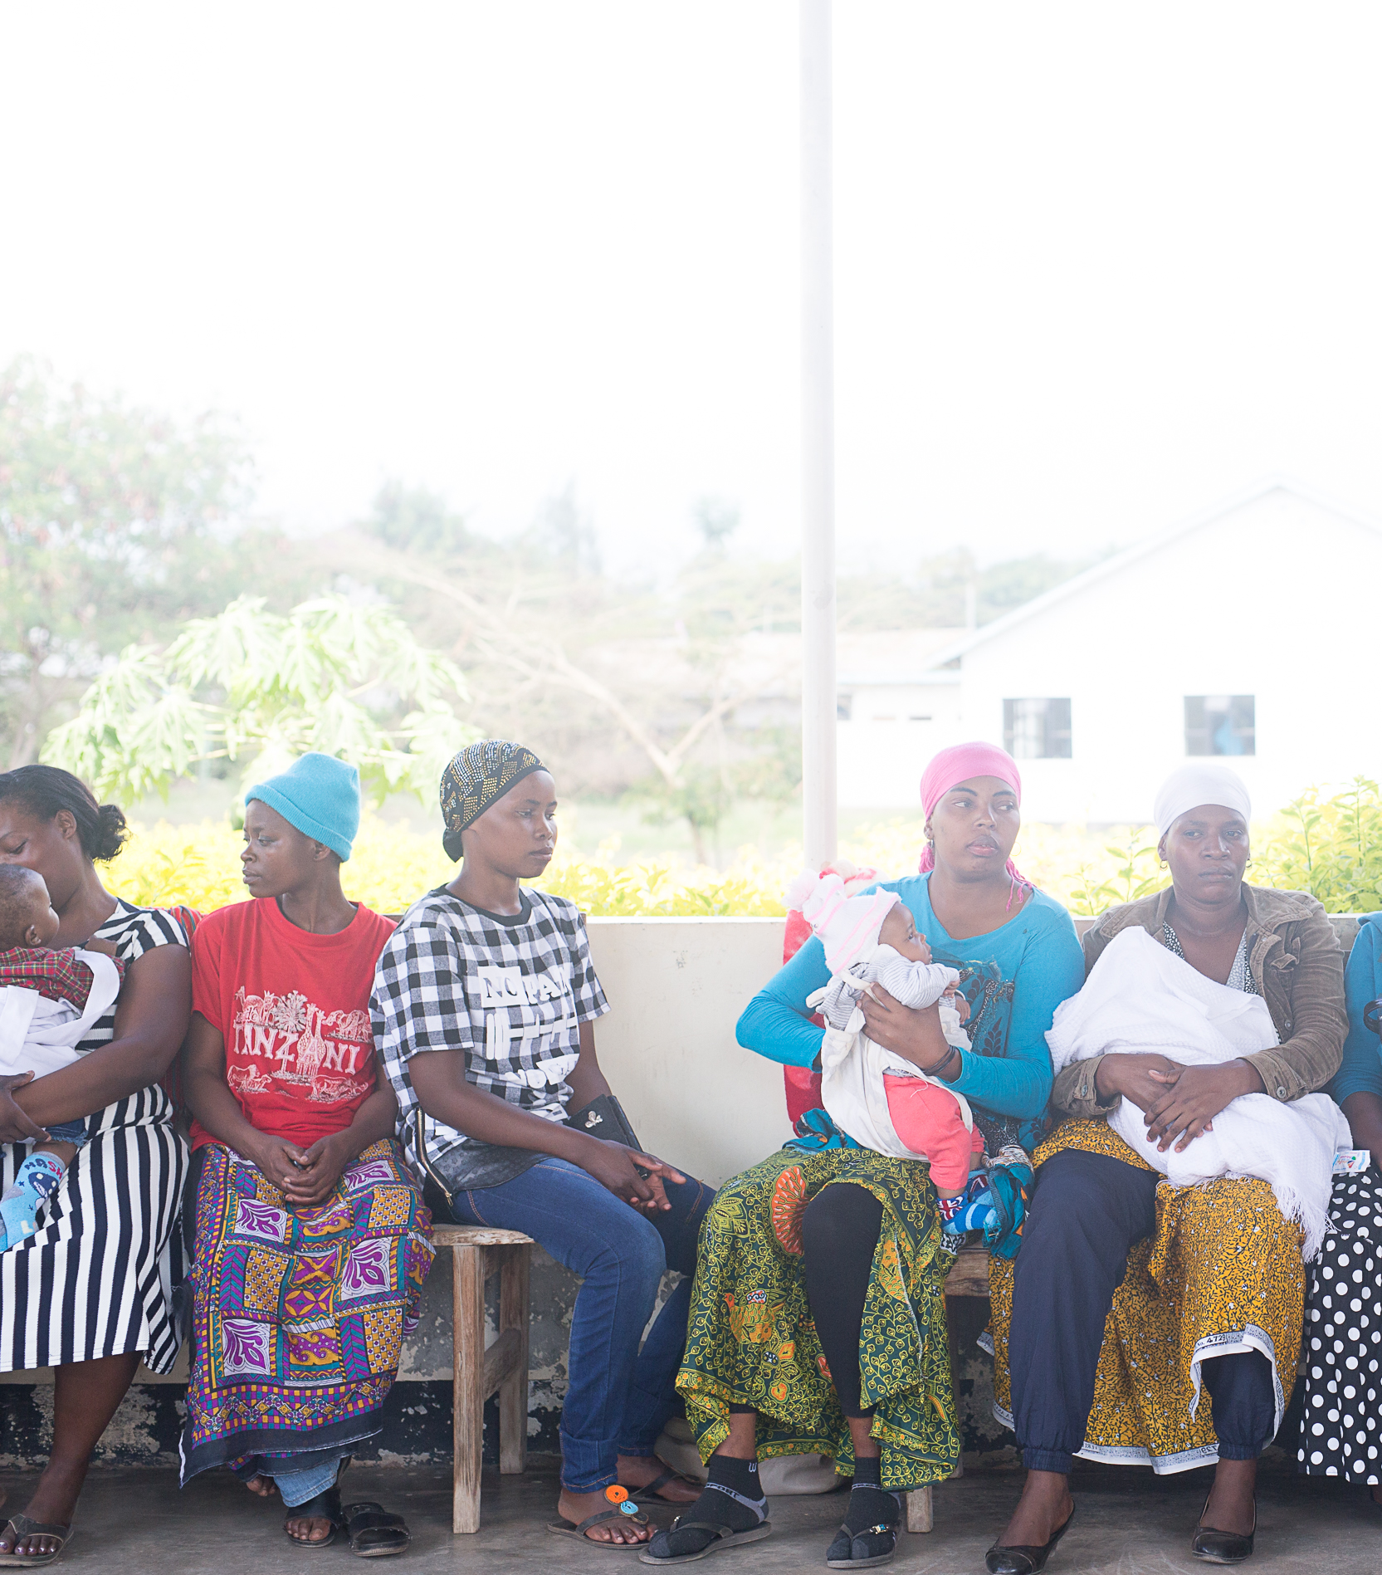

The fifth child
Without reliable health data, coupled with trained and empowered data users, health workers are not able to identify, treat, and take action to provide targeted care.
Notes:
Globally, one in five children does not receive their full course of immunizations, leaving them at risk of vaccine-preventable diseases. Data is critical to closing this gap.
Without reliable, easily accessed, and actionable data on the barriers impeding health, coupled with trained and empowered data users at all levels, those interested in improving health coverage don’t have the needed data and tools to make the best decisions.

Slide 3
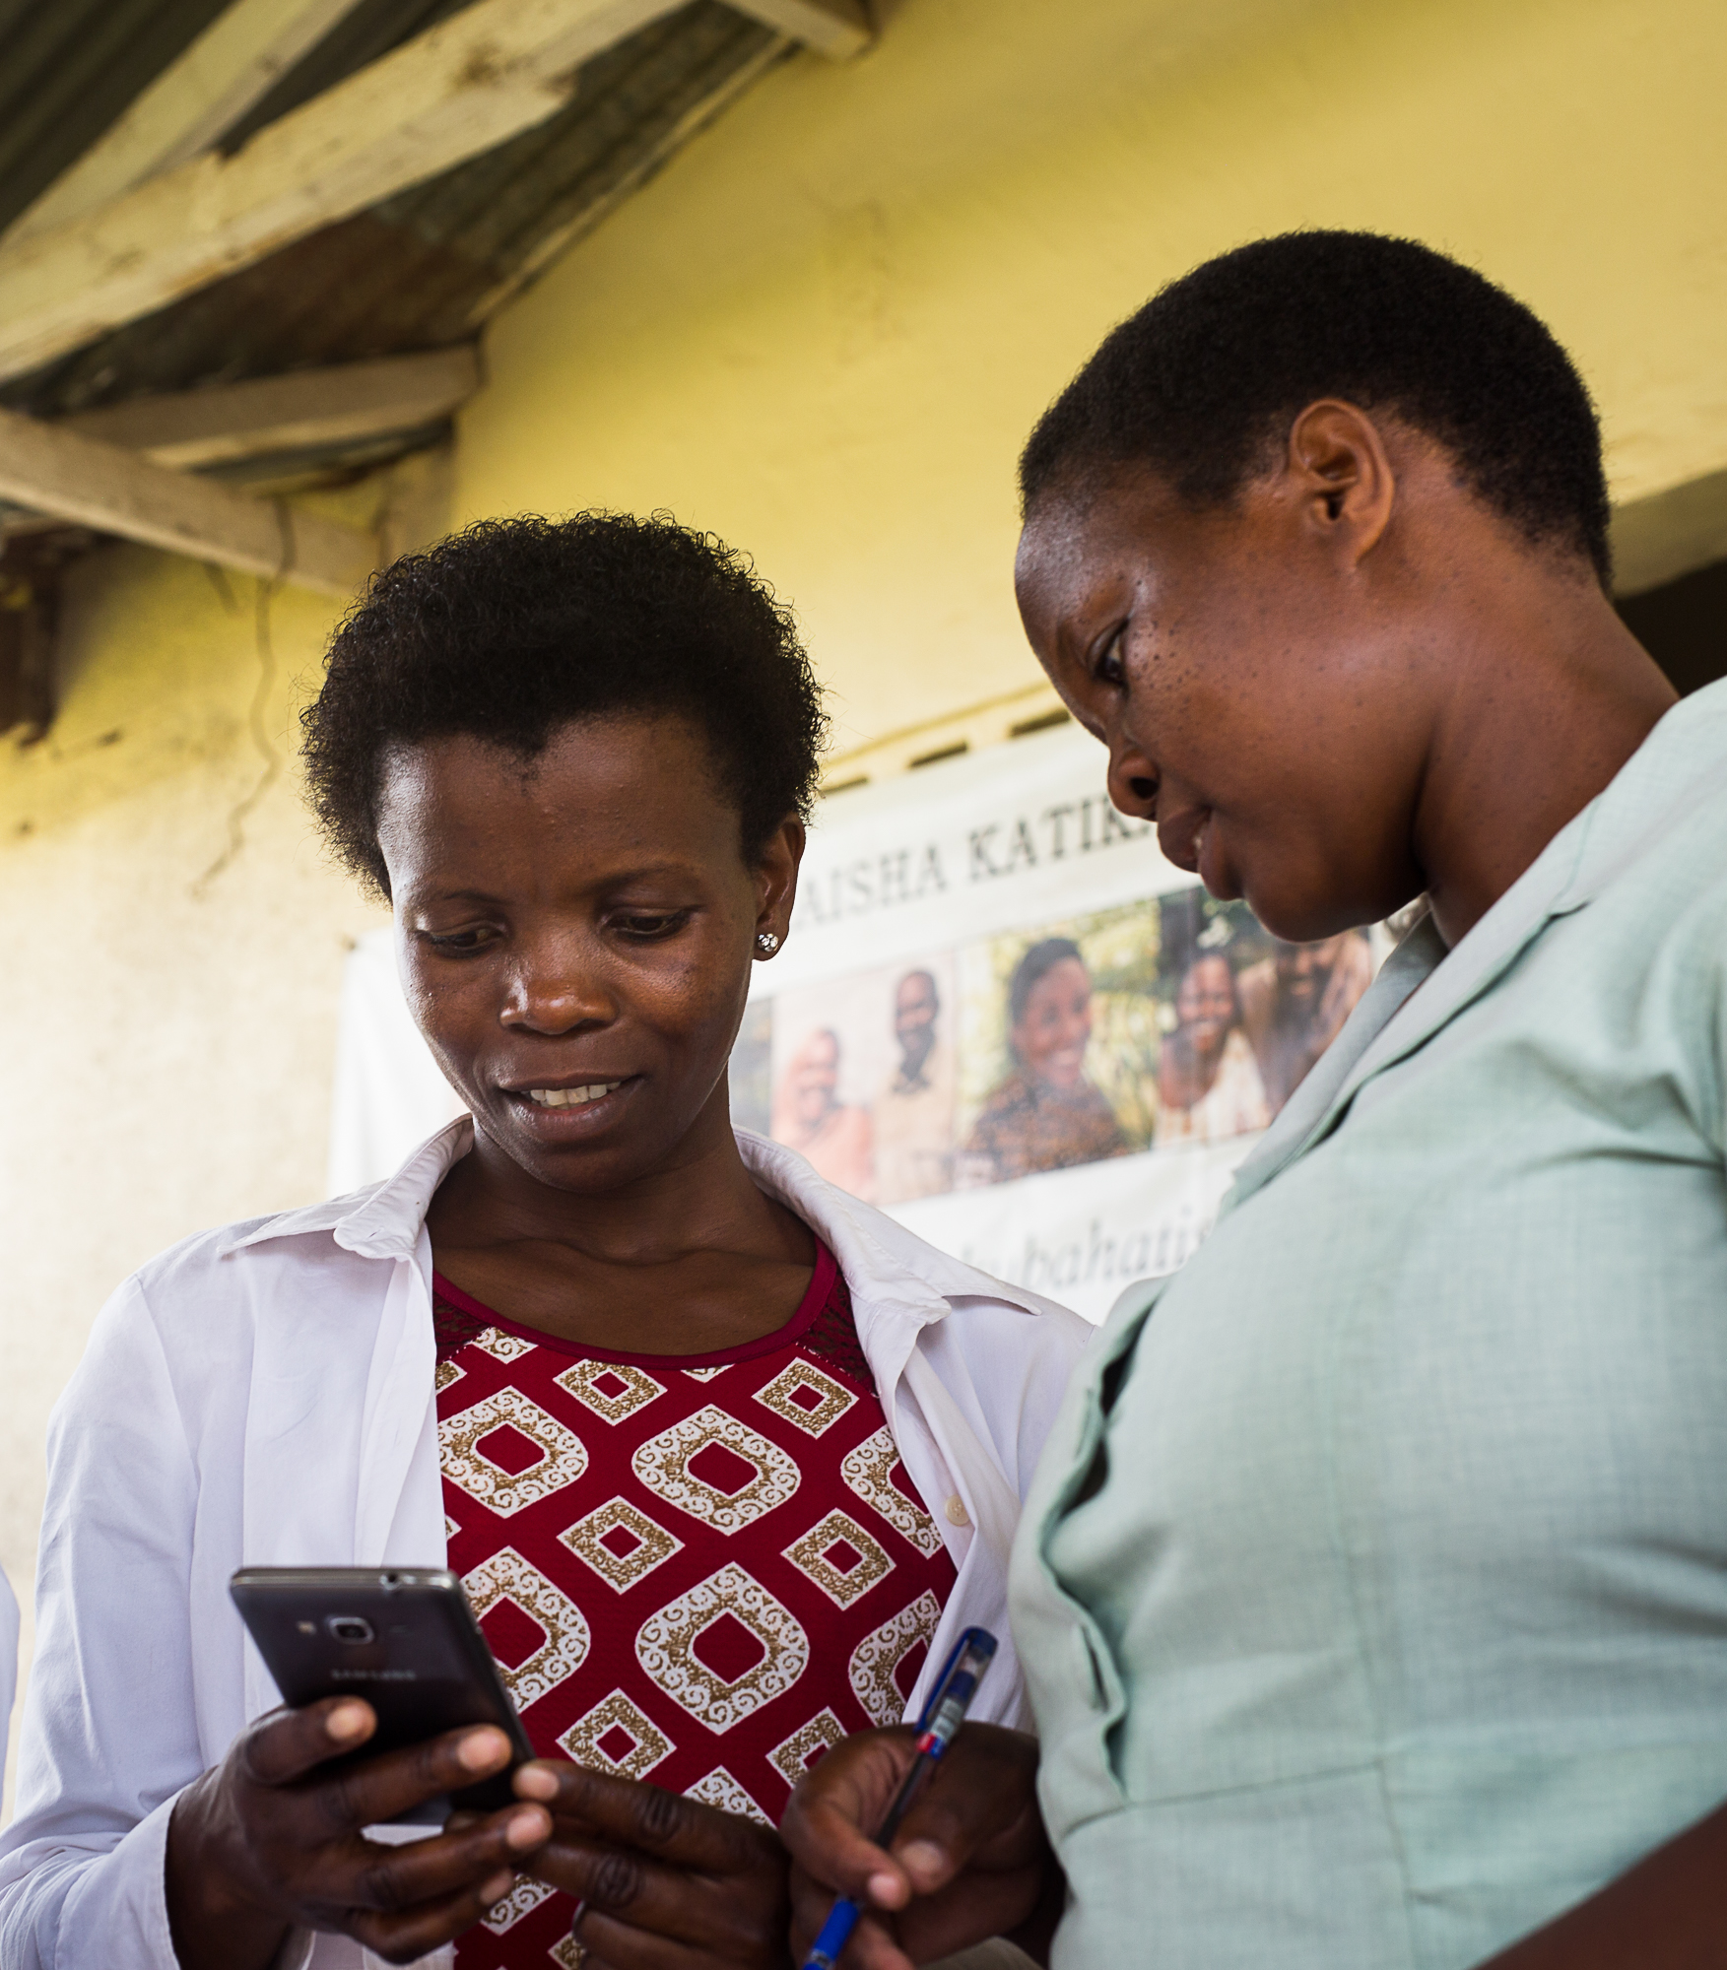

Putting the right information in the right hands
The BID Initiative worked in Tanzania and Zambia to enhance immunization and health service delivery through improved data collection, quality, and use.
Notes:
BID empowers countries to enhance immunization and overall health service delivery through improved data collection, quality, and use.
BID partnered with countries to design, test, and rollout interventions in Tanzania and Zambia. We worked to:
Identify the most pressing routine immunization service delivery problems.
Develop, perfect, and scale solutions with the users on the ground throughout the health system.
Facilitate peer learning with other sub-Saharan African countries in design, testing, and applying interventions.

Slide 4
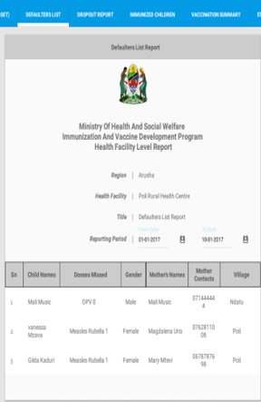
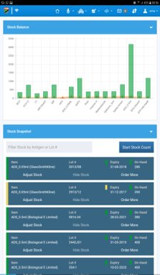
The electronic immunization registries
EIRs provide patient-level data that:
Optimize the process of delivering care.
Link services at well-baby clinics, providing a continuum of care.
Provide decision-making support to health workers.
Generate real time, accurate data to inform health worker decisions.

Slide 5

It used to be hard for Lucy to plan for immunization clinics.
Incomplete, inaccurate, and untimely immunization data meant children missed lifesaving vaccines.
5
Notes:
Lucy is a health care worker at an immunization clinic.
Prior to the EIR introduction, Lucy often worked nights to record data on paper forms. Sifting through paper records, tally numbers, and counting stock made it difficult for Lucy to plan for immunization clinics.
The incomplete, inaccurate, and untimely immunization data captured in these paper-based forms meant children missed lifesaving vaccines.

Slide 6
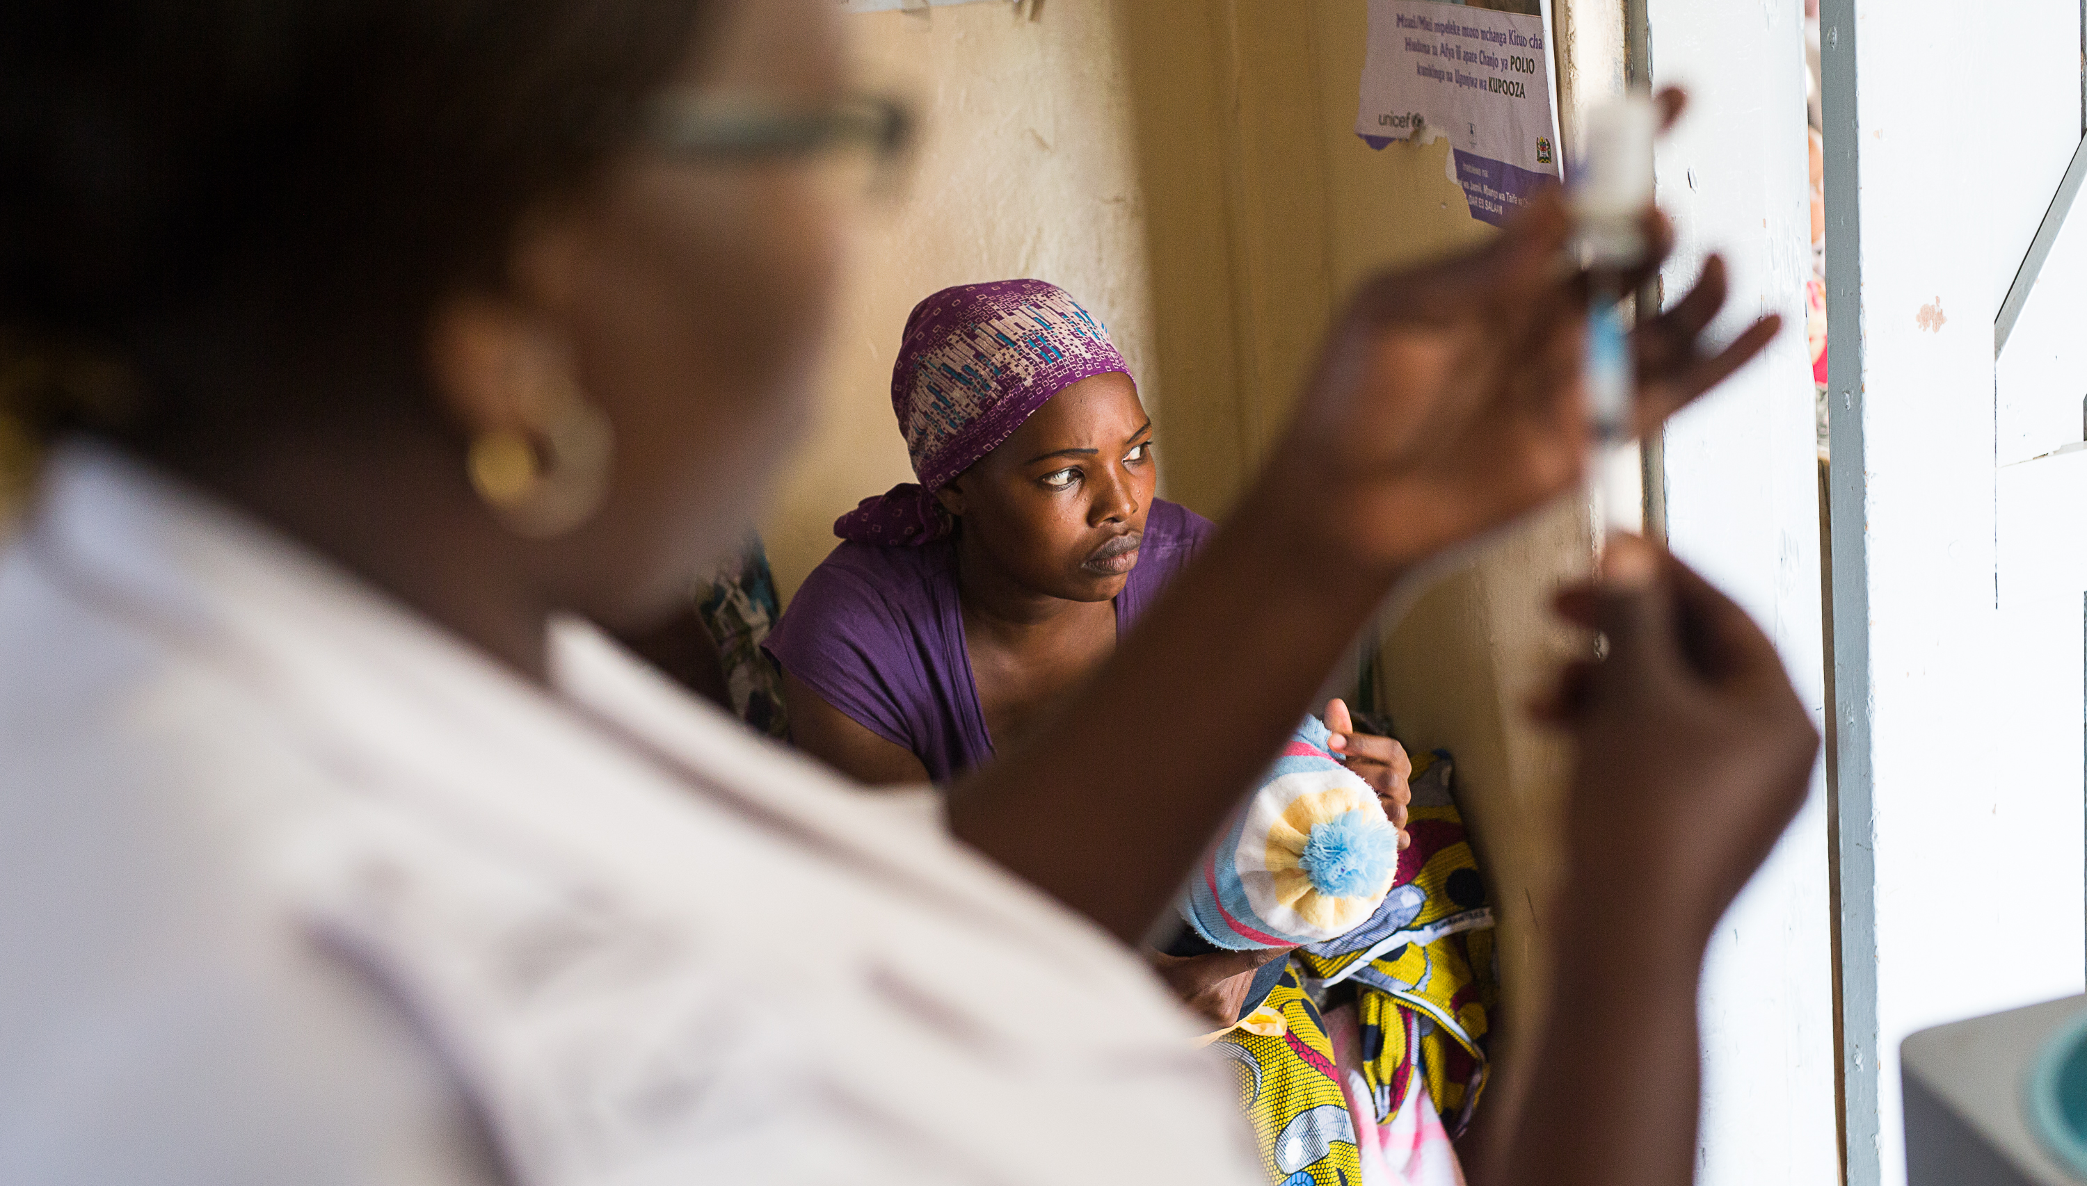
Lucy used to send data to the district, but would rarely see it again.
6
Notes:
Using the paper-based records, monthly reports often took 10+ hours to complete. Lucy would send these reports to the district but...
With no feedback loop and no means to process and analyze this information, she couldn’t
address gaps in care,
accurately calculate her facility’s target population, or
determine children who had recently missed vaccines.
The data had little value or meaning to her, and so she was not motivated to collect or use quality data.

Slide 7
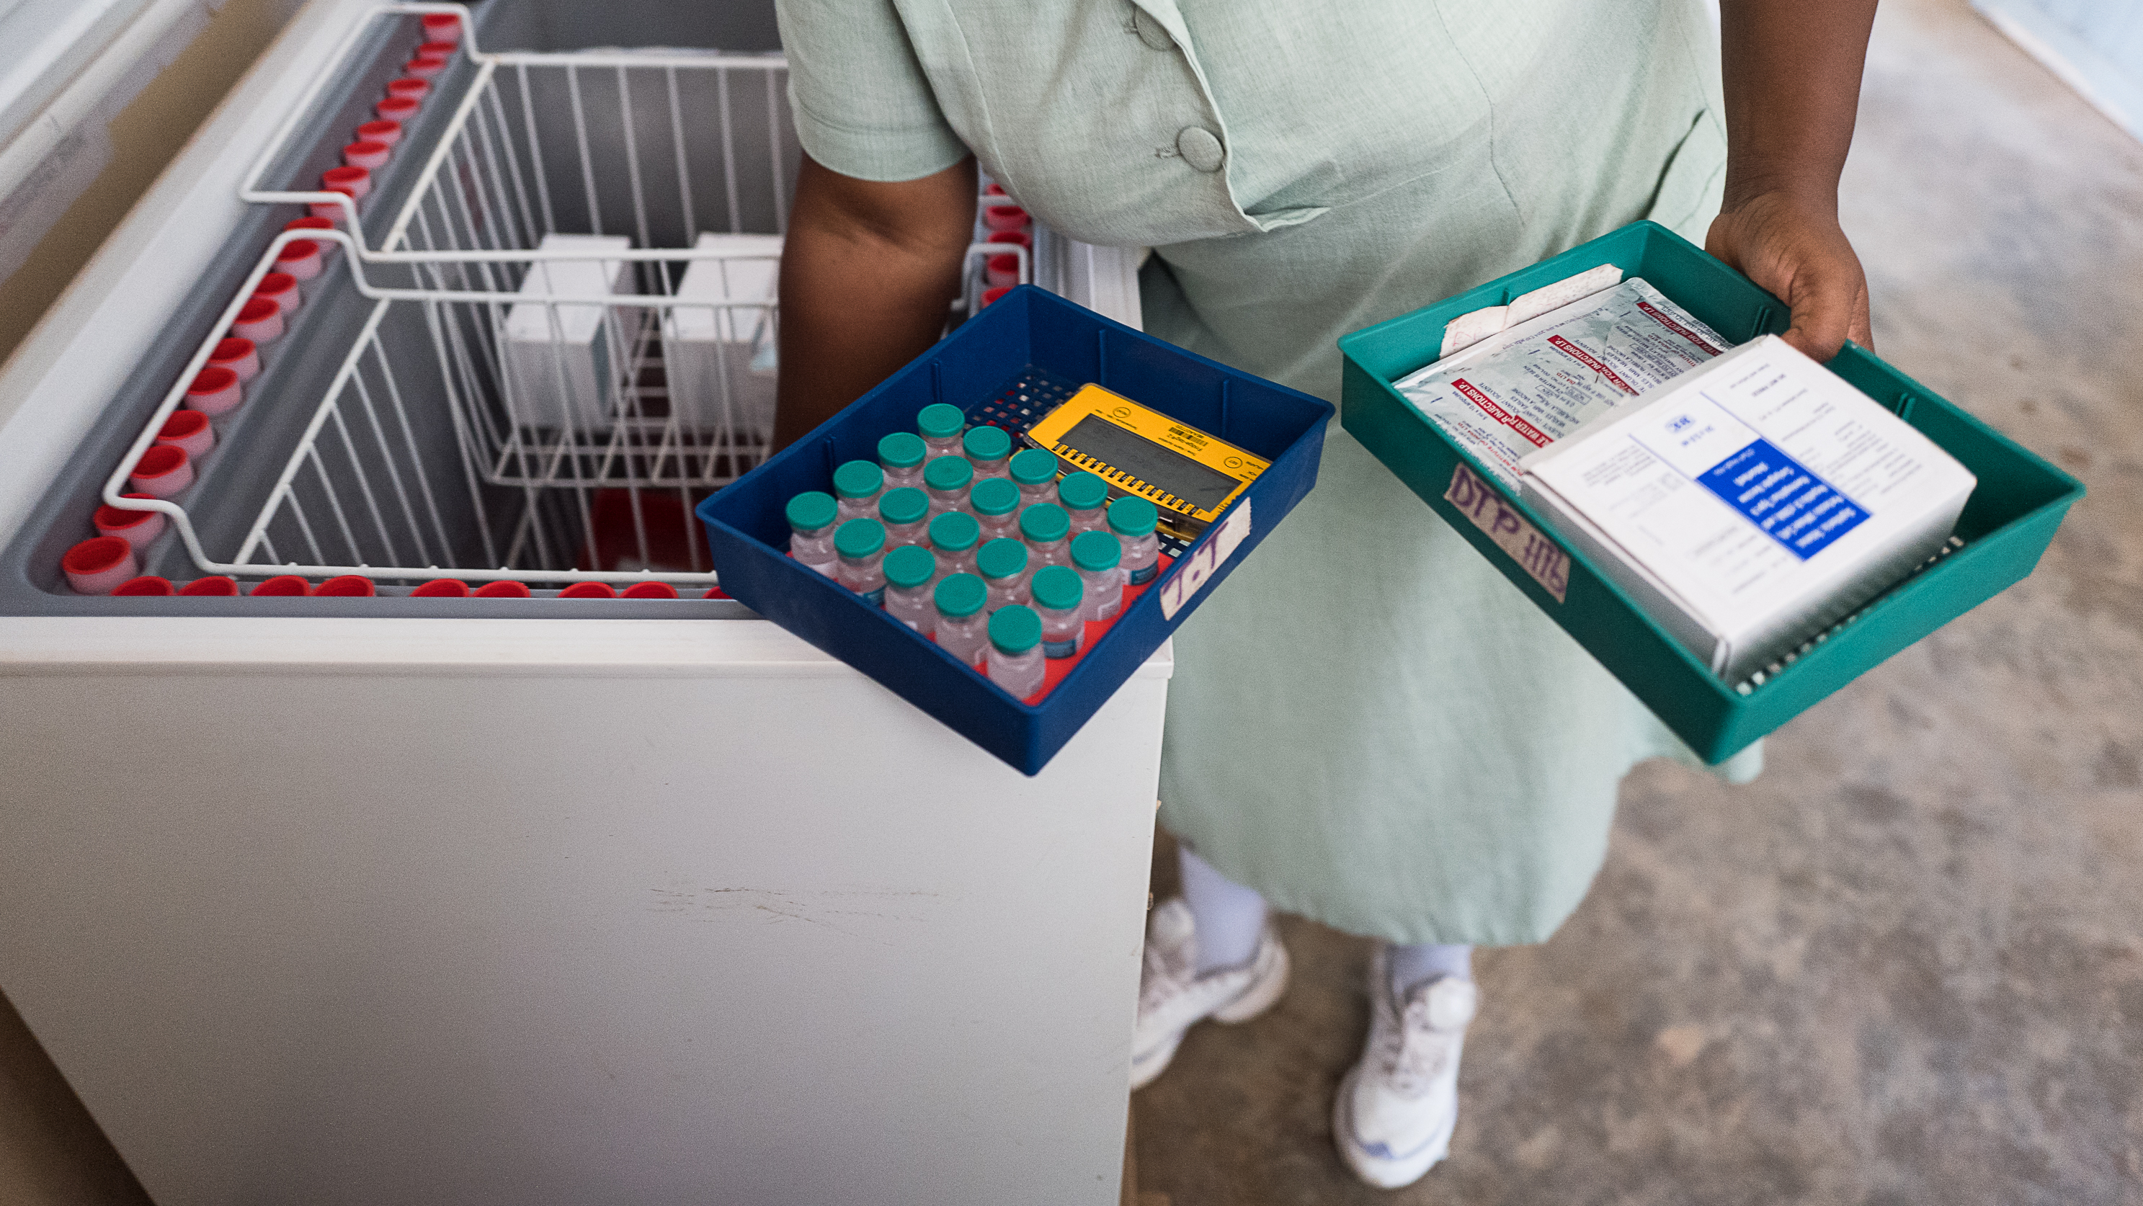
Lucy had poor visibility into vaccine supplies and turned patients away because of stockouts.
7
Notes:
As a result, Lucy did not know how many children to expect at upcoming immunization clinics and how much vaccine stock to order.
She would have to turn patients away because of vaccine stockouts.

Slide 8

Added value of EIRs
With the introduction of an EIR, Lucy has clear visibility into vaccine stock, coverage rates, and which children have missed vaccines, allowing her to provide more targeted care.
The EIRs automate data collection and use, saving Lucy time, so she can care for more patients.
Individual-level data has powerful implications for planning.
Notes:
EIRs automate everything. Lucy spends 41% less time registering and vaccinating children. She no longer reconciles her immunization records. The task is automated – saving her 8 working days each year.
Planning:
Facility level: anticipate which children are due for vaccination in the coming weeks to ensure sufficient stock on hand; target outreach to areas with unvaccinated children.
Regional/National decision-makers now know how to target limited resources and identify underperforming facilities.
Better programmatic decision-making and action can improve health system performance, ultimately contributing to improved coverage and equity.

Slide 9






From paper to electronic
The shift from traditional paper-based reporting to EIR reporting is also a shift from:
Aggregate reports
Individual-level electronic
data
Monthly reports
More timely data
(contingent on timely data entry
and syncing)
Aggregate results
Ability to drill down
(e.g. by patient or provider
characteristics, time and date, etc.)
Notes:
Electronic individual-level data also provides an opportunity to more easily link with other data sources (e.g. civil registration or vital registration data; other medical records; survey data).

Slide 10






2,097,208 children are registered in electronic immunization registries in Tanzania and Zambia.*
By the numbers
*These numbers are from March 2021.

Slide 11


The art of the possible
Notes:
Access to electronic individual-level data opens up many possibilities for how the data can be analyzed and used.
To prioritize possible analyses, we talked to stakeholders about how EIRs can help address common barriers faced by immunization programs. In speaking with experts (from international public health agencies, donor organizations, governments, and NGOs) 4 priority topics rose to the top:
1. Denominators and population movement – to understand where are patients seeking care?
2. Missed opportunities for vaccination – to understand when, where, and among which children these missed opportunities occur?
3. Continuum of care – to identify which children drop out of the full vaccination schedule and when?
4. Continuous quality improvement – to identify trends or outliers to inform targeted quality improvement efforts.
I’m going to pass it over to my colleague Andrew to share some of the recent novel analyses we’ve done using data from the Tanzania EIR. These are still draft / work in progress, but help to illustrate the art of the possible with individual-level data.

Slide 12
Added value of EIRs: an observational case study of the Tanzania Immunization Registry (TImR)
Notes:
Hi everybody. I’m Andrew Secor and I am an M&E Officer with PATH.
I will be presenting on some of the recent analyses that we’ve been conducting with data from the Tanzania Immunization Registry (TImR).
We’re still finalizing our analyses and data sharing permissions with the MoH, so the results presented here are provisional and should be understood as illustrative of possibilities that EIRs open up for exploring vaccination coverage and associated factors rather than as hard and fast results.

Slide 13
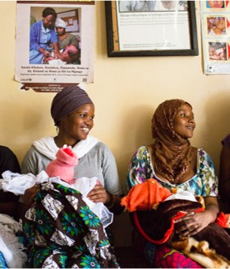
Data overview
EIR records from TImR from 2017 to 2019:
~1 million visits from ~560k unique patients;
57 districts in 10 regions;
Patients were on average younger (<12 mo.) and rural, with roughly equal sex disaggregation.
Notes:
For our analyses we extracted all TImR entries from 2017 to 2019, which after cleaning consisted of a little over 1 million visits from about 560,000 unique children, representing 57 districts in 10 regions.
Unsurprisingly, our sample was younger (most patients were under 12 months) and largely rural.

Slide 14
Population movement and denominators
Aim: to understand patient movement between facilities and associated factors
Notes:
Inaccurate population denominators are a common challenge for monitoring coverage, improving implementation, and informing planning, such as projecting vaccine stock and staffing needs.
EIRs allow us to track individual children across multiple visits and facilities, something that is not feasible with aggregated routine data, allowing us to explore patient movement and associated factors.

Slide 15
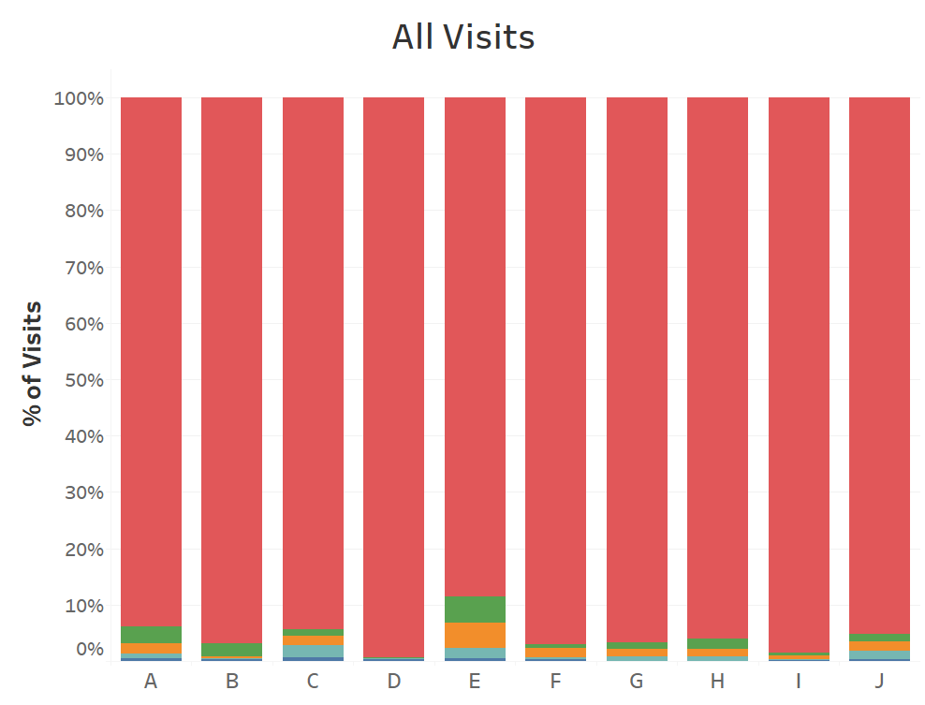
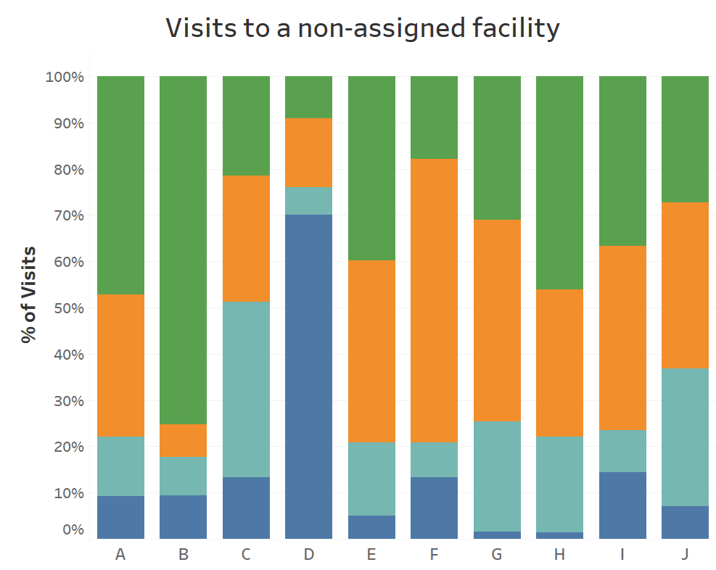
Population movement and denominators
*Illustrative data; results are in progress.
Notes:
As noted, we’re still finalizing some data sharing permissions, so we’ve developed a clever system for anonymizing the regions, so each column here is a region.
When children are registered in the TImR system, they are assigned a home facility based on their preference and where they plan to receive care.
Figure on the left shows all visits by location, with the vast majority of visits being made to a child’s assigned facility (shown in red). Some regional heterogeneity, but by-and-large children were seeking care at their assigned home facility
However, when restricted to just those visits to a non-assigned facility, as shown on the right, we see some notable differences by region. In some regions, the majority of children are staying within the same district, many even staying within 5 km (shown in green), while in other regions many children were traveling to other districts or even different regions to access care.
#EIRs, by tracking individual children, allows us to start to dig into these issues, which can have large impacts on planning, such as projecting vaccine stock and staffing needs.

Slide 16
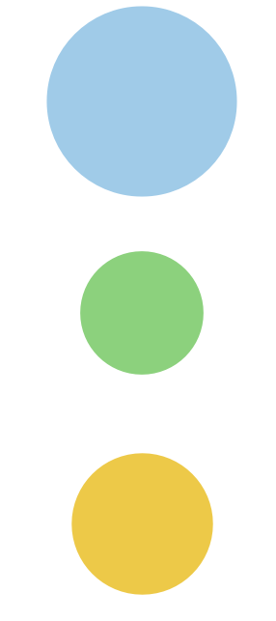

Assigned facility type
Visited facility type
Population movement and denominators
Dispensary
Visits to non-assigned facilities, by children assigned to Health Centers
Health
Center
Health Center
Hospital
*Illustrative data; results are in progress.
Notes:
This table shows visits to non-assigned facilities by assigned and visited facility type.
Our original thinking was that many of these visits to non-assigned facilities could be due to patients seeking more advanced care than they could obtain at their assigned facility.
This figure shows the proportion of visits to non-assigned facilities from children assigned to health centers, with bubble and arrow size indicating the magnitude (number of visits). While some children attended hospitals, some attended other health centers, and most attended lower-level dispensaries, suggesting that there were other reasons leading to children visiting non-assigned facilities, such as stockouts, staffing issues, patient migration, etc., highlighting the need for greater exploration of the mechanisms behind patient movement.

Slide 17
Missed opportunities for vaccination (MOVs)
Aim: to identify MOVs and understand patient, facility, or geographic characteristics associated with MOVs
Notes:
Our analyses also explored missed opportunities for vaccinations. These were defined as: “any visit by a child who is eligible for vaccination which does not result in the child receiving one or more of the vaccine doses for which they are eligible”. Basically if a child visits a facility and doesn’t get one of their eligible doses.

Slide 18
MOVs
Electronic, individual-level data allows for assessment of MOVs by patient and facility characteristics (e.g., age, facility type, stockouts, etc.).
Identify facilities/districts/regions with higher rates of MOVs for targeted improvement efforts.
Identify mechanisms behind MOVs (more limited).
In our sample:
  MOVs were higher among younger age groups (<12 mo.);
  Similar rates of MOVs by facility urbanicity and type;
  Differing rates of MOVs by vaccine type.
Notes:
Since we have a child’s date of birth and vaccination history in the system, we can readily assess if they experienced an MOV at a given visit, something that can be challenging to assess with paper-based systems and is not possible with aggregate data
Electronic, individual-level data allows for assessment of MOVs by patient and facility characteristics (e.g., age, facility type, stockouts, etc.).
Identify facilities/districts/regions with higher rates of MOVs for targeted improvement efforts. – will touch more on that in later slides
Identify mechanisms behind MOVs (although this can be limited).

Slide 19
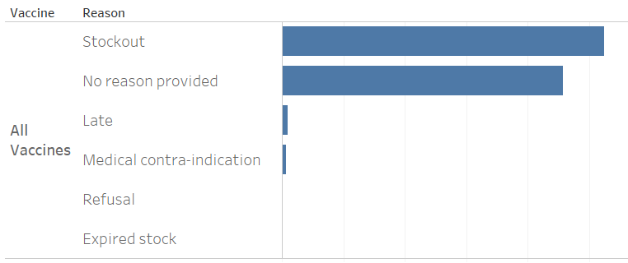
Reasons for MOVs
*Illustrative data; results are in progress.
Notes:
The TImR system allows providers to enter a reason for an eligible dose not being provided. This figure shows the reasons indicated for all MOVs in the data, with stockout being the most common, followed by “no reason provided” (meaning the field was left blank, suggesting that many could be forgotten doses, where the provider wasn’t aware the child was eligible, or forgot to enter the reason). The other reasons, such as patient refusal, expired stock, etc. are fairly uncommon.
We are also able to disaggregate these by vaccine type, patient characteristics, and facility characteristics to explore factors associated with MOVs. For example, we found that stockout was much more commonly cited for Penta and PCV MOVs as compared to the other vaccines, suggesting that stock issues with those two vaccines need to be explored in greater depth.

Slide 20
Continuum of care (CoC)
Aim: to identify children who default / dropout of the continuum of care and associated characteristics
Note: Analysis for CoC was restricted to children aged 12-35 months on 12/31/2019 (artificial data endpoint) and for vaccines scheduled for the first year of life (i.e., through MCV-1).
Notes:
Identifying where in the vaccine schedule some children drop out and why is another key challenge for achieving high levels of vaccine coverage. Understanding which vaccine doses and which child and facility characteristics are associated with failure to complete a vaccine sequence or the full vaccine schedule can help inform service provision as well as training and other quality improvement measures at the facility, regional, and national level. Electronic, individual-level data allows us to do this in a way not possible with aggregate data and difficult to implement with paper-based systems or surveys.

Slide 21
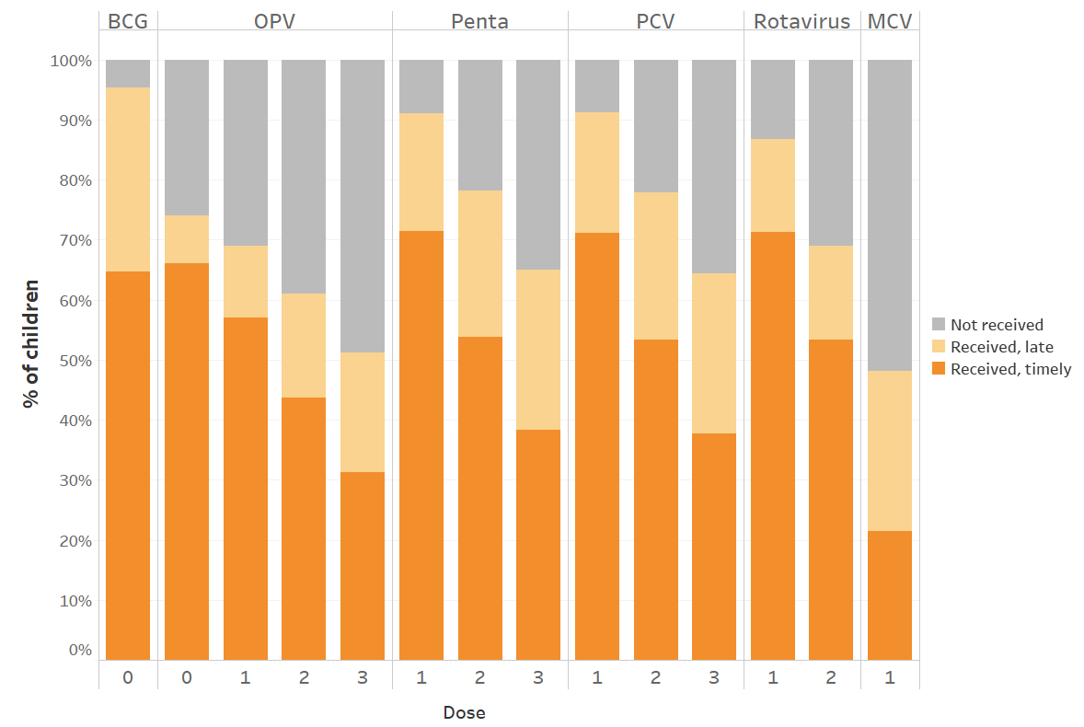
CoC: Doses received and timeliness
*Illustrative example; results are in progress.
Notes:
This figure shows doses received and timeliness (with a dose considered timely if received within a week of eligibility), by vaccine type and dose. As expected, there was drop-off in coverage with later doses in each vaccine sequence. Timeliness also decreased monotonically with later doses in a sequence. As with the other analyses, we can disaggregate this by various patient and facility characteristics to better understand factors associated with child dropout.

Slide 22
CoC: Immunization typologies/profiles
 | Vaccine/dose
Typology | BCG | OPV |  |  |  | Penta |  |  | PCV |  |  | Rota |  | MCV
 | 0 | 0 | 1 | 2 | 3 | 1 | 2 | 3 | 1 | 2 | 3 | 1 | 2 | 1
1 | 1 | 1 | 1 | 1 | 1 | 1 | 1 | 1 | 1 | 1 | 1 | 1 | 1 | 1
2 | 1 | 1 | 1 | 1 | 1 | 1 | 1 | 1 | 1 | 1 | 1 | 1 | 1 | 0
3 | 1 | 0 | 0 | 0 | 0 | 1 | 1 | 1 | 1 | 1 | 1 | 1 | 1 | 1
4 | 1 | 1 | 1 | 0 | 0 | 1 | 0 | 0 | 1 | 0 | 0 | 1 | 0 | 0
5 | 1 | 1 | 1 | 1 | 0 | 1 | 1 | 0 | 1 | 1 | 0 | 1 | 1 | 0
6 | 1 | 1 | 0 | 0 | 0 | 0 | 0 | 0 | 0 | 0 | 0 | 0 | 0 | 0
7 | 1 | 0 | 0 | 0 | 0 | 1 | 1 | 1 | 1 | 1 | 1 | 1 | 1 | 0
8 | 1 | 0 | 0 | 0 | 0 | 1 | 0 | 0 | 1 | 0 | 0 | 1 | 0 | 0
9 | 1 | 0 | 0 | 0 | 0 | 1 | 1 | 0 | 1 | 1 | 0 | 1 | 1 | 0
10 | 1 | 1 | 1 | 1 | 0 | 1 | 1 | 0 | 1 | 1 | 0 | 1 | 0 | 0
Notes:
EIRs also allow for some more novel ways of exploring the data. Here, we’ve developed child vaccination typologies. Each row is a different typology, with columns for each vaccine and dose. A 1 indicates that the vaccine was received in that typology, while a 0 indicates it was not. The most common typology was fully vaccinated – receiving all doses through MCV-1, shown in row 1, followed by all doses except MCV-1, shown in row 2.
This gets interesting with typology 3, which shows that a fair number of children had received all vaccine doses through MCV-1 but none of the OPV vaccines, highlighting that there may be some issues in provision of or access to OPV in particular as the primary barrier to being fully vaccinated.
Don’t need to go through all of these, but this is just to show that with readily accessible individual-level data the data can be explored in some interesting ways to shed light on why full coverage is not being achieved. We can explore the data beyond standard vaccine coverage indicators (e.g., calculating coverage as receiving the first but not last dose of a given vaccine) to drill down into when exactly children are dropping out as well as what type of children are at highest risk for dropout.

Slide 23
Continuous quality improvement (CQI)
Aim: to understand how EIR data can be used to identify trends and challenges and target CQI efforts
Notes:
We also want to quickly discuss some of the ways this data can be operationalized

Slide 24
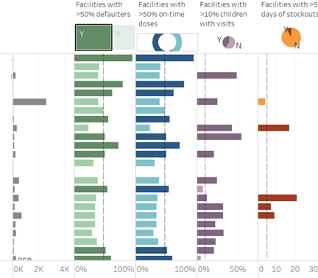
CQI dashboard
Performance dashboard
Shows health facility and district performance with indicators on:
Percent of current defaulters
Percent of doses delivered on time
Percent of children with encounters in a month
Number of days with stockouts
Number of doses delivered
Quality and System Use Dashboard
Shows usage of the TImR system by health workers through indicators on:
Number of weeks without use of TImR in a given month
Number of children under two assigned to a facility
Percent of children entered with missing demographic data
Percent of vaccine doses recorded more than one day after the date of the encounter
Illustrative Performance Dashboard
Facilities
Notes:
The data can also be aggregated into dashboards. Here we propose two different dashboards – one to focus on service/performance, such as percent of assigned children defaulting, number of days with stockouts, etc. – with a mock-up of what that might look like on the right - and another dashboard to look at data quality and system use – things like frequency of system use, data missingness, etc.
These dashboards can help make the data more accessible and interpretable to decision-makers at all levels of the health system. The WHO has rated 54% of low-income countries as nascent, limited, or moderate in their capacity to have data and evidence drive policy and planning. Any system that can make data more accessible and interpretable, especially to those with limited tech and data literacy, will help boost the use of data for decision making.
In our initial results we’re seeing a lot of these issues concentrated in a subset of facilities.

Slide 25

Summary of EIR added value
Studies have shown increased vaccine coverage after introduction of EIRs.¹
Enable routine and low-cost analysis of vaccination issues (e.g., MOVs, dose timeliness), as compared to aggregate HMIS or surveys.
Facilitate targeted continuous quality improvement.
Democratize immunization data, making it easier for providers and facility administrators to access and review relevant data.
Integration with other data systems (e.g., birth registry, LMIS, clinical decision support systems) can further EIR benefits, such as tracking zero dose children.
¹ Chandir et al., 2018, Iproc, doi: 10.2196/11770; Nguyen et al., 2017, MHealth, doi: 10.21037/mhealth.2017.06.03; Uddin et al., 2016, Vaccine, doi: 10.1016/j.vaccine.2015.11.024.

Slide 26
Emily Carnahan, ecarnahan@path.org
Andrew Secor, asecor@path.org
bidinitiative.org
Notes:
We are working with our colleagues in Tanzania to finalize these analyses and hopefully publish them before the end of the year.
In the meantime, if you have additional questions or want to learn more please feel free to email us or learn more about the BID Initiative at bidinitiative.org

Slide 28
Supplemental slides

Slide 29

Limitations
Data restricted to areas that have implemented TImR.
TImR rollout still ongoing; variable length of implementation by region, district, and facility
Zero dose children not represented.
Analyses limited to covariates captured by TImR (e.g., excludes socioeconomic indicators).
Data completeness (e.g., if provider failed to log a dose) not assessed.

Slide 30
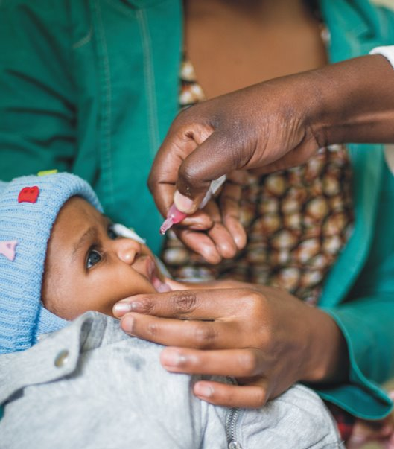
Tanzania vaccination schedule
Vaccine dose | Visit # | Age eligibility
BCG-0, OPV-0 | 1 | Birth or first contact
OPV-1, Penta-1, PCV-1, Rota-1 | 2 | 6 weeks
OPV-2, Penta-2, PCV-2, Rota-2 | 3 | 10 weeks
OPV-3, Penta-3, PCV-3 | 4* | 14 weeks
MCV-1 | 5 | 9 months
MCV-2 | 6 | 18 months
* IPV immunization was excluded from our analyses as it was introduced partway through the analysis period. It would normally be received during visit 4 at 14 weeks of age.

