Slide 1
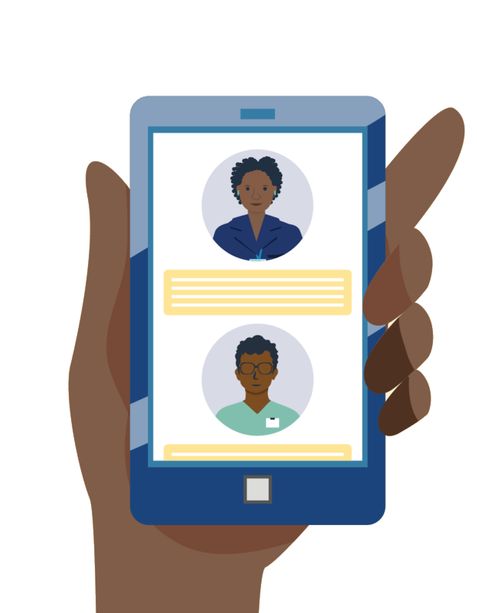
The Global Digital Health Landscape
From Technology to Transformation
Dykki Settle, Chief Digital Officer, PATH

Slide 2

What is the value of digital health?

Slide 3
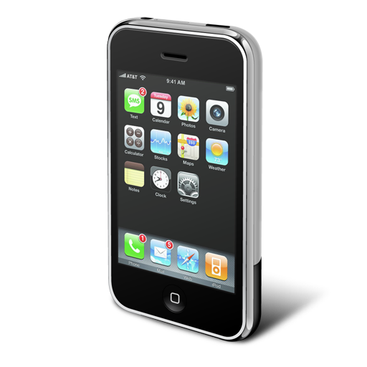

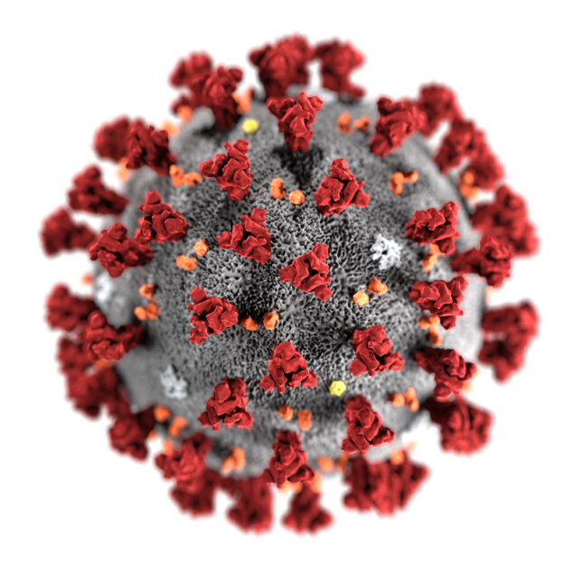













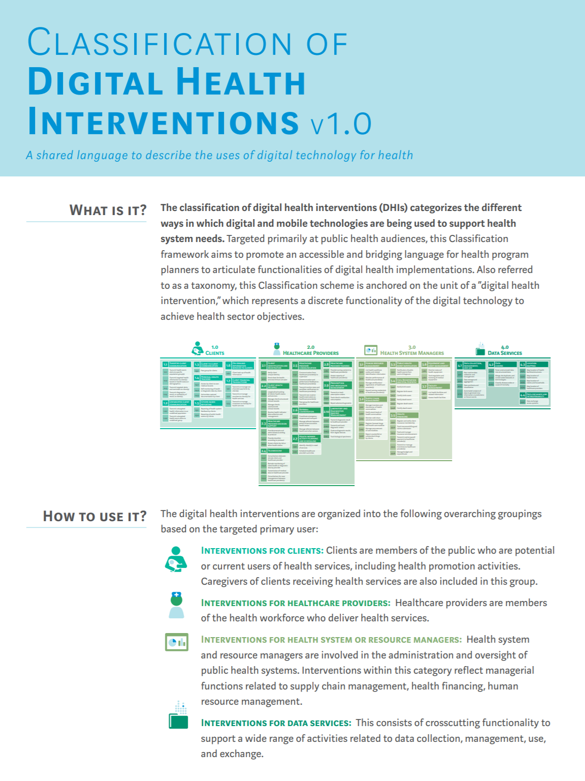

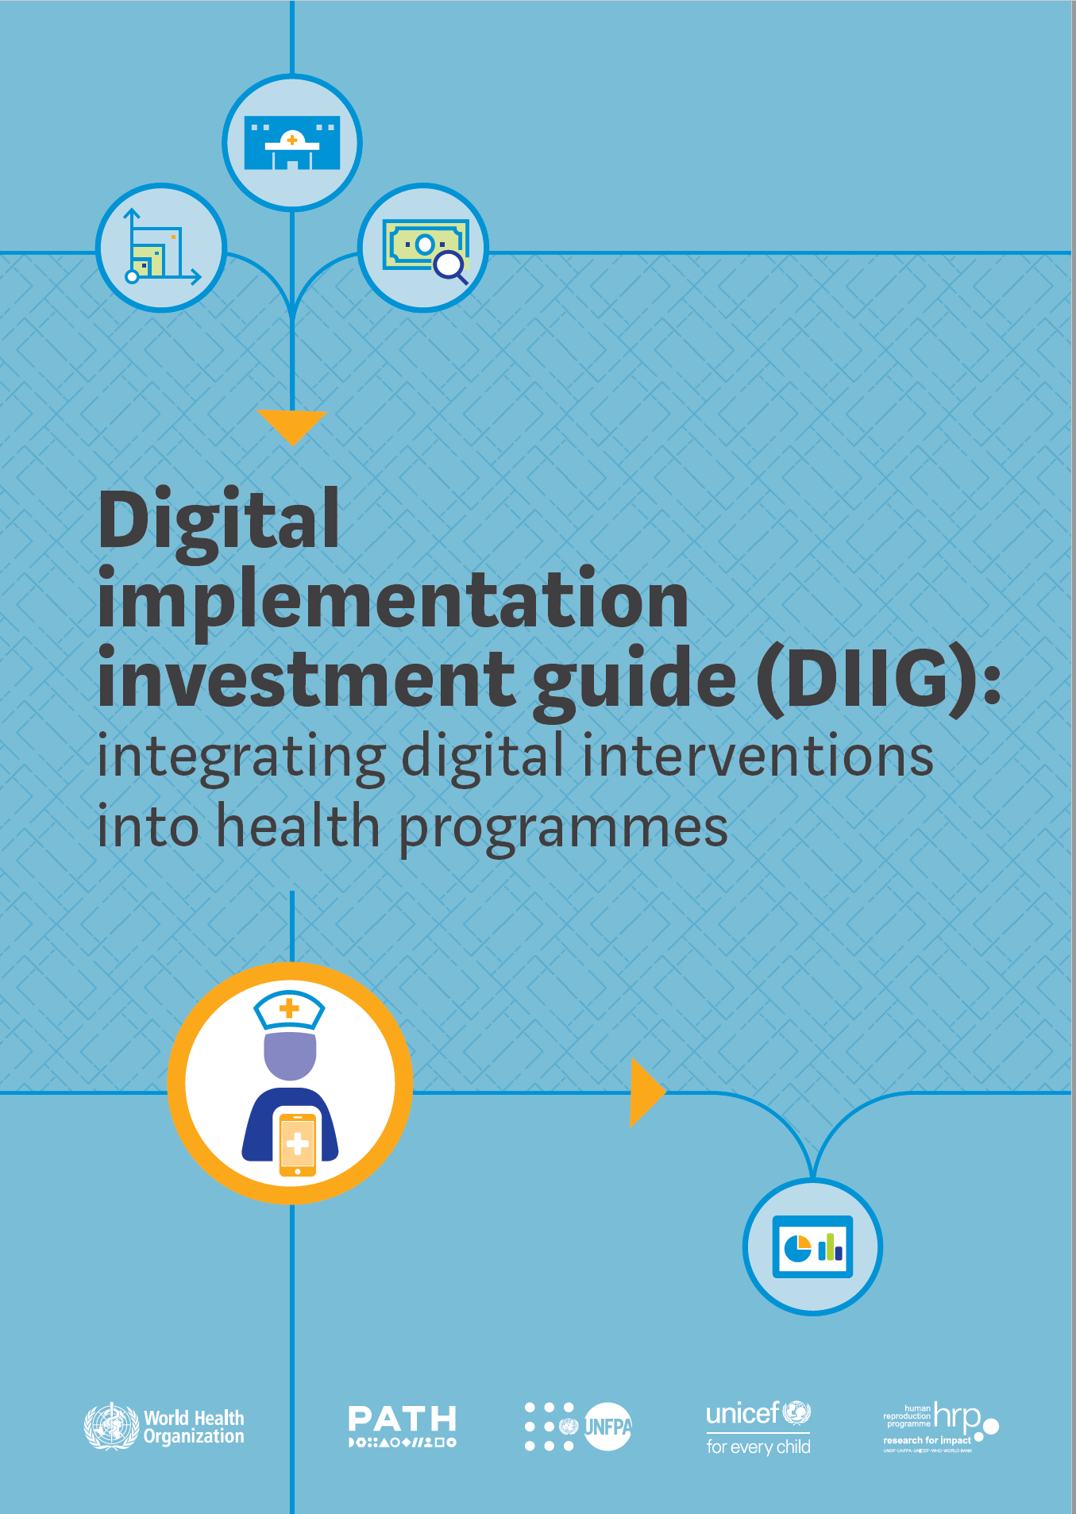
< 2000
2007
2014
2020
2021 >
Digitization
Democratization
Coordination
Transformation
MOTIVATION
Improve data collection and reporting within health systems
MOTIVATION
Put digital tools in the hands of more health workers
MOTIVATION
Make digital systems work better together
MOTIVATION
Redefine health for a digital age
TECHNOLOGY
Computers
TECHNOLOGY
+ Feature Phones + Smart Phones
TECHNOLOGY
+ Standards + Interoperability
+ Principles
+ Guidance
+ Partnerships
TECHNOLOGY
+ Analytics + AI & ML
+ Systems thinking

Slide 4
But the promise of technology to transform health has not yet been fully realized.

Slide 5
Digital tools have been siloed into specific health topics or functions, providing a limited insight into the larger health system.
Many challenges can be addressed in part with great alignment and coordination in the digital health sector.
Countries hesitate to begin the process of digital transformation without a clear long-term financing strategy.
Limited coordination of investments have led to fragmentation and duplication of digital tools.
Global guidance and policies struggle to keep pace with technology innovation.
Digital tools benefit from initial investments but lose momentum when they move from innovation to scale.

Slide 6
The Digital Health Enabling Environment
Leadership and Governance
Strategy and Investment
Services and Applications
Legislation, Policy, and Compliance
Workforce
Standards and Interoperability
Infrastructure

Slide 7






The global digital health community
Academia
Governments
Communities & Health Workers
Investors
Technology Innovators
Global Policymakers

Slide 8
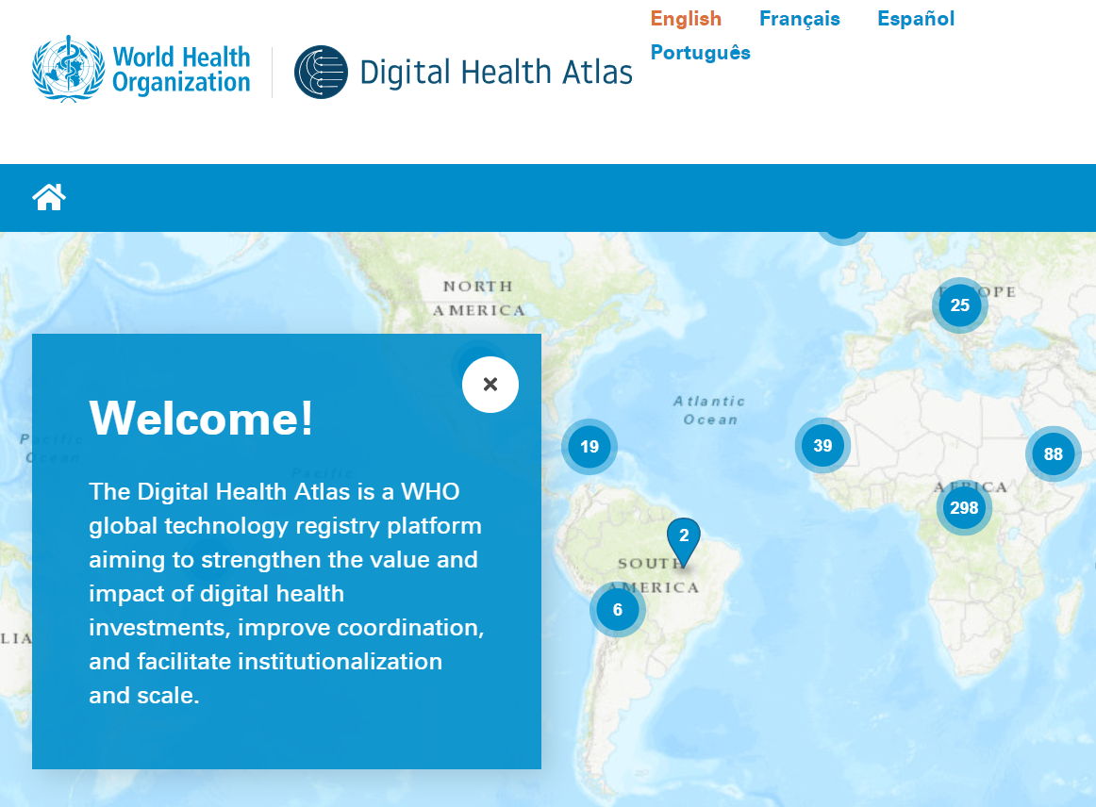


Resources to get started
Connect with us:
Dykki Settle
dsettle@path.org
WHO Classifications of Digital Health Interventions
WHO Digital Health Atlas
WHO Digital Implementation Investment Guide
WHO/ITU eHealth Strategy Toolkit

